Slide 1
Do Now
Draw the structure of the quaternary ammonium salt formed when ethylamine reacts with 1-bromopropane

Slide 2
Other reactions of amines

Slide 3
Addition-Elimination
Two molecules join together, and then a small molecule is eliminated e.g. hydrogen chloride
Acyl chloride + primary amine → N-substituted amide + hydrogen chloride
Mechanism – not needed but will help you understand what is going on!

Slide 4
Addition-Elimination

Slide 5
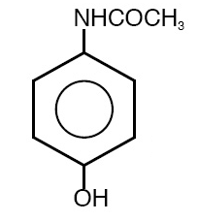
What drug do you think this is?
By what mechanism was it formed?
What could the reactants be to form paracetamol?
Notes:
Paracetamol - N-(4-Hydroxyphenyl)ethanamide

Slide 6
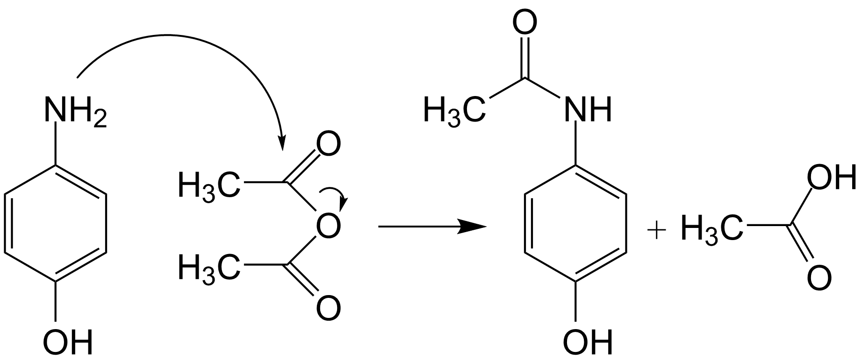
Notes:
4-hydroxyphenylamine

Slide 7
Reactions with copper(II) ions
Will do this when we look at transition metals!!

Slide 8
Exam Questions

