Slide 1
Reactions of Benzene

Slide 2
Benzene Structure Recap
Objective
To know about the structure of benzene
Success criteria
Recall the structure of benzene
Describe the evidence for the structure of benzene
Explain the evidence for the structure of benzene
Name compounds containing benzene

Slide 3
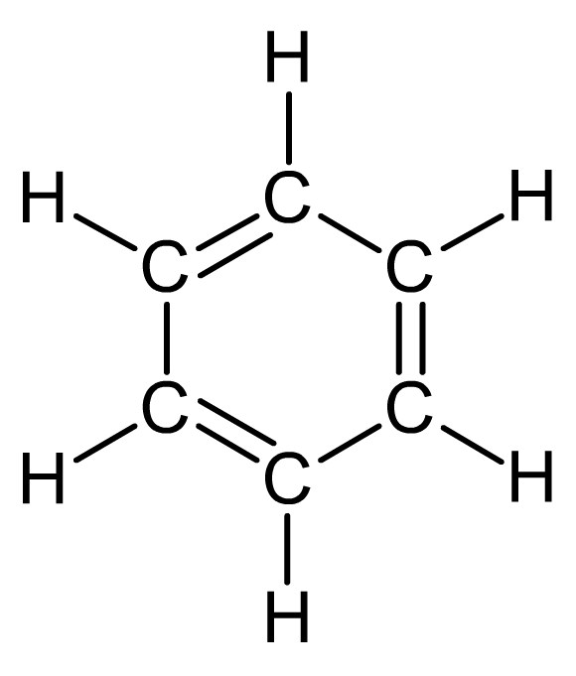
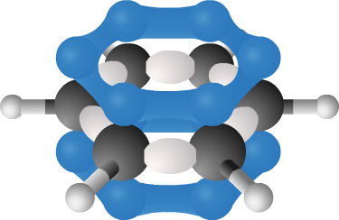
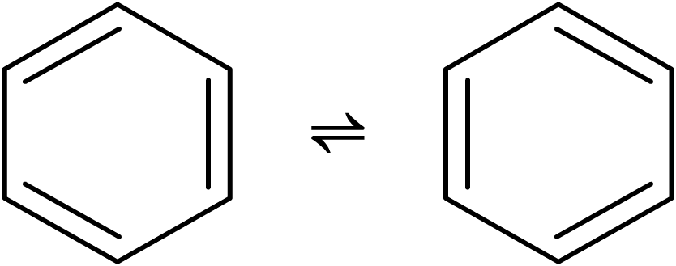
Evolution of scientific knowledge
The history of the structure of benzene exemplifies how scientific knowledge evolves dynamically between different ideas as new data emerges.
C₆H₆
Each successive model can be seen as a working hypothesis that best explains current observations, but which is only tentative in nature, as new information may require revision or even replacement of the current model.

Slide 4
Questions: Benzene Structure
Page 128 workbook

Slide 5
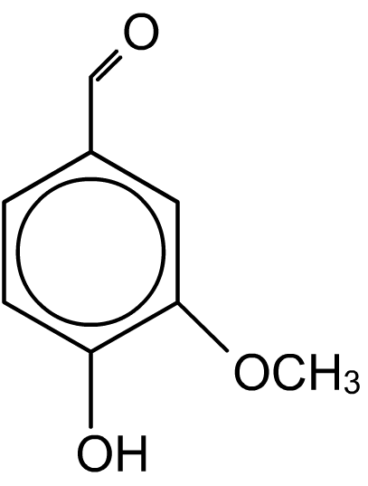
What are arenes?
Arenes are aromatic hydrocarbons that contain one or more benzene rings.
The name aromatic derives from the fact that many strong-smelling substances found in nature, such as plant fragrances, contain benzene rings.
For example, vanillin (right) is the fragrant compound found in vanilla plants.
However, more recently it has been found that the presence of a benzene ring has little to do with the smell of a substance. Many compounds containing benzene rings have no odour.

Slide 6
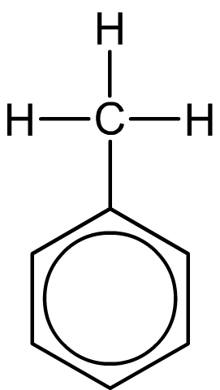
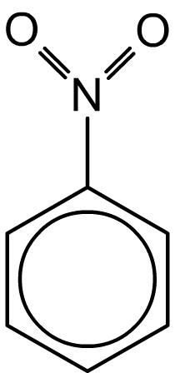
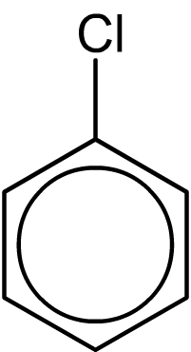
Naming aromatic compounds
Benzene derivatives are named in a similar fashion to other organic compounds, with benzene forming the main part of the name.
The presence of other groups is denoted by the use of a prefix.
methylbenzene
chlorobenzene
nitrobenzene

Slide 7
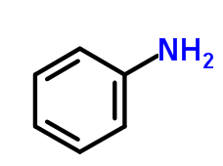
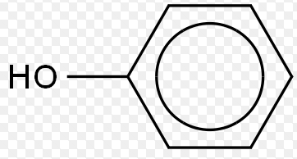
Others are named as compounds with a phenyl group (C₆H₅) attached.
Phenol
Phenylamine

Slide 8
Benzene Structure Recap
Objective
To know about the structure of benzene
Success criteria
Recall the structure of benzene
Describe the evidence for the structure of benzene
Explain the evidence for the structure of benzene
Name compounds containing benzene

