Slide 1
Exam questions are old OCR but mark schemes are similiar in style to edexcel

Slide 2
Starter, quick practical
Work in groups
Gently bend the glow sticks so they start glowing
Put one in a beaker with ice
Put the other in a beaker with hot water from the kettle (be careful with the glow stick after)
Wrapping card around the beakers might help you see the glow if the classroom is too bright
What do you observe?
Can you explain your observations?
Wear goggles and be careful with glow sticks after they have been in hot water

Slide 3
Observations
What did you observe?
Why?

Slide 4
The Boltzmann Distribution
Tuesday, 19 April 2016

Slide 5
The Boltzmann Distribution
Objective: To know about the Boltzmann distribution and its relationship with activation energy, temperature and catalysts
Success criteria
Understand in term of collision theory the effect of change in temperature on the rate of chemical reaction (grade D)
Describe the Boltzmann distribution (grade C)
Explain the relationship between the Boltzmann distribution and activation energy (grade B)
Use the relationship between the Boltzmann distribution and activation energy to explain why temperature changes effect the rate of reaction (grade A)
Link catalytic behaviour to the Boltzmann distribution (grade A)

Slide 6
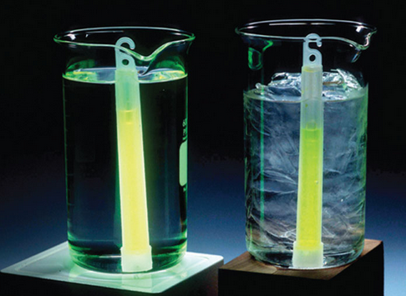
The rate of a reaction depends on:
The frequency of collisions between particles
The energy with which particles collide
Notes:
Link to concentration and temperature

Slide 7
How much energy do particles have?
In a solid, liquid or gas every single molecule has a certain amount of kinetic energy.
Not every molecule has the same amount of energy.
Temperature is actually a measure of the average energy of all the molecules in the system.
Some molecules move fast and have high energy.
Some molecules move slowly and have low energy
MOST molecules have a moderate amount of energy.

Slide 8
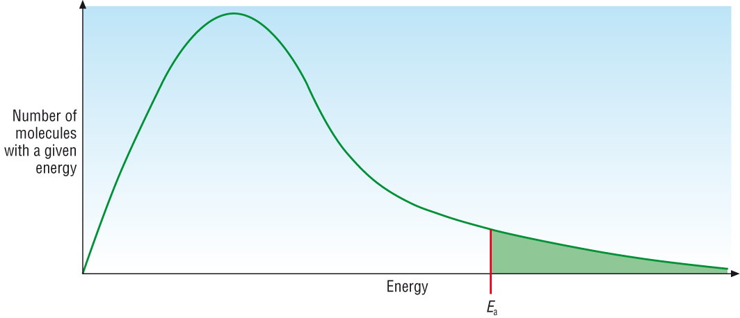
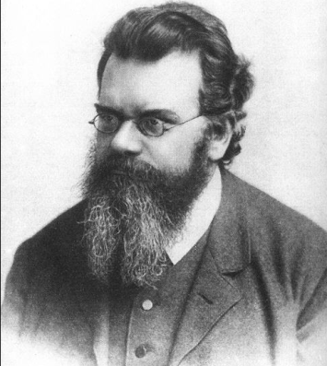
Ludwig Boltzmann developed something called the Boltzmann Distribution.
Definition: The Boltzmann distribution is the distribution of energies of molecules at a particular temperature.
The Boltzmann distribution shows the distribution of molecular energies in a gas at constant temperature.

Slide 9
Distribution of particle speeds
Notes:
Teacher notes
The Maxwell–Boltzmann distribution is a theoretical model developed from kinetic theory.
Ludwig Eduard Boltzmann (1844–1906) was an Austrian physicist. James Clerk Maxwell (1831–1879) was a Scottish mathematician and theoretical physicist. Maxwell used statistical methods to derive the Maxwell distribution, which gives the distribution of velocities of particles in a gas at a given temperature. This was later generalized by Boltzmann to give a distribution function for the distribution of states of a system.

Slide 10
Energy distribution curves

Slide 11
Features of the Boltzmann distribution
Work with the people you sit with.
On post it notes describe what the graph is telling us.
Stick the post it notes on the board at the front of the room.
Write one thing on each post it note, write your name too.

Slide 12
Features of the Boltzmann distribution
Activation energy (E_{a}) = The minimum energy required to start a reaction by the breaking of the bonds

Slide 13
Features of the Boltzmann Distribution
The area under the graph is equal to the total number of molecules in the sample, it will NOT change with conditions.
No molecules have zero energy.
There is no maximum energy, the curve never reaches the x-axis.
All the molecules with energy above E_{a} are candidates to react.
The most probable energy is where the curve peaks. Most particles have energies around this value at any given time.
The average energy if a line is drawn vertically through the average energy the areas on either side of the curve should be equal.

Slide 14
The Boltzmann Distribution
Objective: To know about the Boltzmann distribution and its relationship with activation energy, temperature and catalysts
Success criteria
Understand in term of collision theory the effect of change in temperature on the rate of chemical reaction (grade D)
Describe the Boltzmann distribution (grade C)
Explain the relationship between the Boltzmann distribution and activation energy (grade B)
Use the relationship between the Boltzmann distribution and activation energy to explain why temperature changes effect the rate of reaction (grade A)
Link catalytic behaviour to the Boltzmann distribution (grade A)

Slide 15
The effect of temperature
Use white boards
Sketch a labelled Boltzmann graph.
Add a line showing the distribution of energies at a higher temperature.
Be prepared to explain your answer.

Slide 16
The effect of changing temperature

Slide 17
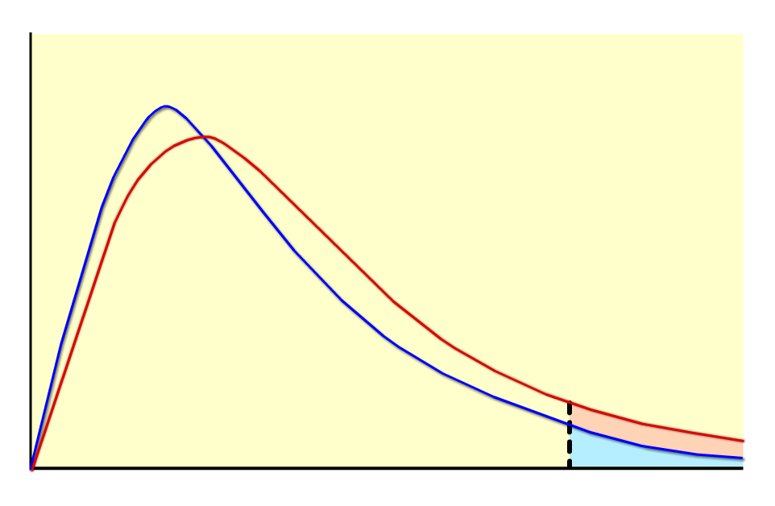
Small temperature changes
The Maxwell–Boltzmann distribution shows that for a small increase in temperature, there is a relatively large increase in the number of particles with at least the activation energy.
A small increase in temperature therefore leads to a large increase in rate.
Note the area under the curve remains the same. This is because the number of particles does not change as the temperature is changed.
no. particles with E_{a} almost doubled
no. of particles
energy
E_{a}
The increase in collision frequency is also a factor, but its effect is small compared to the increase in energy.

Slide 18
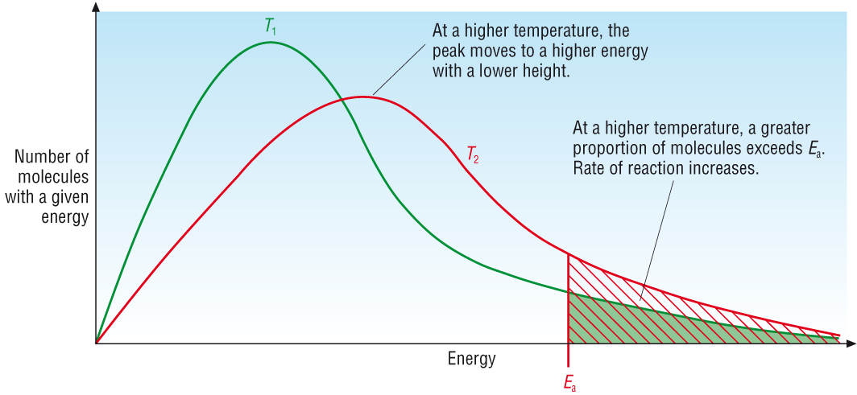
The effect of temperature
Increasing temperature increases the kinetic energy of the molecules.
Boltzmann distribution shifts to the right, the area under the curve remains the same.

Slide 19
Now answer the exam question
1) Hydrogen and chlorine are reacted together to form hydrogen chloride.
H₂ (g) + Cl₂ (g) → 2HCl (g)
The reaction is carried out, and then repeated at a lower temperature.
Describe and explain, by drawing appropriately labelled Boltzmann distributions, what happens to the rate of reaction between H₂ (g) and Cl₂ (g).
(5 marks)
After we will peer assess
Exam question 4c Jan 2012
Notes:
OCR (old)

Slide 20
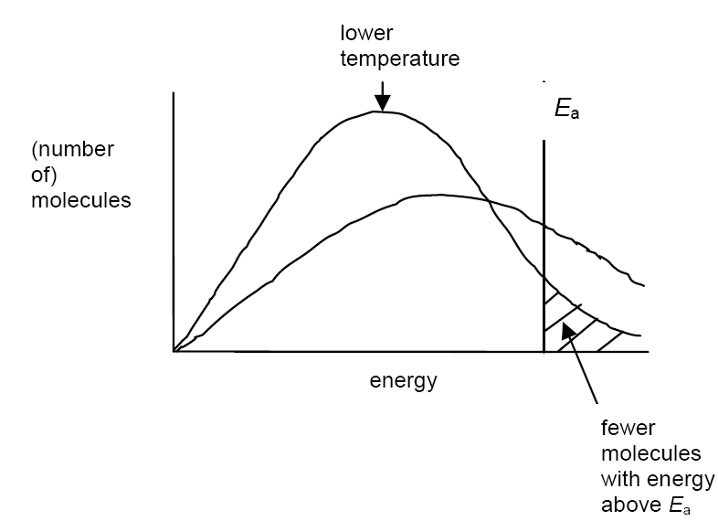

Slide 21
Marks on white boards

Slide 22
The Boltzmann Distribution
Objective: To know about the Boltzmann distribution and its relationship with activation energy, temperature and catalysts
Success criteria
Understand in term of collision theory the effect of change in temperature on the rate of chemical reaction (grade D)
Describe the Boltzmann distribution (grade C)
Explain the relationship between the Boltzmann distribution and activation energy (grade B)
Use the relationship between the Boltzmann distribution and activation energy to explain why temperature changes effect the rate of reaction (grade A)
Link catalytic behaviour to the Boltzmann distribution (grade A)

Slide 23
The effect of catalyst
Use white boards
Sketch a Boltzmann graph.
Catalysts work by providing an alternative pathway for a reaction which has a lower activation energy.
How will a catalyst change the system?
Label this on your curve.
Be prepared to explain your answer.

Slide 24
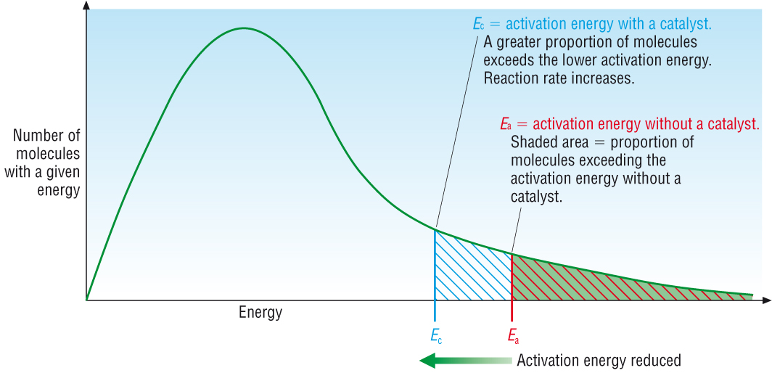
Effect of catalyst
The presence of a catalyst does not effect the energy distribution of molecules, but it lowers the activation energy.

Slide 25
Now answer the exam question.
2) Explain, using a Boltzmann distribution, how the presence of a catalyst increases the rate of reaction.
(3 marks)
After we will peer assess
Jan 2011 4 c
Notes:
OCR (old)

Slide 26
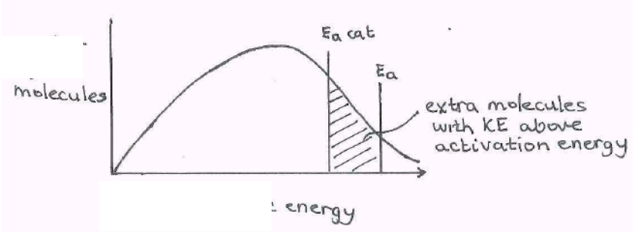
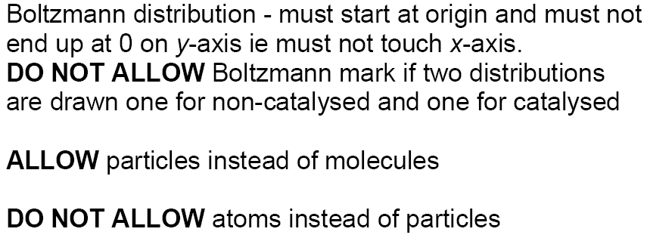

Slide 27
Marks on white boards

Slide 28
The Boltzmann Distribution
Objective: To know about the Boltzmann distribution and its relationship with activation energy, temperature and catalysts
Success criteria
Understand in term of collision theory the effect of change in temperature on the rate of chemical reaction (grade D)
Describe the Boltzmann distribution (grade C)
Explain the relationship between the Boltzmann distribution and activation energy (grade B)
Use the relationship between the Boltzmann distribution and activation energy to explain why temperature changes effect the rate of reaction (grade A)
Link catalytic behaviour to the Boltzmann distribution (grade A)

Slide 29
Plenary
Boltzmann quiz!

Slide 30
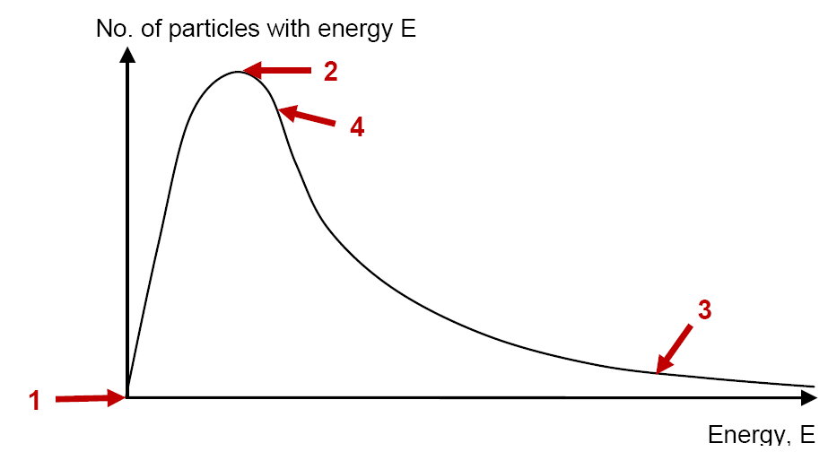
Answer on whiteboards
B
C
D
A

Slide 31
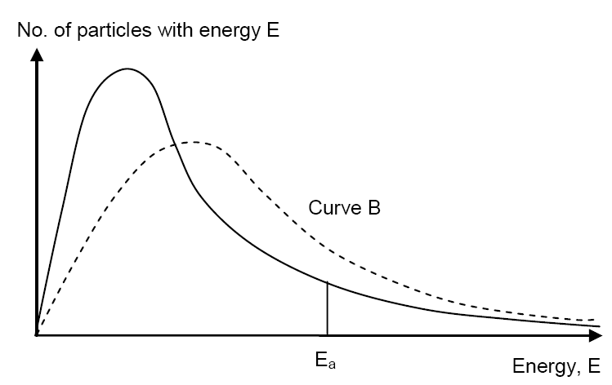
Curve B shows the reaction................
A At a lower temperature
B Using a catalyst
C At a higher concentration
D At a higher temperature
Curve A

Slide 32
The area of curve B compared to curve A is..........
A Less
B Equal
C More
D Half as much
Curve A

Slide 33
A catalyst is added to the system. How do we show this on the graph below? Curve A shows the system under the original condition, Ea is the original activation energy.
A Activation energy A
B Curve B
C Activation energy C
Curve A
E_{a} A
E_{a} C

Slide 34
Which of these statements best defines activation energy
The amount of energy needed for a reaction to happen
The amount of energy needed to start a reaction by the breaking of the bonds
The minimum energy required to start a reaction by the breaking of the bonds
The minimum energy required to start a reaction

Slide 35
The Boltzmann Distribution
Objective: To know about the Boltzmann distribution and its relationship with activation energy, temperature and catalysts
Success criteria
Understand in term of collision theory the effect of change in temperature on the rate of chemical reaction (grade D)
Describe the Boltzmann distribution (grade C)
Explain the relationship between the Boltzmann distribution and activation energy (grade B)
Use the relationship between the Boltzmann distribution and activation energy to explain why temperature changes effect the rate of reaction (grade A)
Link catalytic behaviour to the Boltzmann distribution (grade A)

