Slide 1
Homework
Private study work (bring notes to show me next lesson);
Read pages 60 – 62 in your text book
Complete the questions at the end of each double page spread
Look at the following websites
http://www.chemguide.co.uk/atoms/bonding/electroneg.html#top
http://www.chemnotes.org.uk/f321.html
Topic 5, concentrate on electronegativity and polar bonds

Slide 2
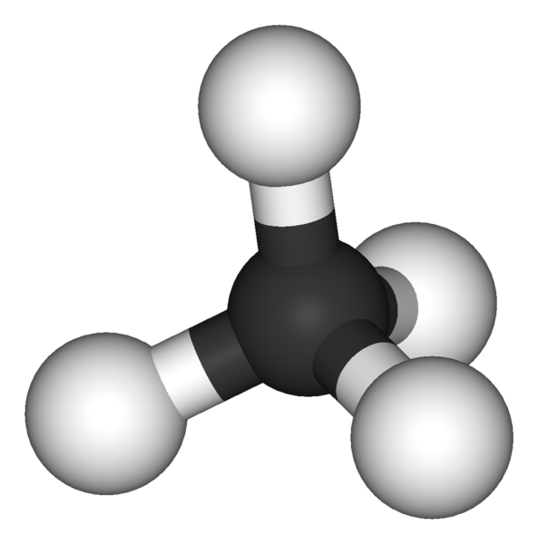
Thinking skills – Try to use key scientific words where possible.
Stage 1: This picture definitely shows me…
Stage 2: I think this picture shows me…
Stage 4: The questions I need to ask about this picture are…
Stage 3: This picture does not show me…

Slide 3
What is Electronegativity?
Write your answer on a piece of paper.

Slide 4
Today’s Objectives
Electronegativity and Bond Polarity
know that electronegativity is the ability of an atom to attract the bonding electrons in a covalent bond
know that ionic and covalent bonding are the extremes of a continuum of bonding type and that electronegativity differences lead to bond polarity in bonds and molecules
understand that molecules with polar bonds may not be polar molecules and be able to predict whether or not a given molecule is likely to be polar
understand the nature of intermolecular forces resulting from the following interactions:
i London forces (instantaneous dipole – induced dipole)
ii permanent dipoles
iii hydrogen bonds

Slide 5
Electronegativity, Polarity and Intermolecular Forces
Learning Outcomes:
Know that ionic and covalent bonding are the extremes of a continuum of bonding type (Grade D)
Describe electronegativity in terms of an atom attracting bonding electrons in a covalent bond (Grade C)
Explain how a permanent dipole can result in a polar bond (Grade B)
Link electronegativity to the bonding type on a compound. (Grade A)

Slide 6
Intermolecular Forces
Strength of Bonds and Forces:
Ionic and covalent bonds are strong.
Ionic bonds hold ions together in a lattice so that at room temperature all ionic compounds are solid.
Covalent bonds hold atoms together by sharing electrons. Many covalent compounds are small molecules with strong covalent bonds within them. These are intra-molecular forces.

Slide 7
Intermolecular Forces
Intermolecular Forces: is an attractive force between neighbouring molecules.
Intermolecular forces are weak compared to covalent bonds.
Intermolecular forces act between different molecules. They are caused by weak attractive forces between very small dipoles in different molecules.
Intra-molecular bonds act within one molecule.

Slide 8
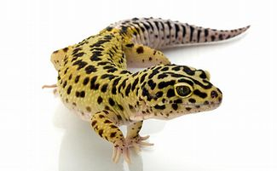
Intermolecular Forces
Intermolecular Forces:
There are three types of intermolecular forces;
Permanent dipole-dipole interactions
London’ forces (induced dipole forces)
Hydrogen bonding.
Bond Type | Relative Strength
Ionic and covalent bonds | 1000
Hydrogen bonds | 50
Dipole-dipole forces | 10
London’ forces | 1

Slide 9
What is the effect of an electrostatic field on a jet of liquid?
Cyclohexane must only be used in a fume cupboard
Equipment: burettes, beakers, funnels, clamps, clamp stands, plastic rods, cloths, cyclohexane, water
Set a burette up on the side, fill it with water
Put a beaker under the burette (to collect the liquid in)
Charge one of the plastic rods by rubbing it with a cloth
Open the burette and put the charged rod next to the water that comes out (but not touching) Record your observations (This can also be done by just putting a tap on)
Set a burette up in the fume cupboard, and fill it with cyclohexane
Put a beaker under the burette (to collect the liquid in)
Repeat the above experiment Record your observations.
Can you explain your observations?
Notes:
Tech notes: A few sets for some students to set up
What is the effect of an electrostatic field on a jet of liquid? (page 213 Nuffield)
Polar and non polar liquids to test (water can be used)
Burettes and beakers to put liquids in
Funnels
Clamps etc for burettes
Fume cupboard (depending on liquids been used)
Plastic rods to test if liquids are polar or not
Cloths to charge rods

Slide 10
Explanation
If you put an electrostatically charged rod next to a jet of a polar liquid, like water, the liquid will move towards the rod. It’s because polar liquids contain molecules that have permanent dipoles. It doesn’t matter if the rod is positively or negatively charged.
The polar molecules in the liquid can turn around so the oppositely charged end is attracted towards the rod.
You can use this experiment to find out if the molecules in a jet of liquid are polar or non polar.

Slide 11
Explanation
The electrostatic field will be interacting with molecules that have an imbalance in charge distribution, that is the molecules are polarised.
We are detecting the polarisation of molecules, the polarisation of bonds can only be inferred from our results.
Also the electrostatic field will create a temporary polarisation in the molecules (next lesson) so our interpretation of the experiment cannot be precise.

Slide 12
Electronegativity and Polarity
Definition: Electronegativity is a measure of the tendency of an atom to attract a bonding pair of electrons in a covalent bond.
Therefore: The greater the electronegativity of an atom, the more it attracts electrons towards it.

Slide 13
Electronegativity and Polarity
The factors affecting electronegativity are the same as those that affect ionisation energies:
Atomic charge;
Distance from the nucleus (Atomic Radius);
Electron shielding

Slide 14
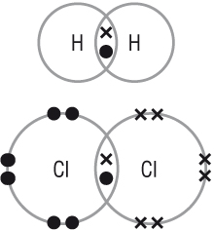
Bonds between Identical atoms
In a covalent bond, electrons are shared.
When the 2 atoms are identical, the electrons are shared equally.
H-H
Cl-Cl

Slide 15
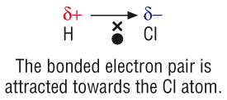
Bonds between different atoms
The more electronegative atom will have a greater share of the electrons.
E.g. Cl is more electronegative than H so in a molecule of HCl, the electrons are pulled towards the Chlorine.
This symbol is called delta and means “slightly”

Slide 16
Charge Difference
The charge difference between H and Cl is called a permanent dipole.
HCl is therefore a polar covalent bond.
HCl is non-symmetrical so it is a polar molecule.

Slide 17
Key terms
Polar covalent bonds are bonds between atoms of different elements. The shared electrons are drawn towards the atom with the stronger pull on the electrons.
The bonds have a positive pole at one end and a negative pole at the other end.
A permanent dipole is a small charge difference across a bond that results from a difference in the electronegativities of the bonded atoms.
A polar covalent bond has a permanent dipole

Slide 18
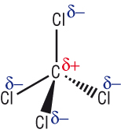
Non-polar molecules.
Symmetrical molecules are non-polar even though they contain polar bonds.
Key term: Polar molecules contain polar bonds which do not cancel each other out, so that the whole molecule is polar
4 dipoles acting in different directions cancel each other out.

Slide 19
Key Concept
The greater the difference in electronegativity between the bonded atoms, the greater the permanent dipole.
The more electronegative atom will take the δ- charge.

Slide 20
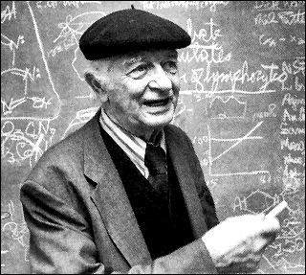
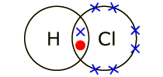
Linus Pauling
1932 – Linus Pauling invented Pauling scale to measure electronegativity on an atom.

Slide 21
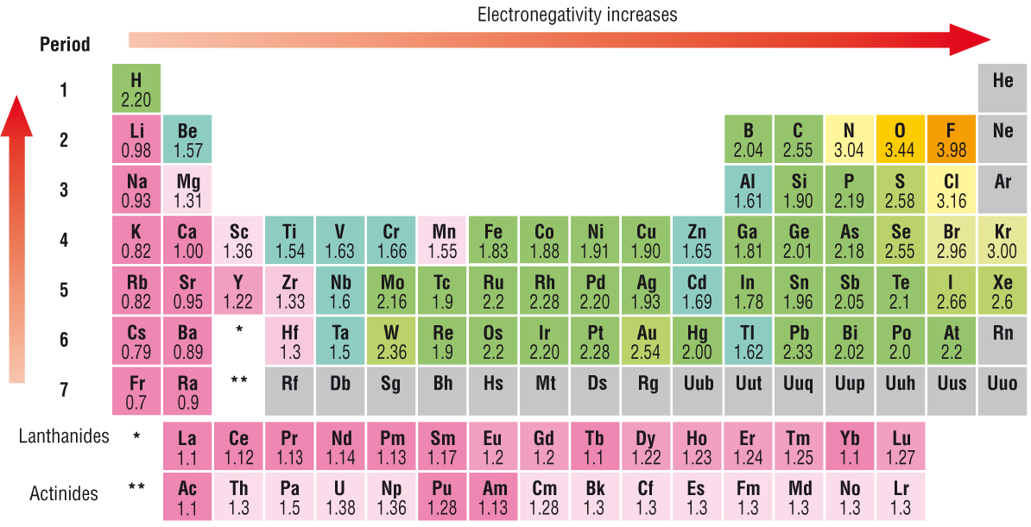
Pauling Scale

Slide 22
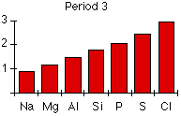
Across a Period
Explain why electronegativity increases across a period.

Slide 23
Across a Period
Both sodium and chlorine have their bonding electrons in the 3-level. The electron pair is screened from both nuclei by the 1s, 2s and 2p electrons, but the chlorine nucleus has 6 more protons in it.

Slide 24
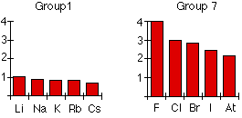
Down a Group
Explain why electronegativity decreases down a group.

Slide 25
Down a Group
The bonding pair is shielded from the fluorine's nucleus only by the 1s² electrons. In the chlorine case it is shielded by all the 1s²2s²2p⁶ electrons.

Slide 26
Covalent → Ionic
No difference between electronegativity = non polar covalent bond.
Small difference in electronegativity = polar covalent bond.
Large difference in electronegativity = ionic bond.

Slide 27
Non Polar Covalent Bond
No difference between electronegativity = non polar covalent bond.
H-H
Cl-Cl

Slide 28
Polar Covalent Bond
Small difference in electronegativity = polar covalent bond.

Slide 29
Ionic Bonding
Large difference in electronegativity = ionic bond.

Slide 30
Think about how electronegativity changes across and down the periodic table.
Give an example of a non-polar covalent bond, a polar covalent bond and an ionic bond.

Slide 31
In ionic compounds where the cations are small and highly charged, these cations distort the electron clouds of the anions in a process called polarisation.
This leads to an increase in the electron density in the space between the ions, some sharing o electrons and partial covalencey.

Slide 32
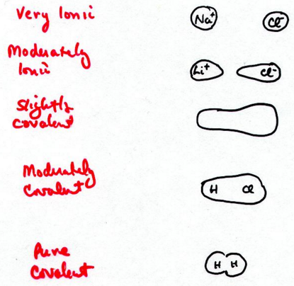
In ionic compounds where the cations are small and highly charged, these cations distort the electron clouds of the anions in a process called polarisation.
This leads to an increase in the electron density in the space between the ions, some sharing o electrons and partial covalencey.

Slide 33
Intermolecular Forces
Intermolecular Forces:
There are three types of intermolecular forces;
Permanent dipole-dipole interactions
London’ forces (induced dipole forces)
Hydrogen bonding.
Bond Type | Relative Strength
Ionic and covalent bonds | 1000
Hydrogen bonds | 50
Dipole-dipole forces | 10
London’ forces | 1

Slide 34
Permanent dipole-dipole interactions
A permanent dipole-dipole force: a weak attractive force between permanent dipoles in neighbouring polar molecules.
Polar molecules have a permanent dipole.
The permanent dipole of one molecule attracts the permanent dipole of another.

Slide 35
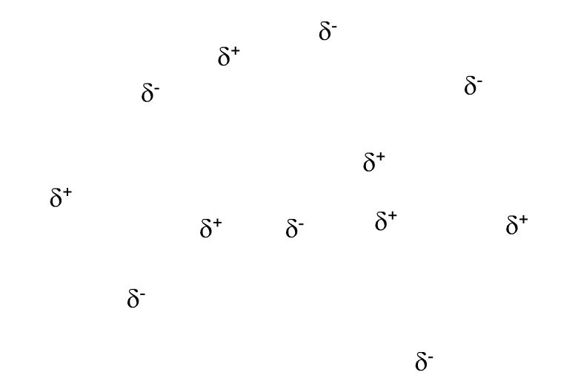
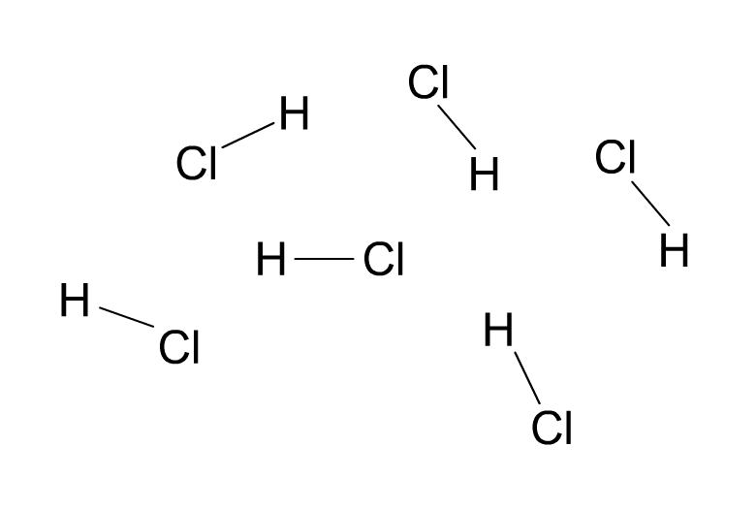
Permanent dipole–dipole forces
If molecules contain bonds with a permanent dipole, the molecules may align so there is electrostatic attraction between the opposite charges on neighbouring molecules.
Permanent dipole–dipole forces (dotted lines) occur in hydrogen chloride (HCl) gas.
The permanent dipole–dipole forces are approximately one hundredth the strength of a covalent bond.
Notes:
Teacher notes
Students could be reminded that molecules need to be polar, i.e. have an overall dipole, for permanent dipole–dipole forces to occur.

Slide 36
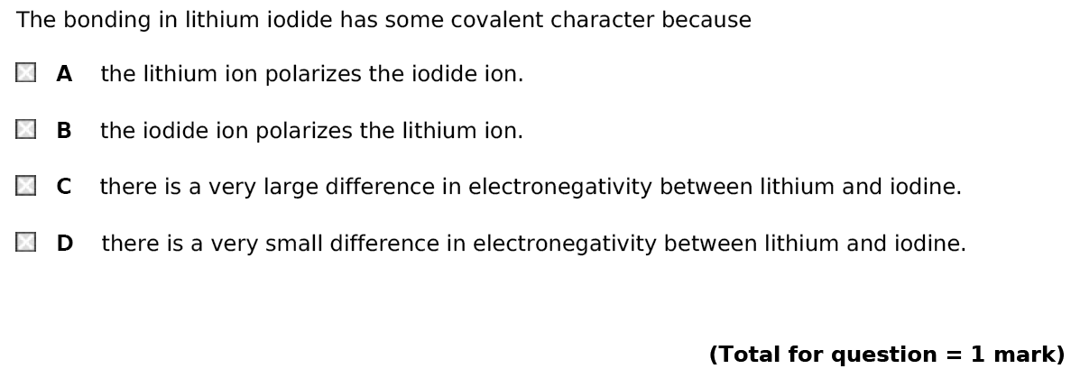
Exam Questions
From new sample materials

Slide 37
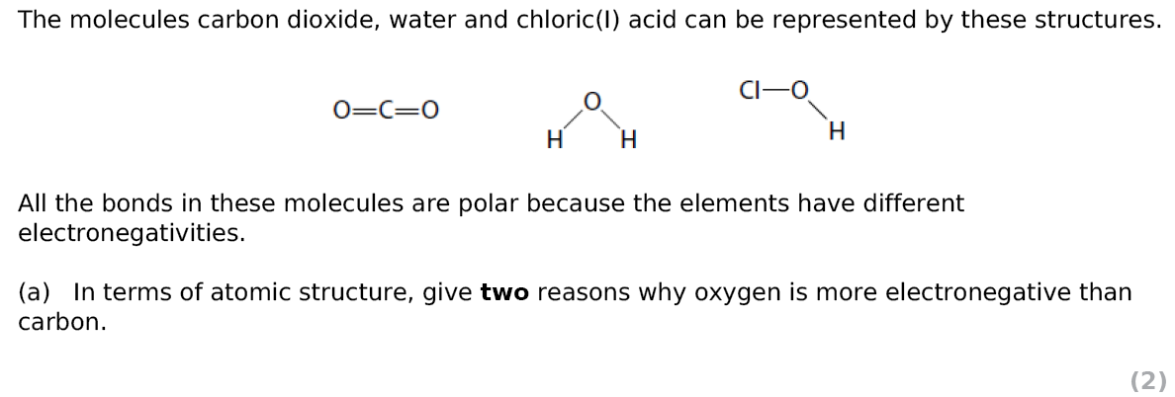
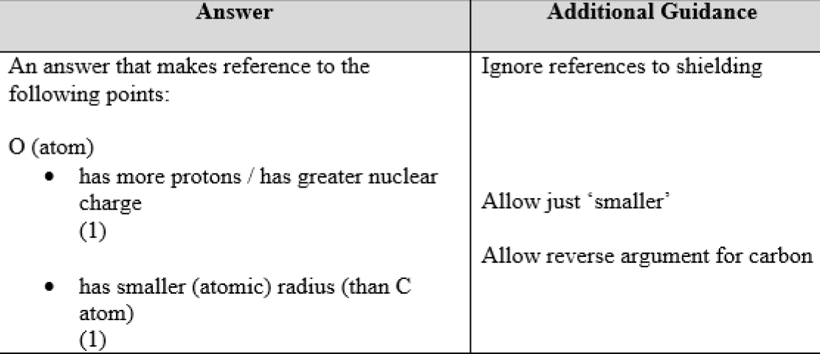
From new sample materials

Slide 38
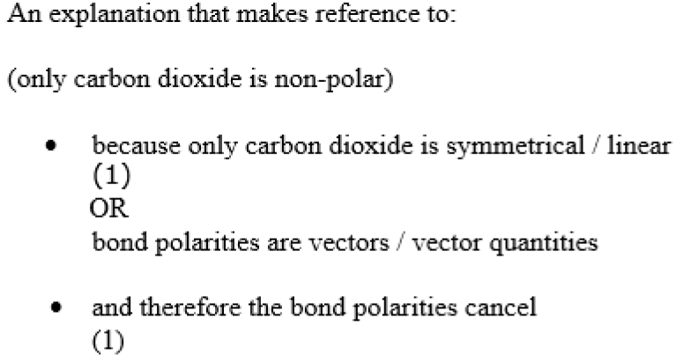
Explain why carbon dioxide is the only non polar molecule of the three (2 marks)
From new sample materials

Slide 39
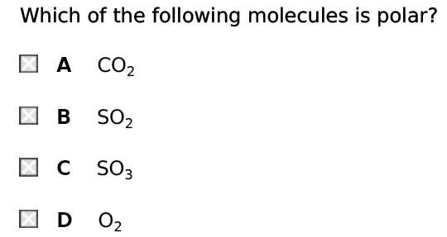
From new sample materials

Slide 40
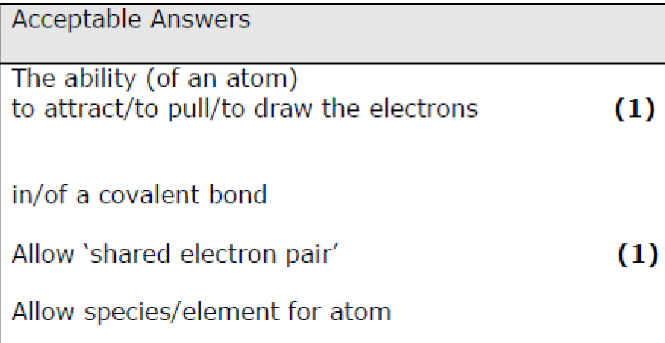
Define the term electronegativity (2 marks)
From new sample materials

Slide 41
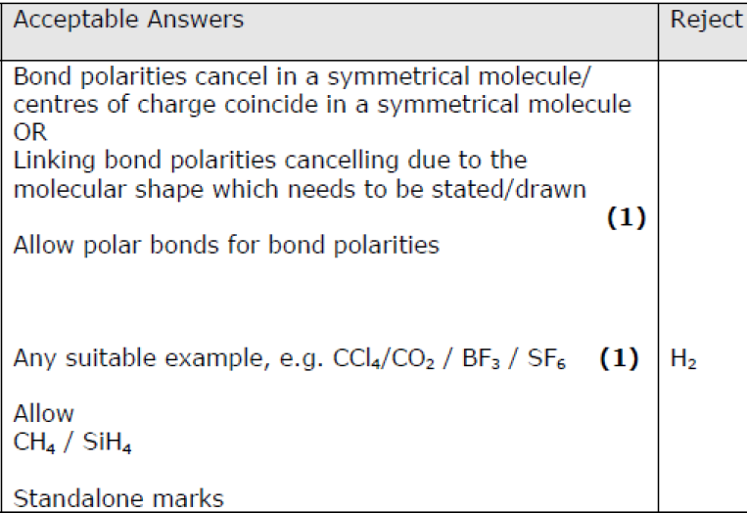
From new sample materials

Slide 42
Today’s Objectives
Electronegativity and Bond Polarity
know that electronegativity is the ability of an atom to attract the bonding electrons in a covalent bond
know that ionic and covalent bonding are the extremes of a continuum of bonding type and that electronegativity differences lead to bond polarity in bonds and molecules
understand that molecules with polar bonds may not be polar molecules and be able to predict whether or not a given molecule is likely to be polar
understand the nature of intermolecular forces resulting from the following interactions:
i London forces (instantaneous dipole – induced dipole)
ii permanent dipoles
iii hydrogen bonds

Slide 43
Electronegativity, Polarity and Intermolecular Forces
Learning Outcomes:
Know that ionic and covalent bonding are the extremes of a continuum of bonding type (Grade D)
Describe electronegativity in terms of an atom attracting bonding electrons in a covalent bond (Grade C)
Explain how a permanent dipole can result in a polar bond (Grade B)
Link electronegativity to the bonding type on a compound. (Grade A)

