Slide 1
Calculations with gases

Slide 2
Calculations With Gases
Objective: to know to use volumes of gases in equations
Outcomes:
be able to calculate amounts of substances (in mol) in reactions involving volume of gas These calculations may involve reactants and/or products.
be able to calculate reacting volumes of gases from chemical equations, and vice versa, using the concepts of amount of substance
be able to calculate reacting volumes of gases from chemical equations, and vice versa, using the concepts of molar volume of gases

Slide 3
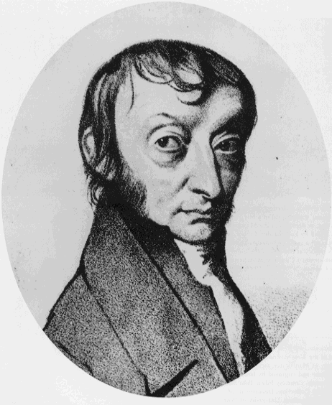
Avogadro’s law
In 1811 the Italian scientist Amedeo Avogadro developed a theory about the volume of gases.
Avogadro’s law:
Equal volumes of different gases at the same pressure and temperature will contain equal numbers of particles.
For example, if there are 2 moles of O₂ in 50 cm³ of oxygen gas, then there will be 2 moles of N₂ in 50 cm³ of nitrogen gas and 2 moles of CO₂ in 50 cm³ of carbon dioxide gas at the same temperature and pressure.
Using this principle, the volume that a gas occupies will depend on the number of moles of the gas.

Slide 4
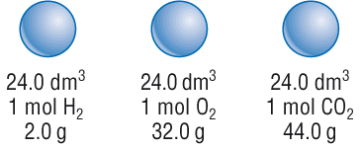

Slide 5
Calculations using reacting volumes of gases
H₂ (g) + Cl₂ (g) → 2HCl (g)
100 cm³ of hydrogen is mixed with 100 cm³ of chlorine, and reacted. What volume of hydrogen chloride is formed?
The ratio in the equation is 1: 1 : 2
The answer is 200 cm³

Slide 6
Calculations using reacting volumes of gases
2SO₂ (g) + O₂ (g) → 2SO₃ (g)
200 cm³ of sulfur dioxide are mixed with 200 cm³ of oxygen and reacted. What volume of sulphur trioxide is formed?
Ratio is 2: 1: 2
All of the sulfur will react but only half of the oxygen will react
200 cm³ of sulfur trioxide will be formed, but 100 cm³ of the oxygen will be left over.

Slide 7
Calculations using reacting volumes of gases
2N₂O₅ (g) → O₂ (g) + 4NO₂ (g)
Calculate the total volume of gas produced when 8.25 dm³ of dinitrogen pentoxide decomposes
2 moles of N₂O₅ produces 1 mole of O₂ and 4 moles of NO₂, which is 5 moles in total.
(5/2) X 8.25 = 20.6 dm³

Slide 8
Molar volumes of gases
If the temperature and pressure are fixed at convenient standard values, the molar volume of a gas can be determined.
Standard temperature is 273 K (0ºC) and pressure is 101.3 kPa.
At standard temperature and pressure (s.t.p) 1 mole of any gas occupies a volume of 22.4 dm³. This is the molar gas volume.
At room temperature and pressure (r.t.p) 1 mole of any gas will occupy a volume of 24 dm³ mol⁻¹ . R. T.P is 293 K (20º C) and 101.3 kPa. This is the molar gas volume.
Notes:
Teacher notes
The definition of standard temperature and pressure varies from source to source. The most recent IUPAC definition is 273 K / 100 kPa, although its old definition was 273 K / 101 kPa. Other common definitions include 293 K / 101 kPa (the National Institute of Standards and Technology (NIST))
At 25°C / 100 kPa, the molar volume of an ideal gas is 24.8 dm³.

Slide 9
Number of moles = Volume in dm³
Molar gas volume
At r.t.p. the molar gas volume is 24 dm³ mol⁻¹
At s.t.p. the molar gas volume is 22.4 dm³ mol⁻¹

Slide 10
Example
How many moles are there in 6.0 dm³ of oxygen at r.t.p.?
Number of moles = 6.0 / 24 = 0.25 moles of oxygen molecules

Slide 11
What amount in moles of gas molecules are in 36 dm³ at r.t.p?
What is the volume of 6 mol SO₂ (g) at r.t.p?
What is the mass of 0.6 dm³ N₂ at r.t.p?
What is the volume of 1.282 g SO₂ (g) at r.t.p?
1.5
144 dm³
0.7 g (use moles = volume/ molar gas constant, then moles = molar mass / mass)
0.48 dm³ (use moles = molar mass / mass, then volume = moles x molar gas volume)

Slide 12
Calculating Gas Volumes Using Molar Calculations
How much gas is produced when 15 g of sodium is reacted with excess water at r.t.p?
2Na (s) + 2H₂O (l) → 2NaOH (aq) + H₂ (g)
M of Na = 23.0 g mol⁻¹ so number of moles in 15 g of Na = 15/23.0 = 0.652 moles
Ratio Na : H₂ = 2 : 1 so moles H₂ = 0.652/2 = 0.326
Volume of H₂ = moles x molar gas volumes = 0.326 x 24 = 7.8 dm³
Note the water is in excess so you know that all of the sodium has reacted

Slide 13
AQA worksheet
Workbook page 36

Slide 14
Measuring Molar Volumes Of Gases
You can find the volume of gas evolved in a reaction by collecting the gas that is produced in a gas syringe of by displacing water from a measuring cylinder.
You can use experiments to work out the molar volume of a gas.

Slide 15
Measuring the volume of gas given off.
Notes:
Record how fast product is produced.

Slide 16
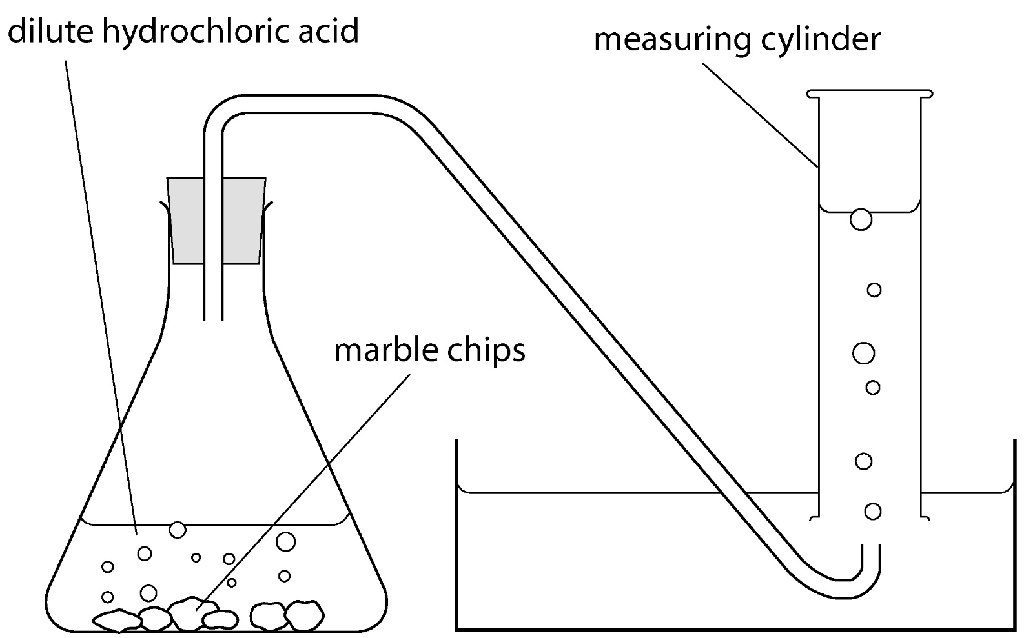
Measuring volume of gas produced

Slide 17
Example
Notes:
Page 60 revision guide

Slide 18
Calculations With Gases
Objective: to know to use volumes of gases in equations
Outcomes:
be able to calculate amounts of substances (in mol) in reactions involving volume of gas These calculations may involve reactants and/or products.
be able to calculate reacting volumes of gases from chemical equations, and vice versa, using the concepts of amount of substance
be able to calculate reacting volumes of gases from chemical equations, and vice versa, using the concepts of molar volume of gases

