Slide 1
Do Now
The word “Redox” comes from 2 words in chemistry (that you have come across before).
Which 2 words?
What do each of the words mean (GCSE definitions)

Slide 2
Starter
The word “Redox” comes from 2 words in chemistry (that you have come across before).
Which 2 words?
Oxidation and Reduction
What do each of the words mean (GCSE definitions)
GCSE:
Oxidation: Gain of Oxygen
Reduction: Loss of Oxygen
A Level:
Oxidation: Loss of electrons
Reduction: Gain of electrons

Slide 3
How can these mean the same thing??
A) Cu(s) + ½ O₂(g) → CuO(s)
B) CuO(s) + H₂(g) → Cu(s) + H₂O(l)
1). From GCSE definition, in terms of OXYGEN, in which reaction is the Copper:
i). Oxidised?
ii). Reduced?
2). i). Which group does oxygen belong to in the periodic table?
ii). Therefore, how many electrons does oxygen have on its outer shell?
iii). Therefore, what would be the charge on a stable oxygen ion?
iv). With your answer to 2). iii). in mind, what would be the charge on Cu in the compound: CuO?
3). Look at reactions A & B again at the top of the page. In terms of ELECTRONS, in which reaction is the copper;
i). Oxidised?
ii). Reduced?

Slide 4
How can these mean the same thing??
A) Cu(s) + ½ O₂(g) → CuO(s)
B) CuO(s) + H₂(g) → Cu(s) + H₂O(l)
1). From GCSE definition, in terms of OXYGEN, in which reaction is the Copper:
i). Oxidised? A
ii). Reduced? B
2). i). Which group does oxygen belong to in the periodic table? 6
ii). Therefore, how many electrons does oxygen have on its outer shell? 6
iii). Therefore, what would be the charge on a stable oxygen ion? -2
iv). With your answer to 2). iii). in mind, what would be the charge on Cu in the compound: CuO? Cu²⁺
3). Look at reactions A & B again at the top of the page. In terms of ELECTRONS, in which reaction is the copper;
i). Oxidised? A
ii). Reduced? B

Slide 5
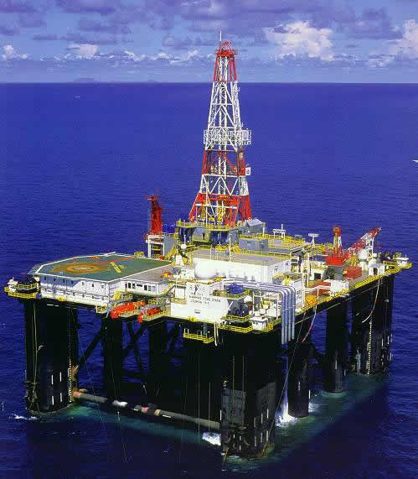
OIL RIG
Oxidation is Loss (of e-)
Reduction is Gain (of e-)
In a redox reaction, there is a GAIN (REDUCTION) of e- by 1 chemical and a LOSS (OXIDATION) of e- by another chemical in the reaction. REDOX

Slide 6
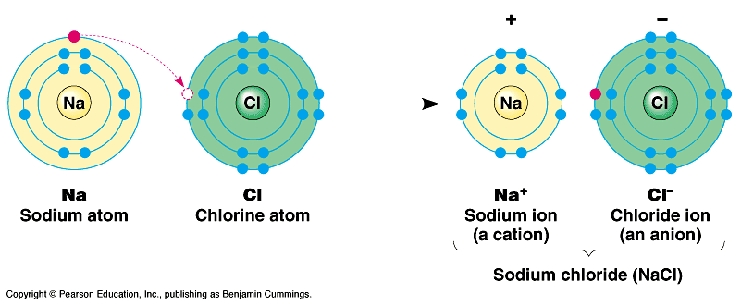
Example
When sodium metal reacts with the green gas chlorine, then white sodium chloride is made.
2Na(s) + Cl₂(g) → 2NaCl(s)
What has been oxidized and what has been reduced?
Each Sodium LOSES an e- (oxidation)
Each Chlorine GAINS an e- (reduction)

Slide 7
Example 2
2Mg + O₂ → 2MgO

Slide 8
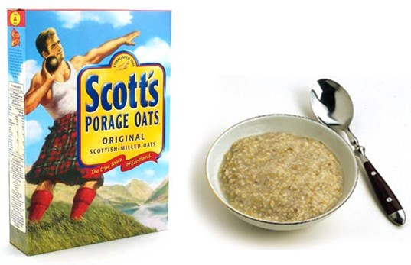
Oxidising Agents and Reducing Agents
Oxidising agent:
A substance that can OXIDISE another substance (an electron acceptor)
Reducing agent:
A substance that can REDUCE another substance (an electron donor)
Notes:
RAD = Reducing Agents Donate
OAT = Oxidising Agents Take (accept)

Slide 9
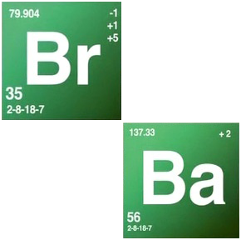
Example
To allow trains to travel at high speeds, the rails must be welded together so that there are no gaps. This is done using the thermite reaction.
Fe₂O₃(s) + 2Al(s) → Al₂O₃(s) + 2Fe(l)
Here the iron(III) oxide is reduced to iron, Fe:
Fe₂O₃ is reduced
Fe₂O₃ is the oxidizing agent
Al is oxidized
Al is the reducing agent
Notes:
Breaking Bad Thermite reaction: https://www.youtube.com/watch?v=Ng79utnURVY
https://www.youtube.com/watch?v=GyVD8V0016w

Slide 10
Check your Understanding
For these reactions, state which substance is:
Being oxidized
Being reduced
Is the oxidizing agent
Is the reducing agent
Fe₂O₃ +3CO → 2Fe + 3CO₂
Mg + PbO → MgO +Pb
2KI + Cl₂ → 2KCl + I₂

Slide 11
Check your Understanding
For these reactions, state which substance is:
Being oxidized
Being reduced
Is the oxidizing agent
Is the reducing agent
Fe₂O₃ + 3CO → 2Fe + 3CO₂
Mg + PbO → MgO + Pb
2KI + Cl₂ → 2KCl + I₂
Reduced
Oxidizing agent
Oxidized
Reducing agent
Oxidized
Reducing agent
Reduced
Oxidizing agent
Reduced
Oxidizing agent
Oxidized
Reducing agent

Slide 13
Answers
1a) Zn → oxidised Cu → reduced
b) Zn → Zn²⁺ + 2e⁻ Cu²⁺ + 2e⁻ → Cu
2a) Oxidised
b) Reduced
c) Neither
d) Reduction
e) Oxidised
f) Neither
3a) Fe → Loses 2 electrons to bond with sulfate ion
b) Na → loses 1 electron to bond with hydride ion
c) Cu(s) → loses 2 electrons to bond with oxygen ion
d) Fe → loses 1 electron (goes from Fe²⁺ to Fe³⁺)
e) Zn → loses 2 electrons

