Slide 1
Equilibrium 1 Chemical Equilibrium
Monday, 25 April 2016

Slide 2
Chemical Equilibrium
Objective: to know what chemical equilibirum is and justify why conditions are used in industry
Success criteria:
know that many reactions are readily reversible and that they can reach a state of dynamic equilibrium in which: i) the rate of the forward reaction is equal to the rate of the backward reaction ii) the concentrations of reactants and products remain constant
be able to predict and justify the qualitative effect of a change in temperature, concentration or pressure on a homogeneous system in equilibrium
evaluate data to explain the necessity, for many industrial processes, to reach a compromise between the yield and the rate of reaction

Slide 3
https://www.youtube.com/watch?v=Aak621puhbM
https://www.youtube.com/watch?v=viWiJtLyXKE
Your homework was to watch these two videos and make notes
Look at the exam question and see how much you can answer
Some questions are from the organic section of the module

Slide 4
Reactions and arrows
The reaction of sodium and chlorine is irreversible.
2Na_{(s)} + Cl_{2(g)} → 2NaCl_{(s)}
Irreversible reactions are represented by a single arrow: →.
The reaction of nitrogen and hydrogen to form ammonia is reversible.
N_{2(g)} + 3H_{2(g)} 2NH_{3(g)}
Ammonia can also decompose to form nitrogen and hydrogen. Reversible reactions that can reach equilibria are represented by two half arrows: .

Slide 5
What is equilibrium?
If a reversible reaction is carried out in a closed container so that the reactants and products cannot escape, a state of dynamic equilibrium can be established.
A + B C + D
This state is dynamic because both the forward and reverse reactions are ongoing.
It is an equilibrium because:
the rates of the forward and reverse reactions are the same
the net concentrations of the components of the reaction mixture remain constant.
Notes:
Teacher notes
It could be pointed out that the above equilibrium could be reached by starting either with a mixture of A and B, or with a mixture of C and D.

Slide 6
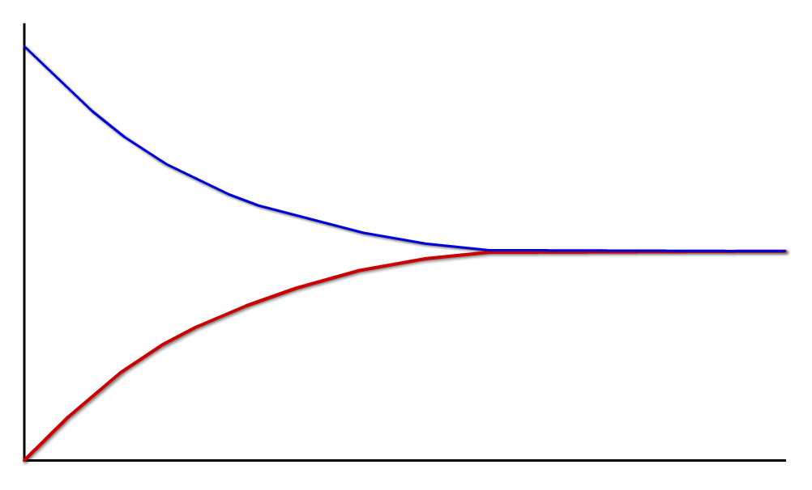
Dynamic equilibrium
This graph illustrates the dynamic nature of equilibrium. It shows that both the forward and back reactions are taking place: they both have non-zero rate. When their rates are equal, equilibrium is reached.
forward reaction: 2SO_{2(g)} + O_{2(g)} → 2SO_{3(g)}
rate
rates are equal at equilibrium
reverse reaction: 2SO_{3(g)} → 2SO_{2(g)} + O_{2(g)}
time

Slide 7
Dynamic Equilibrium.
In dynamic equilibrium the forward and backwards reactions continue at equal rates so the concentrations of reactants and products do not change.
On a molecular scale there is continuous change.
On the macroscopic scale nothing appears to be happening. The system needs to be closed – isolated from the outside world.

Slide 8
Position of the equilibrium
Equilibrium can “lie” to the left or right.
Meaning that once equilibrium has been reached (the point where there is no more change) there could be more products or more reactants.

Slide 9
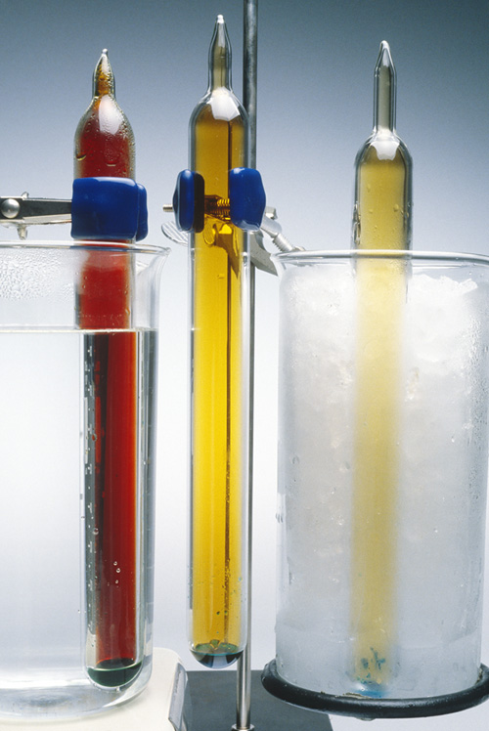
Composition of the reaction mixture
At equilibrium, the proportions of reactants and products present may not be a 50:50 mix.
The proportion of reactants and products depend on the particular reaction, as well as factors such as temperature, concentration and pressure.
However, for a given set of conditions, a particular reaction will always have the same proportions of reactants and products at equilibrium.
At equilibrium the concentration of reactants and products does not change
Notes:
Photo credit: Charles D. Winters / Science Photo Library
Teacher notes
The photo shows the temperature dependence of the equilibria between NO₂ and N₂O₄. Three identical tubes are placed in warm water (left), room temperature (middle) and iced water (right). The greater the proportion of NO₂, the darker the tube.

Slide 10
Chemical Equilibrium
Objective: to know what chemical equilibirum is and justify why conditions are used in industry
Success criteria:
know that many reactions are readily reversible and that they can reach a state of dynamic equilibrium in which: i) the rate of the forward reaction is equal to the rate of the backward reaction ii) the concentrations of reactants and products remain constant
be able to predict and justify the qualitative effect of a change in temperature, concentration or pressure on a homogeneous system in equilibrium
evaluate data to explain the necessity, for many industrial processes, to reach a compromise between the yield and the rate of reaction

Slide 11
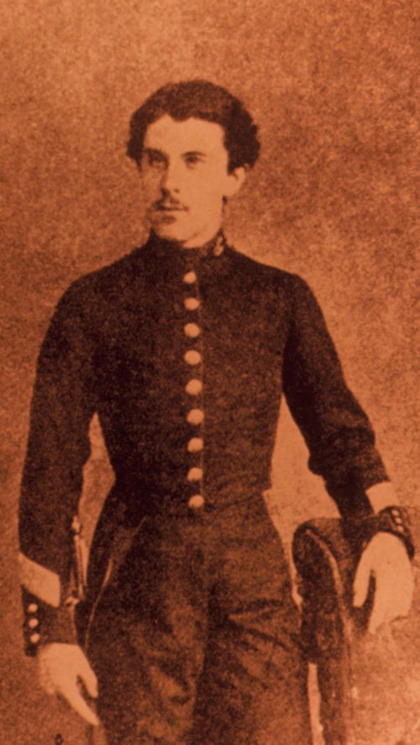
What is Le Chatelier’s principle?
Le Chatelier’s principle states that:
If a factor affecting the position of an equilibrium is altered, the position of the equilibrium shifts to oppose the effect of the change.
Le Chatelier’s principle is used to determine what effect a change will have on a mixture at equilibrium.
However, it does not explain why that change will occur, or what the extent of the change will be.
Notes:
Photo credit: Science Photo Library
Henri Louis Le Chatelier (1850-1936), the French physical chemist and metallurgist, seen here while a student at the Ecole Polytechnique. His early research was on cement; he worked also on the structure of alloys, on flames and on thermometry. In the 1880's he developed the idea known as Le Chatelier's principle: this states that if the conditions (temperature, pressure or volume) of a chemical system initially at equilibrium are changed, then the equilibrium will shift in the direction which will tend to annul the change, if possible. Although far from perfect and much critized, this principle is still used today.
Teacher notes
Henry Louis Le Chatelier (1850–1936) was an influential French chemist. He trained as an engineer, but taught and researched chemistry for much of his life. He is most famous for Le Chatelier’s principle, announced in 1884.

Slide 12
Temperature and equilibrium
Notes:
Teacher notes
See the ‘Energetics’ presentation for more information about exothermic and endothermic reactions.
Students should be familiar with the concept that that an exothermic reaction generates heat and an endothermic reaction takes in heat.

Slide 13
Temperature and equilibrium
Notes:
Teacher notes
See the ‘Energetics’ presentation for more information about exothermic and endothermic reactions.
Students should be familiar with the concept that that an exothermic reaction generates heat and an endothermic reaction takes in heat.

Slide 14
Temperature Summary
Increasing the temperature of a system in dynamic equilibrium favours the endothermic reaction. The system counteracts the change you have made by absorbing the extra heat.
Decreasing the temperature of a system in dynamic equilibrium favours the exothermic reaction. The system counteracts the change you have made by producing more heat.
This isn't in any way an explanation of why the position of equilibrium moves in the ways described. It is only a way of helping you to work out what happens

Slide 15
Concentration and equilibrium

Slide 16
Concentration and equilibrium
If the concentration of one of the substances involved in a dynamic equilibrium changes, the equilibrium will shift to oppose that change.
A + B C + D
If the concentration of A is increased, the equilibrium will shift to the right to reduce the amount of A. Increasing the concentration of any substance causes the equilibrium to shift to use up more of that substance.
If the concentration of A is reduced, the equilibrium will shift to the left to increase the amount of A. Decreasing the concentration of any substance causes the equilibrium to shift to make more of that substance.

Slide 17
Pressure and equilibrium

Slide 18
Pressure and equilibrium

Slide 19
A competition with the rate…
The rate is increased with increasing concentration and temperature – however this may cause the equilibrium to lie in favor of the reactants.
The final conditions will be a compromise between the two.
It is a common exam question to ask you to comment on conditions in terms of favorability for rate and for equilibrium.

Slide 20
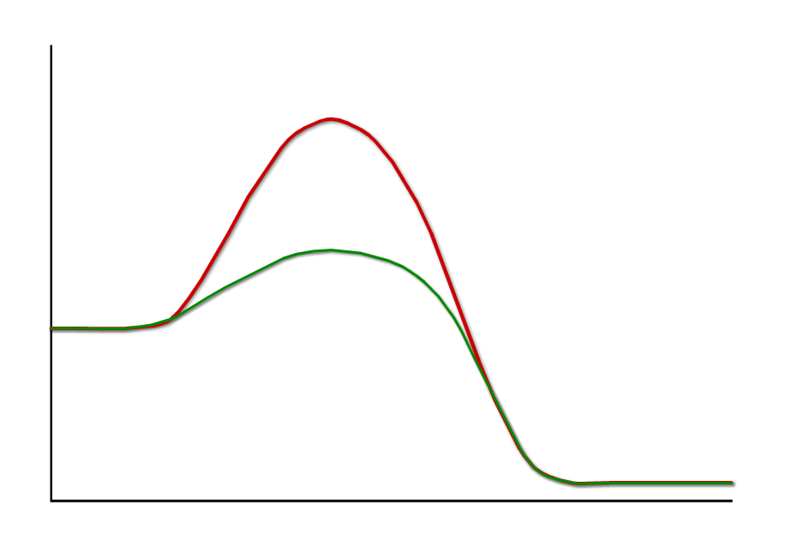
Catalysts and equilibrium
A catalyst is a substance that speeds up the rate of reaction by providing an alternative reaction pathway of lower energy.
without catalyst
energy
with catalyst
When added to a reversible reaction, a catalyst increases the rate of both the forward and reverse reactions equally. This has two results:
time
there is no change to the position of the equilibrium
equilibrium is reached faster.
The use of catalysts is particularly important in industry.
Notes:
Teacher notes
Students could be asked why the use of catalysts is so important in industry if they do not shift the equilibrium position in favour of making more of the product.
Answers could include:
the fact that increasing rate allows more reactions to take place in the same time period,
that temperatures and pressures need not be raised so high in order to increase rate.
This is particularly useful if increasing temperature or pressure shifts the equilibrium away from the desired product. It advantageous in any case because high temperatures and pressures take a lot of money and resources to produce.

Slide 21
Exam Questions
Questions 1, 2, 3
Notes:
Edex cel

Slide 22
The specification says you must be able to:
to describe and predict, in a homogeneous reaction, the qualitative effects on the position of equilibrium of changes in the following conditions:
concentration, temperature, pressure;

Slide 23
Chemical Equilibrium
Objective: to know what chemical equilibirum is and justify why conditions are used in industry
Success criteria:
know that many reactions are readily reversible and that they can reach a state of dynamic equilibrium in which: i) the rate of the forward reaction is equal to the rate of the backward reaction ii) the concentrations of reactants and products remain constant
be able to predict and justify the qualitative effect of a change in temperature, concentration or pressure on a homogeneous system in equilibrium
evaluate data to explain the necessity, for many industrial processes, to reach a compromise between the yield and the rate of reaction

Slide 24
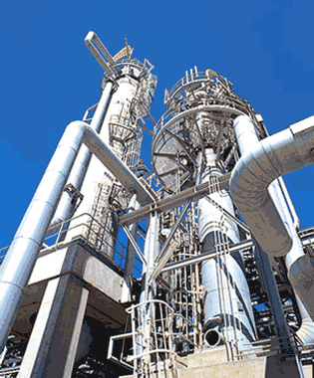
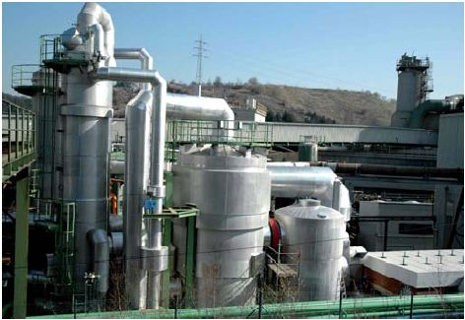
Industry
Many important chemical engineering processes are equilibriums, including:
The Haber process (ammonia)
The Contact process (sulphuric acid)

Slide 25
Industry
In industry Chemists want to make the highest possible yield of the desired chemical.
But what constraints do they usually work under?
Time
Money

Slide 26
Exam Questions
Exam questions 8 b, c, d
Notes:
Edexcel

Slide 27
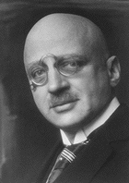
Haber Process
Fritz Haber
Winner of the Nobel prize in 1918 for his work on the Haber process.
He also…
The raw materials of the Haber process are readily available:
Nitrogen –obtained from the air by fractional distillation.
Hydrogen –obtained by reacting natural gas (methane) with water.

Slide 28
Haber Process
How does temperature effect the process?
Colder means equilibrium shifts to the right!
BUT
Colder also means a slower reaction…

Slide 29
Haber Process
How does pressure effect the process?
4 molecules on the left
2 molecules on the right
More pressure shifts equilibrium to the right
BUT
High pressure equipment is VERY expensive.

Slide 30
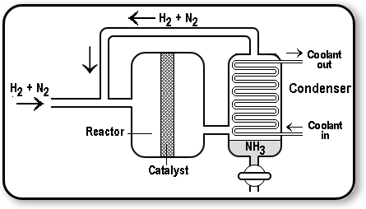
Ammonia Plants
Conditions?

Slide 31
Ammonia Plants
Temperature lowers the yield and increases the cost.
High temperature and catalyst increases the rate of the reaction.
Ammonia plants make a compromise.
400 - 500°C
Iron catalyst
Pressure is as high as is safe and can be economically managed - 200atm.

Slide 32
More exam questions
Q 4, 5, 6, 7
Notes:
edexcel

Slide 33
Chemical Equilibrium
Objective: to know what chemical equilibirum is and justify why conditions are used in industry
Success criteria:
know that many reactions are readily reversible and that they can reach a state of dynamic equilibrium in which: i) the rate of the forward reaction is equal to the rate of the backward reaction ii) the concentrations of reactants and products remain constant
be able to predict and justify the qualitative effect of a change in temperature, concentration or pressure on a homogeneous system in equilibrium
evaluate data to explain the necessity, for many industrial processes, to reach a compromise between the yield and the rate of reaction

Slide 34
Chemical Equilibrium
Objective: to know what chemical equilibirum is and justify why conditions are used in industry
Success criteria:
know that many reactions are readily reversible and that they can reach a state of dynamic equilibrium in which: i) the rate of the forward reaction is equal to the rate of the backward reaction ii) the concentrations of reactants and products remain constant
be able to predict and justify the qualitative effect of a change in temperature, concentration or pressure on a homogeneous system in equilibrium
evaluate data to explain the necessity, for many industrial processes, to reach a compromise between the yield and the rate of reaction

