Slide 1
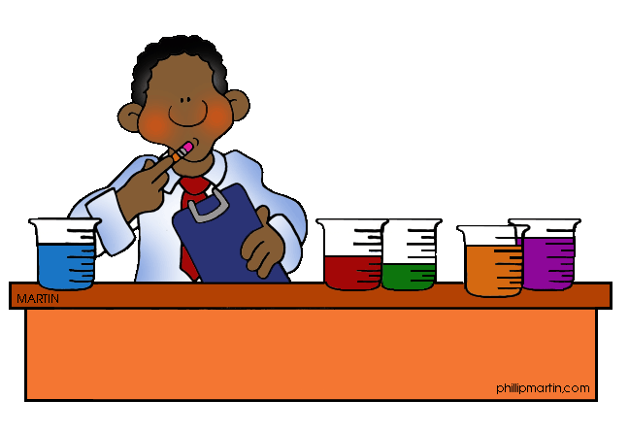
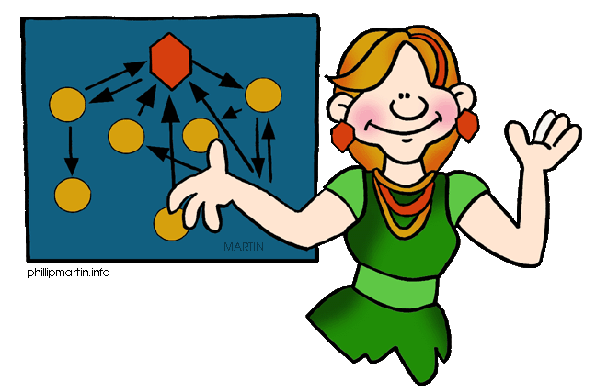
AS Chemistry Homework Ionisation Energy
Total : 37 marks

Slide 2
Question 1
the energy required to remove one electron from
each atom in one mole of gaseous atoms
ALLOW 3 marks for: the energy required to remove one mole of electrons from one mole of atoms atoms in the gaseous state
If no definition, ALLOW one mark for the equation below, including state symbols. X(g) → X+(g) + e– / X(g) – e– → X+(g) ALLOW e for electron IGNORE state symbol for electron
[TOTAL : 3 marks]

Slide 3
Question 2
(i) First ionisation (energy)
Ra_{(g)} → Ra⁺(g) + e−
(1) mark for equation
(1) mark for state symbols
‘-‘ not required on ‘e’
(ii) atomic radii of Ra > atomic radii of Ca/
Ra has electrons in shell further from nucleus than Ca/
Ra has more shells
Ra has more shielding than Ca
: ‘more’ is essential
Ra electron held less tightly/less attraction on electron (any 3)
[TOTAL : 7 marks]

Slide 4
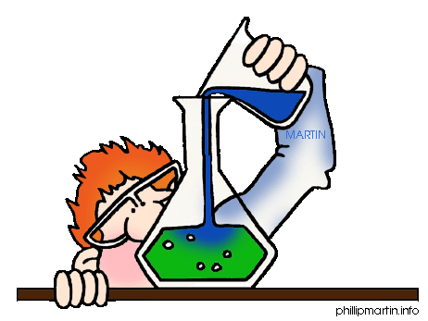
Question 3
(i) Energy change when each atom in 1 mole
of gaseous atoms
Loses an electron (to form 1 mole of gaseous 1+ ions). (3)
(ii) O²⁺ _{(g)} → O³⁺_{(g)} + e− (2)
1 mark for correct species; 1 mark for state symbols
No charge required on electron.
Ignore (g) on e
(iii) Large difference between 6th and 7th IEs
marking a different shell (closer to nucleus)
allow ‘inner shells’/new shell/full shell/
first shell marking points independent.
not sub-shell or orbital (2)
[TOTAL : 7 marks]

Slide 5
Question 4
(i) Ca⁺_{(g)} ---> Ca²⁺_{(g)} + e−
Equation with correct charges and 1 electron lost
state symbols
‘−’ not required on ‘e’ (2)
(ii) same number of protons or same nuclear charge attracting
less electrons / electron removed from an ion/
less electron-electron repulsion (not less shielding)/
ion is smaller (1)
(iii) atomic radii of Sr > atomic radii of Ca/
Sr has electrons in shell further from nucleus than Ca/
Sr has electrons in a higher energy level/
Sr has more shells …… therefore less attraction
Sr has more shielding than Ca
(‘more’ is essential) (3)
increased nuclear charge is outweighed / despite increased nuclear charge …..by at least one of the factors above
[TOTAL : 6 marks]

Slide 6
Question 5
(i) Energy change when each atom in 1 mole of gaseous atoms loses an electron (to form 1 mole of gaseous 1+ ions). (3)
(ii) increasing nuclear charge/number of protons electrons experience greater attraction or pull / atomic radius decreases / electrons added to same shell /same or
similar shielding (2)
(iii) In B, electron being removed is at a higher energy / In Be, electron being removed is at a lower energy
An s electron is lost in Be AND a p electron is lost in B (2)
[TOTAL : 7 marks]

Slide 7
Question 6
(i) O⁺ (g) → O²⁺ (g) + e–
answer must have state symbols ALLOW e for electron ALLOW O⁺_{(g)} – e- → O²⁺ _{(g)} DO NOT ALLOW O⁺(g) + e– → O²⁺ _{(g)} + 2e– IGNORE state symbol for electron (1)
(ii) the O⁺ ion, is smaller than the O atom OR the electron repulsion/shielding is smaller OR the proton : electron ratio in the 2+ ion is greater than in the 1+ ion
ALLOW the outer electrons in an O⁺ ion are closer to
the nucleus than an O atom
DO NOT ALLOW ‘removed from next shell down’ (1)
[TOTAL : 2 marks]

Slide 8
Question 7
(a) Energy change when each atom in 1 mole
of gaseous atoms
loses an electron (to form 1 mole of gaseous 1+ ions). (3)
(b) increasing nuclear charge/number of protons
electrons experience greater attraction or pull/atomic radius decreases/electrons added to same shell/
same or similar shielding (2)
[TOTAL : 5 marks]

