Slide 1
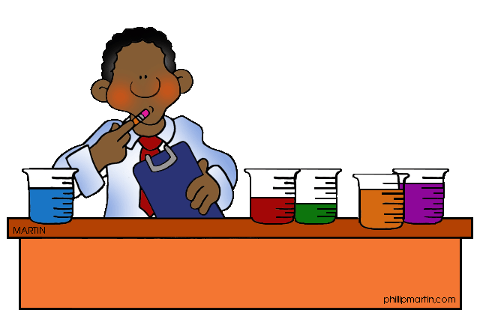
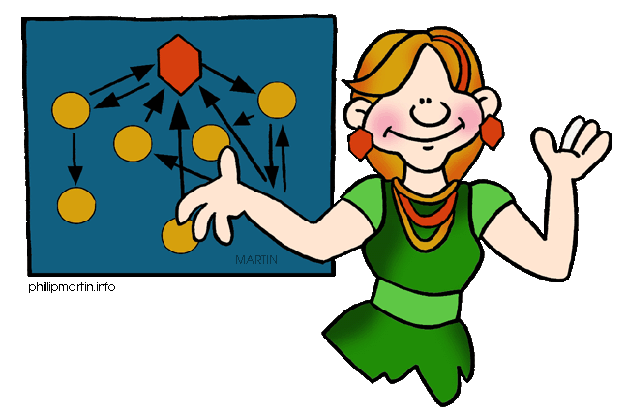
AS Chemistry Homework Periodicity
Total : 54 marks

Slide 2
Question 1
(i) Potassium AND argon
ALLOW K and Ar (1)
(ii) They are arranged in increasing atomic number OR Neither would show properties OR trends of rest of group OR Neither would show properties OR trends of rest of period OR They are arranged by electron configuration
ALLOW any correct property difference e.g. This would place a reactive metal in the same group as
noble gases
ALLOW they do not fit in with the rest of the group (1)
[TOTAL : 2 marks]

Slide 3
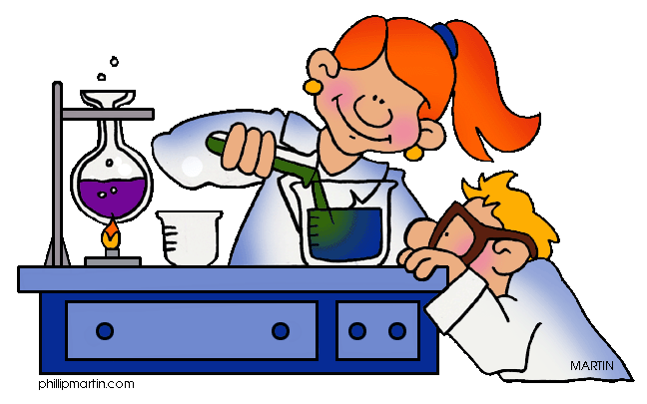
Question 2
(a)
(i) Magnesium ions have a greater charge
Magnesium has more (delocalised OR outer) electrons
Magnesium has greater attraction between ions and electrons OR has stronger metallic bonds
USE annotations with ticks, crosses, ecf, etc for this part.
ALLOW REVERSE ARGUMENT e.g. sodium ions have a smaller charge ALLOW Mg²⁺ / Mg ion / Na ion / Na⁺ ion ALLOW ‘charge density’ as alternative to ‘charge’
ALLOW REVERSE ARGUMENT e.g. sodium has fewer electrons
ALLOW REVERSE ARGUMENT e.g. sodium has less attractions between ions and electrons OR has weaker metallic bonds (3)

Slide 4
(ii) Cl₂ OR S₈ has intermolecular OR van der Waals’ forces
S₈ has stronger intermolecular forces OR van der Waals’
forces than Cl₂ OR
S₈ has more electrons
ALLOW REVERSE ARGUMENT ie Cl₂ has weaker Intermolecular forces OR van der Waals’ forces DO NOT ALLOW comparison involving covalent bonds
ALLOW REVERSE ARGUMENT Cl₂ has fewer electrons (2)

Slide 5
(b) nuclear charge increases/ protons increase
electrons added to the same shell OR screening OR shielding remains the same
greater attraction OR greater pull
USE annotations with ticks, crosses, ecf, etc for this part.
Nuclear OR proton(s) OR nucleus spelt correctly ONCE
IGNORE ‘atomic number increases’
IGNORE ‘nucleus gets bigger’ or ‘charge increases’ is not sufficient ALLOW ‘effective nuclear charge increases’ OR ‘shielded nuclear charge increases’
IGNORE reference to atomic radius staying the same
ALLOW shielding is similar DO NOT ALLOW extra shielding
A comparison must be included: i.e. ‘greater pull’, ‘more pull’, ‘held more tightly’ (3)
[TOTAL : 8 marks]

Slide 6
Question 3
(i) S (1)
(ii) Al (1)
(iii) B (1)
(iv) Ca (1)
(v) K (1)
(vi) K (1)
[TOTAL : 6 marks]

Slide 7
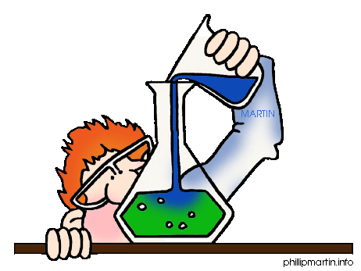
Question 4
(a)
Element Mg Si S
Structure giant giant simple
Bonding metallic covalent covalent
1 mark for each correct row (3)
(b) Si has strong forces between atoms/ covalent bonds are broken P has weak forces between molecules/ intermolecular forces/van der Waals’ forces are broken (2)

Slide 8
(c) From Na ® Al, no of delocalised electrons increases charge on positive ion increases
ionic size decreases
charge density increases attraction between + ions and electrons increases
metallic bonding gets stronger (2)
[TOTAL : 7 marks]

