Slide 1
Give printed notes to highlight for feedback

Slide 2
Fuels
Tuesday, 07 February 2017

Slide 3
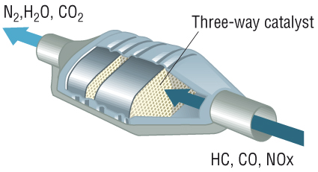
The diagram shows a catalytic converter, which is found on cars.
Look at the diagram and on Post Its write down:
What it does?
How does it help?
Can you see any disadvantages of a catalytic converter?
Write down anything that you know about the pollutants.
Write your name on the Post It

Slide 4
Controlling Air Pollution
Objective: To know the problems of using fossil fuels and the alternative fuels available
Success Criteria
State why alkanes make good fuels (grade D)
Describe how carbon monoxide, oxides of nitrogen and oxides of sulfur form in an internal combustion engine (grade C)
Evaluate the use of biofuels as an alternative to using fossil fuels (grade A)
Explain how a catalytic converter decreases carbon monoxide and nitrogen monoxide emissions from internal combustion engines (grade A)

Slide 5
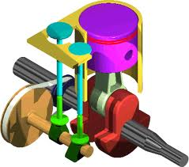
The Internal Combustion Engine
In addition to carbon dioxide, the modern engine emits three main groups of atmospheric pollutants:
Carbon monoxide
Oxides of nitrogen
Oxides of sulfur
Unburnt hydrocarbons

Slide 6
Group Activity
Work in your groups
Each of you will be given a topic
Use the resources you have (e.g. text book, revision guide) to research the topic
You must include information covered by the specification
After you will tell the rest of your group about your topic

Slide 7
Group Activity
Now you need to tell each other about your topic.
While you are listening to the rest of your group you need to look at the printed notes you have been given and highlight anything that is said.
Add any other useful information that you are taught.
Also check the specification.
You also need to think of a question to ask the person teaching you the topic.
These will be asked at the end once everyone has had a chance to teach the topic.
After we will review this as a class.

Slide 8
Carbon Monoxide
Created by the incomplete combustion of hydrocarbon fuels.
In the UK it comes mostly from traffic pollution.
It takes one month for atmospheric CO to be oxidised to CO₂
Poisonous – combines irreversibly with haemoglobin.
The blood therefore can carry less oxygen leading to:
Reduced dexterity
Disturbed vision
Tiredness
Inability to perform complex tasks.

Slide 9
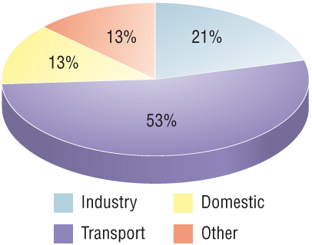
Oxides of Nitrogen
In the hot engine some nitrogen from the air is oxidised to:
Nitrogen oxide (NO)
Nitrogen dioxide (NO₂).
Nitrogen dioxide contributes to the formation of low-level ozone.
Most nitrogen dioxide is converted to nitric acid –acid rain.
Nitrogen oxides are also respiratory irritants effecting asthmatics.

Slide 10
Unburnt Hydrocarbons
Volatile Organic Compounds (VOCs) – released in vehicle exhaust gases.
Especially benzene and buta-1,3-diene.
Found in petrol
Human carcinogens
Unburnt hydrocarbons also react with NO₂ to form low-level ozone.
Energy provided by sunlight

Slide 11
Controlling Air Pollution
Objective: To know the problems of using fossil fuels and the alternative fuels available
Success Criteria
State why alkanes make good fuels (grade D)
Describe how carbon monoxide, oxides of nitrogen and oxides of sulfur form in an internal combustion engine (grade C)
Evaluate the use of biofuels as an alternative to using fossil fuels (grade A)
Explain how a catalytic converter decreases carbon monoxide and nitrogen monoxide emissions from internal combustion engines (grade A)

Slide 12
How can we reduce the pollutants?

Slide 13
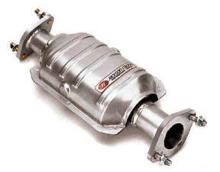
Catalytic Convertors
Since 1993 every new petrol car in the EU has had a catalytic convertor.
It is a platinum/rhodium/palladium catalyst on a honeycomb mesh.
The mesh can have the surface area of 2 football pitches!
Hot gases pass over the catalyst and are converted into less-harmful products.

Slide 14
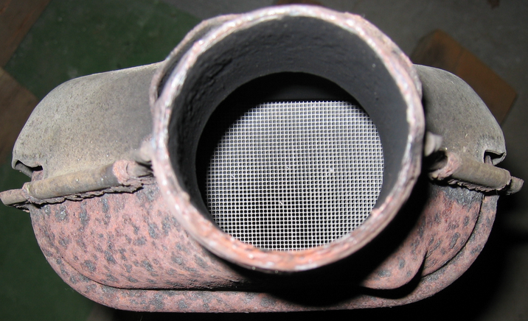
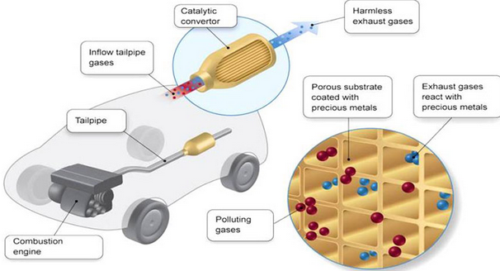
Catalytic Convertors
It is a platinum/rhodium/palladium catalyst on a honeycomb mesh.
Hot gases pass over the catalyst and are converted into less-harmful products.

Slide 15
Oxidation Catalyst
Fitted to diesel engines to decrease emissions of carbon monoxide and unburnt hydrocarbons.
Usually combined with a filter system, they also remove particulate matter and nitrogen oxides.
Decrease CO
2CO(g) +O₂(g) → CO₂(g)
Reduce unburnt hydrocarbons
C₁₂H₂₆(l) + 18.5 O₂(g) → 12 CO₂(g) + 13H₂O(l)

Slide 16
Three-way catalyst
Fitted to petrol engines.
Removes CO and oxides of nitrogen:
2CO(g) + 2NO(g) → 2CO₂(g) + N₂(g)
Can you see a problem with this?

Slide 17
Levels of Emissions
 | Emissions (g.km⁻¹)
 | CO | Unburnt hydrocarbons | NO₂
No catalyst | 5.99 | 1.67 | 1.04
With catalyst | 0.61 | 0.07 | 0.04

Slide 18
Controlling Air Pollution
Objective: To know the problems of using fossil fuels and the alternative fuels available
Success Criteria
State why alkanes make good fuels (grade D)
Describe how carbon monoxide, oxides of nitrogen and oxides of sulfur form in an internal combustion engine (grade C)
Evaluate the use of biofuels as an alternative to using fossil fuels (grade A)
Explain how a catalytic converter decreases carbon monoxide and nitrogen monoxide emissions from internal combustion engines (grade A)

Slide 19
Biofuels
Biofuels are fuels made from living matter
They are carbon neutral
However they use up a lot of land

Slide 20
Controlling Air Pollution
Objective: To know the problems of using fossil fuels and the alternative fuels available
Success Criteria
State why alkanes make good fuels (grade D)
Describe how carbon monoxide, oxides of nitrogen and oxides of sulfur form in an internal combustion engine (grade C)
Evaluate the use of biofuels as an alternative to using fossil fuels (grade A)
Explain how a catalytic converter decreases carbon monoxide and nitrogen monoxide emissions from internal combustion engines (grade A)

Slide 21
Complete the questions hydrocarbons as fuels and alternative fuels
Notes:
Pages 47 – 48 in workbook

Slide 22
Plenary
Answer the following exam questions on white boards

Slide 23
Grade C
Exam questions

Slide 24
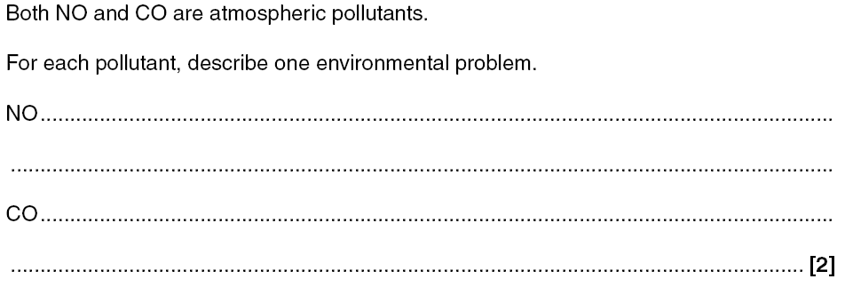
Grade D
Exam questions

Slide 25
Grade D
Exam questions

Slide 26
Exam Questions
Grade C

Slide 27
Controlling Air Pollution
Objective: To know the problems of using fossil fuels and the alternative fuels available
Success Criteria
State why alkanes make good fuels (grade D)
Describe how carbon monoxide, oxides of nitrogen and oxides of sulfur form in an internal combustion engine (grade C)
Evaluate the use of biofuels as an alternative to using fossil fuels (grade A)
Explain how a catalytic converter decreases carbon monoxide and nitrogen monoxide emissions from internal combustion engines (grade A)

