Slide 1
Gas Law Group Activity (Print pages 2 and 3 back-to-back as worksheet) (Print the other sheets and place around the room) Group mathematicians with non-mathematicians

Slide 2
The Ideal Gas Equation Task: Using the information, answer the following questions:
1. What did Robert Boyle observe?
2. What did Jacques Charles state?
3 .What is Avogadro’s Law?
4. What did Gay-Lussac state?
5. What does inversely proportional mean?
6. What does directly proportional mean?
7. Why are gases so easy to compress?
.
8. What temperature scale is used in gas equations?
10. R=
9. What must the units of P, V, R, and T be?
P:
V:
R:
T:
11. 0K = .......... °C
So to convert K to °C you must ..............................................
The Ideal Gas Equation is:

Slide 3
The Ideal Gas Equation is:
Units
P;
V:
n:
R:
T:
P=
Examples:
V=
n=
T=

Slide 4
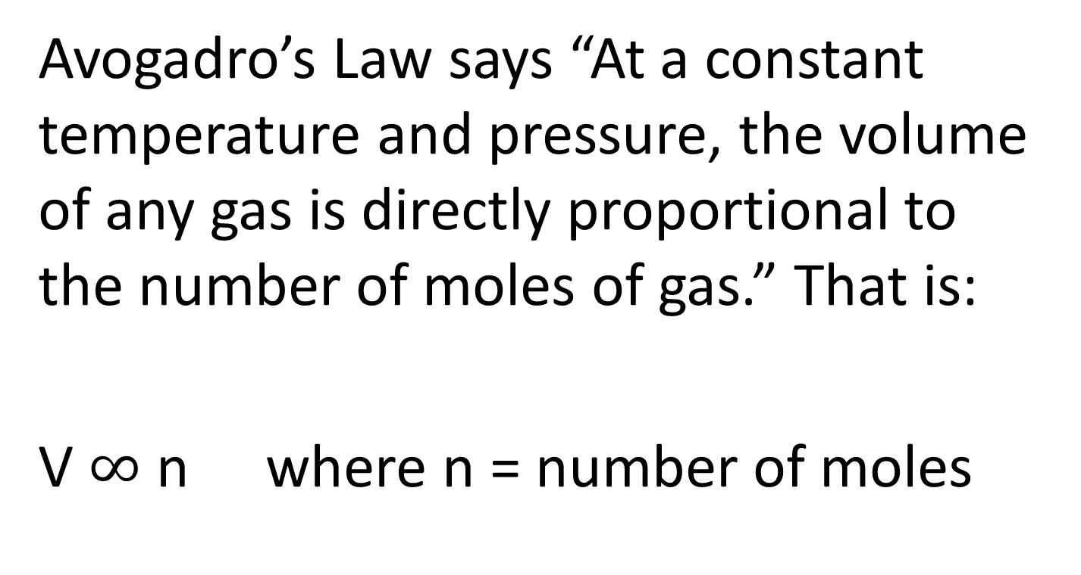
Avogadro’s Law
Avogadro’s Law says “At a constant temperature and pressure, the volume of any gas is directly proportional to the number of moles of gas.” That is:
V $∞$ n where n = number of moles

Slide 5
Boyle’s Law
The product of pressure and volume is a constant as long as the temperature remains constant.
PV = constant

Slide 6
Charles’ Law
The volume is proportional to the temperature as long as the pressure remains constant.
V $∝T$ and V/T = constant

Slide 7
Gay-Lussac’s Law
The pressure is proportional to the temperature as long as the volume remains constant.
P $∝T$ and P/T = constant

Slide 8
The Ideal Gas Equation: Units
When using the ideal gas equation, consistent units must be used these are called SI units:
Pressure must be in Pascal, Pa, (N/m² )
Volume must be in m³
Temperature must be in kelvin (K)
R (gas constant) must be in J K⁻¹ mol⁻¹

