Slide 1
Complete spot the bonding worksheet

Slide 2
Homework
Private study work (bring notes to show me next lesson);
Read pages 66 – 71 in your text book
Complete the summary questions on each double page spread.
Look at the following websites
http://www.chemguide.co.uk/atoms/structsmenu.html#top
(Not the structures of period 3)
http://www.chemnotes.org.uk/f321.html
Topic 5, concentrate on structure, bonding and properties

Slide 3
Properties of giant covalent and simple covalent substances
Friday, 21 October 2016

Slide 4
Demo
Sand and water
Heat in Bunsen what happens. What does this show? Why?
What happens to sand in water?
Set up a circuit.
What happens to the bulb? Why?

Slide 5
Properties of giant and simple covalent substances
For giant and simple covalent substances
know that giant lattices are present in: ii) covalently bonded solids, such as diamond, graphite and silicon(IV) oxide (giant covalent lattices)
know that the structure of covalently bonded substances such as iodine, I₂, and ice, H₂O, is simple molecular
know the different structures formed by carbon atoms, including graphite, diamond and grapheme
be able to predict the type of structure and bonding present in a substance from numerical data and/or other information
be able to predict the physical properties of a substance, including melting and boiling temperature, electrical conductivity and solubility in water, in terms of: i) the types of particle present (atoms, molecules, ions, electrons) ii) the structure of the substance iii) the type of bonding and the presence of intermolecular forces, where relevant

Slide 6
Simple molecules
Small discrete molecules
Strong covalent bonds within molecules
Weak intermolecular forces between molecules
Low melting and boiling points
Solids, liquids or gases at room temperature
Normally soft and brittle when solid
Usually more soluble in non-polar solvents such as hexane, than in water, and the solutions in hexane do not conduct electricity
Never conduct electricity
Typical examples – CO₂ , H₂O, Br₂, S₈

Slide 7
Simple Molecular Lattice
Some covalent substances are made from small, simple molecules:
H₂
O₂
Ne
Can you draw the dipoles in these 3 molecules?
NO! They are non-polar.
So what are the forces between the molecules?
van der Waals
These are weak so these substances have low m.p.s and b.p.s

Slide 8
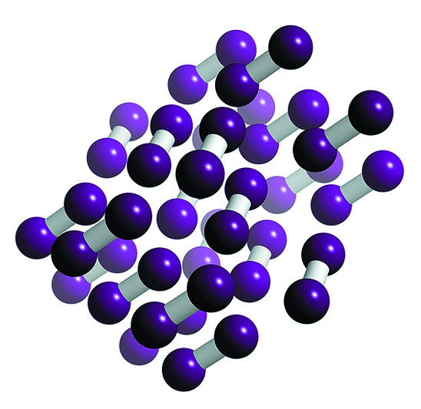
Simple molecular lattice
Simple covalent molecules can be solidified and form a simple molecular lattice.
The I₂ molecules are held together by weak van der Waals forces.

Slide 9
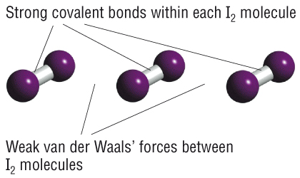
Simple molecular lattice
Describe the changes in bonding that occur when solid I₂ changes state.
The weak van der Waals forces between the molecules are broken but the strong I-I covalent bonds do not break.

Slide 10
Don’t conduct electricity as solids, liquids or gases because they don’t contain ions or free electrons to carry the electric charge

Slide 11
Simple Molecules
What are the properties of simple covalent molecules?
Melting and boiling points
Electrical conductivity
Solubility
Melting and boiling points
These are low because the intermolecular forces are weak.
(van der Waals only)
Electrical conductivity
Non-conductors
(there are no charged particles that are free to move)
Solubility
Soluble in non-polar solvents e.g. hexane
(van der Waals form between the simple molecule and the solvent, this weakens the lattice.)

Slide 12
Properties of giant and simple covalent substances
For giant and simple covalent substances
know that giant lattices are present in: ii) covalently bonded solids, such as diamond, graphite and silicon(IV) oxide (giant covalent lattices)
know that the structure of covalently bonded substances such as iodine, I₂, and ice, H₂O, is simple molecular
know the different structures formed by carbon atoms, including graphite, diamond and grapheme
be able to predict the type of structure and bonding present in a substance from numerical data and/or other information
be able to predict the physical properties of a substance, including melting and boiling temperature, electrical conductivity and solubility in water, in terms of: i) the types of particle present (atoms, molecules, ions, electrons) ii) the structure of the substance iii) the type of bonding and the presence of intermolecular forces, where relevant

Slide 13
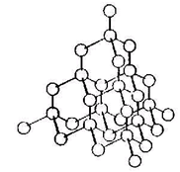
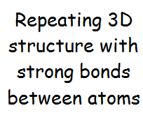
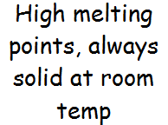
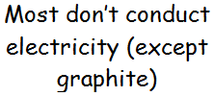
Giant covalent structure

Slide 14
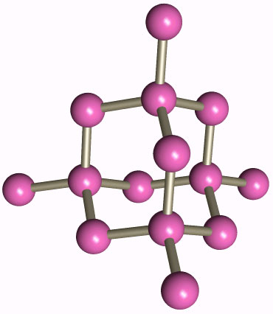
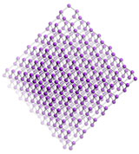
Giant molecular substances
In these materials strong covalent bonds join atoms together with other atoms of the same type to make giant structures, rather than little groups.
Every C atom joined to 4 others
Diamond
carbon atom
(this is only part of the structure - the same pattern carries on in every direction)
Only strong bonds

Slide 15
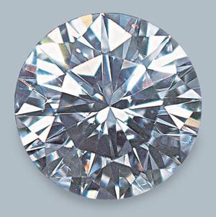
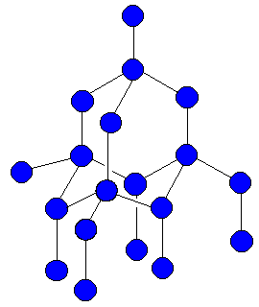
Because all the atoms in Giant Structures are joined by STRONG BONDS they:
Have HIGH melting / boiling points
Are usually HARD and STRONG
Also conducts thermal energy well
Tetrahedral shape
Because all the atoms in Giant Structures are UNCHARGED, they will not conduct electricity.

Slide 16
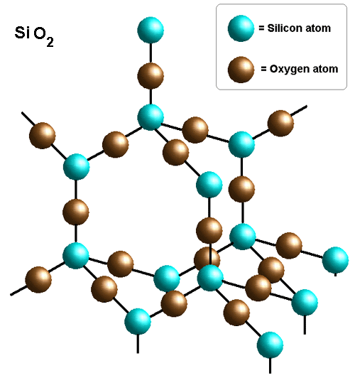
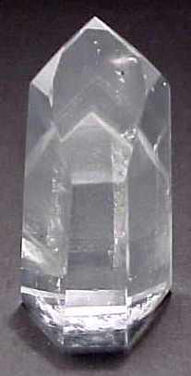
Silica (Silicon dioxide SiO₂) has a similar structure to diamond
Every Si atom joined to 4 O atoms
Silica is the main substance in rocks. Pure silica is called quartz

Slide 17
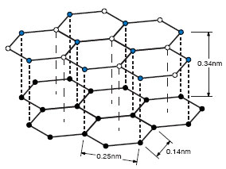
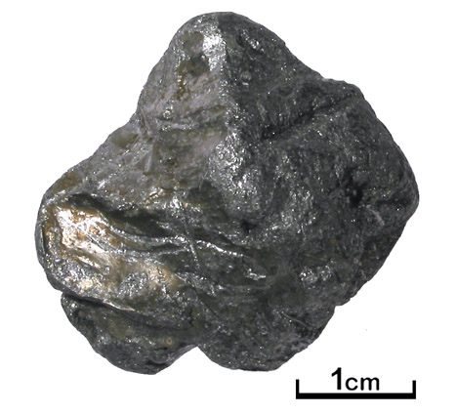
Graphite – a special case
Common form of carbon found in soot, charcoal, pencil leads
Carbon atoms each joined to 3 others with STRONG bonds to make hexagonal sheets of atoms
WEAK BONDS
STRONG BONDS
The sheets of atoms are joined to other sheets by WEAK bonds

Slide 18
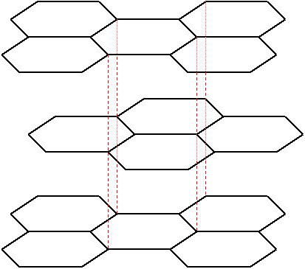
Flate shape
As the bonds between the layers of atoms are weak, they can easily slide over each other
As the C atoms are only bonded to 3 others, the extra electrons form clouds of ‘free electrons’ between the layers

Slide 19
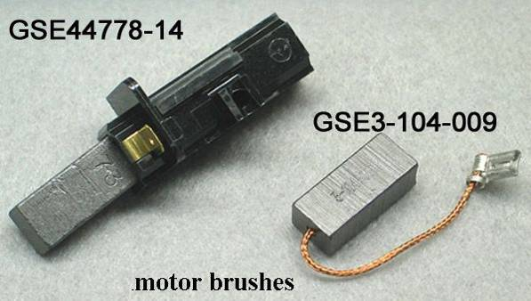
Graphite - Properties
The STRONG BONDS between the ATOMS mean it has HIGH MELTING and BOILING POINTS
The WEAK BONDS between the LAYERS mean it is SOFT and SLIPPERY as the layers SLIDE over each other easily (used in pencils and as a solid lubricant)
The FREE ELECTRONS between the layers mean that graphite CONDUCTS ELECTRICITY (used as sliding contacts in electric motors)

Slide 20
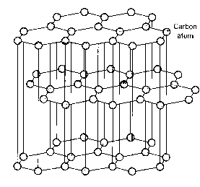
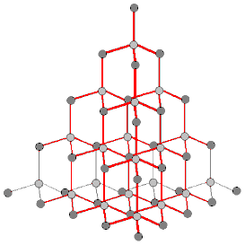
Graphite | Diamond
Conducts electricity, delocalised electron | Is a non-conductor, strong covalent bonds
Acts as a lubricant – it is soft and brittle | Is the hardest natural substance – used in drill bits

Slide 21
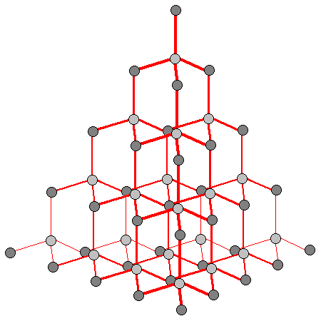
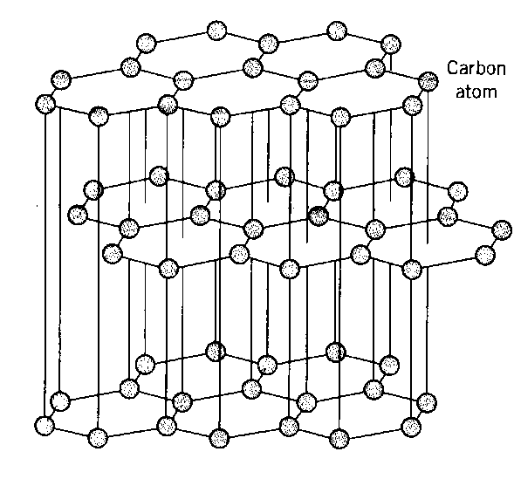
Allotropes
Different structures of the same element are called allotropes. They have different physical properties but similar chemical properties.
Graphite, diamond and buckminsterfullerene are all allotropes of carbon

Slide 22
Fullerenes
These are molecules of carbon
Each one has a definite number of carbon atoms joined by strong covalent bonds
There is much research into possible uses of the fullerenes

Slide 23
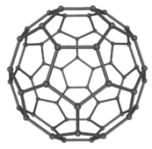
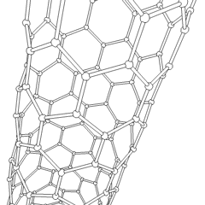
More on carbon: Buckminsterfullerene (C₆₀)
Also called “buckyballs”. Discovered in 1985. Is a fullerene, there are other fullerenes, e.g. C₅₀, C₇₀, C₈₄, C₁₀₀
C₆₀: The original fullerene.
It can be found naturally in soot.
Its structure is the same as that of a football – pentagons and hexagons.
Carbon nanotubes: extensions of buckyballs.

Slide 24
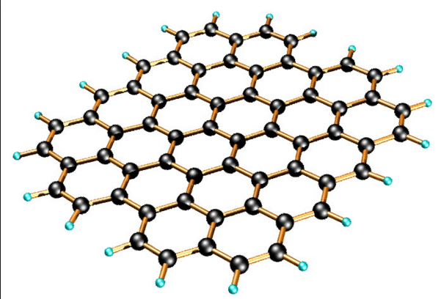
Graphene is a one atom thick layer of carbon atoms

Slide 25
Properties of giant and simple covalent substances
For giant and simple covalent substances
know that giant lattices are present in: ii) covalently bonded solids, such as diamond, graphite and silicon(IV) oxide (giant covalent lattices)
know that the structure of covalently bonded substances such as iodine, I₂, and ice, H₂O, is simple molecular
know the different structures formed by carbon atoms, including graphite, diamond and grapheme
be able to predict the type of structure and bonding present in a substance from numerical data and/or other information
be able to predict the physical properties of a substance, including melting and boiling temperature, electrical conductivity and solubility in water, in terms of: i) the types of particle present (atoms, molecules, ions, electrons) ii) the structure of the substance iii) the type of bonding and the presence of intermolecular forces, where relevant

Slide 26
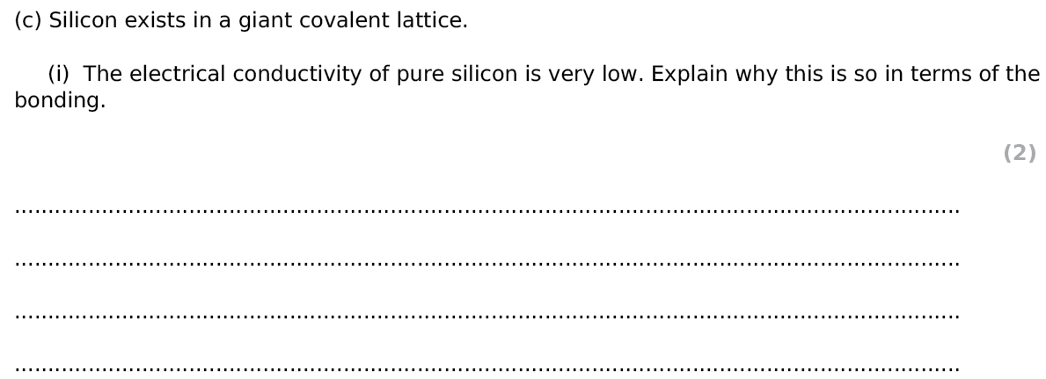
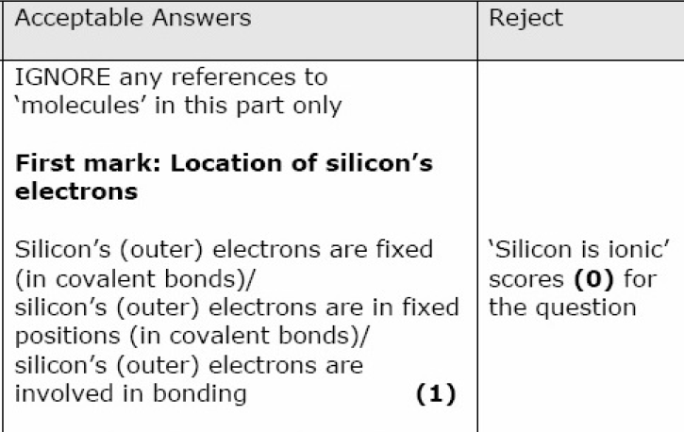
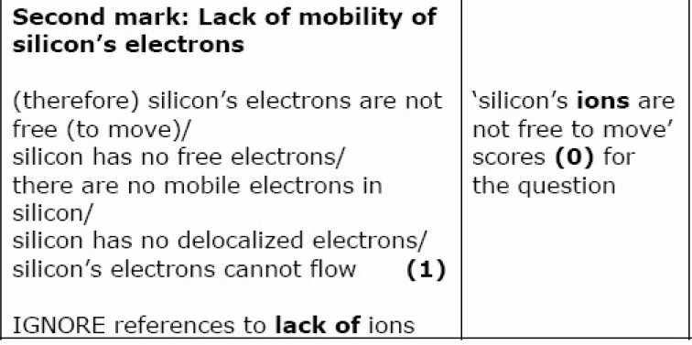
Exam Questions
Notes:
edexcel

Slide 27
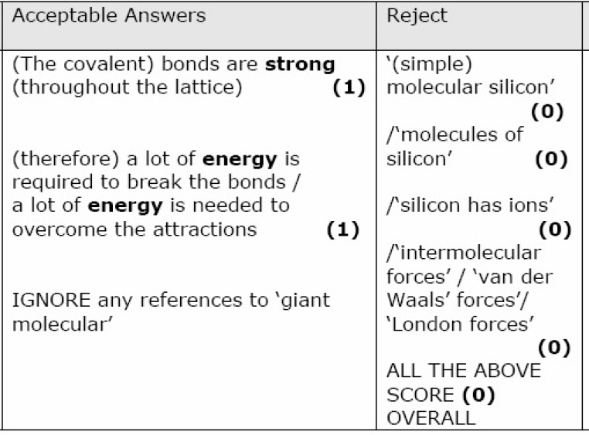
Exam Questions
Notes:
edexcel

Slide 28
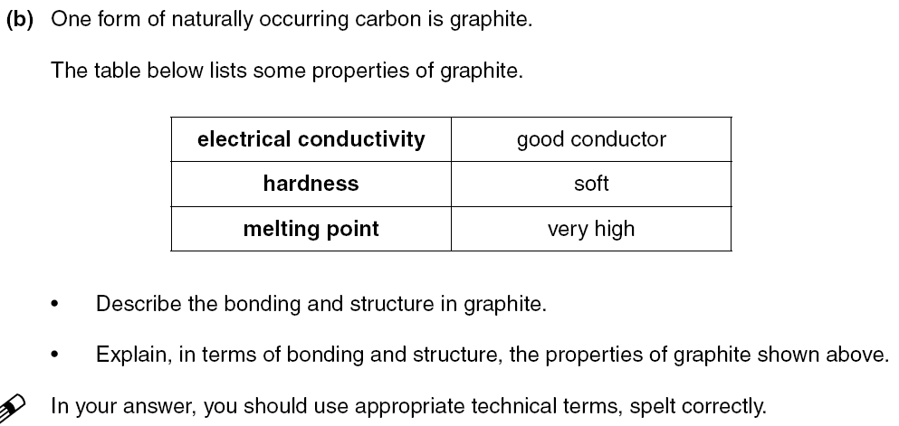
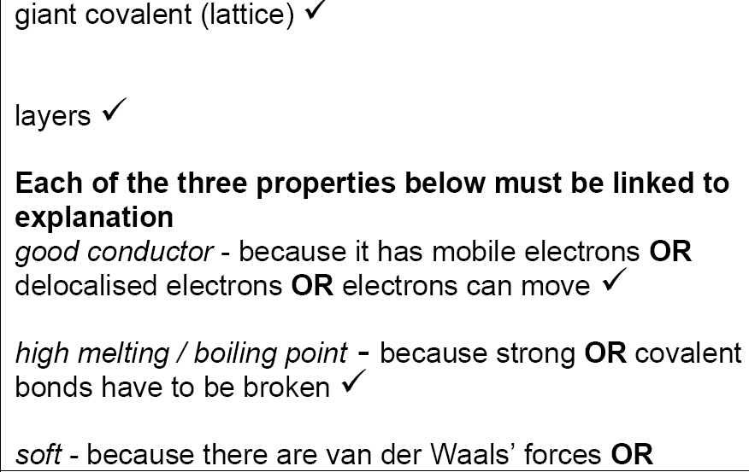
5 marks

Slide 29
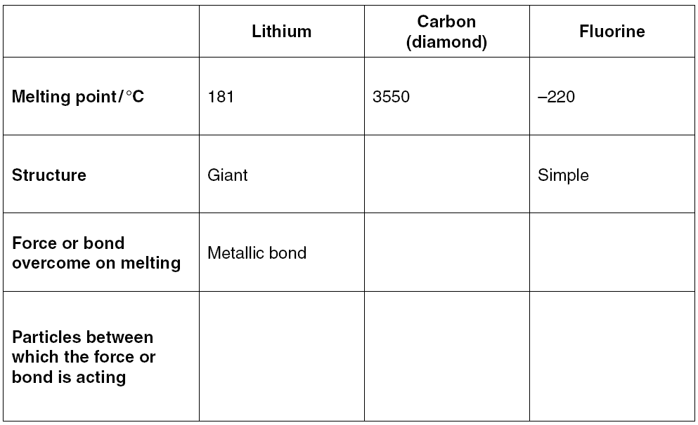
6 marks
Notes:
Could have been used in previous lessons

Slide 30
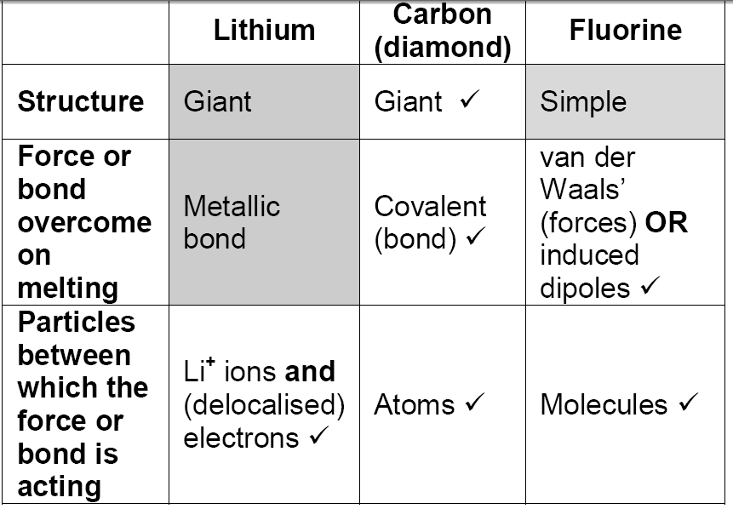
6 marks

Slide 31
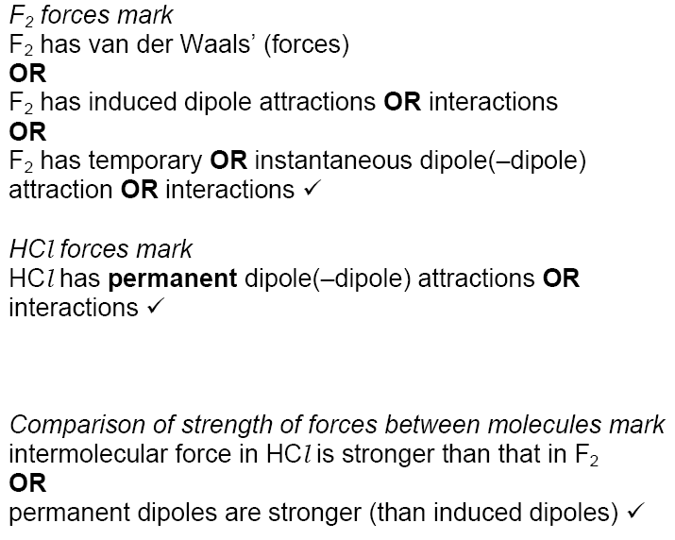
4 marks

Slide 32
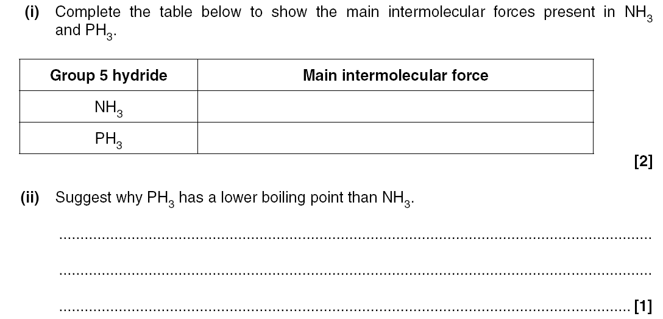
Notes:
Could have been used in previous lessons

Slide 34
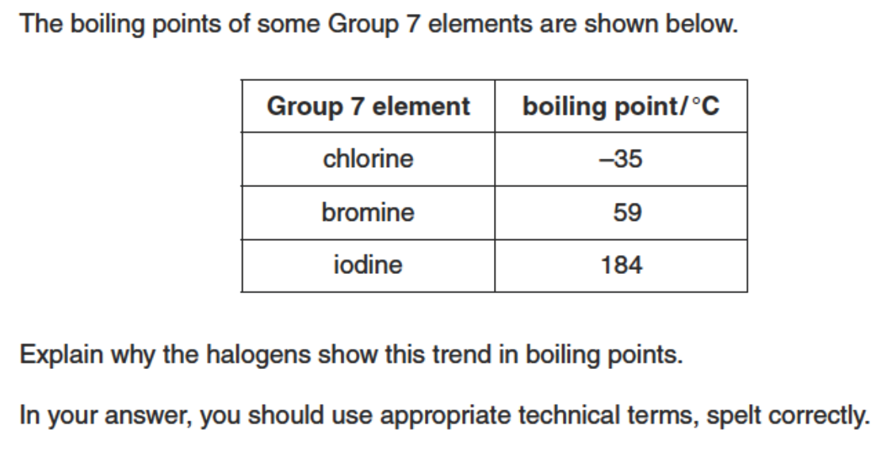
Exam question
(3 marks)

Slide 35
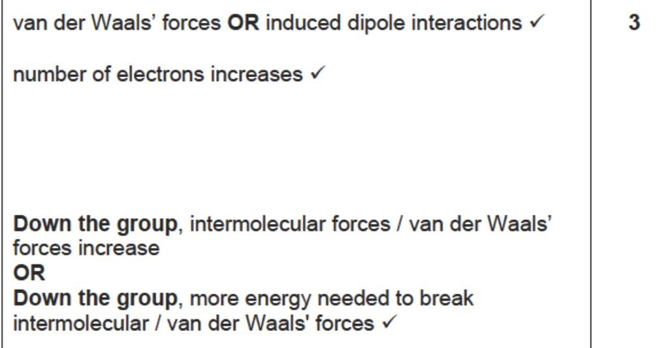
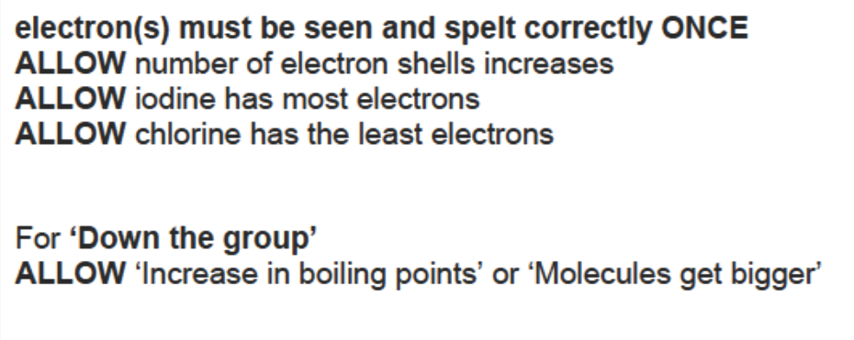

Slide 36
Exam questions
State and explain the trend in the boiling points of chlorine, bromine and iodine.
(3 marks)
b) The halogen astatine does not exist in large enough quantities to observe any of its reactions.
Why would astatine be expected to react similarly to other halogens?
(1 mark)

Slide 37
a)

Slide 39
Periodicity exam questions, Q9

Slide 40
Properties of giant and simple covalent substances
For giant and simple covalent substances
know that giant lattices are present in: ii) covalently bonded solids, such as diamond, graphite and silicon(IV) oxide (giant covalent lattices)
know that the structure of covalently bonded substances such as iodine, I₂, and ice, H₂O, is simple molecular
know the different structures formed by carbon atoms, including graphite, diamond and grapheme
be able to predict the type of structure and bonding present in a substance from numerical data and/or other information
be able to predict the physical properties of a substance, including melting and boiling temperature, electrical conductivity and solubility in water, in terms of: i) the types of particle present (atoms, molecules, ions, electrons) ii) the structure of the substance iii) the type of bonding and the presence of intermolecular forces, where relevant

