Slide 1
Group 7 The Halogens

Slide 2
Starter
What can you remember from GCSE?

Slide 3
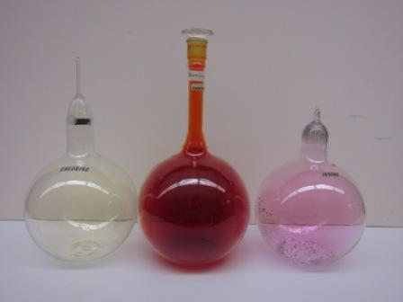
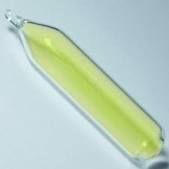
The Halogens
Chlorine, Cl₂
Green Gas
Bromine, Br₂
Brown – red liquid
Iodine, I₂
Black solid
Fluorine, F₂
Pale Yellow Gas
Notes:
Fluorine photo is fake. Fluorine reacts with glass and it even reacts with water

Slide 4
Halogen/ Appearance | Atomic Number Z | Formula | Electron arrangement | Bond Energy | Electro negativity | Atomic (covalent) Radius/nm | Melting Point / K | Boiling Point/K | Reactivity
Fluorine
Chlorine
Bromine
Iodine
Increases or Decreases?
Increases or Decreases?
Increases or Decreases?
Increases or Decreases?
Increases or Decreases?
Complete the summary table and EXPLAIN the trends in each
Notes:
Pupils discuss and predict the trends first of all then use textbook p166-167 to complete the summary table.

Slide 5
Halogen/ Appearance | Atomic Number Z | Formula | Electron arrangement | Bond Energy | Electro negativity | Atomic (covalent) Radius/nm | Melting Point / K | Boiling Point/K | Reactivity
Fluorine
Chlorine
Bromine
Iodine

Slide 6
Why is Fluorine Unusual?
x
x
F
F
x
x
x
x
x
Bond | Bond Energy kJ mol -¹
F-F | 158
Cl-Cl | 243
Br-Br | 193
I-I | 151
Notes:
Due to atoms being very small the F atoms are very close to each other. This means that the F-F bond is very weak as the NON-BONDING pairs will repel.
Fluorine was suspected to be an element as early as 1810 but wasn't successfully isolated until 1886. Many chemists trying to isolate the element would be blinded or even killed by the violent reactions that generally accompany fluorine gas.
Fluorine is the 13th most common element in the Earth's crust.

Slide 7
The Halogens: Chemical Properties
Specification 3.2.3
Targets
To understand the trends in oxidizing ability of the halogens.
E.g., displacement reactions of the halogens.

Slide 8
Observations
• You will often have to carry out test tube reactions and record your observations.
• You must indicate what the reagents were like before mixing and what they were during/after mixing.
• You must clearly state the colour and whether they are solids or solutions.
• Some good examples are shown below:
“No observable reaction”
“Solution”
“Precipitate”
“Solid”
“Effervesce”
“Clear/colourless”!!
Notes:
Go through some key observation words such as ‘no observable reaction’, solution, precipitate, solid, effervescence etc.

Slide 9
Displacement Reactions and Oxidising Power of Halogens
Cl₂(aq) + 2NaBr(aq) → Br₂(aq) + 2NaCl(aq)
Notes:
Write down oxidation states under equation. Get rid of spectator ions and explain why chlorine is the oxidising agent using ½ equations.
Follow this with chemsheets halogen displacement experiment.

Slide 10
Practical
Practical Opportunity: Students carry out test-tube reactions of solutions of the halogen (Cl₂, Br₂, I₂) with solutions containing their halide ions (e.g. KCl, KBr, KI).

Slide 11
Reaction | Observations
Cl₂ + KCl
Cl₂ + KBr
Cl₂ + KI
Br₂ + KCl
Br₂ + KBr
Br₂ + KI
Notes:
http://www.nuffieldfoundation.org/practical-chemistry/reactions-aqueous-solutions-halogens
https://www.youtube.com/watch?v=CJc4x3fUbao
https://www.youtube.com/watch?v=QYuOobnP2sI

Slide 12
 | Cl₂(aq) | Br₂(aq) | I₂(aq)
Cl–(aq)
Br–(aq)
I–(aq)
© www.chemsheets.co.uk AS 035 10-Jul-12

Slide 13
 | Cl₂(aq) | Br₂(aq) | I₂(aq)
Cl–(aq) |  | Stays yellow solution (no reaction)
Br–(aq)
I–(aq)
© www.chemsheets.co.uk AS 035 10-Jul-12

Slide 14
 | Cl₂(aq) | Br₂(aq) | I₂(aq)
Cl–(aq) |  | Stays yellow solution (no reaction) | Stays brown solution (no reaction)
Br–(aq)
I–(aq)
© www.chemsheets.co.uk AS 035 10-Jul-12

Slide 15
 | Cl₂(aq) | Br₂(aq) | I₂(aq)
Cl–(aq) |  | Stays yellow solution (no reaction) | Stays brown solution (no reaction)
Br–(aq) | Yellow solution forms (Br₂ forms) Cl₂ + 2 Br⁻→ 2 Cl⁻ + Br₂
I–(aq)
© www.chemsheets.co.uk AS 035 10-Jul-12

Slide 16
 | Cl₂(aq) | Br₂(aq) | I₂(aq)
Cl–(aq) |  | Stays yellow solution (no reaction) | Stays brown solution (no reaction)
Br–(aq) | Yellow solution forms (Br₂ forms) Cl₂ + 2 Br⁻→ 2 Cl⁻ + Br₂ |  | Stays brown solution (no reaction)
I–(aq)
© www.chemsheets.co.uk AS 035 10-Jul-12

Slide 17
 | Cl₂(aq) | Br₂(aq) | I₂(aq)
Cl–(aq) |  | Stays yellow solution (no reaction) | Stays brown solution (no reaction)
Br–(aq) | Yellow solution forms (Br₂ forms) Cl₂ + 2 Br⁻→ 2 Cl⁻ + Br₂ |  | Stays brown solution (no reaction)
I–(aq) | Brown solution forms (I₂ forms) Cl₂ + 2 I⁻ → 2 Cl⁻ + I₂
© www.chemsheets.co.uk AS 035 10-Jul-12

Slide 18
 | Cl₂(aq) | Br₂(aq) | I₂(aq)
Cl–(aq) |  | Stays yellow solution (no reaction) | Stays brown solution (no reaction)
Br–(aq) | Yellow solution forms (Br₂ forms) Cl₂ + 2 Br⁻→ 2 Cl⁻ + Br₂ |  | Stays brown solution (no reaction)
I–(aq) | Brown solution forms (I₂ forms) Cl₂ + 2 I⁻ → 2 Cl⁻ + I₂ | Brown solution forms (I₂ forms) Br₂ + 2 I⁻ → 2 Br⁻ + I₂
© www.chemsheets.co.uk AS 035 10-Jul-12

Slide 19
Oxidising power trend: Cl₂ > Br₂ > I₂
When a halogen acts as an oxidising agent, it gains electrons (taken from the oxidised species).
X₂ + 2 e⁻ → 2 X⁻
Cl
Down the group it becomes harder to gain an electron because:
atoms are larger & there is more shielding (due to extra electron shell)
Br
I

Slide 20
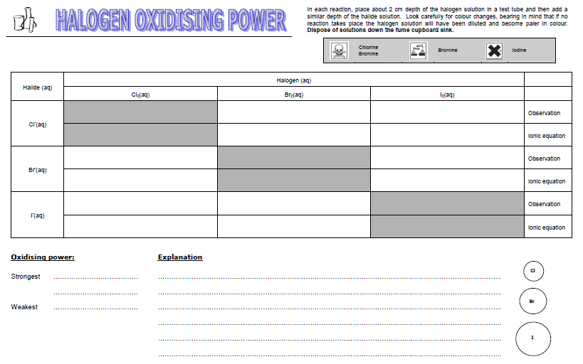
No observable change
No observable change
No reaction
No reaction
Turns from colourless to red
No observable change
Cl₂ + 2Br⁻ → 2Cl⁻ + Br₂
No reaction
Turns from colourless to brown
Turns from colourless to brown
Cl₂ + 2I⁻ → 2Cl⁻ + I₂
Br₂ + 2I⁻ → 2Br⁻ + I₂
Chlorine has the strongest oxidising power. The increased shielding of extra shells reduces the effect of the increasing nuclear charge down the group. Since the chlorine has the smallest atomic radius it can accept electrons easier as they can get closer to the nucleus.
Chlorine
Bromine
Iodine

Slide 21
Stand up – True Sit down - False
Oxidising agents donate electrons
Reducing agents accept electrons

Slide 22
The Extraction of Bromine from Sea Water
Sea water contains small amounts of bromide ions that can be oxidised by chlorine to give bromine:
Cl₂(aq) + 2 Br⁻(aq)→ 2 Cl⁻(aq) + Br₂(aq)

Slide 23
The Extraction of Iodene from Kelp
Iodene discovered in 1811
Kelp is obtaned by burning seaweed
Salts such as NaCl, KCl, K₂SO₄ are removed from the kelp by washing
Water used (ionic compounds)
Residue heated with manganese dioxide and conc. Sulfuric acid.
2 I⁻ + MnO₂ +4H+→ Mn²⁺(aq) + I₂(aq) +2H₂O
Is this an oxidation or a reduction reaction? Why?

