Slide 1
Do Now
What is an ‘electrophile’?
What does a curly arrow represent?
What is meant by ‘heterolytic fission’?
What is meant by ‘homolytic fission’?
Give an example for question 3
Give an example for question 4
What is the mechanism know as when but-1-ene reacts with hydrogen bromide?
Draw this mechanism

Slide 2
Halogenoalkanes

Slide 3
What numbered group are the halogens?

Slide 4
7

Slide 5
Does the reactivity increase or decrease down the group?

Slide 6
Decrease

Slide 7
Chlorides, bromides and iodides are together know as what?

Slide 8
Halides

Slide 9
Is fluorine more or less electronegative than Bromine?

Slide 10
More

Slide 11
Is Iodine more or less electronegative than Chlorine?

Slide 12
Less

Slide 13
The General Formula
Haloalkanes have an alkane skeleton with one or more halogen atoms in place of hydrogen atoms.
The general formula of a haloalkane with a single halogen atom is C_{n}H_{2n+1}X where X is the halogen.
Haloalkanes are often shortened to R-X.

Slide 14
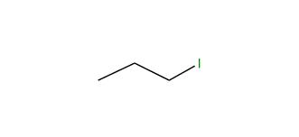
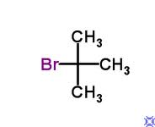
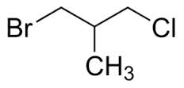
Recap: Name Those Halogens!
1
2
3
4

Slide 15
Recap: Name Those Halogens!
Are these primary, secondary or tertiary halogenoalkanes?
1
2
3
4

Slide 16
Bond Polarity
Haloalkanes have a C-X bond.
This bond is polar, C^{δ+} - X^{δ-} because halogens are more electronegative than carbon.
Look at the table. What happens to the electronegativity as you go down the group?
Element | Electronegativity
Carbon | 2.5
Fluorine | 4.0
Chlorine | 3.5
Bromine | 2.8
Iodine | 2.6

Slide 17
Bond Polarity
The halogens are more electronegative than carbon.
Why do you think the carbon has a partial positive charge?
Because it is considered electron deficient – the electrons are more attracted to the halogen.
2. Which haloalkane would be the most reactive? Why?
C-F because it is the most polar so has the most positive charge. It can be easily attacked.
3. Which haloalkane would be the least reactive? Why?
C-I because it is the least polar so has the least positive charge. It cannot be attacked easily.

Slide 18
Hydrolysis Reactions
Added to water
Water molecule contains polar bonds
Oxygen atom attracted to carbon in halogenoalkane
RX + H₂O → ROH + HX or RX + H₂O → ROH + H⁺ + X⁻
ROH = alcohol

Slide 19
What do we use to test for halide ions?
What results would you see if a) chloride is present? b) bromide is present? c) iodide is present?

Slide 20
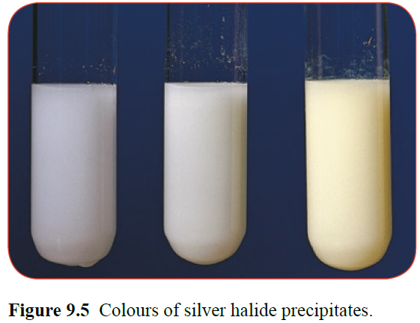
How could you measure the rate of the hydrolysis reaction?

Slide 21
What would be the solvent in the reaction and why?
What would you control?
What you be difficult carrying out this experiment?
What would you compare?

Slide 22
Results
Same structure but different halogen | Result
1-iodobutane | Fastest
1-bromobutane
1-chlorobutane | Slowest
Does this surprise you?

Slide 23
How the Haloalkanes React
When haloalkanes react it is almost always the C-X bond that breaks.
There are two factors that determine how readily the C-X bond breaks:
1. The C^{δ+} X^{δ} bond polarity
2. The C-X bond enthalpy

Slide 24
Bond Polarity
Haloalkanes have a C-X bond.
This bond is polar, C^{δ+} - X^{δ-} because halogens are more electronegative than carbon.
Look at the table. What happens to the electronegativity as you go down the group?
Element | Electronegativity
Carbon | 2.5
Fluorine | 4.0
Chlorine | 3.5
Bromine | 2.8
Iodine | 2.6

Slide 25
Bond Enthalpy
What is meant by the word “enthalpy”?

Slide 26
Bond Enthalpy
Measure of energy!

Slide 27
Bond Enthalpy
Bond | BE/kJmol⁻¹
C-F | 467
C-H | 413
C-Cl | 346
C-Br | 290
C-I | 228
What can you say about the bond enthalpies between the different bonds?

Slide 28
Bond Enthalpy
Fluorine is the smallest atom of the halogens and the shared electrons in the C-F bond are strongly attracted to the fluorine nucleus.
This makes it a very strong bond.
As we go down the group, the shared electrons are getting further and further away from the attractive nucleus (increase in shielding), so the bonds become weaker.
We would predict that iodo-compounds, with the weakest bonds would be the most reactive and fluoro-compounds, with the strongest bonds would be the least reactive.

Slide 29
HOLD ON A SECOND!!!!

Slide 30
When discussing polarity, the reactivity increases as you go up the group….
So which one is it?
When discussing enthalpy, the reactivity increases as you go down the group….

Slide 31
Summary Questions
a) Draw the displayed formula for each haloalkane and mark the polarity of the C-X bond
b) Name each haloalkane
c) Predict which of them would have the highest boiling point and explain your answer.
i CH₃CH₂CH₂CH₂I
ii CH₃CHBrCH₃
iii CH₂ClCH₂CH₂CH₃
iv CH₃CH₂CHBrCH₃
2. Why do the haloalkanes get less reactive as we go up the halogen group?

