Slide 1
Identifying if a sample is an aldehyde or a ketone

Slide 2
http://www.rsc.org/learn-chemistry/resource/res00001065/recrystallisation?cmpid=CMP00001931#!cmpid=CMP00007772
http://www.rsc.org/learn-chemistry/resource/res00001065/recrystallisation
Video on melting point
Demo

Slide 3
Identifying a sample from it’s melting point
This method can be used to identify a product (for your exams an aldehyde or a ketone). Once you have measured the melting point you can compare it to a database to identify the sample.
Melting point determinations are carried out in the following way:
Break off around 5 cm of a capillary tube and seal one end in a Bunsen burner.
Pack 1 cm of the solid as densely as possible into the sealed end of the capillary tube.
Place the capillary tube in the melting point apparatus. Ensure that the apparatus heats up very slowly as the expected melting point of the substance approaches. Record the temperature when the liquid starts to melt and when it finishes melting.
Compare the melting point to a data table for identification.
(You can also compare the melting point range to the known melting point of the pure solid to test it’s purity. A pure sample will melt sharply at a temperature close to the known melting point.)
(The melting point of your sample is 78ºC – 80ºC)

Slide 4
Question
Explain how you would use the solid obtained from the reaction of an aldehyde with 2,4 – dinitrophenylhydrazine to prove the orginal aldehyde was butanal.

Slide 5
Answer
The solid would be purified by recrystalistion and filtered to produce a fine, dry crystalline solid.
The melting point of this solid would be taken and compared to a data table for identification.

Slide 6
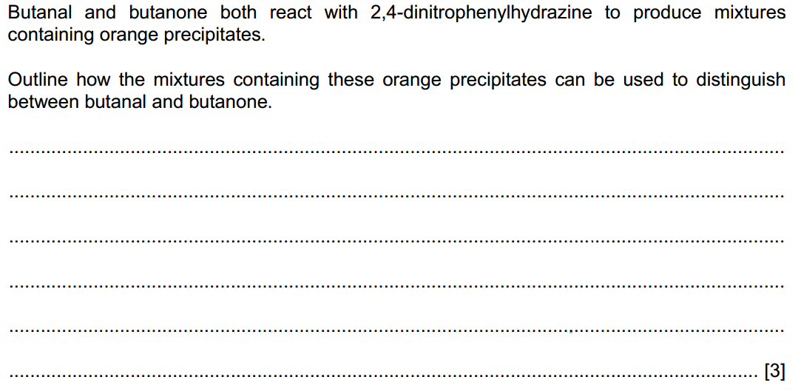
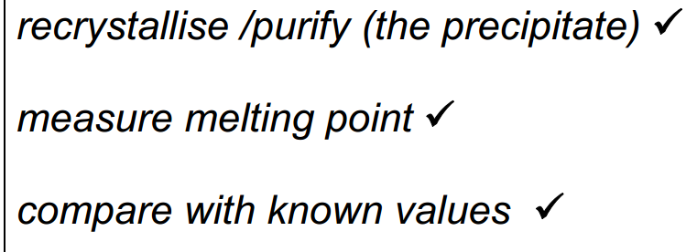
Exam question
Notes:
Old spec

