Slide 1
Homework
Look at the following websites
http://www.chemguide.co.uk/atoms/bonding/ionic.html#top
http://www.chemnotes.org.uk/f321.html
Topic 5, concentrate on ionic bonding
Notes:
All questions edexcel

Slide 2
http://www.youtube.com/watch?v=TjJsYXdchZo
Watch the video.
Can you explain what happens and why?

Slide 3
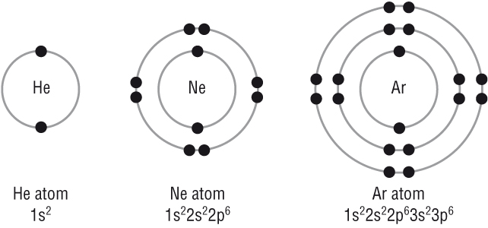
GCSE recall
What is special about the electron configuration of the Noble gases?
They all have full outer shells:
Predict the type of bonding in the following compounds (give reasons):
CO
NaCl

Slide 4
Ionic Bonding
Tuesday, 22 September 2015

Slide 5
Learning Objectives
Ionic bonding
Describe ionic bonding
Draw dot and cross diagrams for ionic for ionic compounds
Explain what effects the strength of an ionic bond
Describe evidence for the existence of ions in ionic compounds
Explain trends in ionic radii down a group and for a set of isoelectronic ions
Metallic bonding
Explain what metallic bonding is

Slide 6
Migration of ions
Equipment needed: potassium manganate, chromatography paper, tweezers, ruler, pencil, 20 V power supply
Cut a strip of chromatography paper to the width, but slightly longer than a microscope slide.
Mark the middle with a pencil line, moisten with tap water and place on a slide.
Use tweezers to place a small crystal of potassium manganate (VII) in the centre of the paper, and cover with another slide to reduce evaporation.
Connect the paper to a 20 DC power supply using crocodile clips and leave for about 20 minutes.
Record your observations (hint look at what is happening at each electrode).
Use them to answer the questions below:
What does the experiment show about the colour of potassium ions?
How does this experiment show that ions are charged particles?
Notes:
Set up and leave while introducing ionic bonding

Slide 7
Migration of ions
Wet the filter paper with ammonium solution and put on a single crystal of copper sulphate and single crystal of potassium permanganate
Observe the movement of the ions
The copper ion is blue and the permanganate is purple
On the power pack the red socket is positive
What can you deduce about the charge on the ions?

Slide 8
Noble Gases
All electrons are paired with another electron of opposite spin.
The full outer shell is an extremely stable configuration.

Slide 9
Bonding
Through bonding atoms acquire a noble gas configuration with 8 electrons in the outer shell.
This is called the octet rule.
There are 3 main types of bonding:
Ionic
Covalent
Metallic

Slide 10
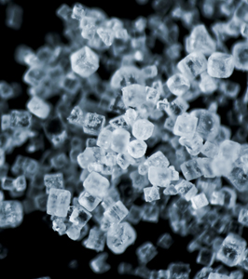
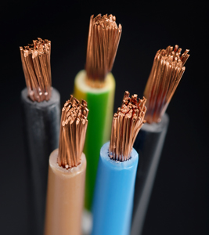
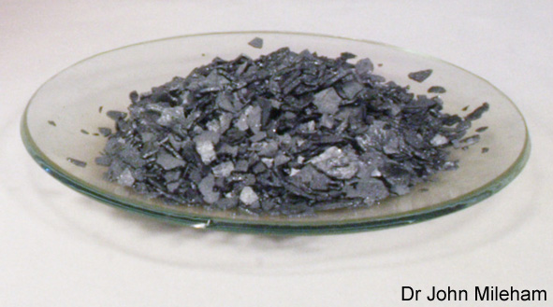
Types of bonding
There are three types of bond that can occur between atoms:
an ionic bond occurs between a metal and non-metal atom (e.g. NaCl)
a covalent bond occurs between two non-metal atoms (e.g. I2, CH4)
a metallic bond occurs between atoms in a metal (e.g. Cu)
Notes:
Photo credit (left): Vladimir Zivkovic / shutterstock.com
Microscope shot of salt (NaCl) crystals.
Photo credit (middle): Dr John Mileham
Iodine crystals
Photo credit (right): demarcomedia / shutterstock.com
Copper wire
Teacher notes
It could be stressed to students that covalent bonding does not have to occur between two atoms of the same element, as is the case in iodine. It should also be pointed out that while a single ionic or covalent bond occurs between just two atoms, multiple ionic bonds exist in an ionic lattice, and multiple covalent bonds occur in covalent compounds containing more than two atoms.

Slide 11
Types of bonding
The type of bonding can be predicted from the types of atom involved:
 | metal | non-metal
metal
non-metal
Metallic bonding
-electrons delocalised
across the structure
Ionic bonding
-electrons move from
the metal atom to the
non-metal
Ionic bonding
-electrons move from
the metal atom to the
non-metal
Covalent bonding
-electrons shared
Between the atoms

Slide 12
Ionic Bonding
What do we know about ionic bonding from GCSE?
Write down the formula for sodium chloride
Draw a dot and cross diagram for sodium chloride
How would you know sodium chloride contains ionic bonding from it’s name?

Slide 13
Ionic Bonding
Definition
An ionic bond is the electrostatic attraction between oppositely charged ions
In ionic compounds we have
negatively charged non-metal ions (anions)
and
positively charged metal ions (cations)
These oppositely charged ions are bonded together by electrostatic attraction.
This attraction is the ionic bond.

Slide 14
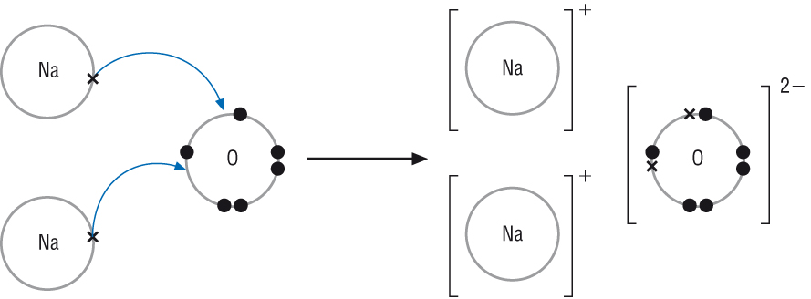
For example Na₂O
ionic bond
Why do we have two sodium ions and one oxygen atom?

Slide 15
Drawing ionic dot and cross diagrams
Remember it is the outer electrons involved in chemical bonds.
So you only need to draw the outer electrons.
In exams you only need to draw the ions formed, i.e. Do not draw the electron transfer part (remember this is just a model to help us)
Finally if it is ionic the electrons are not shared. This is the most common mistake made!

Slide 16
CaO
On white boards draw a dot and cross diagram for:

Slide 17
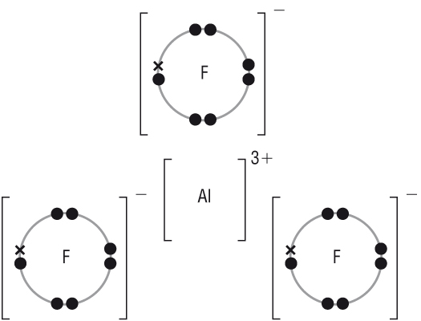
AlF₃
On white boards draw a dot and cross diagram for:
Notes:
Can do more examples if necessary

Slide 18
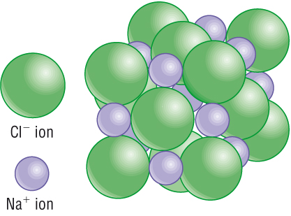
Ionic Bonding
Each ion ends up surrounded by oppositely charged ions to which it is attracted.
This is called a giant ionic lattice.

Slide 19
Limitations of ionic models
Most bonds aren’t purely ionic or covalent
The dot and cross model makes it look like sodium chloride (and others) are made up of 1 sodium ion bonded to 1 chloride ion. It’s actually a giant ionic lattice made of equal numbers of the two ions

Slide 20
Learning Objectives
Ionic bonding
Describe ionic bonding
Draw dot and cross diagrams for ionic for ionic compounds
Explain what effects the strength of an ionic bond
Describe evidence for the existence of ions in ionic compounds
Explain trends in ionic radii down a group and for a set of isoelectronic ions
Metallic bonding
Explain what metallic bonding is

Slide 21
Migration of ions
Equipment needed: potassium manganate, chromatography paper, tweezers, ruler, pencil, 20 V power supply
Cut a strip of chromatography paper to the width, but slightly longer than a microscope slide.
Mark the middle with a pencil line, moisten with tap water and place on a slide.
Use tweezers to place a small crystal of potassium manganate (VII) in the centre of the paper, and cover with another slide to reduce evaporation.
Connect the paper to a 20 DC power supply using crocodile clips and leave for about 20 minutes.
Record your observations (hint look at what is happening at each electrode).
Use them to answer the questions below:
What does the experiment show about the colour of potassium ions?
How does this experiment show that ions are charged particles?
Notes:
Set up and leave while introducing ionic bonding

Slide 22
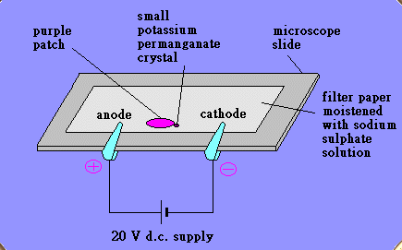

Slide 23
Migration of ions answers
Record your observations (hint look at what is happening at each electrode).
Use them to answer the questions below:
1) What does the experiment show about the colour of potassium ions?
They are colourless Potassium ions have a 1+ charge. So the potassium ions in the diagram must be moving towards the cathode. Since you can’t see a colourful streak moving in that direction they must be colourless.
2) How does this experiment show that ions are charged particles?
When a current is passed through the solution, the ions/particles move to the oppositely charged electrode.

Slide 25
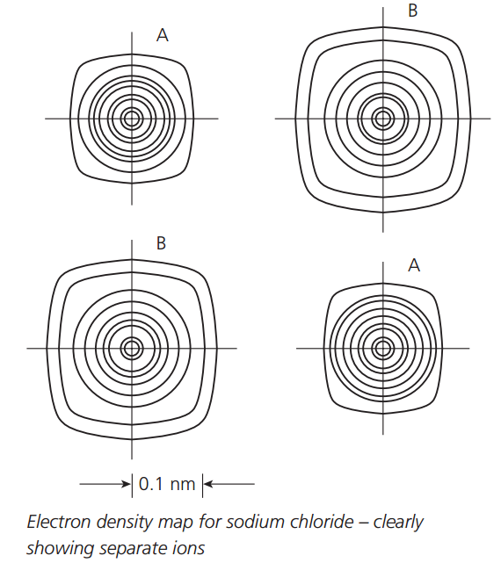
A = Na⁺
B=Cl⁻
High electron density
Low electron density

Slide 26
The physical properties of ionic compounds provide evidence that supports the theory of ionic bonding
High melting points → atoms held together by a strong attractions. + and – ions are strongly attracted
Soluble in water but non polar solvents → particles are charged. Ions are pulled apart by polar molecules, but not non polar molecules.

Slide 27
Learning Objectives
Ionic bonding
Describe ionic bonding
Draw dot and cross diagrams for ionic for ionic compounds
Explain what effects the strength of an ionic bond
Describe evidence for the existence of ions in ionic compounds
Explain trends in ionic radii down a group and for a set of isoelectronic ions
Metallic bonding
Explain what metallic bonding is

Slide 28
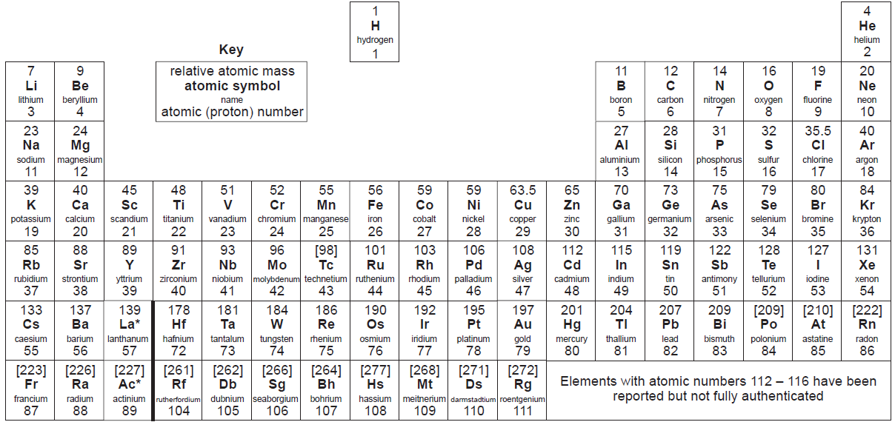
Electrons and the periodic table
Groups (columns)
1 2 3 4 5 6 7 0
1
2
3
4
5
6
7
1
2
3
4
5
6
7
Transition metals
Periods (rows)
Group number = the number of electrons in the outer shell
Is there a link between this and the charges on the ions formed?

Slide 29
Charge on the ions
Look at the table below
What do you notice about the charges that the ions form?
Group
1
2
3
4
5
6
7
8/0
Charge
1+
2+
3+
N/A
3-
2-
1-
N/A
Example
Na⁺
Mg²⁺
Al³⁺
N/A
N³⁻
O²⁻
F⁻
N/A

Slide 30
Each sodium atom has lost one electron to obtain the electron configuration of the noble gas, neon:
2Na → 2Na+ 2e⁻
1s²2s²2p⁶3s¹ → 1s²2s²2p⁶
An oxygen atom has gained two electrons to obtain the electron configuration of the noble gas neon too
O + 2e⁻ → O²⁻
1s²2s²2p⁴ → 1s²2s²2p⁶

Slide 31
Charge on the ions
Metals lose electrons to form positive ions while non-metals gain electrons to form negative ions.
The number of electrons gained or lost by an atom is related to the group in which the element is found.
Group
1
2
3
4
5
6
7
8/0
Charge
1+
2+
3+
N/A
3-
2-
1-
N/A
Example
Na⁺
Mg²⁺
Al³⁺
N/A
N³⁻
O²⁻
F⁻
N/A
The elements in groups 4 and 8 (also called group 0) do not gain or lose electrons to form ionic compounds.

Slide 32
Exceptions
Atoms of Be, B, C and Si do not normally form ions.
It would take too much energy to transfer the required number of outer shell electrons.
Remember, some atoms can form more than one ion:
Iron (III) means Fe³⁺
Iron (II) means Fe²⁺

Slide 33
Molecular Ions
Sometimes a covalently bonded group of atoms can lose or gain electrons to form an ion.
This is called a molecular ion.
For example:
Ammonium = NH₄⁺
Nitrate = NO₃⁻
Sulphate = SO₄²⁻
Carbonate = CO₃²⁻
Learn these!!!!

Slide 34
Predicting the Formulae of Ionic Compounds
You can predict the formula of an ionic compound by following some simple rules:
Work out which ions are involved from the name of the compound.
Work out the charges on these ions from the periodic table.
The total charge must add up to 0.
Select as many of each type of ion as necessary to balance the charges.

Slide 35
Predict the formula for the following ionic compounds.
Write your answers on white boards.
Notes:
Next slide or make others up

Slide 36
Size of ions
The size of an ion (ionic radius) depends on its atomic number and charge
It increases as you go down a group
Within a group the ions will have the same charge
The ionic radius will increase because more electron shells are added
E.g. For group 1
Ion | Ionic radius (nm)
Li⁺ | 0.060
Na⁺ | 0.095
K⁺ | 0.133
Rb⁺ | 0.148

Slide 37
Isoelectronic ions are ions of different atoms with the same number of electrons
The ionic radius of a set of isoelectronic ions decreases as the atomic number increases
The number of electrons stays the same but the number of protons increases
This means that the electrons are attracted to the nucleus more strongly
This pulls the electrons in a little so the ionic radius decreases
Ion | Number of electrons | Number of protons | Ionic radius (nm)
N³⁻ | 10 | 7 | 0.171
O²⁻ | 10 | 8 | 0.140
F⁻ | 10 | 9 | 0.136
Na⁺ | 10 | 11 | 0.095
Mg²⁺ | 10 | 12 | 0.065
Al³⁺ | 10 | 13 | 0.050

Slide 38
Learning Objectives
Ionic bonding
Describe ionic bonding
Draw dot and cross diagrams for ionic for ionic compounds
Explain what effects the strength of an ionic bond
Describe evidence for the existence of ions in ionic compounds
Explain trends in ionic radii down a group and for a set of isoelectronic ions
Metallic bonding
Explain what metallic bonding is

Slide 39
Melting points of ionic compounds
The melting point of sodium chloride is lower than that of magnesium oxide because it has weaker ionic bonds, which need less heat energy to overcome.
This is for two reasons:
The Na⁺ and Cl– ions in sodium chloride have fewer charges than the Mg²⁺and O^{2–} ions in magnesium oxide
Na⁺ ions are larger than Mg²⁺ and cannot get as close to the negatively charged ions
Also oxygen ions are smaller than chlorine atoms

Slide 40
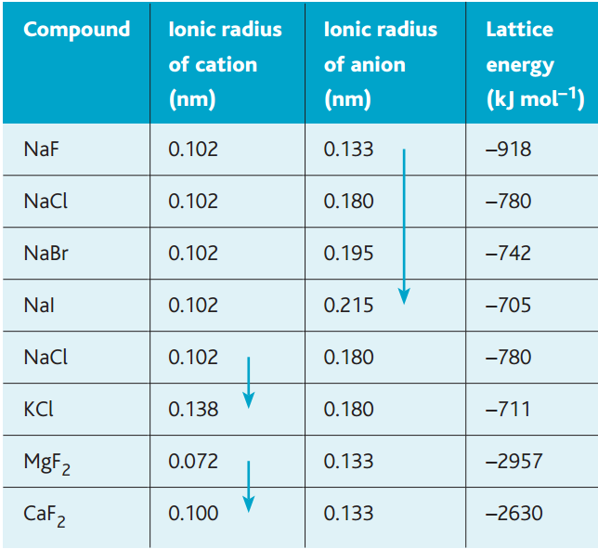
Looking at table, you can see that the lattice energy of a compound is affected by both the charge and the size of the ions. The effect of the ionic radius is shown by the trend in the sodium halides, in the chlorides of sodium and potassium, and in the fluorides of magnesium and calcium. The lattice energy becomes less negative as the size of the ions increases. In smaller ions the attractive force of the positive nucleus holds the outer electrons more tightly because they are closer to the nucleus.

Slide 41
You can also see that the lattice energy becomes more negative with ions of greater charge (Mg2+, Ca2+) because they attract other ions more strongly – compare the lattice energy of sodium fluoride with those of magnesium fluoride and calcium fluoride, which have a much greater magnitude.

Slide 42
Learning Objectives
Ionic bonding
Describe ionic bonding
Draw dot and cross diagrams for ionic for ionic compounds
Explain what effects the strength of an ionic bond
Describe evidence for the existence of ions in ionic compounds
Explain trends in ionic radii down a group and for a set of isoelectronic ions
Metallic bonding
Explain what metallic bonding is

Slide 43
Questions
Predict the formula for these ionic compounds:
Calcium iodide
Magnesium phosphide
Nickel (II) chloride
Titanium (IV) chloride
Iron (III) sulfite
Aluminium sulfate
Sodium dichromate
CaI₂
Mg₃P₂
NiCl₂
TiCl₄
Fe₂(SO₃)₃
Al₂(SO₄)₃
Na₂Cr₂O₇

Slide 44
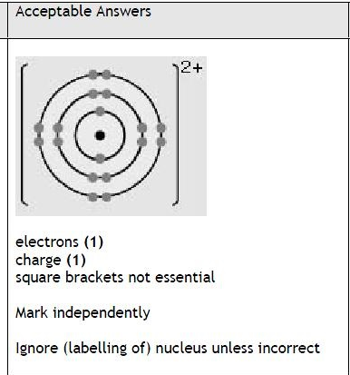
Exam questions
Solid calcium carbonate, CaCO₃, has a giant ionic structure.
Draw a diagram (using dots or crosses) for a calcium ion. Show ALL the electrons and the charge on the ion. (2 marks)

Slide 45
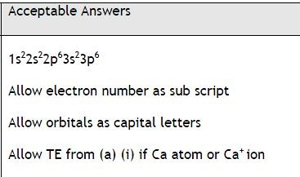
Exam questions
Complete the electronic configuration for a calcium ion (1 mark)
1s²
[2]

Slide 46
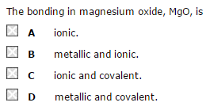
Exam questions

Slide 47
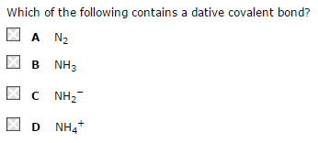
Exam questions

Slide 48
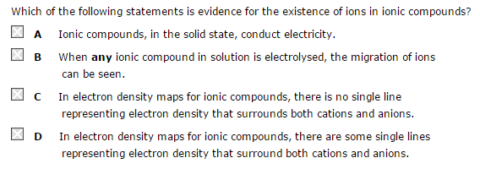
Exam questions

Slide 49
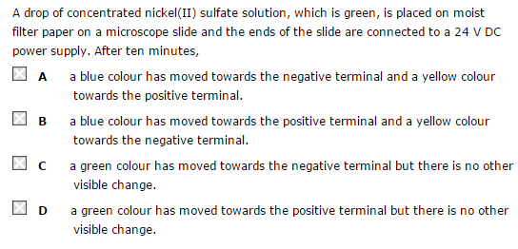
Exam questions

Slide 50
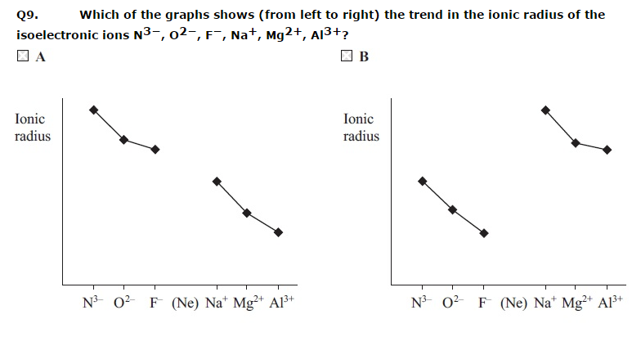
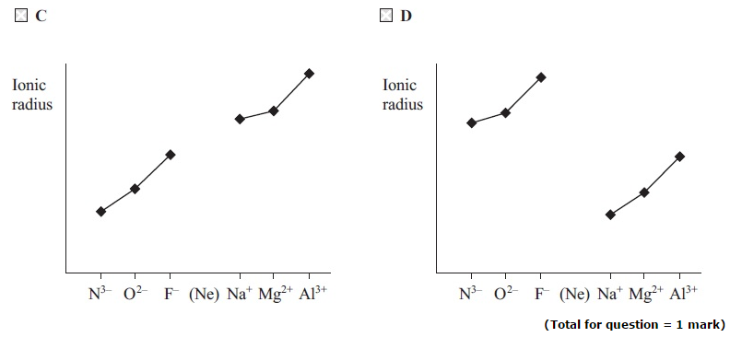
Exam questions

Slide 51
Question
Why does magnesium oxide have a higher melting point than sodium chloride?
Answer
Each magnesium atom donates two electrons to an oxygen atom, which means that stronger ionic bonds exist between magnesium and the oxide than if only one electron was transferred as in sodium chloride
Magnesium ions have a small radius than sodium ions so can get very close to oxygen atoms, which makes the bonds between magnesium and the oxide ion stronger (and oxygen ions are smaller than chlorine ions)

Slide 52
The ions O2⁻ and Na⁺ have the same number of electrons as an element in group 0. Which element?
Explain the difference in atomic radius between the two ions and the group 0 atom.
Explain how an electron density map of NaCl shows that electrons are not being shared between the atoms.
Neon
O²⁻ ion has a larger ionic radius than the Ne atom. The Ne atom has two more protons than the O²⁻ ion, so it attracts its 10 electrons more strongly. The Na⁺ ion has a smaller ionic radius than the Ne atom. The Na⁺ ion has one more proton than the Ne atom, so it attracts its 10 electrons more strongly.

Slide 53
Learning Objectives
Ionic bonding
Describe ionic bonding
Draw dot and cross diagrams for ionic for ionic compounds
Explain what effects the strength of an ionic bond
Describe evidence for the existence of ions in ionic compounds
Explain trends in ionic radii down a group and for a set of isoelectronic ions
Metallic bonding
Explain what metallic bonding is

Slide 54
Metallic bonding

Slide 55
Metallic Bonding
As with all bonding metals move towards a stable structure.
They delocalise their outer shell electrons, leaving a fixed lattice of positive ions.
The delocalised electrons are free to move throughout the structure.

Slide 56
Metallic Bonding
Metallic bonding is the attraction of the positive ions to the sea of electrons.
Over the whole structure the charges balance.
It is impossible to tell which electron originated from which particular positive ion.

Slide 57
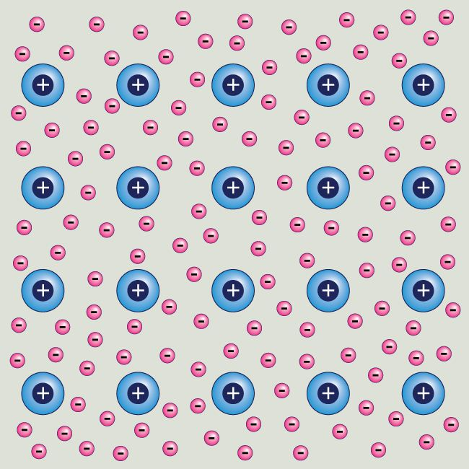
In a metal the atoms LOSE SEVERAL OF THEIR OUTER ELECTRONS which drift around between the metal ions, the electrons are delocalised. It is referred to as a sea of electrons.
As they have LOST a few electrons, the atoms become POSITIVE IONS
delocalised electrons
electrostatic forces of attraction between the delocalised electrons and positive metal ions

Slide 58
Definitions
Metallic bonding | Electrostatic attraction between positive metal ions and delocalised electrons
Delocalised electrons | Electrons that are shared between more than 2 atoms
Giant Metallic lattice | 3-D Structure of positive ions and delocalised electrons bonded together by strong metallic bonds

Slide 59
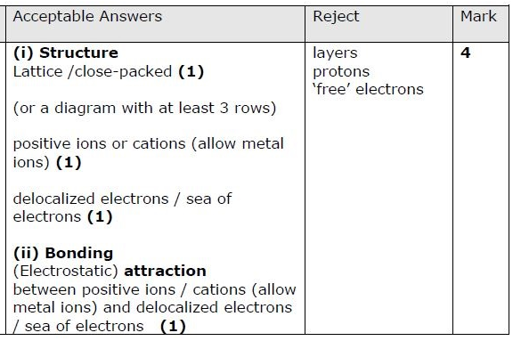
Exam questions
i) Describe the structure of a metal (2 marks)
ii) Explain the bonding in a metal (2 marks)

Slide 60
Exam questions
Explain the bonding in a metal (2 marks)

Slide 62
Learning Objectives
Ionic bonding
Describe ionic bonding
Draw dot and cross diagrams for ionic for ionic compounds
Explain what effects the strength of an ionic bond
Describe evidence for the existence of ions in ionic compounds
Explain trends in ionic radii down a group and for a set of isoelectronic ions
Metallic bonding
Explain what metallic bonding is

Slide 63
Learning Objectives
Ionic bonding
Describe ionic bonding
Draw dot and cross diagrams for ionic for ionic compounds
Explain what effects the strength of an ionic bond
Describe evidence for the existence of ions in ionic compounds
Explain trends in ionic radii down a group and for a set of isoelectronic ions
Metallic bonding
Explain what metallic bonding is

