Slide 1
Topic 17A: Chirality
know that optical isomerism is a result of chirality in molecules with a single chiral centre
understand that optical isomerism results from chiral centre(s) in a molecule with asymmetric carbon atom(s) and that optical isomers are object and non-superimposable mirror images
know that optical activity is the ability of a single optical isomer to rotate the plane of polarisation of plane-polarised monochromatic light in molecules containing a single chiral centre
understand the nature of a racemic mixture

Slide 2
Isomerism Recap
Isomers are molecules with the same molecular formula (i.e. the same number and type of atoms) but in which the atoms are arranged in a different way.
There are two main categories of isomerism: structural isomerism and stereoisomerism.
Structural isomers have different structural formulae. Three types of structural isomerism are chain isomerism, positional isomerism and functional group isomerism.
Stereoisomers have the same structural formula, but the 3D arrangement of atoms is different. Two types are cis–trans isomerism and optical isomerism.

Slide 3
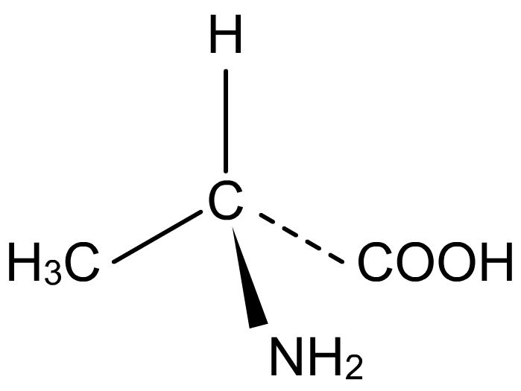
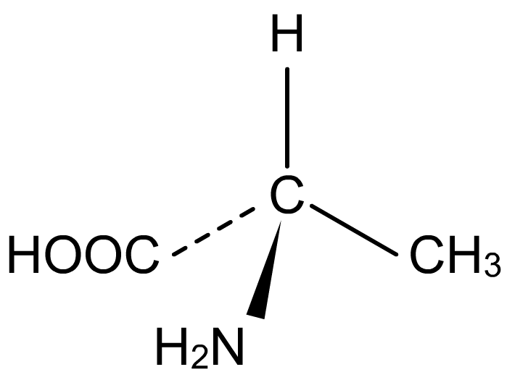
Optical isomerism
Another form of stereoisomerism is optical isomerism, in which a molecule can exist as two isomers that are non-superimposable, mirror images of each other, just like a left hand and right hand.
optical isomers of the amino acid alanine
Optical isomers have the same physical properties, but they rotate polarised light in opposite directions.
Notes:
Teacher notes
The property of an object existing as either a left-hand or right-hand version is called chirality. The central point of a chiral molecule is called the ‘chiral centre’ and is often a carbon atom. In these cases, the carbon is referred to as being an asymmetric carbon atom. Optical isomers are also called enantiomers, and have four different atoms/groups attached to the central carbon.
Several biologically-important molecules exist as optical isomers, with important differences between them. For example, the drug thalidomide exists as optical isomers. One isomer is teratogenic, causing the severe birth defects associated with the drug’s use in the 1950s and 1960s. The other isomer is non-teratogenic but alleviates morning sickness during pregnancy, the reason the drug was introduced in Europe. The version sold consisted of a mix of the two types of isomer (a mixture containing an equal amount of each isomer is called a ‘racemic’ mixture) but even if the safe isomer was isolated and sold, it would be still converted into the teratogenic isomer once in the body.
Other examples of chirality include:
morphine: one isomer is highly addictive and not as effective at pain relief, whereas the other is highly effective at pain relief but not as addictive
LSD: only one isomer is hallucinogenic
the amino acid asparagine: one tastes bitter, the other tastes sweet

Slide 4
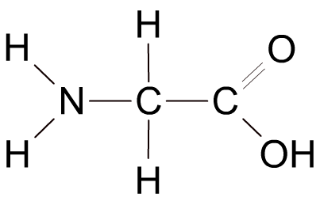
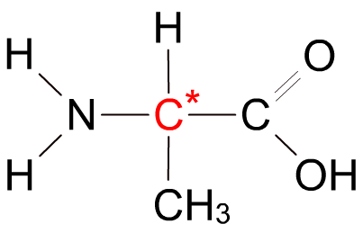
Chiral carbon atoms
For a compound to be optically active it must contain a carbon atom to which four different groups are attached.
Such a carbon atom is called a chiral carbon, and is denoted by a *.
glycine
alanine
The amino acid glycine does not contain a chiral carbon whereas alanine does. Alanine would be therefore be optically active but glycine would not.

Slide 5
Mirror images
If a chiral compound is drawn in 3D it is possible to see how the two enantiomers are different:
optical isomers of alanine
The two enantiomers are mirror images of each other. No matter how you rotate the molecules, it is impossible to superimpose them on top of each other.

Slide 6
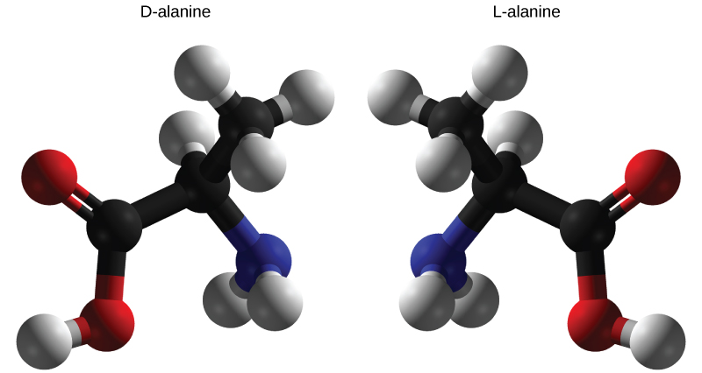
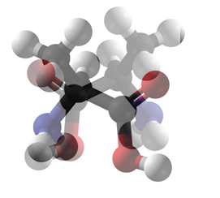
Super-imposability
Object are super-imposable on each other if they can perfectly overlap with each other if they were in the same place.

Slide 7
Here is a molecule gazing into the mirror

Slide 8
Here is its mirror image come to life

Slide 9
Here is the molecule sat next to its mirror image

Slide 10
Can they super-impose?
Apparently not… the molecule is chiral

Slide 11
How many different groups are there attached to the central carbon atom?
Does the molecule have a plane of symmetry?

