Slide 1
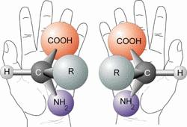
Optical isomers are:
Mirror images;
Non superimposable;
Chiral*;
Exclusive to asymmetrical compounds;
No plane of symmetry;
Simplest example has 4 different groups attached to a central carbon atom;
This carbon atom is known as the chiral centre;
Referred to as enantimers;
Optically active.
* Chiral means hand in greek*

Slide 2
Light waves
Light can be considered as a series of transverse waves, oscillating at 90° to the direction the light is moving.
Transverse waves can be modelled by moving one end of a Slinky up and down.
direction of wave propagation
Notes:
Photo credit: © Liudmila Gridina, shutterstock.com

Slide 3
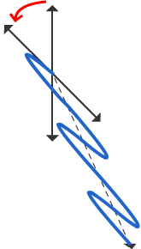
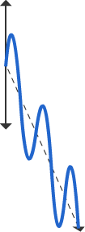
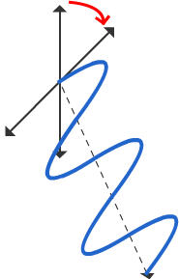
Optically active compounds
Optically active compounds have the ability to rotate the plane of polarized light.
Optically active compounds exist as two isomers, known as enantiomers.
One rotates the plane of polarized light clockwise; d enantiomer (dextrorotatory), +. The other rotates the plane of polarized light anticlockwise; l enantiomer (laevorotatory), -.
l enantiomer, -
polarized light
d enantiomer, +
Notes:
Teacher notes
See the Boardworks AS Chemistry ‘Introducing Organic Chemistry’ presentation for more information about different types of isomers.

Slide 4
The real thing - plane polarised light
Light is also made up of vibrations - this time, electromagnetic.
Polaroid has the ability to screen out all the vibrations apart from those in one plane and so produce plane polarised light.
If you wear one pair of Polaroid sunglasses and hold another pair up in front of them so that the glasses are held vertically rather than horizontally, you'll find that no light gets through - you will just see darkness. This is equivalent to the two slits at right angles in the string analogy. The polaroids are described as being "crossed".

Slide 5
Chiral Molecules
Enantiomers:
are optically active;
have different effects on plane polarised light;
A solution of one enantiomer rotates the plane of polarisation in a clockwise direction named the (+) form. The dextrorotatory enantiomer (d).
The other enantiomer will rotate the plane of polarisation in the other direction, named the (-) form. The laevorotatory enantiomer (l).
They will rotate the light by equal but opposite amounts e.g. +10º and -10º.

Slide 6
Chiral Molecules
A racemic mixture (racemate) has equal quantities of both the enantiomers.
It does not rotate the plane of plane – polarised light.

Slide 7
Polarimetry
Polarimetry measures the angle of rotation:
The analyser is rotated to maximum darkness
A solution of an optically active substance is put in a tube between the polariser and analyser
The analyser is rotated again until maximum darkness is obtained
The angle of rotation is measured
Monochromatic light is light of a single frequency. This light gives a more accurate reading than white light.

Slide 8
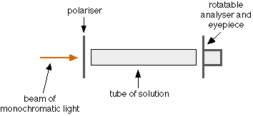
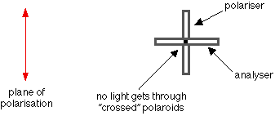
How can you tell that the plane of polarisation has been rotated?

Slide 9
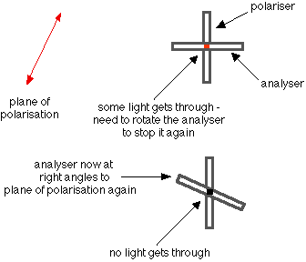
Optically active sample:
You can easily tell whether the plane of polarisation has been rotated clockwise or anti-clockwise, and by how much.

Slide 10
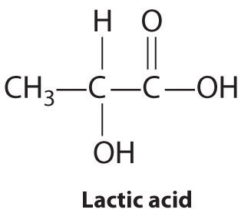
Question
Lactic acid, 2-hydroxypropanoic acid, is a compound found in sour milk and in muscles.
Explain why lactic acid is chiral. Indicate the feature involved on the structure below. (3 marks)
It has an asymmetric carbon atom (circled) which has four different groups attached, so the molecule is non – superimposable on its mirror image (could also say that is 3D molecule with no plane of symmetry)

