Slide 1
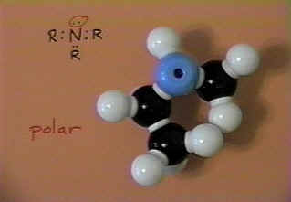
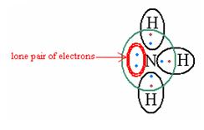
AMINES

Slide 2
Amines
Lesson objective: Know what amines are and some reactions of amines
Outcomes:
Identify amines
Explain the reactions of primary aliphatic amines, using butylamine as an example, with: water to form an alkaline solution, acids to form salts, halogenoalkanes, copper(II) ions to form complex ions
Explain reasons for the difference in basicity of ammonia, primary aliphatic and primary aromatic amines given suitable data
Describe how we can make amines using primary aliphatic amines reacting with halogenoalkanes and by the reduction of nitriles

Slide 3
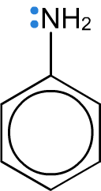
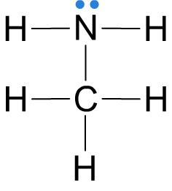
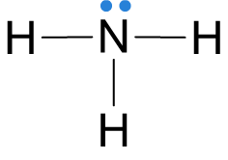
Ammonia and amines
Amines are nitrogen-containing organic compounds derived from ammonia, where one or more of the hydrogen atoms has been replaced by an alkyl or aryl group.
ammonia
methylamine
phenylamine
Amines have unpleasant odours: those with low boiling points smell like ammonia, whereas those that are liquid at room temperature have fishy aromas.
Notes:
Teacher notes
Alkyl group = a saturated hydrocarbon sidegroup derived from an alkane
Aryl group = an unsaturated hydrocarbon sidegroup derived from an arene (i.e. containing a benzene ring).

Slide 4
NAMING AMINES
Imagine ammonia and replace a hydrogen or hydrogen's with an organic group.
The easiest way to think of amines is as near relatives of ammonia, NH₃.
Amines fall into different classes depending on how many of the hydrogen atoms are replaced.
Primary amines | Replace one of the hydrogen atoms | RNH₂
Secondary amines | Replace two of the hydrogen atoms | R₂NH
Tertiary amines | Replace three of the hydrogen atoms | R₃N
Quaternary Ammonium Ions | All hydrogens replaced and extra bond due to lone pair on nitrogen | R₄N⁺
Naming amines can be quite confusing because there are so many variations on the names. Only use the method in the text book!

Slide 5
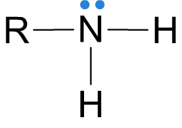
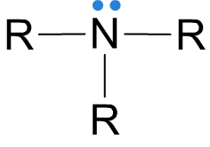
Structure of amines
An alkyl or aryl group can be represented by an R when drawing a chemical structure. This is referred to as an R group.
Primary (1°) amines have one R group attached to the nitrogen atom.
Secondary (2°) amines have two R groups attached to the nitrogen atom.
Tertiary (3°) amines have three R groups attached to the nitrogen atom.
Notes:
Teacher notes
The R group attached to the nitrogen atom in secondary and tertiary amines may be the same or different.

Slide 6
Identifying amines

Slide 7
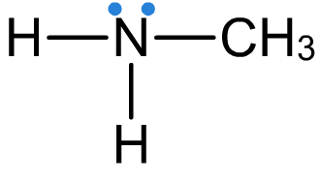
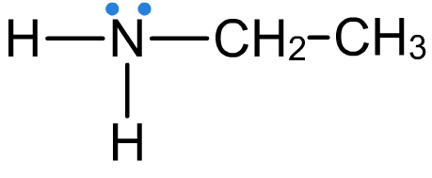
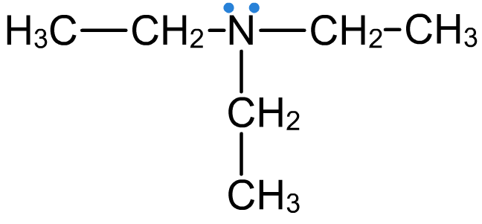
Naming amines
Amines are named using the suffix –amine.
methylamine
ethylamine
propylamine
If two identical R groups are attached, the prefix di– is used, and if three identical groups are present, then tri– is used.
diethylamine
triethylamine

Slide 8
Aliphatic means that the compound doesn’t have a benzene ring
Aromatic means that the compound does have a benzene ring

Slide 9
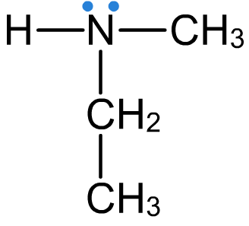
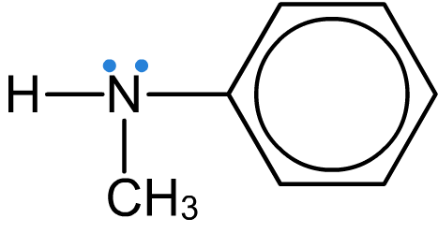
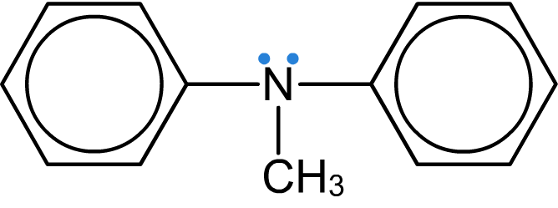
Naming amines
If two different alkyl or aryl groups are present, they are listed alphabetically.
ethylmethylamine
ethyldipropylamine
methylphenylamine
methyldiphenylamine

Slide 10
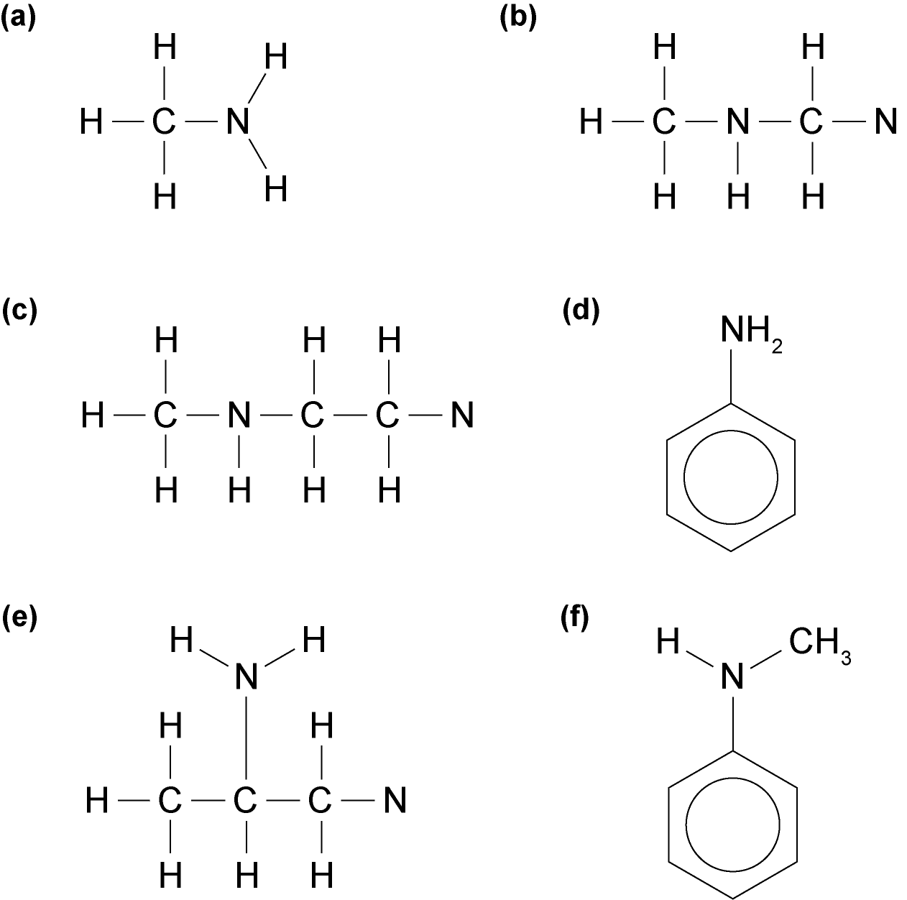
Question 1
a) methylamine
b) Dimethylamine
c) N-methylethanamine
d) phenylamine
e) propan-2-amine
f) N-methylphenylamine

Slide 11
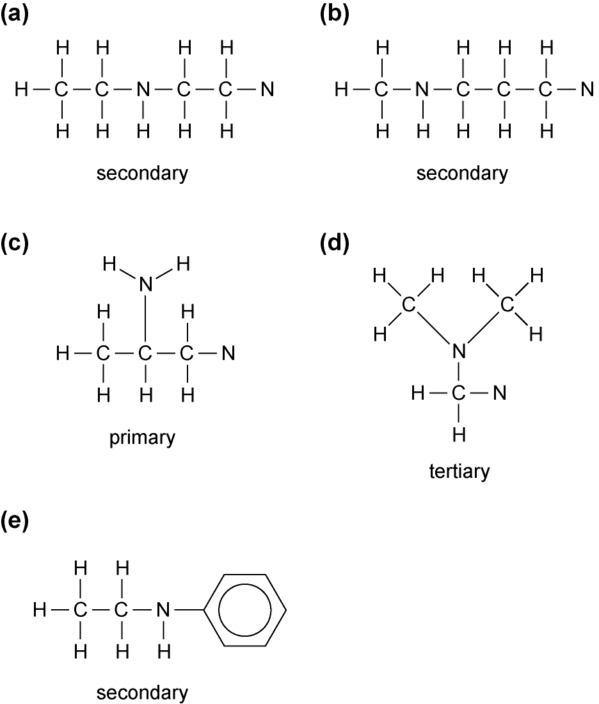
Question 2
Draw the following molecules and classify each one as primary, secondary, or tertiary.
a) N-ethylethanamine
b) N-methylpropanamine
c) propan-2-amine
d) N,N-dimethylmethanamine
e) N-ethylphenylamine

Slide 12
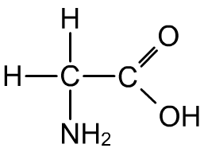
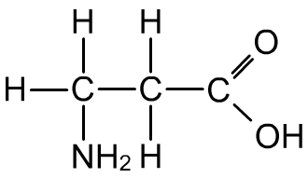
Naming amines
If other functional groups are present in the molecule, the presence of amine groups is denoted using the amino– prefix.
2-aminoethanoic acid
3-aminopropanoic acid
1,2-diaminopentane
Notes:
Teacher notes
See the Boardworks AS Chemistry ‘Alkanes’ presentation for revision of how to name structures with multiple functional groups. Also see the Boardworks A2 Chemistry ‘Acyl Compounds’ presentation for naming substances derived from carboxylic acids.

Slide 13
Amines
Lesson objective: Know what amines are and some reactions of amines
Outcomes:
Identify amines
Explain the reactions of primary aliphatic amines, using butylamine as an example, with: water to form an alkaline solution, acids to form salts, halogenoalkanes, copper(II) ions to form complex ions
Explain reasons for the difference in basicity of ammonia, primary aliphatic and primary aromatic amines given suitable data
Describe how we can make amines using primary aliphatic amines reacting with halogenoalkanes and by the reduction of nitriles

Slide 14
Ammonia as a base
Ammonia, NH₃, is soluble in water because it can form hydrogen bonds with water molecules.
It also reacts with water.
The lone pair on the nitrogen atom has a lone pair of electrons.
This means ammonia can act as a Bronsted – Lowry base.

Slide 15
Ammonia as a base
Ammonia dissolves in water to form an alkaline solution:
NH₃(aq) + H₂O(l) ← → NH₄⁺ (aq) + OH⁻(aq)
Ammonia is only partially dissociated in solution, so it is a weak base.
Its pK_{a} at 298K is 9.25

Slide 16
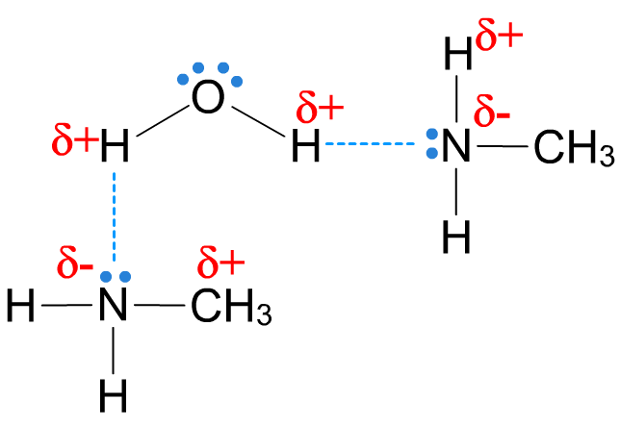
Solubility of primary amines
Shorter chain amines are soluble in water, as the lone pair of electrons on the nitrogen atom allows them to form hydrogen bonds with water molecules.
Longer chain amines are only sparingly soluble, as the larger R groups (carbon chain) interfere with the hydrogen bonds.
Remember the carbon chain can’t form hydrogen bonds.
Bigger molecules have greater London forces so need more energy to overcome them.
Notes:
Teacher notes
Shorter chain amines are also soluble in ethanol, as they form hydrogen bonds with the OH group in a similar way as shown for water.
For more information on how amines act in solution, see slide 21, ‘Amines as Brønsted–Lowry bases’.

Slide 17
Solubility of primary amines
In aqueous solution, amine molecules are able to accept an H⁺ ion from the water molecules, resulting in an alkaline solution due to the remaining OH⁻ ions.
CH₃CH₂CH₂CH₂NH₂ _{(aq)} + H₂O _{(l)} ← → CH₃CH₂CH₂CH₂NH₃⁺ _{(aq)} + OH⁻_{(aq)}
They act as Bronsted Lowry bases
Notes:
Teacher notes
Shorter chain amines are also soluble in ethanol, as they form hydrogen bonds with the OH group in a similar way as shown for water.
For more information on how amines act in solution, see slide 21, ‘Amines as Brønsted–Lowry bases’.

Slide 18
Amines as Brønsted–Lowry bases
Notes:
Teacher notes
See the ‘Acids and Bases’ presentation for more information about Brønsted–Lowry bases.

Slide 19
Amines are bases
Amines act as weak bases because they accept protons
There’s a lone pair of electrons on the N atom that can forma dative covalent bond with a H⁺ ion
Diagram
Notes:
Pg 93 CGP

Slide 20
Amines are bases
The strength of the base depends on how available the nitrogen’s lone pair of electrons is
The more available the lone pair is the more likely the amine is to accept a proton and the stronger a base it will be
A lone pair of electrons will be more available if its electron density is higher
Notes:
Pg 93 CGP

Slide 21
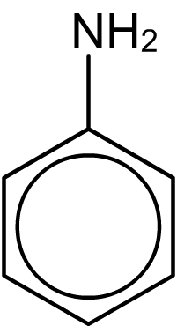
Aliphatic and aromatic amines
Aliphatic amines have at least one alkyl group bonded to the nitrogen. The lone pair of electrons on the nitrogen means that aliphatic amines behave similarly to ammonia:
they act as nucleophiles and take part in reactions involving donation of the lone pair
they act as Brønsted–Lowry bases (H⁺ acceptors).
Aromatic amines contain a benzene ring directly attached to the NH₂ group.
The delocalized system of the benzene group is able to incorporate the lone pair of electrons from the nitrogen atom, meaning that aromatic amines have different properties to aliphatic amines.
Notes:
Teacher notes
See the ‘Acids and Bases’ presentation for more information about Brønsted–Lowry bases.

Slide 22
Basicity of primary amines
Compared to ammonia, primary aliphatic amines:
Are stronger bases
Have higher pK_{a} values (and lower K_{a} values)
Form solutions with higher pH values (when they are at the same concentration)
This is because alkyl groups repel electrons, leading to an increase in negative charge around the nitrogen so that it more readily attracts and accepts an H⁺ ion.
As the alkyl chain length increases the base strength increases
Notes:
Teacher notes
See the ‘Acids and Bases’ presentation for more information about the strength of bases and pK_{b}.
The base strength of amines also increases with alkyl chain length.

Slide 23
Basicity of aromatic amines
Compared to ammonia primary aliphatic amines:
Weaker bases
Have lower pK_{a} values (and higher K_{a} values)
Form solutions with lower pH values (when they are at the same concentration)
The lone pair of electrons on the nitrogen atom delocalises with the delocalised pi electrons in the benzene ring
This decreases the electron density on the nitrogen atom
The lone pair of electrons becomes less available to form a dative bond with water or on the H⁺ ion
Notes:
Teacher notes
See the ‘Acids and Bases’ presentation for more information about the strength of bases and pK_{b}.
The base strength of amines also increases with alkyl chain length.

Slide 24
Reactions of amines as bases
Amines accept protons (H⁺) from acids to form salts:
ethylamine
ethylammonium chloride
If the reaction is carried out in solution, the amine accepts an H⁺ from a hydroxonium ion to form an ionic salt and water (a neutralization reaction)

Slide 25
Methylamine Methylammonium nitrate
CH₃NH₂ + HNO₃ → CH₃NH₃⁺ + NO₃⁻
Butylamine
CH₃CH₂CH₂CH₂NH₂ + HCl
←→ CH₃CH₂CH₂CH₂NH₃⁺ + Cl⁻
Butylammonium chloride

Slide 26
Amines
Lesson objective: Know what amines are and some reactions of amines
Outcomes:
Identify amines
Explain the reactions of primary aliphatic amines, using butylamine as an example, with: water to form an alkaline solution, acids to form salts, halogenoalkanes, copper(II) ions to form complex ions
Explain reasons for the difference in basicity of ammonia, primary aliphatic and primary aromatic amines given suitable data
Describe how we can make amines using primary aliphatic amines reacting with halogenoalkanes and by the reduction of nitriles

Slide 27
Amines from halogenalkanes
Primary aliphatic amines can be made from halogenoalkanes
Either mix the halogenalkane with conc ammonia
Or heat the halogenalkane with excess ammonia gas under pressure in a sealed container
E.g.
Notes:
e.g. page 132 edexcel

Slide 28
Amines from nitriles
Nitriles can be reduced to primary amines using strong reducing agents such as lithium tetrahydridoaluminate (LiAlH₄) in the presence of dry ether, which can be represented as [H]:
RCN + 4[H] → RCH₂NH₂
E.g: CH₃CH₂CN + 4[H] → CH₃CH₂CH₂NH₂
propanenitrile
propylamine
Notes:
Teachers notes
Nitriles are compounds containing the –CN group (where there is a triple bond between the C and N atoms).

Slide 29
Which method should you use?
The N atom in the amine group has a lone pair of electrons so amines can act as nucleophiles
This means that further substitution can happen when you use halogenoalkanes, leading to the production of secondary and tertiary amines
This is why you need excess ammonia – it reduces the change of these compounds forming
There is only one organic product when primary amines are prepared by the reduction of nitriles

Slide 30
Preparation of phenylamine
Aromatic amines can be prepared by the reduction of nitrated arenes using a mixture of tin metal and concentrated hydrochloric acid:
phenylamine
This method is commonly used to prepare aromatic amines in the lab. A similar method, using iron instead of tin, is used to prepare phenylamine industrially.
Notes:
Teacher notes
See the ‘Aromatic Compounds’ presentation for more information about compounds containing a benzene ring.

Slide 31
C₆H₅NO₂ + 6[H] → C₆H₅NH₂ + 2H₂O

Slide 32
Amines
Lesson objective: Know what amines are and some reactions of amines
Outcomes:
Identify amines
Explain the reactions of primary aliphatic amines, using butylamine as an example, with: water to form an alkaline solution, acids to form salts, halogenoalkanes, copper(II) ions to form complex ions
Explain reasons for the difference in basicity of ammonia, primary aliphatic and primary aromatic amines given suitable data
Describe how we can make amines using primary aliphatic amines reacting with halogenoalkanes and by the reduction of nitriles

Slide 33
Amines and copper (II) ions
Primary aliphatic amines can take part in reactions with copper (II) ions, butylamine:
Forms a blue precipitate (acid – base reaction):
Forms a deep blue solution when in excess (ligand -exchange reaction):
Notes:
Edexcel guide page 134, CGP page 93

Slide 34
Amines and halogenoalkanes
Halogenoalkanes undergo nucleophilic substitution reactions with ammonia to form amines. The same can happen with primary aliphatic amines to form secondary amines.
In general:
R₁NH₂ + R₂X → R₁NHR₂ + HX
E.g.
X is a halogen atom
Amine alkyl group
Halogenoalkane alkyl group
Notes:
Edexcel guide 134

Slide 35
The nitrogen atom in the primary amine that is formed has a lone pair of electrons so it is also a nucleophile.
Primary, secondary and tertiary amines all have a lone pair of electrons on their nitrogen atom, so are able to react with halogenoalkanes in nucleophilic substitution to form more substituted amines
Quaternary do not have lone pairs so can’t take place in any further nucleophilic substitution reactions

Slide 36
Amines
Lesson objective: Know what amines are and some reactions of amines
Outcomes:
Identify amines
Explain the reactions of primary aliphatic amines, using butylamine as an example, with: water to form an alkaline solution, acids to form salts, halogenoalkanes, copper(II) ions to form complex ions
Explain reasons for the difference in basicity of ammonia, primary aliphatic and primary aromatic amines given suitable data
Describe how we can make amines using primary aliphatic amines reacting with halogenoalkanes and by the reduction of nitriles

Slide 37
Questions page 94 CGP guide
Workbook page 132 – 134
Pearson guide 132 - 134

Slide 38
Amines
Lesson objective: Know what amines are and some reactions of amines
Outcomes:
Identify amines
Explain the reactions of primary aliphatic amines, using butylamine as an example, with: water to form an alkaline solution, acids to form salts, halogenoalkanes, copper(II) ions to form complex ions
Explain reasons for the difference in basicity of ammonia, primary aliphatic and primary aromatic amines given suitable data
Describe how we can make amines using primary aliphatic amines reacting with halogenoalkanes and by the reduction of nitriles

