Slide 1
Reactions of benzene: Friedel Crafts Reactions

Slide 2
Reactions of benzene: Friedel - Crafts
understand the reactions of benzene with: iv) halogenoalkanes and acyl chlorides with aluminium chloride as catalyst (Friedel-Crafts reaction)
understand the mechanism of the electrophilic substitution reactions of benzene (halogenation, nitration and Friedel-Crafts reactions), including the generation of the electrophile

Slide 3
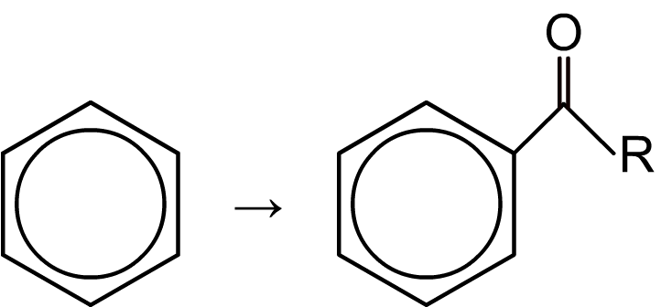
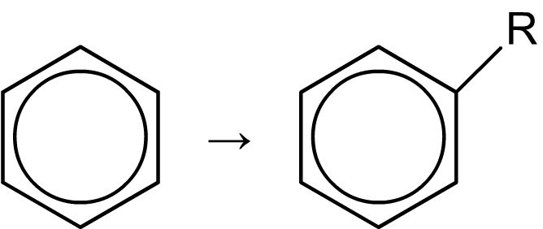
Friedel–Crafts reactions
Friedel–Crafts reactions are substitution reactions used to attach extra carbon atoms to a benzene ring.
There are two main types of Friedel–Crafts reaction: alkylation is used to add alkyl groups (―R), and acylation is used to add acyl groups (―COR).
Friedel–Crafts alkylation
Friedel–Crafts acylation
Friedel–Crafts reactions are important in industry; for example, in the production of plastics, detergents and petrol.

Slide 4
Friedel–Crafts alkylation and acylation

Slide 5
Friedel–Crafts alkylation mechanism

Slide 6
Friedel–Crafts acylation mechanism

Slide 7
Reactions of benzene: Friedel - Crafts
understand the reactions of benzene with: iv) halogenoalkanes and acyl chlorides with aluminium chloride as catalyst (Friedel-Crafts reaction)
understand the mechanism of the electrophilic substitution reactions of benzene (halogenation, nitration and Friedel-Crafts reactions), including the generation of the electrophile

Slide 8
Questions
Notes:
From revision guide and exam questions

Slide 9
Acylation Question
Benzene reacts with ethanoyl chloride, in the presence of an aluminium chloride catalyst, to form phenylethanone and hydrogen chloriode.
Write the curly arrow mechanism for this reaction.
Notes:
Page 131 Edexcel revision guide

Slide 10
More Friedel Crafts Questions
The following compounds can be made from benzene using Friedel-Crafts reactions.
For each one, state the name and structural formula of the other organic reactant.
Draw the displayed formula of the electrophile it forms.
Propylbenzene

Slide 11
More Friedel Crafts Questions
The following compounds can be made from benzene using Friedel-Crafts reactions.
For each one, state the name and structural formula of the other organic reactant.
Draw the displayed formula of the electrophile it forms.
2. Phenylpropan-1-one

