Slide 1
Groups 1 and 2 Compounds
Wednesday, 06 January 2016

Slide 2
Groups 1 & 2 Compounds
Lesson Objective: To know the reactions of groups 1 and 2 compounds and how to investigate the patterns on thermal decomposition of nitrates and carbonates
Success Criteria:
know the reactions of the oxides of Group 2 elements with water and dilute acid, and their hydroxides with dilute acid
know the trends in solubility of the hydroxides and sulfates of Group 2 elements
understand reasons for the trends in thermal stability of the nitrates and the carbonates of the elements in Groups 1 and 2 in terms of the size and charge of the cations involved
understand experimental procedures to show patterns in thermal decomposition of Group 1 and 2 nitrates and carbonates

Slide 3
Solubility of group 2 hydroxides practical
Place a small quantity (about 0.02 g) of each group 2 hydroxide in a separate test tube.
Add 10 cm3 of deionised water to each tube and shake well.
What happens?
Add 3 drops of universal indicator.
Record the pH.

Slide 4
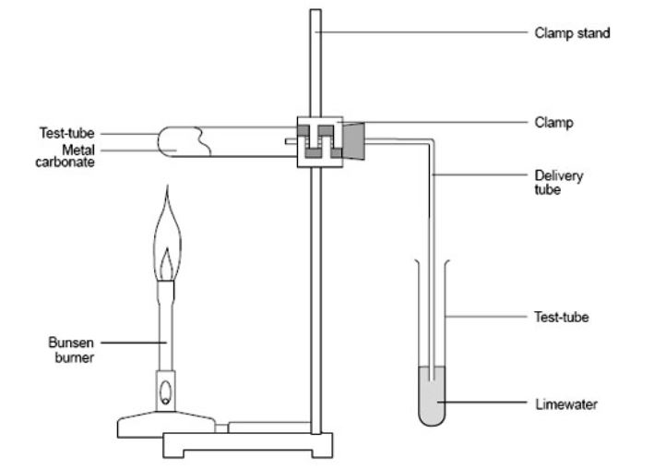
Thermal decomposition of carbonates practical
a) Put a large spatula measure of the carbonate to be tested in a test-tube.
b Fit a delivery tube and then clamp the test-tube so that the delivery tube dips into a second test-tube containing 2-3 cm³ limewater.
c) Heat the solid gently at first, then more strongly.
d) Lift the delivery tube from the limewater before, or as soon as, the heating is stopped. This is to avoid 'suck-back'.
e) Write down all observations. Notice what happens to the limewater and how long it takes to turn milky (if at all). Notice whether any melting occurs in the heated test-tube and any colour changes taking place. Write your results in tabular form.
f) Repeat the experiment with the other metal carbonates supplied, and in each case write down your observations.
g) Wash your hands thoroughly at the end of these experiments, since some of the metal carbonates are toxic.

Slide 5
Investigating the thermal decomposition of nitrates
This can be done either by measuring how long it takes until oxygen is produced (i.e. To relight a glowing splint)
Or
Measuring how long it takes until a brown gas (NO₂) is produced. This needs to be done in a fume cupboard because NO₂ is toxic.
Notes:
Carbonates and nitrates thermal decomposition pages 119 – 122 advanced practical chemistry

Slide 6
Alternative Thermal decomposition of group 2 carbonates practical
Weigh a test tube.
Place 2 g of a Group 2 metal carbonate in the test tube and reweigh.
Attach the delivery tube to the test tube. Place the other end of the delivery tube into a test tube which is one third full of limewater.
Start the stopwatch and heat the test tube with the hottest flame possible.
Time how long it takes for the limewater to go milky.
Continue heating for a total of 5 minutes (even if the limewater does not go milky).
Remember to remove the delivery tube from the limewater before removing the flame from the test tube.
After cooling reweigh the borosilicate tube.
Repeat with each group 2 carbonate.
Analysis
Calculate the loss in mass of each metal carbonate.
Using the above evidence place the metal carbonates in order of thermal stability.
Notes:
borosilicate tube

Slide 7
Groups 1 & 2 Compounds
Lesson Objective: To know the reactions of groups 1 and 2 compounds and how to investigate the patterns on thermal decomposition of nitrates and carbonates
Success Criteria:
know the reactions of the oxides of Group 2 elements with water and dilute acid, and their hydroxides with dilute acid
know the trends in solubility of the hydroxides and sulfates of Group 2 elements
understand reasons for the trends in thermal stability of the nitrates and the carbonates of the elements in Groups 1 and 2 in terms of the size and charge of the cations involved
understand experimental procedures to show patterns in thermal decomposition of Group 1 and 2 nitrates and carbonates

Slide 8
Group 2 Compounds:
Oxides and Hydroxides
Oxides and Hydroxides of group 2 metals are bases
They are neutralised by acids to form salt and water.
e.g. MgO(s) + 2HCl(aq) → MgCl₂(aq) + H₂O(l)
or Ca(OH)₂(s) + 2HCl(aq) → CaCl₂(aq) + 2H₂O(l)
As the products of these reactions are soluble you will see the solid oxides or hydroxides dissolve

Slide 9
Group 2 Compounds:
Oxides
Oxides react with water to form a solution of the metal hydroxide.
MgO(s) + 2H₂O(l) → Mg(OH)₂(aq)
Typical pH is about 10-12

Slide 10
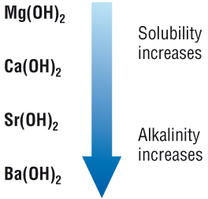
Group 2 Compounds:
Hydroxides
Hydroxides dissolve in water to form alkaline solutions.
Mg(OH)₂ + aq→ Mg²⁺ + 2OH⁻(aq)
Typical pH is about 10-12
Solubility increases on descending the group
The resulting solutions are also more alkaline
Mg(OH)₂ is only slightly soluble in water
Ba(OH)₂ much more soluble, therefore more OH- goes into solution = more alkaline.
Notes:
This is because the more of the hydroxide that dissolves, the greater the concentration of hydroxide ions (OH⁻) in the solution formed

Slide 11
Solubilities of group 2 sulfates
The solubility of the group 2 sulfates decreases down the group. Magnesium and calcium sulfate are considered to be soluble, whereas strontium and barium sulfate are considered to be insoluble.
Group 2 hydroxide
Note that this decrease in solubility down the group is the opposite of the trend for the solubility of the group 2 hydroxides.
Solubility
MgSO₄
soluble
CaSO₄
slightly soluble
SrSO₄
insoluble
BaSO₄
insoluble
Notes:
Teacher notes
Beryllium sulfate is soluble, following the trend shown here.

Slide 12
This can be seen in the water test for sulfate ions.
Acidified barium chloride is added to the solution. If a white precipitate (an insoluble solid) is produced sulfates are present.
Ba²⁺ (aq) + SO₄²⁻ (aq) → BaSO₄ (s)
White precipitate

Slide 13
Groups 1 & 2 Compounds
Lesson Objective: To know the reactions of groups 1 and 2 compounds and how to investigate the patterns on thermal decomposition of nitrates and carbonates
Success Criteria:
know the reactions of the oxides of Group 2 elements with water and dilute acid, and their hydroxides with dilute acid
know the trends in solubility of the hydroxides and sulfates of Group 2 elements
understand reasons for the trends in thermal stability of the nitrates and the carbonates of the elements in Groups 1 and 2 in terms of the size and charge of the cations involved
understand experimental procedures to show patterns in thermal decomposition of Group 1 and 2 nitrates and carbonates

Slide 14
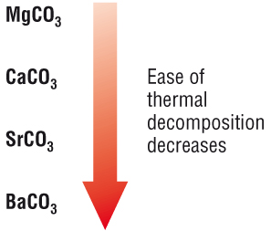
Group 2 Compounds:
Carbonates
Carbonates are decomposed by heat → metal oxide and carbon dioxide gas
MgCO₃(s) → MgO(s) + CO₂(g)
This is called thermal decomposition
The carbonates are more difficult to decompose on descending the group.
The stability increases down the group

Slide 15
Decomposition of group 2 nitrates
Thermal decomposition of group 2 metal nitrates forms the metal oxide, nitrogen dioxide and oxygen.
2M(NO₃)_{2(s)} → 2MO_{(s)} + 4NO_{2(g)} + O_{2(g)}
E.g.2Mg(NO₃)₂ → 2MgO + 4NO₂ + O₂
Like the group 2 metal carbonates, the nitrates become more stable to thermal decomposition down the group.
magnesium nitrate: Mg(NO₃)₂
increasing stability
calcium nitrate: Ca(NO₃)₂
strontium nitrate: Sr(NO₃)₂
barium nitrate: Ba(NO₃)₂
Notes:
Teacher notes
Note that the ‘M’ in the equation represents any group 2 metal.

Slide 16
Group 1 carbonates
All white with general formula M₂CO₃.
Unusual because they dissolve in water forming alkaline solutions
Also unusual because most of them do not decompose on heating.
Lithium carbonate is an exception.

Slide 17
Group 1 nitrates
White crystalline solids with general formula MNO₃.
Very soluble in water
Harder to decompose on heating than most other metal nitrates
They only decompose as far as the nitrite (MNO₂)
E.g. 2KNO₃ (s) → 2KNO₂ (s) + O₂ (g)
Like with the carbonates of group 1, lithium nitrate is the exception behaving as most other nitrates.

Slide 18
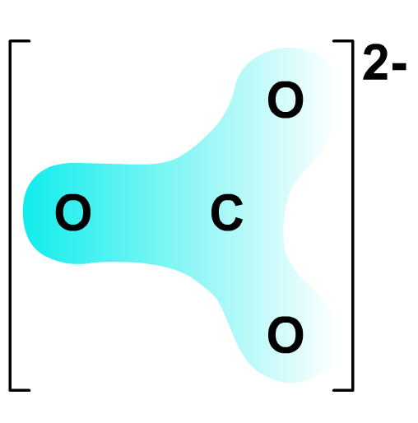
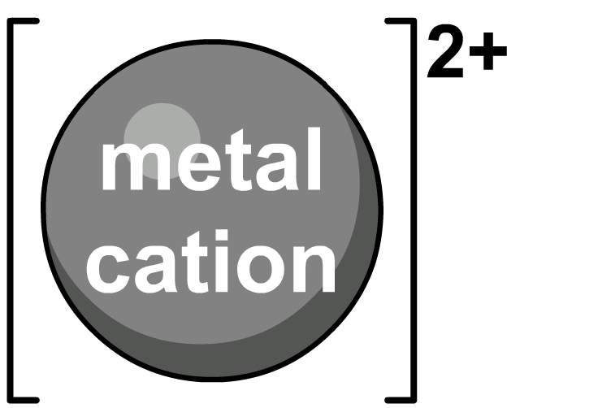
Explaining the trend in thermal stability
Metal ions become larger down group 2 but have the same charge. This means their charge density is reduced.
A metal ion with a high charge density has strong polarizing power. It can therefore polarize the carbonate ion, making it more likely to split into O²⁻ and CO₂ when heated.
polarization
A metal ion with a low charge density has weak polarizing power, meaning the carbonate ion is less polarized and therefore more thermally stable.
This is the same for nitrates

Slide 19
Why the difference between group 1 and 2?
The thermal stabilities of the carbonates and nitrates depends on the charge on the metal ions and the size of the metal ions.
Group 2 compounds are less thermally stable than group 1 compounds.
The greater the charge on the cation the greater the distortion and the less stable the carbonate/nitrate ion becomes
Group 2 cations have 2+ charge, compared to 1+ charge for Group 1 cations.
So Group 2 carbonates and nitrates are less stable than those of Group 1.

Slide 20
Groups 1 & 2 Compounds
Lesson Objective: To know the reactions of groups 1 and 2 compounds and how to investigate the patterns on thermal decomposition of nitrates and carbonates
Success Criteria:
know the reactions of the oxides of Group 2 elements with water and dilute acid, and their hydroxides with dilute acid
know the trends in solubility of the hydroxides and sulfates of Group 2 elements
understand reasons for the trends in thermal stability of the nitrates and the carbonates of the elements in Groups 1 and 2 in terms of the size and charge of the cations involved
understand experimental procedures to show patterns in thermal decomposition of Group 1 and 2 nitrates and carbonates

Slide 21
Questions
1. Write the equations for the following reactions;
Barium oxide with hydrochloric acid
Radium carbonate with nitric acid
Strontium with water
The thermal decomposition of magnesium carbonate
Calcium oxide with nitric acid
From page 91 of text book

Slide 22
Practice Questions
When heated, X, a compound of calcium, produces a gas A and a solid B. The gas A is bubbled through a solution of limewater to give a cloudy precipitate of C. Give the formulae of the substances A, B, C and X (4 marks)
A = CO₂
B = CaO
C = CaCO₃ (precipitate formed in the reaction between CO2 and limewater)
X = CaCO₃
1 mark each
Notes:
Pg 67 revision guide

Slide 23
Practice Questions
A) Write a balanced equation for the thermal decomposition of sodium nitrate (1 mark) B) How could you test for the gas produced in the thermal decomposition? (1 mark) C) Place the following in order of ease of thermal decomposition (easiest first) Magnesium nitrate Potassium nitrate Sodium nitrate Explain your answer (3 marks)
2NaNO₃ (g) → 2NaNO₂ (s) + O₂ (g)
Oxygen relights a glowing splint
Magnesium nitrate, sodium nitrate, potassium nitrate (1 mark)
Group 2 nitrates decompose more easily than Group 1 nitrates (the greater the charge on the cation the less stable the nitrate anion) (1 mark)
The further down the group, the more stable the nitrate (the larger the cation, the less distortion on the nitrate anion) (1 mark)
Notes:
Pg 67 revision guide

Slide 24
Groups 1 & 2 Compounds
Lesson Objective: To know the reactions of groups 1 and 2 compounds and how to investigate the patterns on thermal decomposition of nitrates and carbonates
Success Criteria:
know the reactions of the oxides of Group 2 elements with water and dilute acid, and their hydroxides with dilute acid
know the trends in solubility of the hydroxides and sulfates of Group 2 elements
understand reasons for the trends in thermal stability of the nitrates and the carbonates of the elements in Groups 1 and 2 in terms of the size and charge of the cations involved
understand experimental procedures to show patterns in thermal decomposition of Group 1 and 2 nitrates and carbonates

