Slide 1
Took two lessons plus practical lesson on tests

Slide 2
Carbonyls theory
Saturday, 21 October 2017

Slide 3
Carbonyl Compounds
Objective: To know what carbonyl compounds are and how we test for them
Success criteria
Identify aldehyde and ketone functional groups
Explain their reactions with Fehling’s and Benedict’s solutions, Tollen’s reagent and acidified dichromate (VI) ions
Explain how we can use 2,4-DNP as a test for the presence of a carbonyl group and to identify a carbonyl compound using the melting temperature of a derivative
Explain how their physical properties are affected by the intermolecular forces that they form (including solubility in water)

Slide 4
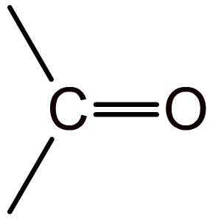
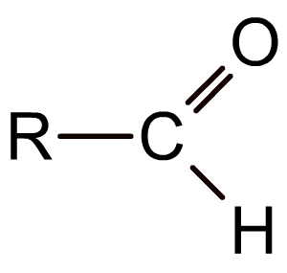
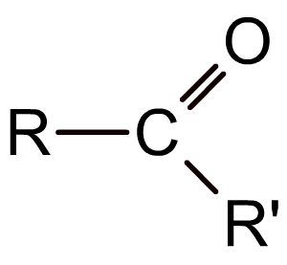
The carbonyl group
The carbonyl group (>C=O) is the functional group found in compounds such as aldehydes, ketones, and carboxylic acids.
In aldehydes the carbonyl group is at the end of the carbon chain and so has at least one hydrogen attached to it.
In ketones the carbonyl group is in the middle of a carbon chain and so has two alkyl groups attached to it.
Notes:
Teacher notes
It could be pointed out to students that the carbonyl group is sometimes orientated differently in different displayed formulae (compare the top diagram with the bottom two) and that they should take care when identifying such structures.

Slide 5
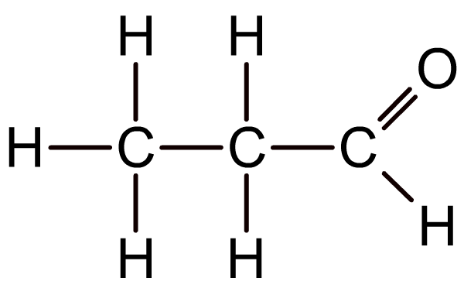
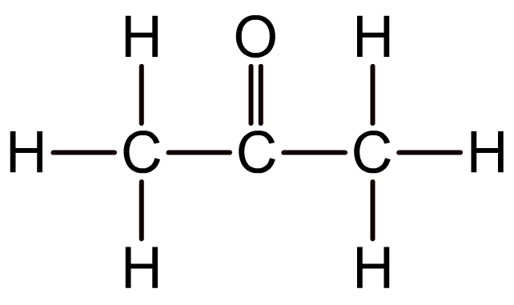
Representing aldehydes and ketones
Aldehydes and ketones cannot be distinguished by their molecular formula because they have the same functional group.
What is the molecular formula of the aldehyde and ketone below?
an aldehyde
a ketone
Both have the molecular formula C₃H₆O

Slide 6
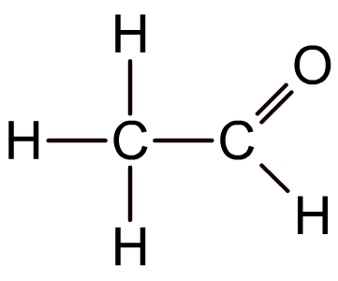
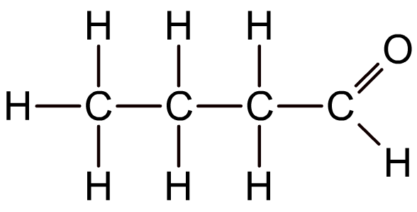
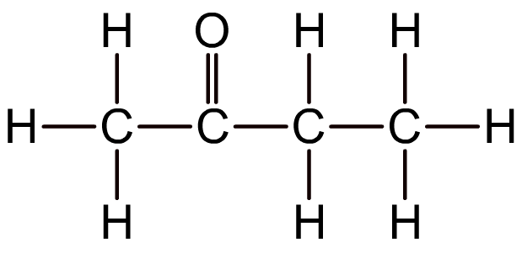
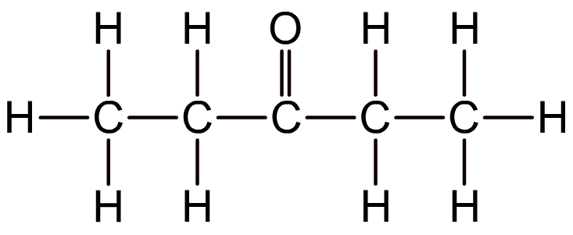
Representing aldehydes and ketones
Aldehydes and ketones are therefore represented either using displayed or structural formulae.
CH₃CHO
CH₃CH₂CH₂CHO
CH₃COCH₂CH₃
CH₃CH₂COCH₂CH₃
Notes:
Teacher notes
See the Boardworks AS Chemistry ‘Introducing Organic Chemistry’ presentation for more information about representing chemical structures.

Slide 7
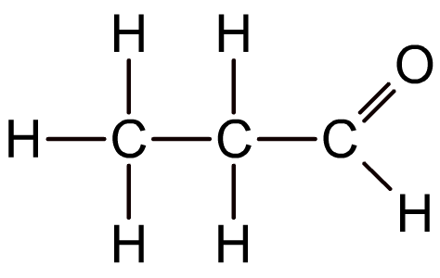
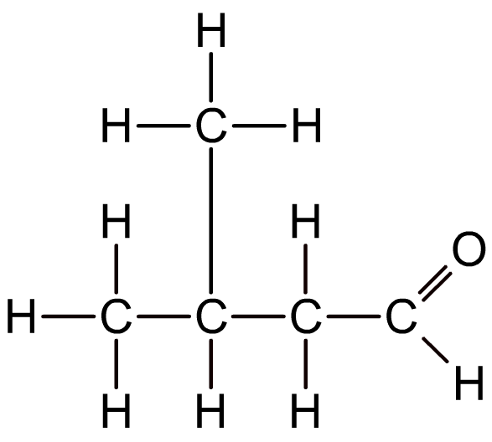
Naming aldehydes
Aldehydes are named using the suffix –al, and follow the same conventions as for naming alkanes.
ethanal
propanal
2-methylbutanal
Notes:
Teacher notes
See the Boardworks AS Chemistry ‘Alkanes’ presentation for more information about naming alkanes, including branched-chain alkanes.

Slide 8
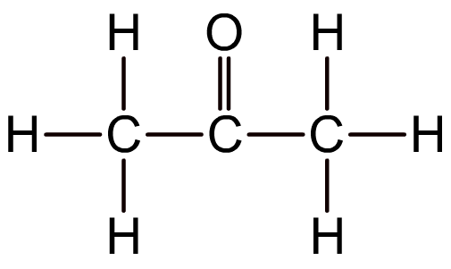
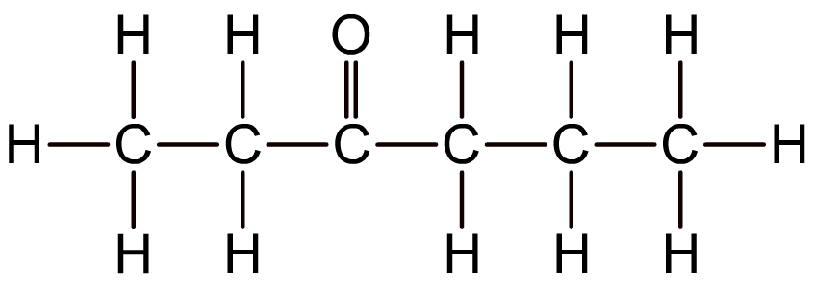
Naming ketones
Ketones are named using the suffix –one.
propanone
hexan-3-one
Like alkenes, ketones with four or more carbon atoms display positional isomerism because the carbonyl group may appear between different carbon atoms. In these cases, a number is used before the –one to indicate the first carbon involved.
Notes:
Teacher notes
See the Boardworks AS Chemistry ‘Alkenes’ presentation for more information about naming alkenes.
Propanone is more commonly known as acetone, which is an important solvent.

Slide 9
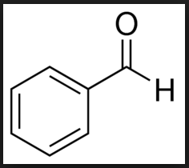
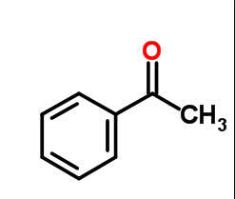
Aromatic aldehydes and ketones contain both a benzene ring and a carbonyl group
E.g.
Benzaldehyde
Phenylethanone

Slide 10
Carbonyl Compounds
Objective: To know what carbonyl compounds are and how we test for them
Success criteria
Identify aldehyde and ketone functional groups
Explain their reactions with Fehling’s and Benedict’s solutions, Tollen’s reagent and acidified dichromate (VI) ions
Explain how we can use 2,4-DNP as a test for the presence of a carbonyl group and to identify a carbonyl compound using the melting temperature of a derivative
Explain how their physical properties are affected by the intermolecular forces that they form (including solubility in water)

Slide 11
Polarity
Do these have polar bonds?
They don’t have polar O-H bonds
propanone
propanal

Slide 12
Polarity
They don’t have polar OH bonds.
So they can’t form hydrogen bonds with other aldehyde/ketone molecules.
The molecules of aldehydes and ketones will bond with each other through London forces and permanent dipole – permanent dipole bonds.
What does this mean for their properties?
propanone
propanal

Slide 13
Boiling points
Propanone = 56ºC
Propanal = 48ºC
Propan – 1 – ol = 97ºC
What do you notice?
Can you explain why?
Alcohols can form hydrogen bonds as they do have a polar O-H bond. This means that they have higher boiling points than their equivalent ketones and aldehydes (which don’t form hydrogen bonds).

Slide 14
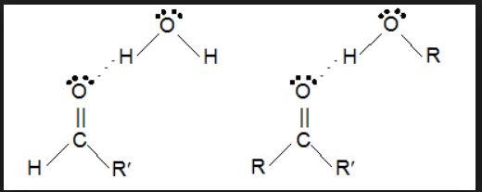
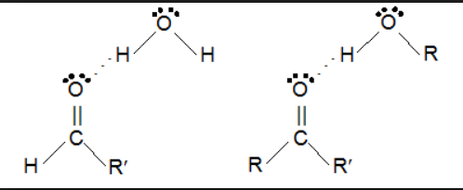
What about aldehydes/ketones with water?
Aldehydes/ketones don’t have a polar O-H bond but they do have a lone pair of electrons on the O atom of the C=O group.
The oxygen atom uses its lone pairs to form hydrogen bonds with the hydrogen atoms on water molecules.
Small aldehydes and ketones will dissolve in water
Hydrogen bond

Slide 15
Longer chained aldehydes/ketones aren’t able to form hydrogen bonds with water.
This is because the hydrocarbon chains disrupt the hydrogen bonding between the water molecules, but can’t hydrogen bond themselves
Remember the solubility rules
With large aldehydes/ketones the intermolecular forces are London forces
The London forces between the aldehyde/ketone molecules and the hydrogen bonding with the water molecules will be stronger than the hydrogen bonds that could form between the aldehyde/ketone and water.

Slide 16
Carbonyl Compounds
Objective: To know what carbonyl compounds are and how we test for them
Success criteria
Identify aldehyde and ketone functional groups
Explain their reactions with Fehling’s and Benedict’s solutions, Tollen’s reagent and acidified dichromate (VI) ions
Explain how we can use 2,4-DNP as a test for the presence of a carbonyl group and to identify a carbonyl compound using the melting temperature of a derivative
Explain how their physical properties are affected by the intermolecular forces that they form (including solubility in water)

Slide 17
Testing For Aldehydes
The chemical tests used to distinguish between aldehydes and ketones.
All work on the idea that an aldehyde can easily be oxidised but ketones can’t.
As an aldehyde is oxidised, another compound is reduced and this will have a colour change.
In general
XCHO + [O] → XCOOH
Aldehyde + Oxidising agent → Carboxylic acid
E.g. Propanal being oxidised to propanoic acid
CH₃CH₂CHO + [O] → CH₃CH₂COOH

Slide 18
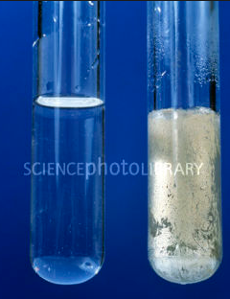
Testing with Tollen’s the silver mirror test
Tollen’s reagent is a colourless solution of silver nitrate dissolved in aqueous ammonia.
Heat your sample with Tollen’s.
Ketone’s produce no reaction
Aldehydes produce “silver mirror”
Safety
Many organic compounds are flammable, do not heat them directly over a flame.
Use a water bath or heating mantle.

Slide 19
Testing with Tollen’s the silver mirror test
Ag(NH₃)₂⁺ _{(aq)} + e⁻ → Ag_{(s)} + 2NH₃ _{(aq)}
_{silver}
2Ag(NH₃)₂⁺_{(aq)} + RCHO_{(aq)} + 3OH⁻_{(aq)} → 2Ag_{(s)} + RCOO⁻_{(aq)} + 4NH_{3(aq)} + 2H₂O
RCHO + [O] → RCOOH
Ketone’s produce no reaction
Aldehydes produce “silver mirror”

Slide 20
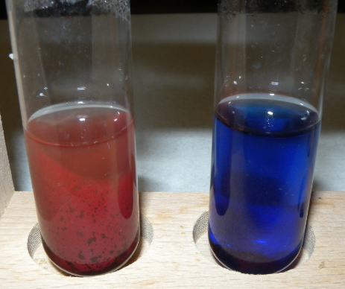
Distinguishing between aldehydes and ketones
Benedict’s solution is a blue solution of complexed copper (II) ions dissolved in sodium carbonate.
When heated with an aldehyde the blue copper (II) ions are reduced to a brick – red precipitate of copper (I) oxide.
If heated with a ketone nothing happens as ketones cannot be easily oxidised.
Benedict's solution
Positive test with an aldehyde

Slide 21
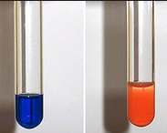
Distinguishing between aldehydes and ketones
Fehling’s solution can also be used.
This contains copper (II) ions dissolved in sodium hydroxide.
The colour change is the same for an aldehyde (blue to red).
Again there is no reaction with a ketone.
Positive test with an aldehyde
Fehling's solution

Slide 22
Distinguishing between aldehydes and ketones
Cu²⁺_{(aq)} + e⁻ → Cu⁺_{(aq)}
Blue Brick red
RCHO_{(aq)} + 2Cu²⁺ + 5OH⁻ → RCOO⁻_{(aq)} + Cu₂O_{(s)} + 3H₂O_{(l)}
RCHO + [O] → RCOOH
Positive test with an aldehyde
Fehling's solution

Slide 23
Distinguishing aldehydes & ketones

Slide 24
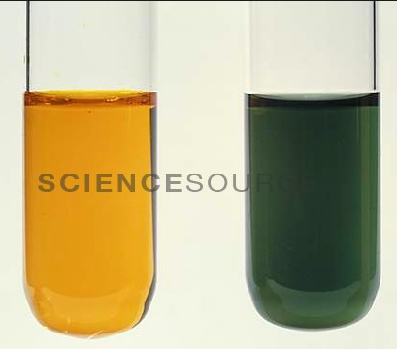
Oxidation of aldehydes using Cr₂O₇²⁻/H⁺ to form carboxylic acids
Potassium dichromate is reduced in its reactions with aldehydes and changes from orange to green
Acidified dichromate
Positive test with an aldehyde

Slide 25
When an aldehyde is heated with acidified dichromate (VI) ions you get a carboxylic acid
Potassium dichromate (VI) with dilute sulphuric acid is often used
Ketones won’t oxidise with dichromate (VI) ions
Cr₂O₇²⁻ → 14H⁺ + 6e⁻ → 2Cr³⁺ + 7H₂O
Orange Green

Slide 26
Carbonyl Compounds
Objective: To know what carbonyl compounds are and how we test for them
Success criteria
Identify aldehyde and ketone functional groups
Explain their reactions with Fehling’s and Benedict’s solutions, Tollen’s reagent and acidified dichromate (VI) ions
Explain how we can use 2,4-DNP as a test for the presence of a carbonyl group and to identify a carbonyl compound using the melting temperature of a derivative
Explain how their physical properties are affected by the intermolecular forces that they form (including solubility in water)

Slide 27
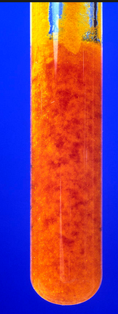
Testing for aldehydes and ketones using 2,4-DNP (2,4-dinitrophenylhydrazine)
Orange/yellow precipitate is formed when added to an aldehyde or a ketone
It only happens with C=O groups, not with more complicated ones like -COOH (in carboxylic acids)
2,4-DNP is also known as Brady’s reagent
The precipitate is the derivative

Slide 28
Melting Point
The orange precipitate is a derivative of the carbonyl compound which can be purified by recrystalisation. (Derived from a particular carbonyl)
Each different carbonyl compound gives a crystalline derivative with a different melting point.
If you measure the melting point of the crystals and compare it to a table of known melting points of the possible derivatives, you can identify the original carbonyl compound

Slide 29
Carbonyl Compounds
Objective: To know what carbonyl compounds are and how we test for them
Success criteria
Identify aldehyde and ketone functional groups
Explain their reactions with Fehling’s and Benedict’s solutions, Tollen’s reagent and acidified dichromate (VI) ions
Explain how we can use 2,4-DNP as a test for the presence of a carbonyl group and to identify a carbonyl compound using the melting temperature of a derivative
Explain how their physical properties are affected by the intermolecular forces that they form (including solubility in water)

Slide 30
Identifying Aldehydes And Ketones Questions
Two isomers of C₃H₆O, isomer A and isomer B, both contain a carbonyl group.
Describe the expected observations when 2,4-dinitrophenylhydrazine is added to them (1 mark)
Describe how you could identify each carbonyl compound using the products in part a. (3 marks)
An orange – yellow precipitate forms
Recrystalise the products to purify them, and then dry them (1 mark). Measure their melting temperatures (1 mark) and compare them with values from a data book (1 mark).
Notes:
Page 121 pearson revision guide

Slide 31
Other than using Brady’s reagent, describe a simple laboratory test to distinguish between the two carbonyl compounds in the previous question. (3 marks)
One must be an aldehyde (propanal) and the other must be a ketone (propanone). (1 mark)
(1 mark for test and 1 mark for observation)
Warm with acidified K₂Cr₂O_{7.} Solution goes green with aldehyde. No change/stays orange with ketone
Fehling’s solution/Benedict’s solution, red precipitate forms with aldehyde. No visible change/stays blue with ketone
Tollens’ regent. Silver mirror forms with aldehyde. No visible change/solution stays colourless with ketone.

Slide 32
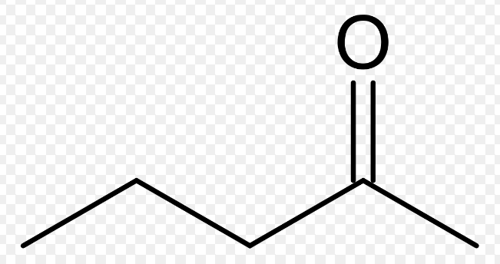
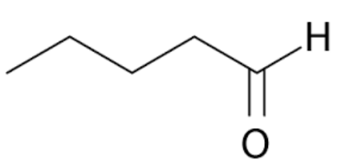
The skeletal formulae of three compounds are shown below:
Predict which compound has the highest boiling point
b
a
c
C
Notes:
Page 77 CGP

Slide 33
The skeletal formulae of three compounds are shown below:
b) Which compound(s) do not form silver precipitates when reacted with Tollens’reagent?
b
a
c
B, C
Notes:
Page 77 CGP

Slide 34
The skeletal formulae of three compounds are shown below:
c) Compound B is heated with potassium dichromate (VI) and dilute sulphuric acid. No colour changes occur. Explain why.
b
a
c
Compound b is ketone and is therefore not oxidised by acidified dichromate (VI) ions and no colour change occurs
Notes:
Page 77 CGP

Slide 35
Carbonyl Compounds
Objective: To know what carbonyl compounds are and how we test for them
Success criteria
Identify aldehyde and ketone functional groups
Explain their reactions with Fehling’s and Benedict’s solutions, Tollen’s reagent and acidified dichromate (VI) ions
Explain how we can use 2,4-DNP as a test for the presence of a carbonyl group and to identify a carbonyl compound using the melting temperature of a derivative
Explain how their physical properties are affected by the intermolecular forces that they form (including solubility in water)

