Slide 1
Physical properties of halogens
Can you complete the table?

Slide 2
Group 7 elements properties
Monday, 04 January 2016

Slide 3
Group 7 (the Halogens) elements properties
understand reasons for the trends in melting and boiling temperatures, physical
state at room temperature, and electronegativity for Group 7 elements
understand reasons for the trend in reactivity of Group 7 elements down the group
understand the trend in reactivity of Group 7 elements in terms of the redox reactions of Cl2, Br2 and I with halide ions in aqueous solution, followed by the addition of an organic solvent
be able to make predictions about fluorine and astatine and their compounds, in terms of knowledge of trends in halogen chemistry
the disproportionation reaction of chlorine with water and the use of chlorine in water treatment
the disproportionation reaction of chlorine with cold, dilute aqueous sodium hydroxide to form bleach
the disproportionation reaction of chlorine with hot alkali
reactions analogous to those specified above

Slide 4
What are the halogens?
The halogens are the elements in Group 7 of the periodic table.
The name halogen comes from the Greek words for salt-making.

Slide 5
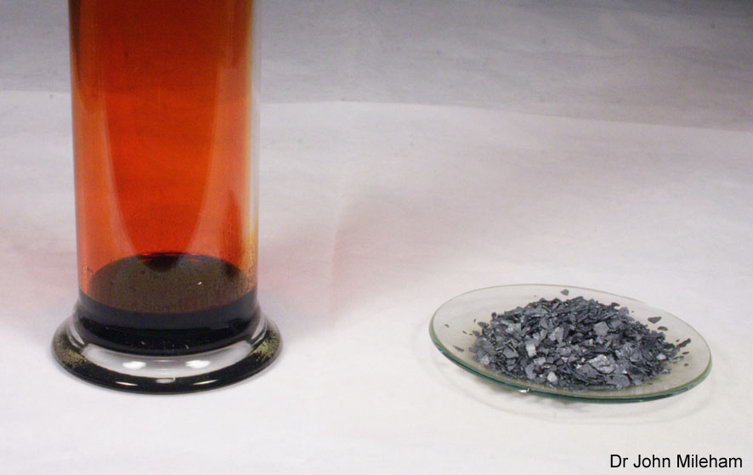
Why are they called the ‘halogens’?
Halogens are very reactive non metals.
They are all toxic or harmful because they are so reactive. Before antiseptics, iodine was used to clean wounds as it is harmful to all things, including bacteria.
They are also never found free in nature because of their reactivity – they are found as compounds with metals.
These halogen-metal compounds are salts, which give halogens their name – ‘halo-gen’ means ‘salt-former’.
Notes:
Photo credit: Dr John Mileham
Liquid bromine in a jar on the left, iodine on the right.

Slide 6
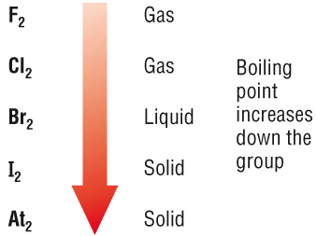
Boiling Points
How do boiling points change as we descend group 7?
Why?

Slide 7
Boiling Points
Why do boiling points increase we descend group 7?
What forces make Bromine a liquid?
What happens to the number of electrons as we descend Group 7?
More electrons means stronger…
…Van der Waals forces.

Slide 8
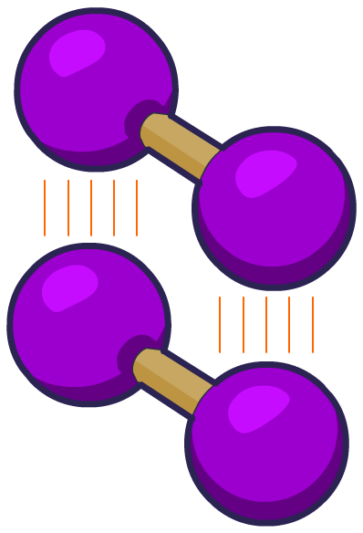
Trends in boiling point
Halogen molecules increase in size down the group. This leads to greater van der Waals forces between molecules, increasing the energy needed to separate the molecules and therefore higher melting and boiling points.
van der Waals forces
fluorine atomic radius = 42 × 10⁻¹² m boiling point = -118 °C
iodine atomic radius = 115 × 10⁻¹² m boiling point = 184 °C
Notes:
Teacher notes
See the ‘Bonding and Intermolecular Forces’ presentation for more information about van der Waals forces.

Slide 9
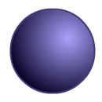
What is the physical state of the halogens?
The melting and boiling points of the halogens increase down the group, as the molecules become bigger.
Halogen
Relative size
Melting point (°C)
Boiling point (°C)
State at room temperature
-220
-118
gas
-101
-34
gas
-7
59
liquid
114
184
solid

Slide 10
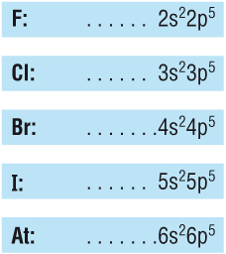
Electron Configuration
What are the electron configurations of the halogens?

Slide 11
Electron Configuration
Each halogen is one electron short of a noble gas configuration.
They are very good at loosing/gaining an electron.
This makes them very strong oxidising/reducing agents.
Reactivity increases/decreases as we descend the group

Slide 12
Reactivity
Why does reactivity increase as we descend group 7?
To react the atom must form an ion (write a half equation)
Cl_{2(g)} + 2e⁻ → 2Cl⁻_{(g)}
So the tendency to gain an electron must be lower as we descend the group.
WHY?

Slide 13
Reactivity
Why does the tendency to gain an electron reduce as we descend the group?
Number of protons increases!!!
BUT this is outweighed by:
Increasing atomic radius
Increasing electron shielding

Slide 14
How does electron structure affect reactivity?
The reactivity of alkali metals decreases going down the group. What is the reason for this?
The atoms of each element get larger going down the group.
F
This means that the outer shell gets further away from the nucleus and is shielded by more electron shells.
Cl
The further the outer shell is from the positive attraction of the nucleus, the harder it is to attract another electron to complete the outer shell.
decrease in reactivity
Br
This is why the reactivity of the halogens decreases going down group 7.

Slide 15
Trends in electronegativity
Electronegativity of the halogens decreases down the group due to an increase in atomic radius.
Increased nuclear charge has no significant effect because there are more electron shells and more shielding. Iodine atoms therefore attract electron density in a covalent bond less strongly than fluorine.
fluorine atomic radius = 42 × 10⁻¹² m electronegativity = 4.0
iodine atomic radius = 115 × 10⁻¹² m electronegativity = 2.5
Notes:
Teacher notes
See the ‘Bonding and Intermolecular Forces’ presentation for more information about electronegativity and its relationship to atomic radius and shielding.

Slide 16
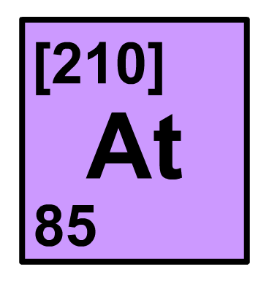
Astatine
The name astatine comes from the Greek word for unstable.
Astatine exists in nature in only very tiny amounts. It is estimated that only 30 grams of astatine exist on Earth at any one time. This is because it is radioactive, and its most stable isotope (²¹⁰At) has a half-life of only 8 hours.
It was first made artificially in 1940, by bombarding ²⁰⁹Bi with α-radiation.
What do you predict for these properties of astatine?
colour
state at room temperature
electronegativity.
Notes:
Teacher notes
The square brackets around the mass number for astatine indicate that this is the atomic mass of the most stable isotope.
Astatine is the rarest naturally-occurring element.
The properties of astatine: black (presumed), solid at room temperature (presumed), Pauling electronegativity of 2.2

Slide 17
Group 7 (the Halogens) elements properties
understand reasons for the trends in melting and boiling temperatures, physical
state at room temperature, and electronegativity for Group 7 elements
understand reasons for the trend in reactivity of Group 7 elements down the group
understand the trend in reactivity of Group 7 elements in terms of the redox reactions of Cl2, Br2 and I with halide ions in aqueous solution, followed by the addition of an organic solvent
be able to make predictions about fluorine and astatine and their compounds, in terms of knowledge of trends in halogen chemistry
the disproportionation reaction of chlorine with water and the use of chlorine in water treatment
the disproportionation reaction of chlorine with cold, dilute aqueous sodium hydroxide to form bleach
the disproportionation reaction of chlorine with hot alkali
reactions analogous to those specified above

Slide 18
Practical
On worksheet
Note some differences to equipment
Hexane (or cyclohexane) must be stoppered in test tubes when not been used.
Answer questions at bottom page
Notes:
Page 129 – 129 advanced level chemistry text book

Slide 19
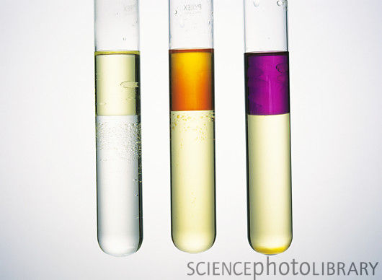
The Halogens: Recognising them
The halogens form solutions with different colours. A colour change will show if a reaction has taken place.
Halogen | Water | cyclohexane
Cl₂ | Pale-green | Pale-green
Br₂ | Orange | Orange
I₂ | Brown | violet
If you shake the reaction mixture with an organic solvent it can help distinguish between halogens that have reacted

Slide 20
Displacement of halogens
If a halogen is added to a solution of a compound containing a less reactive halogen, it will react with the compound and form a new one.
This is called displacement.
+
sodium chloride
sodium fluoride
+
fluorine
➔
chlorine
F₂
+
2NaCl
➔
2NaF
+
Cl₂
A more reactive halogen will always displace a less reactive halide from its compounds in solution.

Slide 21
Halogen displacement reactions
Halogen displacement reactions are redox reactions.
Cl₂ + 2KBr → 2KCl + Br₂
To look at the transfer of electrons in this reaction, the following two half equations can be written:
Cl₂ + 2e⁻ → 2Cl⁻
2Br⁻ → Br₂ + 2e⁻
What has been oxidized and what has been reduced?
Chlorine has gained electrons, so it is reduced to Cl⁻ ions.
Bromide ions have lost electrons, so they have been oxidized to bromine.
Notes:
Teacher notes
See the ‘Redox Reactions’ presentation for more information about redox reactions.

Slide 22
Displacement reactions: summary
The reactions between solutions of halogens and metal halides (salts) can be summarised in a table:
salt
potassium chloride
potassium bromide
potassium iodide
halogen
chlorine
2KCl + Br₂
2KCl + I₂
bromine
no reaction
2KBr + I₂
iodine
no reaction
no reaction

Slide 23
Group 7 (the Halogens) elements properties
understand reasons for the trends in melting and boiling temperatures, physical
state at room temperature, and electronegativity for Group 7 elements
understand reasons for the trend in reactivity of Group 7 elements down the group
understand the trend in reactivity of Group 7 elements in terms of the redox reactions of Cl2, Br2 and I with halide ions in aqueous solution, followed by the addition of an organic solvent
be able to make predictions about fluorine and astatine and their compounds, in terms of knowledge of trends in halogen chemistry
the disproportionation reaction of chlorine with water and the use of chlorine in water treatment
the disproportionation reaction of chlorine with cold, dilute aqueous sodium hydroxide to form bleach
the disproportionation reaction of chlorine with hot alkali
reactions analogous to those specified above

Slide 24
Chlorine in water
Chlorine is slightly soluble in water and will react to form a mixture of two acids:
Chlorine + Water → Chloric (I) acid + Hydrochloric acid
Cl_{2(aq)} + H₂O_{(l)} → HClO_{(aq)} + HCl_{(aq)}
Calculate the oxidation states of Chlorine in each place.
Cl_{2(aq)} 0
HClO_{(aq)} +1 chloric(I) acid (Cl oxidised)
HCl_{(aq)} -1 hydrochloric acid (Cl reduced)
What sort of reaction is this?
Disproportionation
Why?

Slide 25
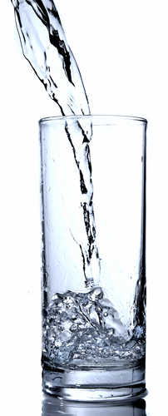
Reaction of chlorine with water
Chlorine is used to purify water supplies because it is toxic to bacteria, some of which can cause disease. Adding it to water supplies is therefore beneficial for the population.
However, chlorine is also toxic to humans, so there are risks associated with gas leaks during the chlorination process. There is also a risk of the formation of chlorinated hydrocarbons, which are also toxic.
Chlorination of drinking water raises questions about individual freedom because it makes it difficult for individuals to opt out.
Notes:
Photo credit: Danvlchenko Iaroslav / Shutterstock.com
Teacher notes
Addition of fluoride to drinking water is also carried out in certain areas and there are debates about extending the practice. The main benefit is reduction of tooth decay. However, fluoride can cause dental fluorosis (flecks of white in the teeth which can turn brown) and critics have linked it to other, more serious, health problems.

Slide 26
Chlorine in Sodium Hydroxide (aq)
This is how household bleach is made:
Cl_{2(aq)} + 2NaOH_{(aq)} → NaCl_{(aq)} + NaClO_{(aq)} + H₂O_{(aq)}
Calculate the oxidation states of Chlorine in each place.
Is this a disproportionation reaction?
Cl_{2(aq)} 0
NaCl_{(aq)} -1 (Cl reduced)
NaClO_{(aq)} +1 (Cl oxidised)
(NaClO = sodium (I) chlorate, common household bleach)

Slide 27
Disproportionation reaction of chlorine with hot alkali
On heating the chlorate (I) ions disproportionate to chlorate (V) and chloride ions:
3ClO⁻ _{(aq)} + 2NaOH_{(aq)} → ClO₃⁻ _{(aq)} + 2Cl⁻ _{(aq)}
+1 +5 -1

Slide 28
Disproportionation reaction of chlorine with hot alkali
What is the overall equation for the reaction of chlorine with hot sodium hydroxide?
3Cl₂ (g) + 6OH⁻ (aq) → ClO₃ (aq) + 5Cl⁻ (aq) + 3H₂O (l)
Bromine and iodine react in a similar way to chlorine with alkalis.

Slide 29
Group 7 (the Halogens) elements properties
understand reasons for the trends in melting and boiling temperatures, physical
state at room temperature, and electronegativity for Group 7 elements
understand reasons for the trend in reactivity of Group 7 elements down the group
understand the trend in reactivity of Group 7 elements in terms of the redox reactions of Cl2, Br2 and I with halide ions in aqueous solution, followed by the addition of an organic solvent
be able to make predictions about fluorine and astatine and their compounds, in terms of knowledge of trends in halogen chemistry
the disproportionation reaction of chlorine with water and the use of chlorine in water treatment
the disproportionation reaction of chlorine with cold, dilute aqueous sodium hydroxide to form bleach
the disproportionation reaction of chlorine with hot alkali
reactions analogous to those specified above

Slide 30
Questions, based on practical

Slide 31
What is the order of ability of halogens to gain an electron?
Cl>Br>I
2. Explain the order in question 1 in terms of atomic radius and nuclear charge.
A chlorine atom has the smallest radius so the outer orbital is closest to the nucleus and the outer electrons are attracted the most. Chlorine also has the least electron shielding. This is all despite chlorine having the smallest nuclear charge. So as you move down the halogen group, the atomic radius increases as does the electron shielding and the halogens become less able to attract and gain an extra electron to form a halide ion.

Slide 32
3. Give the equation for the reaction between chlorine and potassium iodide including state symbols.
Cl₂(aq) + 2KI(aq) → I₂(aq/s) + 2KCl(aq)
4. Now write the ionic equation for the reaction in question 3.
Cl₂ + 2I⁻ → I₂ + 2Cl⁻

Slide 33
5. Predict the reaction between:
chlorine and potassium astatide;
astatine and potassium iodide.
(a) Cl₂ + 2KAt → At₂ + 2KCl
Black solid formed; chlorine is more reactive than astatine.
(b) No reaction as astatine is less reactive than iodine.

Slide 34
Group 7 (the Halogens) elements properties
understand reasons for the trends in melting and boiling temperatures, physical
state at room temperature, and electronegativity for Group 7 elements
understand reasons for the trend in reactivity of Group 7 elements down the group
understand the trend in reactivity of Group 7 elements in terms of the redox reactions of Cl2, Br2 and I with halide ions in aqueous solution, followed by the addition of an organic solvent
be able to make predictions about fluorine and astatine and their compounds, in terms of knowledge of trends in halogen chemistry
the disproportionation reaction of chlorine with water and the use of chlorine in water treatment
the disproportionation reaction of chlorine with cold, dilute aqueous sodium hydroxide to form bleach
the disproportionation reaction of chlorine with hot alkali
reactions analogous to those specified above

