Slide 1
Polyamides
Monday, 11 December 2017

Slide 2
Amides and Polyamides
Objective: To know what amides are and how we can make polyamides
Outcomes:
Recognise amides
Recognise amino acids
Describe how we can make amides
Describe how we make polyamides
Draw the structural formulae of repeat units for the following condensation polymers dicarboylix acids and diamines amino acids

Slide 3
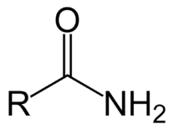
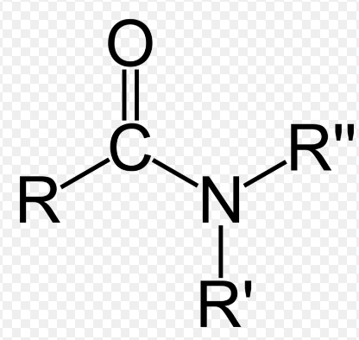
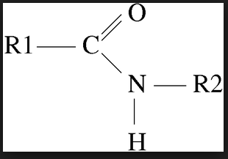
Amides
Amides contain the functional group –CONH₂
The carbonyl group pulls electrons away from the rest of the –CONH₂ group so amides behave differently from amines.
You get primary amides and N-substituted amides depending on how many carbon atoms the nitrogen is bonded to.
Secondary amide, Tertiary amide, both hydrogen
Primary amide one of the hydrogen atoms atoms are replaced by an alkyl is replaced by an alkyl or or aryl group
aryl group

Slide 4
Amides
Amide group consists of a carbonyl group, C = O and an amino group –NH₂ on the same C atom.
In primary amides the amide group is located at carbon atom 1.
E.g.
Notes:
Page 135 edexcel guide

Slide 5
Amides
Secondary
Tertiary
Notes:
Page 135 edexcel guide

Slide 6
Amides
Their names end in –amide and you show the functional group as CONH₂ in structural formula.
E.g.
Methanamide, HCONH₂
Ethanamide, CH₃CONH₂
Propanamide, CH₃CH₂CONH₂

Slide 7
Making amides
Ethanoyl chloride added to conc aqueous solution of the amine
Violent reaction, produces a solid white mixture of the products
H atom on the amine is swapped for the acyl group, RCO, to produce an N-substituted amide and HCl
HCl reacts with another molecule of the amine to produce a salt.
E.g.
Notes:
Cgp 94

Slide 8
Making amides
Acyl chlorides react with primary amines to produce secondary amides and hydrogen chloride.
E.g. ethanoyl chloride reacts with ethanamide to produce N-ethylethanamide
Notes:
Pg 135 edexcel guide

Slide 9
Making amides from ammonia
Acyl chlorides react with conc ammonia to produce a primary amide and hydrogen chloride
E.g.
CH₃COCl + NH₃ → CH₃CONH₂ + HCl
Ethanoyl chloride Ethanamide
This is an addition – elimination reaction
Notes:
Cgp 95

Slide 10
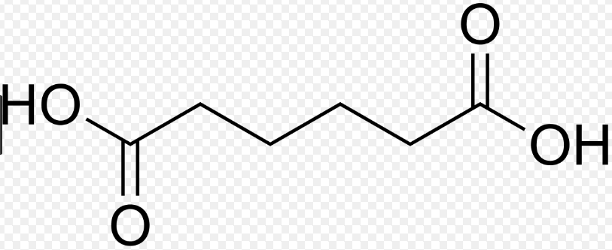
Polyamides
Made from a carboxyl group (-COOH) and an amino (-NH₂) to form amide (-CONH-) links.
A water molecule is lost each time an amide link is formed, it’s a condensation reaction.
A diamine (a compound with two amino groups)
Butane-1,4-diamine
A dicarboxylic acid (a compound with two carboxyl groups) or a dioyl dichrloide (a compound with two acyl chloride groups)
Butane – 1,4- dioic acid

Slide 11
Polyamides
Butane – 1,4- dioic acid Butane-1,4-diamine
Two amino groups
Two carbonyl groups
A carboxyl group on the dicarboxylic acid can react with an amino group on the diamine.
Organic product has a carboxyl group and an amino group. Further reactions can happen, leading to a long polymer molecule.
Notes:
Pg 136 edexcel guide

Slide 12
Remember polyesters are condensation polymers
Notes:
Cgp 96

Slide 13
Finding monomers of a condensation polymer
Notes:
Cgp 97

Slide 14
Finding functional groups of a condensation polymer
Notes:
Cgp 97

Slide 15
Amides and Polyamides
Objective: To know what amides are and how we can make polyamides
Outcomes:
Recognise amides
Recognise amino acids
Describe how we can make amides
Describe how we make polyamides
Draw the structural formulae of repeat units for the following condensation polymers dicarboylix acids and diamines amino acids

Slide 16
Questions
Workbook 135 – 136
Edexcel guide 135 – 136
CGP 95 - 97
Notes:
Cgp 97

Slide 17
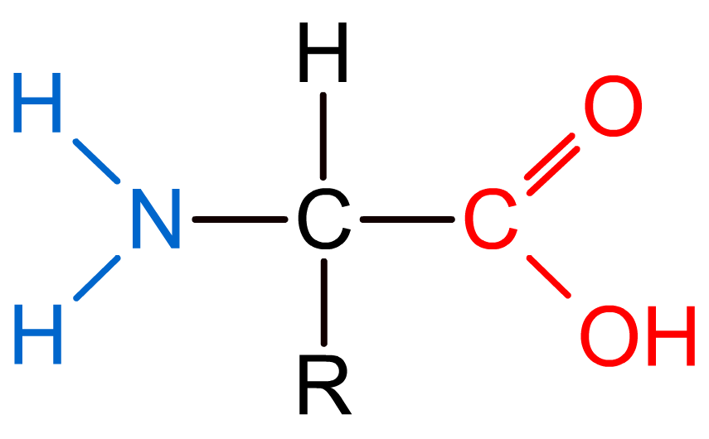
Proteins and amino acids
Proteins are a diverse group of large and complex polymer molecules, made up of long chains of amino acids.
Amino acids contain both amine (NH₂) and carboxyl (COOH) functional groups.
The groups are on different carbon atoms so amino acids retain their properties.
Amine group
Carboxyl group
Amino acids found in proteins are 2-amino acids:
The carboxyl group is located on carbon atom 1
The amino group is located on carbon atom 2
Notes:
Teacher notes
Students should be aware that many more non-proteinogenic amino acids exist.

Slide 18
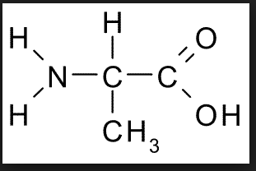
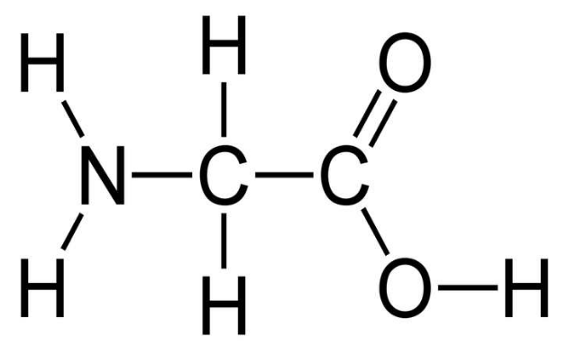
Naming Amino Acids
Amino acids have the common names used by biologists and systematic names.
E.g.
R group = H R group = CH₃
Systematic name: Systematic name: 2-aminopropanoic acid
Aminoethanoic acid Common name: alanine
Common name: glycine

Slide 19
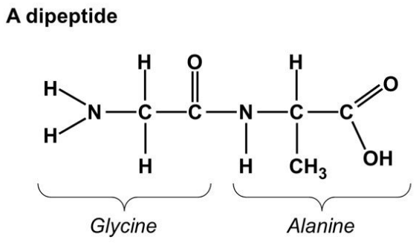
Dipeptides
Two amino acid molecules can react together in condensation reactions between the -OH group in the carboxyl group of one amino acid and one of the H atoms in the amino group of the other amino acid.
A dipeptide and water are formed (condensation reaction)
E.g. glycine and alanine produce form glycine – alanine dipeptide
+ →

Slide 20
Dipeptides
If they react the other way round then alanine – glycine dipeptide forms instead.
+ →
Notes:
Pg 138 Edexcel

Slide 21
Dipeptides
The peptide bond is written as CONH in structural formulae
Is identical to the amide link/bond
Can form at either end of the molecule
+ →
Peptide bond

Slide 22
Polyamides
Dipeptides have an amino group at one end and a carboxyl group at the other, like amino acids.
This means that amino acids can continue to join either end, forming condensation polymers.
The amino acid units are called residues:
Polypeptides are polymers with fewer than about 20 amino acid residues
Proteins are polymers with more amino acid residues (could be thousands)
Peptide bond

Slide 23
Polyamides
You can draw repeat units for simple polypeptides made from one type of amino acid.
E.g. monomer is 2 – aminopropanoic acid (alanine)
Notes:
Pg 138 Edexcel

Slide 24
Questions
138 edexcel guide
136 – 137 workbook
97 Cgp
Notes:
Pg 138 Edexcel

Slide 25
Amides and Polyamides
Objective: To know what amides are and how we can make polyamides
Outcomes:
Recognise amides
Recognise amino acids
Describe how we can make amides
Describe how we make polyamides
Draw the structural formulae of repeat units for the following condensation polymers dicarboylix acids and diamines amino acids

