Slide 1
Group 7 Reactions and Compounds
Tuesday, 05 January 2016

Slide 2
Reactions of the halogens and halogen compounds
Objectives:
understand, in terms of changes in oxidation number, the following reactions of the halogens: oxidation reactions with Group 1 and 2 metals
Understand the following reactions:
solid Group 1 halides with concentrated sulfuric acid, to illustrate the trend in reducing ability of the hydrogen halides
precipitation reactions of the aqueous anions Cl–, Br– and I– with aqueous silver nitrate solution, followed by aqueous ammonia solution
hydrogen halides with ammonia and with water (to produce acids)

Slide 3
Practical
Notes:
Experiment 57 page 134 advanced chemistry practical book

Slide 4
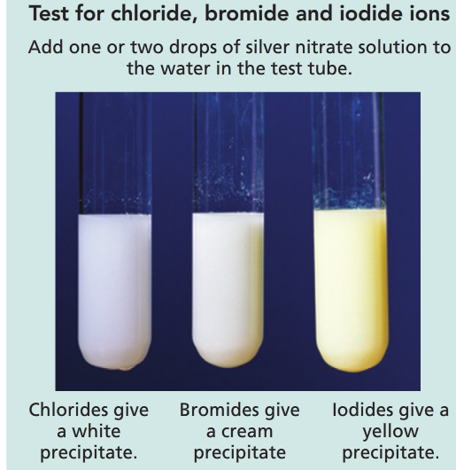
Testing for halide ions
A further test involves adding aqueous ammonia, NH₃ (aq).
AgCl is soluble in dilute NH₃ (aq)
AgBr is soluble in concentrated NH₃ (aq)
AgI is insoluble in concentrated NH₃(aq)

Slide 5
Theory
First fluorine videos

Slide 6
Testing for halide ions
A further test involves adding aqueous ammonia, NH₃ (aq).
AgCl is soluble in dilute NH₃ (aq)
AgBr is soluble in concentrated NH₃ (aq)
AgI is insoluble in concentrated NH₃(aq)
Silver fluoride is soluble so gives no precipitate
Silver chloride precipitate quickly turns purple grey in sunlight

Slide 7
Equations

Slide 8
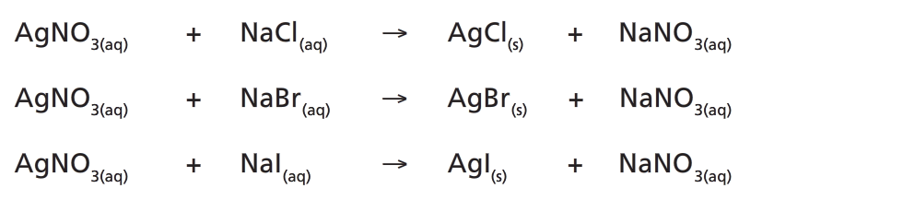
Equations
Ionic equation:
Ag⁺ (aq) + Cl- (aq) → AgCl (s)

Slide 9
Displacement of halogens
If a halogen is added to a solution of a compound containing a less reactive halogen, it will react with the compound and form a new one.
This is called displacement.
+
sodium chloride
sodium fluoride
+
fluorine
➔
chlorine
F₂
+
2NaCl
➔
2NaF
+
Cl₂
A more reactive halogen will always displace a less reactive halide from its compounds in solution.

Slide 10
Displacement reactions: summary
The reactions between solutions of halogens and metal halides (salts) can be summarised in a table:
salt
potassium chloride
potassium bromide
potassium iodide
halogen
chlorine
2KCl + Br₂
2KCl + I₂
bromine
no reaction
2KBr + I₂
iodine
no reaction
no reaction

Slide 11
Halogen displacement reactions
Halogen displacement reactions are redox reactions.
Cl₂ + 2KBr → 2KCl + Br₂
To look at the transfer of electrons in this reaction, the following two half equations can be written:
Cl₂ + 2e⁻ → 2Cl⁻
2Br⁻ → Br₂ + 2e⁻
Chlorine has gained electrons, so it is reduced to Cl⁻ ions.
Bromide ions have lost electrons, so they have been oxidised to bromine.
What is the oxidising agent?
Notes:
Teacher notes
See the ‘Redox Reactions’ presentation for more information about redox reactions.

Slide 12
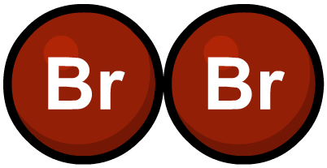
Oxidising ability of halogens
In displacement reactions between halogens and halides, the halogen acts as an oxidising agent.
fluorine
This means that the halogen:
oxidises the halide ion to the halogen
gains electrons
chlorine
is reduced to form the halide ion.
increasing oxidszing ability
What is the order of oxidising ability of the halogens?
bromine
iodine
Notes:
Teacher notes
Students could be encouraged to see the relative oxidizing ability of the halogens as their ability to accept electrons, relating it to the size, nuclear charge and shielding. Also they could connect this trend to the electronegativity values and with the electron structures of the ions.

Slide 13
Reactions of the halogens and halogen compounds
Objectives:
understand, in terms of changes in oxidation number, the following reactions of the halogens: oxidation reactions with Group 1 and 2 metals
Understand the following reactions:
solid Group 1 halides with concentrated sulfuric acid, to illustrate the trend in reducing ability of the hydrogen halides
precipitation reactions of the aqueous anions Cl–, Br– and I– with aqueous silver nitrate solution, followed by aqueous ammonia solution
hydrogen halides with ammonia and with water (to produce acids)

Slide 14
Reaction with group 1 and 2 metals
Chlorine and bromine react with s block metals to form ionic halides.
Iodine also reacts but because of the polarisability of the large iodide ion if it’s reacting with a small or highly charged cation it is essentially covalent.

Slide 15
When group 2 metals react with chlorine, they form the metal chloride. For example:
Ca_{(s)} + Cl_{2(g)} → CaCl_{2(s)}
oxidation states
0
0
+2
-1
The oxidation state of calcium has increased from 0 in its elemental form to +2 when it is in calcium chloride. This means the calcium has been oxidized.
The oxidation state of chlorine has decreased from 0 in its elemental form to -1 when it is in calcium chloride. This means the chlorine has been reduced.
Notes:
Teacher notes
See the ‘Redox Reactions’ presentation for more information about oxidation and reduction.

Slide 16
What about group 1?

Slide 17
Reactions of the halogens and halogen compounds
Objectives:
understand, in terms of changes in oxidation number, the following reactions of the halogens: oxidation reactions with Group 1 and 2 metals
Understand the following reactions:
solid Group 1 halides with concentrated sulfuric acid, to illustrate the trend in reducing ability of the hydrogen halides
precipitation reactions of the aqueous anions Cl–, Br– and I– with aqueous silver nitrate solution, followed by aqueous ammonia solution
hydrogen halides with ammonia and with water (to produce acids)

Slide 18
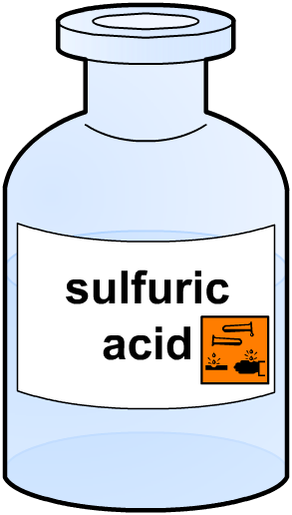
Solid group 1 halides and sulfuric acid
The sodium halides (and other group 1 halides) react with concentrated sulfuric acid.
During this reaction two things can happen to the sulfuric acid. It can
be reduced
act as an acid.
The reactions of solid group 1 halides with concentrated sulfuric acid demonstrate the relative strengths of the halide ions as reducing agents.
Notes:
Teacher notes
Here the simplest definition of ‘acid’ to use is the Bronsted–Lowry definition of an acid as a proton (H⁺) donor.

Slide 19
Summary
Fluoride and chloride ions won't reduce concentrated sulphuric acid.
Bromide ions reduce the sulphuric acid to sulphur dioxide. In the process, the bromide ions are oxidised to bromine.
Iodide ions reduce the sulphuric acid to a mixture of products including hydrogen sulphide. The iodide ions are oxidised to iodine.
Reducing ability of the halide ions increases as you go down the Group.

Slide 20
Examples
Notes:
Page 72 revision guide

Slide 21
Halides as reducing agents
A substance that donates electrons in a reaction (i.e. is oxidised) is a reducing agent because it reduces the other reactant.
fluoride
The larger the halide ion, the easier it is for it to donate electrons and therefore the more reactive it is.
Why?
What is the order of reducing ability?
chloride
increasing reducing ability
bromide
This is because its outermost electrons are further from the attraction of the nucleus and more shielded from it by other electrons. The attraction for the outermost electrons is therefore weaker.
iodide
Notes:
Teacher notes
See the ‘Trends in Period 3’ presentation for more information about shielding.

Slide 22
Reactions of the halogens and halogen compounds
Objectives:
understand, in terms of changes in oxidation number, the following reactions of the halogens: oxidation reactions with Group 1 and 2 metals
Understand the following reactions:
solid Group 1 halides with concentrated sulfuric acid, to illustrate the trend in reducing ability of the hydrogen halides
precipitation reactions of the aqueous anions Cl–, Br– and I– with aqueous silver nitrate solution, followed by aqueous ammonia solution
hydrogen halides with ammonia and with water (to produce acids)

Slide 23
Hydrogen Halides
Compounds of hydrogen with the halogens
All colourless, molecular compounds
Have general formula HX (where X is a halogen)
Contain polar bonds

Slide 24
Hydrogen Halides Reactions With Water
Hydrogen chloride, hydrogen bromide and hydrogen iodide are similar in that they are:
Colourless gases at room temp and fume in moist air
Very soluble in water, forming acidic solutions which ionise completely in water
Strong acids, so they ionise completely in water

Slide 25
Hydrogen Halides Reactions With Water
The reaction of hydrogen chloride with water
Hydrogen chloride is a strong acid which is fully ionised in aqueous solution
HCl + H₂O → Cl⁻ (aq) + H₃O⁺ (aq)
H⁺ is transferred oxonium ion
Hydrobromide acid and hydroiodic acid are formed in the same way

Slide 26
Hydrogen Halides Reactions With Ammonia
All hydrogen halides produce a white smoke when reacting with ammonia
The white smoke is an ammonium salt
Ammonia molecules turn into ammonium ions (NH₄⁺)
Ammonia is acting as a base by accepting hydrogen ions from the hydrogen halides
NH₃ (g) + HCl (g) → NH₄Cl (s)

Slide 27
Reactions of the halogens and halogen compounds
Objectives:
understand, in terms of changes in oxidation number, the following reactions of the halogens: oxidation reactions with Group 1 and 2 metals
Understand the following reactions:
solid Group 1 halides with concentrated sulfuric acid, to illustrate the trend in reducing ability of the hydrogen halides
precipitation reactions of the aqueous anions Cl–, Br– and I– with aqueous silver nitrate solution, followed by aqueous ammonia solution
hydrogen halides with ammonia and with water (to produce acids)

Slide 28
Be able to make predictions about fluorine and astaine and their compounds, in terms of knowledge of trends in halogen chemistry
Questions
The halogen below iodine in Group 7 is astaine (At). Predict, giving an explanation , whether or not:
Hydrogen sulfide gas would be evolved when concentrated sulfuric acid is added to a solid sample of sodium astaide (4 marks)
Silver astaide will dissolve in concentrated ammonia solution (3 marks)
Notes:
Page 73 cgp revision guide

Slide 29
Questions
The halogen below iodine in Group 7 is astaine (At). Predict, giving an explanation , whether or not:
Hydrogen sulfide gas would be evolved when concentrated sulfuric acid is added to a solid sample of sodium astaide (4 marks)
NaI (via HI) reduces H2SO4 to H2S (1 mark). The reducing power of halide ions increases down the group (1 mark) and At is below I in the group (1 mark), so H2S will be produced (1 mark)
Notes:
Page 73 cgp revision guide

Slide 30
Questions
The halogen below iodine in Group 7 is astaine (At). Predict, giving an explanation , whether or not:
b) Silver astaide will dissolve in concentrated ammonia solution (3 marks)
AgI is insoluble in concetrated ammonia solution (1 mark).
The solubility of the halides in ammonia solution decreases down the group (1 mark), so AgAt will not dissolve (1 mark)
Notes:
Page 73 cgp revision guide

Slide 31
Reactions of the halogens and halogen compounds
Objectives:
understand, in terms of changes in oxidation number, the following reactions of the halogens: oxidation reactions with Group 1 and 2 metals
Understand the following reactions:
solid Group 1 halides with concentrated sulfuric acid, to illustrate the trend in reducing ability of the hydrogen halides
precipitation reactions of the aqueous anions Cl–, Br– and I– with aqueous silver nitrate solution, followed by aqueous ammonia solution
hydrogen halides with ammonia and with water (to produce acids)

