Slide 1
Testing for carbonyl compounds

Slide 2
Carbonyl videos
Demo test with potassium dichromate
Page 359 Nuffield

Slide 3
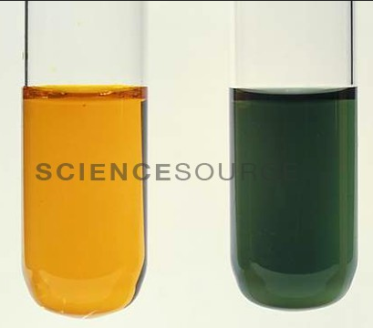
Oxidation of aldehydes using Cr₂O₇²⁻/H⁺ to form carboxylic acids
Potassium dichromate is reduced in its reactions with aldehydes and changes from orange to green

Slide 4
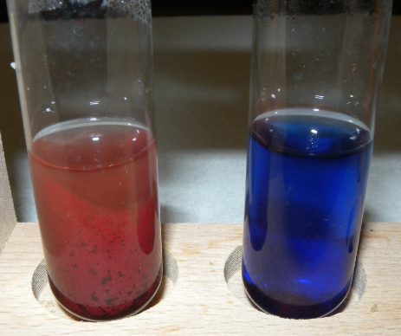
Distinguishing between aldehydes and ketones
Benedict’s solution is a blue solution of complexed copper (II) ions dissolved in sodium carbonate.
When heated with an aldehyde the blue copper (II) ions are reduced to a brick – red precipitate of copper (I) oxide.
If heated with a ketone nothing happens as ketones cannot be easily oxidised.
Benedict's solution
Positive test with an aldehyde

Slide 5
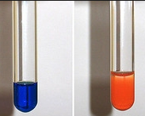
Distinguishing between aldehydes and ketones
Fehling’s solution can also be used.
This contains copper (II) ions dissolved in sodium hydroxide.
The colour change is the same for an aldehyde (blue to red).
Again there is no reaction with a ketone.
Positive test with an aldehyde
Fehling's solution

Slide 6
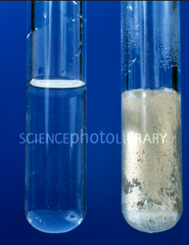
Testing with Tollen’s the silver mirror test
Tollen’s reagent is a colourless solution of silver nitrate dissolved in aqueous ammonia.
Heat your sample with Tollen’s.
Ketone’s produce no reaction
Aldehydes produce “silver mirror”
Safety
Many organic compounds are flammable, do not heat them directly over a flame.
Use a water bath or heating mantle.

Slide 7
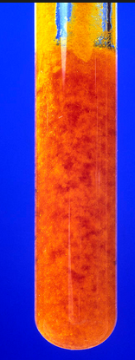
Testing for aldehydes and ketones using 2,4-DNP
Orange/yellow precipitate is formed when added to an aldehyde or a ketone

Slide 8
Practical
Complete the practical “Investigation of the reactions of aldehydes and ketones”
Page 359, practical 15.1
Practical 2 has been demoed to you
For practical 4 using Brady’s reagent add the Brady’s reagent to both samples
You must wear nitrile gloves when using Brady’s reagent
Also carry out the Tollen’s test on both samples. Follow the given method to make Tollen’s reagent.

Slide 9
Tollens’ Test
Prepare some Tollens’ reagent by placing 2 cm³ of silver nitrate solution into a test tube.
Add two drops of sodium hydroxide solution to the silver nitrate solution. Dissolve the precipitate formed by adding ammonia solution drop-wise until the precipitate just dissolves.
Add Tollens’ reagent to your samples
Place the test tubes into a beaker of boiled water. Leave until no further changes occur – this may take as long as five minutes. Record your observations.

Slide 10
Testing with Tollen’s the silver mirror test
Ketone’s produce no reaction
Aldehydes produce “silver mirror”
Testing for aldehydes and ketones using 2,4-DNP
Orange/yellow precipitate is formed when added to an aldehyde or a ketone

Slide 11
Positive test with an aldehyde
Fehling's solution
Benedict's solution
Positive test with an aldehyde

