Slide 1
Carboxylic Acids
Tuesday, 31 October 2017

Slide 2
Carboxylic Acids
Lesson objective: To know about carboxylic acids
Success criteria:
Identify the carboxylic acid functional group
Explain the physical properties of carboxylic acids, in relation to their boiling temperatures and solubility
Explain how carboxylic acids can be prepared
Explain the reactions of carboxylic acids with: - lithium tetrahydridoaluminate (lithium aluminium hydride) in dry ether -bases to produce salts

Slide 3
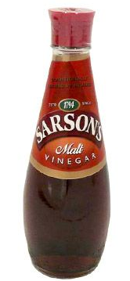
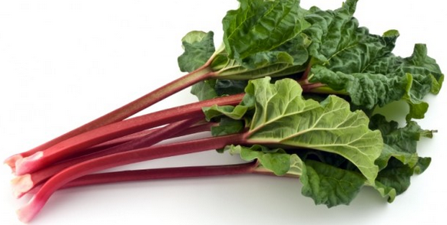
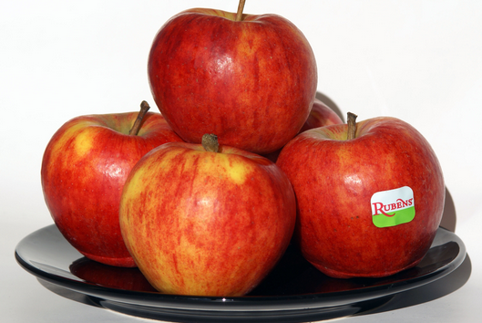
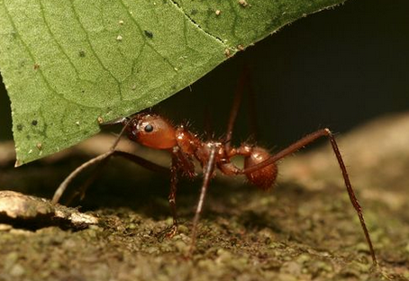

Slide 4
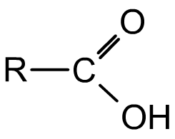
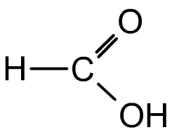
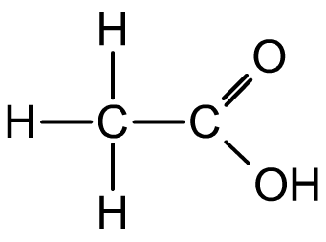
Carboxylic acids
Carboxylic acids have a carboxyl group (-COOH) consisting of a carbonyl group and a hydroxyl group attached to the terminal carbonyl carbon.
Carboxylic acids are named using the suffix –oic acid.
Methanoic acid is the simplest carboxylic acid and is found in bee and ant stings.
Ethanoic acid is the acid that gives vinegar its sharp taste and smell. It is also important in the chemical industry and about 6.5 million tonnes are used worldwide each year

Slide 5
Naming Carboxylic Acids
Methanoic acid, HCOOH
Ethanoic acid, CH₃COOH
Propanoic acid, CH₃CH₂COOH

Slide 6
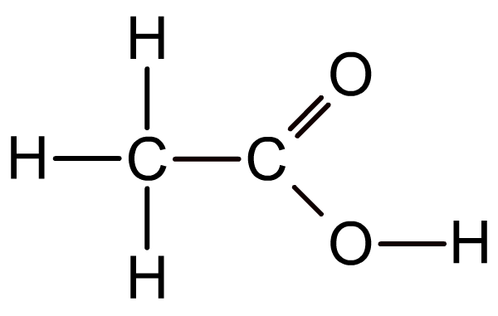
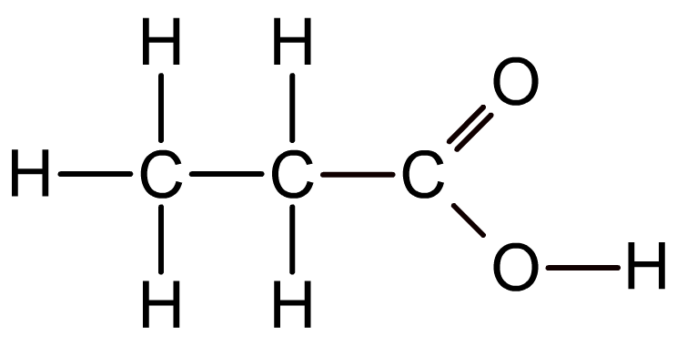
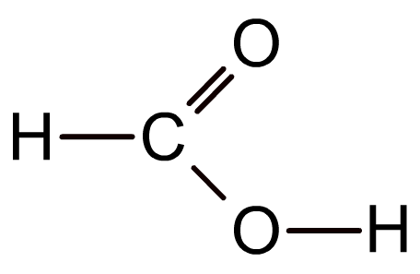
Carboxylic Acids
Carboxylic acids contain -COOH
methanoic acid (HCOOH)
ethanoic acid (CH₃COOH)
propanoic acid (CH₃CH₂COOH)

Slide 7
Naming carboxylic acids

Slide 8
Carboxylic Acids
Lesson objective: To know about carboxylic acids
Success criteria:
Identify the carboxylic acid functional group
Explain the physical properties of carboxylic acids, in relation to their boiling temperatures and solubility
Explain how carboxylic acids can be prepared
Explain the reactions of carboxylic acids with: - lithium tetrahydridoaluminate (lithium aluminium hydride) in dry ether -bases to produce salts

Slide 9
Making Carboxylic Acids
You can oxidise primary alcohols and aldehydes
If you oxidise a primary alcohol you will first oxidise it to an aldehyde, this will then be further oxidised to a carboxylic acid
Often acidified potassium dichromate is used (K₂Cr₂O₇/H₂SO₄)
E.g. CH₃CH₂CH₂OH + 2[O] → CH₃CH₂COOH + H₂O
Propan – 1 – ol
CH₃CH₂CHO + [O] → CH₃CH₂COOH
Propanal

Slide 10
Making Carboxylic Acids
You make them by hydrolysing a nitrile
You reflux the nitrile with dilute hydrochloric acid
You then distil off the carboxylic acid
E.g.
CH₃CH₂CN + H⁺ + 2H₂O → CH₃CH₂COOH + NH₄⁺

Slide 11
Carboxylic Acids
Lesson objective: To know about carboxylic acids
Success criteria:
Identify the carboxylic acid functional group
Explain the physical properties of carboxylic acids, in relation to their boiling temperatures and solubility
Explain how carboxylic acids can be prepared
Explain the reactions of carboxylic acids with: - lithium tetrahydridoaluminate (lithium aluminium hydride) in dry ether -bases to produce salts

Slide 12
Physical Properties
What intermolecular forces are there between carboxylic acid molecules?
δ-
δ+
δ-
δ+

Slide 13
Physical Properties
The intermolecular forces between carboxylic acids include:
London forces
Permanent dipole – dipole forces (due to their polar C = O, C – O and O – H bonds
Hydrogen bonds (unlike carbonyl compounds)
How do you think these affect their physical properties?

Slide 14
Physical Properties
Carboxylic acids with fewer than about 10 carbon atoms are liquids at room temperature.
Their boiling temperatures increase as their molar masses increase and the London forces increase.

Slide 15
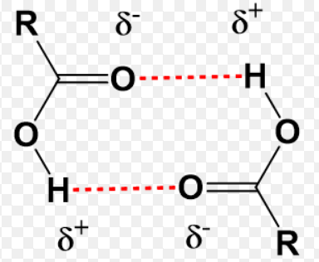
Physical Properties
In pure, liquid carboxylic acids, dimers can also form. This is when a molecule hydrogen bonds with just one other molecule. This increases the size of the molecule, increasing the intermolecular forces and so their boiling point.

Slide 16
Solubility in water
In the presence of water, the carboxylic acids don't dimerise. Instead, hydrogen bonds are formed between water molecules and individual molecules of acid.
The carboxylic acids with up to four carbon atoms will mix with water in any proportion. When you mix the two together, the energy released when the new hydrogen bonds form is much the same as is needed to break the hydrogen bonds in the pure liquids.
The solubility of the bigger acids decreases very rapidly with size. This is because the longer hydrocarbon "tails" of the molecules get between water molecules and break hydrogen bonds. In this case, these broken hydrogen bonds are only replaced by much weaker van der Waals dispersion forces.

Slide 17
Solubility in water
Very small carboxylic acids are soluble in water.
The highly polar C = O and O – H bonds allow carboxylic acid molecules to form hydrogen bonds with water molecules.
As the number of carbon atoms in the carbon acids increases, the solubility decreases.
This is the result of the longer non – polar hydrocarbon chain in the molecule, which does not interact with water molecules.

Slide 18
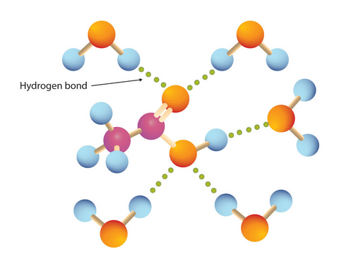
Solubility of carboxylic acids
Carboxylic acids with between one and four carbon atoms are very soluble in water.
The highly polar C = O and O – H bonds allow carboxylic acid molecules to form hydrogen bonds with water molecules.

Slide 19
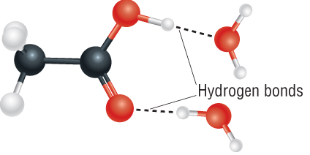
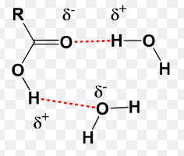
Solubility of carboxylic acids

Slide 20
Carboxylic Acids
Lesson objective: To know about carboxylic acids
Success criteria:
Identify the carboxylic acid functional group
Explain the physical properties of carboxylic acids, in relation to their boiling temperatures and solubility
Explain how carboxylic acids can be prepared
Explain the reactions of carboxylic acids with: - lithium tetrahydridoaluminate (lithium aluminium hydride) in dry ether -bases to produce salts

Slide 21
Reacting with bases
Carboxylic acids are neutralised by aqueous bases (alkalis) to form salts and water
CH₃COOH + NaOH → CH₃COONa + H₂O
Ethanoic acid Sodium ethanoate
With carbonates and hydrogencarbonates carbon dioxide is also made
Salts of carboxylix acids are called carboxylates.
Their names end in -oate

Slide 22
Reacting with bases
Carboxylic acids are neutralised by aqueous bases (alkalis) to form salts and water
They are weak acids
CH₃COOH + NaOH → CH₃COONa + H₂O
Ethanoic acid Sodium ethanoate
With carbonates and hydrogencarbonates carbon dioxide is also made
Salts of carboxylix acids are called carboxylates.
Their names end in -oate

Slide 23
Reaction with lithium tetrahydridoaluminate
It is hard to reduce a carboxylic acid, you need a powerful reducing agent.
E.g. LiAlH₄ in dry ether (lithium tetrahydridoaluminate, lithium aluminium hydride)
It reduces the carboxylic acid right down to an alcohol.
You can’t get the reduction to stop at the aldehyde.
E.g.
CH₃CH₂COOH + 4[H] → CH₃CH₂CH₂OH + H₂O
Propan-1-ol

Slide 24
Reaction with lithium tetrahydridoaluminate
It is hard to reduce a carboxylic acid, you need a powerful reducing agent.
E.g. LiAlH₄ in dry ether (lithium tetrahydridoaluminate, lithium aluminium hydride)
It reduces the carboxylic acid right down to an alcohol.
You can’t get the reduction to stop at the aldehyde.
E.g.
CH₃CH₂COOH + 4[H] → CH₃CH₂CH₂OH + H₂O
Propanoic acid Propan-1-ol

Slide 25
Reaction with lithium tetrahydridoaluminate
It is hard to reduce a carboxylic acid, you need a powerful reducing agent.
E.g. LiAlH₄ in dry ether (lithium tetrahydridoaluminate, lithium aluminium hydride)
It reduces the carboxylic acid right down to an alcohol.
You can’t get the reduction to stop at the aldehyde.
E.g.
CH₃CH₂COOH + 4[H] → CH₃CH₂CH₂OH + H₂O
Propanoic acid Propan-1-ol

Slide 26
Carboxylic Acids
Lesson objective: To know about carboxylic acids
Success criteria:
Identify the carboxylic acid functional group
Explain the physical properties of carboxylic acids, in relation to their boiling temperatures and solubility
Explain how carboxylic acids can be prepared
Explain the reactions of carboxylic acids with: - lithium tetrahydridoaluminate (lithium aluminium hydride) in dry ether -bases to produce salts

Slide 27
Carboxylic Acids Questions
Butane molecules and ethanoic acid molecules have a similar number of electrons but butane is a gas at room temperature and ethanoic acid is a liquid.
Why is this?
Because ethanoic acid has hydrogen bonding but butane does not

Slide 28
Carboxylic Acids Questions
Carboxylic acids can be prepared by the oxidation of alcohols or aldehydes.
A suitable oxidising agent is acidified potassium dichromate (VI).
Name a suitable dilute acid to acidify the potassium dichromate (VI) solution
Sulfuric acid

Slide 29
Carboxylic Acids Questions
Carboxylic acids can be prepared by the oxidation of alcohols or aldehydes.
Name the aldehyde that could be oxidised to produce ethanoic acid.
Ethanal

Slide 30
Carboxylic Acids Questions
Carboxylic acids can be prepared by the oxidation of alcohols or aldehydes.
Write an equation to represent the production of ethanoic acid from ethanol.
CH₃CH₂OH + 2[O] → CH₃COOH + H₂O

Slide 31
Carboxylic Acids Questions
Carboxylic acids can also be produced by the hydrolysis of nitriles in the presence of dilute hydrochloric acid.
Write an equation to represent the production of ethanoic acid from ethanenitrile, CH₃CN.
CH₃CN + H⁺ + 2H₂O → CH₃COOH + NH₄⁺
Or
CH₃CN + HCl + 2H₂O → CH₃COOH + NH₄Cl

Slide 32
Carboxylic Acids Questions
Carboxylic acids can also be produced by the hydrolysis of nitriles in the presence of dilute hydrochloric acid.
Give the reaction condition necessary for this preparation.
Reflux

Slide 33
Carboxylic Acids Questions
Write an equation for the reaction between propanoic acid and calcium carbonate and the name the salt produced.
2CH₃CH₂COOH + CaCO₃ → (CH₃CH₂COO)₂Ca + H₂O + CO₂
Calcium propanoate

Slide 34
Carboxylic Acids
Lesson objective: To know about carboxylic acids
Success criteria:
Identify the carboxylic acid functional group
Explain the physical properties of carboxylic acids, in relation to their boiling temperatures and solubility
Explain how carboxylic acids can be prepared
Explain the reactions of carboxylic acids with: - lithium tetrahydridoaluminate (lithium aluminium hydride) in dry ether -bases to produce salts -phosphorus(V) chloride (phosphorus pentachloride)

