Slide 1
Phenols
What is phenol?

Slide 2
Phenols
Objective: To know what phenol is
Success criteria:
Recognise phenol compounds
Recall the reaction of phenol with bromine water
Compare the reactions of phenols to that of bromine
Explain the difference in reactivity between phenols and benzene

Slide 3
Identifying Phenols
A phenol is an organic compound containing a benzene ring with a hydroxyl (-OH) group attached to it.
The oxygen must be directly bonded to a carbon in the ring.
If not, the compound is known as an aromatic alcohol instead.
Number the carbon atoms from the one with –OH on
Examples of Phenols
Phenol
4 - methylphenol

Slide 4
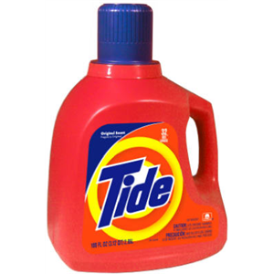
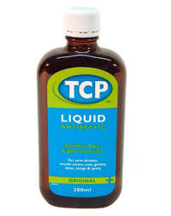
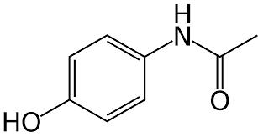
Uses of Phenols
Alkyl phenols are used in detergents
Chlorophenols are used as antiseptics.
Salicylic acid is important in the synthesis of analgesics.

Slide 5
Properties of Phenols
Phenol is solid under standard conditions.
It is slightly water soluble due to hydrogen bonding between OH groups.
The large, non-polar benzene ring decreases its solubility.

Slide 6
Properties of Phenols
Phenol is weakly acidic when aqueous.
It dissociates to form H⁺ ions:
C₆H₅OH ⇌ C₆H₅O⁻ + H⁺

Slide 7
Properties of Phenols
It reacts just like other weak acids:
With metals, e.g. sodium to product a salt:
2 C₆H₅OH + 2 Na ⇌ 2 C₆H₅O⁻⁺Na + H₂
(aq)
(s)
(aq)
(g)
Sodium phenoxide

Slide 8
Reaction of phenol and sodium

Slide 9
Properties of Phenols
It reacts just like other weak acids:
With alkalis, e.g. potassium hydroxide to product a salt + water.
Neutralisation.
C₆H₅OH + K⁺⁻OH ⇌ C₆H₅O⁻⁺K + H₂O
(aq)
(aq)
(aq)
(l)

Slide 10
Reactions of Phenol
Phenol reacts with halogens similarly to benzene -> Electrophilic substitution
However, phenol will react with molecular halogens at room temperature -> no catalyst required:
White precipitate
The –OH group makes the ring very attractive to electrophiles, so substitution happens more than once.

Slide 11
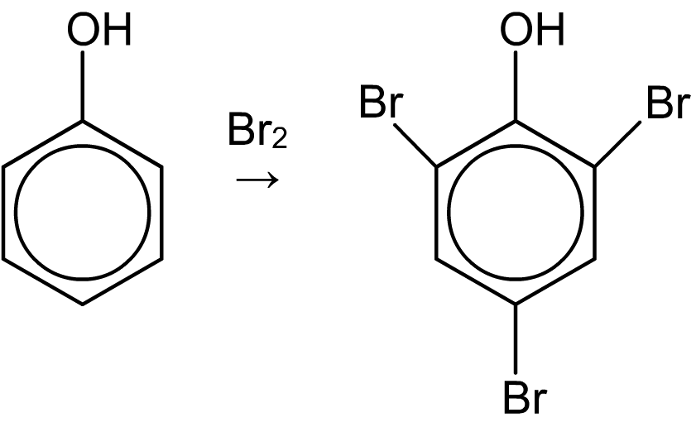
Reaction of phenol with bromine
Unlike benzene, phenol reacts instantly with bromine in the absence of a catalyst, and at room temperature, to form a precipitate of 2,4,6-tribromophenol.
3
The increased reactivity of phenol is due to the fact that, in solution, the lone pair of electrons from the oxygen atom are drawn into the delocalized ring, increasing its overall electron density.
Notes:
Teacher notes
For the mechanism of this reaction see notes to slide 33, ‘Reaction with bromine’. Due to the increased electron density of its delocalized ring structure, phenol is able to induce a dipole in non-polar molecules such as bromine, and therefore react in the same way as the alkenes.
A similar compound is 2,4,6-trichlorophenol – the household antiseptic TCP.
In 1870, Joseph Lister introduced the first effective antiseptic into hospitals, using a compound based on phenol.

Slide 12
Phenol’s Reactivity
The lone pairs on the –OH group are in p orbitals.
This overlaps with Benzene’s delocalised π system.
This increases the electron density of the benzene ring.
This allows the ring to induce a dipole across halogens.
The positive end of the halogen induced dipole acts as an electrophile.

Slide 13
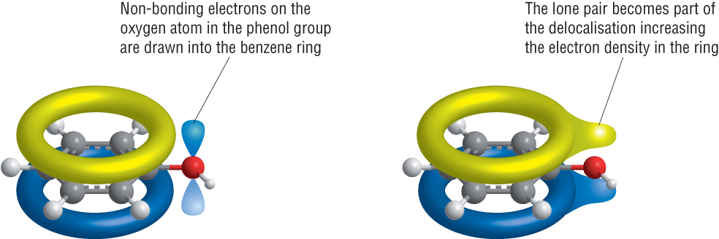
Phenol’s Reactivity
The lone pairs on the –OH group are in p orbitals.
This overlaps with Benzene’s delocalised π system.
This increases the electron density of the benzene ring.

Slide 14
Phenol’s Reactivity
This allows the ring to induce a dipole across halogens.
The positive end of the halogen induced dipole acts as an electrophile.

Slide 15
Phenol Questions
Explain why phenol can be brominated at room temperature without a catalyst. (3 marks)
Phenol has a hydroxyl group. (1 mark)
One of the lone pairs of electrons on the oxygen atom in this group delocalises with the electrons in the delocalised pi bond. (1 mark)
This increases the electron density of the ring, activating it and making it more susceptible to electrophilic attack. (1 mark)

Slide 16
Phenol Questions
Bromine water can be used to distinguish between benzene and phenol. Describe what you would observe in each case and name any products formed (2 marks)
Explain why phenol reacts differently from benzene (2 marks)
Name the type of reaction that occurs between phenol and bromine (1 mark)
With benzene there will be no reaction but with phenol a reaction will occur which decolourises the brown bromine water and forms a precipitate (1mark). The product from the reaction with phenol is 2,4,-6 tribromophenol (1 mark)
Electrons from one of oxygen’s p – orbitals overlap with the benzene ring’s delocalised system, increasing its electron density (1 mark). This makes the ring more likely to be attacked by electrophiles (1 mark)
Electrophilic substitution (1 mark)

Slide 17
Good exam practise Qs
Complete the exam questions “Reactions of benzene”

Slide 18
Phenols
Objective: To know what phenol is
Success criteria:
Recognise phenol compounds
Recall the reaction of phenol with bromine water
Compare the reactions of phenols to that of bromine
Explain the difference in reactivity between phenols and benzene

