Slide 1
Starter
Last lesson review:
How do we calculate the mole?
Q.
1.) How many moles are there in 20g of Carbon?
2.) What is the relative atomic mass of 0.5 mol of an element, with a mass of 10g?
1.67mol
20g

Slide 2
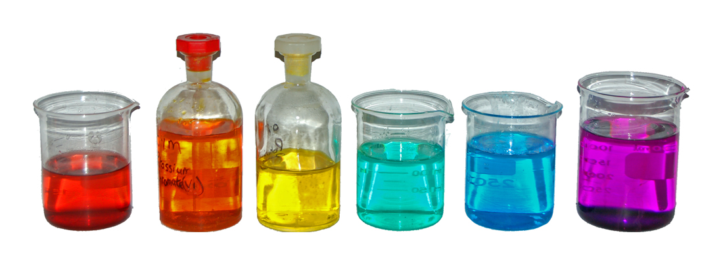
Moles and solutions
What units do we use to measure concentration of solutions?

Slide 3
Moles and solutions
Objective: to know how we can calculate concentration
Outcomes:
carry out calculations, using amount of substance in mol, involving solution volume and concentration
deduce stoichiometric relationships from calculations
use the terms concentrated and dilute as qualitative descriptions for the concentration of a solution.

Slide 4
How can we measure moles of a dissolved substance?
In chemistry we are very often reacting dissolved substances.
In a solution there is the solute and the solvent.
Usually we are interested in how much solute we have.
The amount of solute that there is in a certain volume of solvent is called the …?
Concentration!

Slide 5
The concentration of a solution is how many moles are dissolved per dm³ (1 litre) of solution.
The units are mol dm⁻³

Slide 6
Concentrations
Concentrations are measured in: moles per decimetre cubed - mol.dm⁻³
A chemist dissolves 0.25 moles of NaCl (14.625g) in one litre of water.
What is the concentration?
0.25 mol.dm⁻³
How much NaCl would have to be dissolved in 250ml of water to get the same concentration?

Slide 7
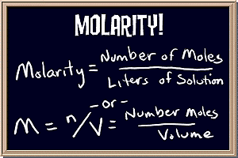
Molarities
Concentrations are traditionally expressed in molarities.
A solution that is 1 mol.dm⁻³ is described as being 1 molar (1M)
A solution that is 0.25 mol.dm⁻³ is described as being:
0.25M
This is the terminology that you usually see on the side of bottles of chemicals.

Slide 8
Main activity
Calculating Concentration
n = cv
n = amount of substance in mol (number of moles)
c = concentration in mol dm⁻³ (or M)
v = volume in dm³

Slide 9
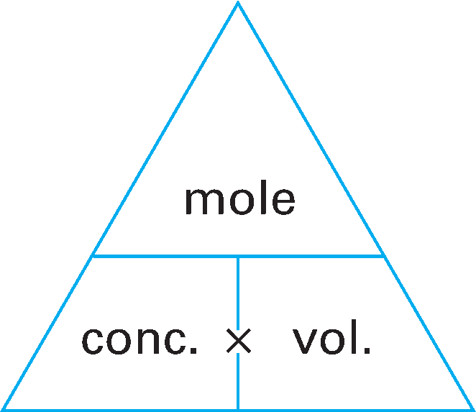
n
or
c x v
Notes:
One way to remember how to work out concentration is to think “concentration is moles over voles”. This “magic triangle” can help you see how the equation can be rearranged.
Section 2.15

Slide 10
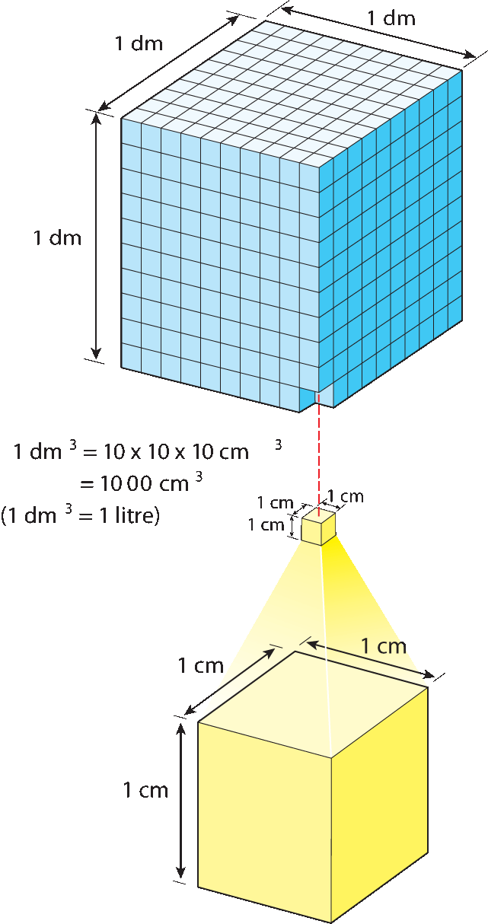
There are 1000cm³ in 1dm³.
Notes:
There are 1000cm³ in 1dm³.
Section 2.15

Slide 11
For our calculations, dm³ must always be used
÷1000
cm³
dm³
x1000

Slide 12
Calculating concentration
Find out how many moles of solute you have.
Find out how many dm⁻³ of solution you have.
Perform the simple calculation:

Slide 13
Calculating concentration
Find out how many moles of solute you have. Moles = Mass M_{r}
Find out how many dm³ of solution you have. Volume in dm³ = volume in cm³ 1000

Slide 14
Calculating concentration
Perform the simple calculation: concentration(mol.dm-3) = moles . volume (dm³)

Slide 15
Mass concentration
The concentration of a solution can also be measured by how many grams of a substance are dissolved per dm³ of the solution.
Mass concentration is expressed as the mass of solute in 1dm⁻³ of solution:
concentration(g.dm⁻³) = mass(g) . volume (dm³)

Slide 16
Moles and solutions
Objective: to know how we can calculate concentration
Outcomes:
carry out calculations, using amount of substance in mol, involving solution volume and concentration
deduce stoichiometric relationships from calculations
use the terms concentrated and dilute as qualitative descriptions for the concentration of a solution.

Slide 17
Questions
1) Calculate the concentration of these solutions:
a) 1.0mol of solute in 2.0dm³ of solution.
b) 2.0mol of solute in 250cm³ of solution.
c) 2.0g of Sodium Hydroxide (NaOH) in 25cm³ of solution.
2) How many moles of solute are dissolved in:
a) 0.5dm³ of a 2.5mol dm⁻³ solution?
b) 250cm³ of a 0.05M solution?
3) What mass of anhydrous sodium carbonate, Na₂CO_{3,} is needed to make 250cm³ of a 0.10M solution?

Slide 18
Answers
1.
0.5 mol dm⁻³
8 mol dm⁻³
2 mol dm⁻³
2.
1.25 mol
0.0125 mol
3. Number of moles Na₂CO₃ is 0.25 x 0.1 = 0.025
number of moles = mass ÷ M_{r}
0.025 = mass ÷ ((23x2)+12+(16x3))
mass = 0.025 x 106
= 2.65g

Slide 19
Standard solutions
A standard solution has a known concentration
If you need to make up a standard solution you will need to weigh out a substance.
To do this you need to: -consider the volume of solution required -work out the amount, in mol, of a solute needed - and convert this amount of solute in a mass, in g, so that you know how much to weigh out

Slide 20
Making a standard solution
Activity A6.01 :Making a standard solution of sodium carbonate

Slide 21
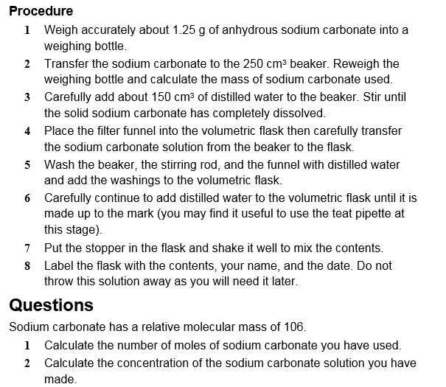

Slide 22
Practice questions
Starters for 10
Page 55 edexcel revision guide
OCR text book page 17
Q3 mass concentration

Slide 23
Moles and solutions
Objective: to know how we can calculate concentration
Outcomes:
carry out calculations, using amount of substance in mol, involving solution volume and concentration
deduce stoichiometric relationships from calculations
use the terms concentrated and dilute as qualitative descriptions for the concentration of a solution.

