Slide 1
Esters
Sunday, 19 November 2017

Slide 2
Esters
Lesson Objective: To know how esters are made from carboxylic acids and alcohols and about the hydrolysis of esters
Success criteria
Recognise esters (E)
Name esters (D)
Describe how esters are made from carboxylic acids and alcohols (C)
Explain the hydrolysis reactions of esters in acidic and alkaline solutions (A)

Slide 3
Esters
Esters can be made by a condensation reaction between an alcohol and a carboxylic acid.
H
H
H
OH
H - C - C
H- O - C - C –H
O
H
H
H
Ethanoic acid
Ethanol
Ester produced
The functional group is COO
H
H
H
H - C - C
O - C - C –H
+ H₂O
H
O
H
H
Ethyl ethanoate

Slide 4
The easiest way to draw an ester is to draw the acid and alcohol from which it is made with their functional groups facing each other.
The OH is then removed from the acid and the H (of the OH) from the alcohol to form water.
H
H
H
OH
H- O - C - C –H
H - C - C
O
H
H
H
This is a condensation reaction because two molecules react to produce a large molecule an a small molecule (in this case water)

Slide 5
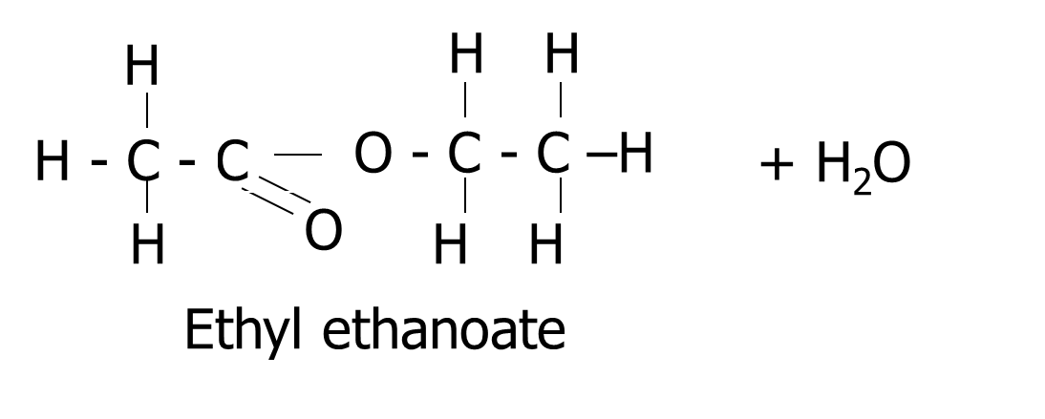
H
H
H
OH
H- O - C - C –H
H - C - C
O
H
H
H
The C of the acid has only 3 bonds and the O of the alcohol has only 1 bond. So they join.
H
H
H
H - C - C
O - C - C –H
+ H₂O
O
H
H
H
Ester produced

Slide 6
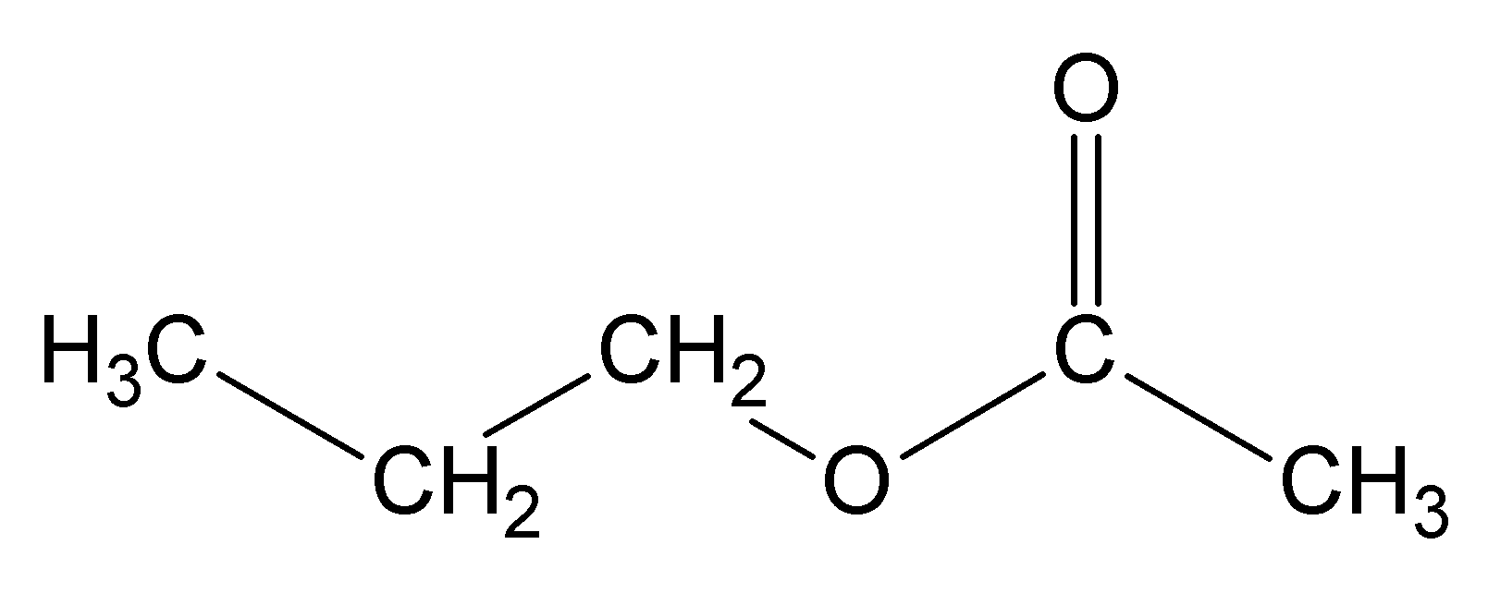
Naming Esters
First part from the alcohol
Second part from the acid
From the alcohol (propanol)
From the acid (Ethanoic Acid)
Propyl Ethanoate

Slide 7
Esters
H
H
H
OH
H - C - C
H- O - C - C –H
O
H
H
H
Ethanoic acid
Ethanol
Ester produced
H
H
H
H - C - C
O - C - C –H
+ H₂O
H
O
H
H
Ethyl ethanoate
The alkyl group coming from the alcohol goes first.
The second part of the name comes from the acid, the ending is changed from oic to oate

Slide 8
Esters are named by joining the name of the alcohol with the name of the acid.
Ethanol + ethanoic acid
Ethyl ethanoate
CH₃COOCH₂CH₃
The part coming from the alcohol is on the right of COO
The functional group is written as COO
Propanol + ethanoic acid
Propyl ethanoate
Butanol + ethanoic acid
Butyl ethanoate
Ethanol + propanoic acid
Ethyl propanoate
Ethanol + benzoic acid
Ethyl benzoate

Slide 9
Naming Esters
If either carbon chain is branched you need to name the attached groups too.
For an ester you number the carbons starting from the C atoms in the C-O-C bond
E.g.
Notes:
Page 82 CGP

Slide 10
Naming Esters
Example with benzene ring
Notes:
Page 82 CGP

Slide 11
When naming an ester from a structure, look for the C = O of the acid.
H
O
Also look for the bond which will break
H - C – O - C - H
H
H
O
H - C – O - C - H
H
This bit of the ester came from the alcohol
This bit of the ester came from the acid
H
O
methanoic acid
methanol
H – C - O - H
H – O - C - H
H
The original ester is methyl methanoate

Slide 12
Esters
Lesson Objective: To know how esters are made from carboxylic acids and alcohols and about the hydrolysis of esters
Success criteria
Recognise esters (E)
Name esters (D)
Describe how esters are made from carboxylic acids and alcohols (C)
Explain the hydrolysis reactions of esters in acidic and alkaline solutions (A)

Slide 13
Making Esters
Heat a carboxylic acid with an alcohol in the presence of an acid catalyst (e.g. conc H₂SO₄ or HCl.
This is called esterification
E.g. to make ethyl ethanoate you reflux ethanoic acid with ethanol and conc H₂SO₄ acid catalyst.

Slide 14
Making Esters
The reaction is slow even with a catalyst.
It is also reversible so the product is constantly separated as it’s formed, e.g. using distillation the product is removed at the appropriate temperature
The product is mixed with sodium carbonate solution to react with any carboxylic acid that might have got mixed in
The ester forms a layer on top of the aqueous layer and can be separated using a separating funnel.
Esters smell fruity and are often used as solvents

Slide 15
Esters
Lesson Objective: To know how esters are made from carboxylic acids and alcohols and about the hydrolysis of esters
Success criteria
Recognise esters (E)
Name esters (D)
Describe how esters are made from carboxylic acids and alcohols (C)
Explain the hydrolysis reactions of esters in acidic and alkaline solutions (A)

Slide 16
Hydrolysis of an ester. Breaking it in to the acid and alcohol that made it by breaking the ester link and adding on the elements of water.
Ester link
O
O – C
This is where the ester breaks
The C = O bond came form the acid and the O came from the alcohol

Slide 17
Ester link
O
O – C
This is where the ester breaks
O
O
H
C
HO
The OH of water adds on to the acid
The H of water adds on to the alcohol.

Slide 18
Acid hydrolysis of esters
Reflux the ester with a dilute acid, e.g. hydrochloric or sulphuric
It is the reverse of esterification, you split the ester up in to the alcohol and carboxylic acid that made it
It is reversible reaction
E.g.
A lot of water is used to push the equilibrium to the right

Slide 19
Base hydrolysis of esters
Reflux the ester with a dilute alkali e.g. sodium hydroxide
You get a carboxylate ion and an alcohol
This reaction is irreversible.
E.g.
In general
Sodium ethanoate can be converted to ethanoic acid by heating it with excess dilute hydrochloric acid (or sulfuric) e.g.
Notes:
Pg 83 CGP and pg 126 pearson

Slide 20
Esters
Lesson Objective: To know how esters are made from carboxylic acids and alcohols and about the hydrolysis of esters
Success criteria
Recognise esters (E)
Name esters (D)
Describe how esters are made from carboxylic acids and alcohols (C)
Explain the hydrolysis reactions of esters in acidic and alkaline solutions (A)

Slide 21
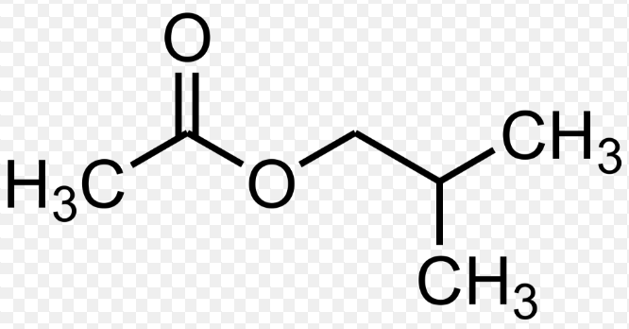
Questions
The compound below is found in raspberries.
Name the compound.
2 – methylpropyl ethanoate

Slide 22
Questions
Draw and name the structures of the products formed when the compound is refluxed with dilute sulphuric acid.
b) What kind of reaction is this?

Slide 23
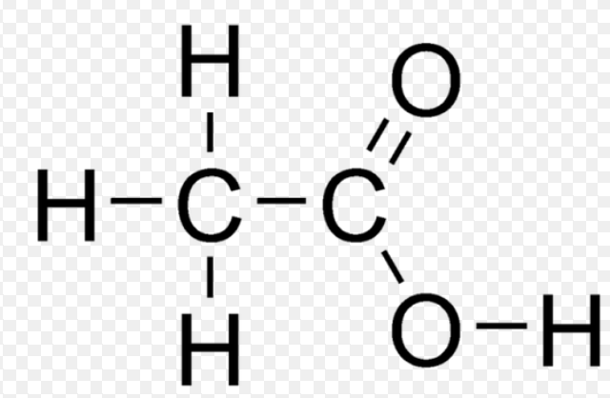
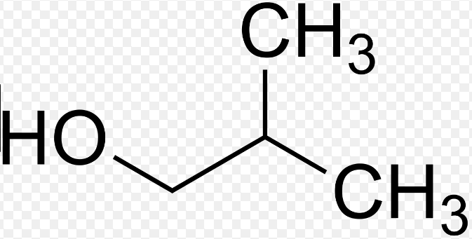
Questions
Draw and name the structures of the products formed when the compound is refluxed with dilute sulphuric acid.
Ethanoic acid
2-methylpropan-1-ol
b) Acid hydrolysis reaction

Slide 24
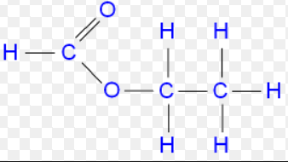
Questions
1- methylethyl methanoate is an ester.
Draw the structure of this ester.

Slide 25
Questions
1- methylethyl methanoate is an ester.
a) Write an equation to show the formation of this ester from a suitable acid and an alcohol.
HCOOH + CH₃CH(CH₃)OH ←→ HCOOCH(CH₃) + H₂O
b) Name the type of reaction that is taking place to form this ester.
Esterification reaction
H⁺

Slide 26
Questions
Describe how you could hydrolyse the ester methyl ethanoate in acidic conditions.
Include an equation.
Add some dilute hydrochloric acid or dilute sulphuric acid, then heat under reflux conditions.
CH₃COOCH₃ + H₂O ← → CH₃COOH + CH₃OH

Slide 27
Questions
Write an equation to show the hydrolysis of ethyl propanoate using sodium hydroxide solution
CH₃CH₂COOCH₂CH₃ + NaOH → CH₃CH₂COONa + CH₃CH₂OH

Slide 28
Esters
Lesson Objective: To know how esters are made from carboxylic acids and alcohols and about the hydrolysis of esters
Success criteria
Recognise esters (E)
Name esters (D)
Describe how esters are made from carboxylic acids and alcohols (C)
Explain the hydrolysis reactions of esters in acidic and alkaline solutions (A)

