Slide 1
Titrations

Slide 2
Photocopy revision guide page 63

Slide 3
Titrations
Objective: to know how we carry out titrations
Outcomes:
be able to calculate solution concentrations, in mol dm⁻³ and g dm⁻³, including simple acid-base titrations using a range of acids, alkalis and indicators
The use of both phenolphthalein and methyl orange as indicators will be expected.

Slide 4
Objectives
can carry out an acid-base titration accurately and safely (C)
can identify potential errors and mistakes in the titration procedure (B)
can predict the effect of mistakes on the true value of the titre (A)

Slide 5
Why Titrate?
A titration is a method of analysis that will allow you to determine the precise endpoint of a reaction and therefore the precise quantity of reactant in the titration flask.
A burette is used to deliver the second reactant to the flask and an indicator or pH Meter is used to detect the endpoint of the reaction.

Slide 6
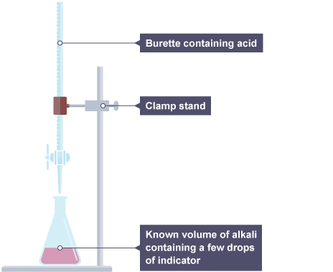
Titration Apparatus

Slide 7
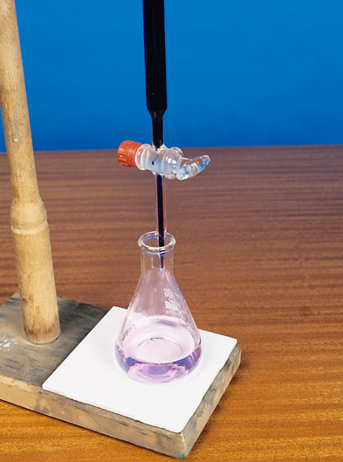
What is a titration?
A titration is a procedure used to identify the concentration of a solution by reacting it with a solution of known concentration and measuring the volume required for a complete reaction.
The number of moles in the standard solution is calculated. Using a balanced equation for the reaction, the number of moles in the solution of unknown concentration can also be calculated.
Once the number of moles for the solution is known, the concentration can be easily calculated.
Notes:
Photo credit: Andrew Lambert Photography / Science Photo Library
Potassium permanganate (purple) being added, from a burette, to a known volume of iron(II) solution, in a flask. This is the end point of the reaction. As the potassium permanganate reacts with the iron it becomes colourless. At the end point there are no more iron ions for the potassium permanganate to react with, and so the last drop retains its colour. The burette is graduated to show volumes, allowing the volume of the potassium permanganate added to the iron to be measured. The volume of potassium permanganate is compared to the known volume of iron, giving information on reaction chemistry and chemical concentrations.
Teacher notes
Titrations can be used to monitor water purity, measure blood composition and for quality control in the food industry.

Slide 8
Indicators
Indicators are chemicals that change colour depending on the pH.
For titrations we use indicators that change colour quickly over a very small pH range.
Methyl orange: yellow to orange when adding acid to alkali
Phenolphthalein: red to colourless when adding acid to alkali

Slide 9
Errors and Mistakes
We’ll come back to errors and uncertainties later in the unit…today we need to concentrate on the mistakes
leaving funnel in top of burette
not getting rid of air bubbles in burette
going past the end point
not reading burette at eye level
Deduce the effect each of these mistakes would have on you final titre

Slide 10
Reliability and Accuracy
How do you know if your results are reliable?
How do you know if your results are accurate?

Slide 11
Titration calculations examples
What is the concentration of an NaOH solution if 25.0 cm³ is neutralized by 23.4 cm³ 0.998 mol dm⁻³ HCl solution?
1. Calculate no. moles HCl:
moles = (conc. × volume) / 1000
= (0.998 × 23.4) / 1000
= 0.0234
2. Determine ratio of NaOH to HCl:
NaOH + HCl → NaCl + H₂O
ratio NaOH:NaCl = 1:1
3. Calculate no. moles of NaOH:
0.0234 moles HCl = 0.0234 moles NaOH
4. Calculate conc. of NaOH:
conc. = (moles × 1000) / volume
= (0.0234 × 1000) / 25.0
= 0.936 mol dm⁻³

Slide 12
Homework
Write ‘An idiot’s guide to titration’
Highlight the key parts of the procedure, include references to how you ensure accuracy and reliability.
Make sure you point out potential mistakes and how to avoid them!

