Slide 1
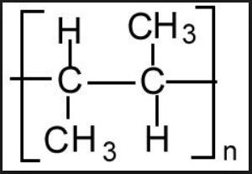
Thinking skills – Try to use key scientific words where possible.
Stage 1: This picture definitely shows me…
Stage 2: I think this picture shows me…
Complete on Post Its and stick on the board!
Stage 4: The questions I need to ask about this picture are…
Stage 3: This picture does not show me…

Slide 2
Polyesters
Sunday, 19 November 2017

Slide 3
Polyesters
Lesson objective: To know how we make polyesters
Success criteria:
Identify the monomer(s) required to form a given section of a polymer and vice versa
Describe condensation polymerisation
Compare addition and condensation polymerisation
Explain how polyesters are formed during condensation polymerisation

Slide 4
Rearrange the words to define ‘Condensation’
which two small
such as water
molecules react
is a reaction in
a larger molecule,
of a small molecule
with the elimination
together to form
Is a reaction in which two small molecules react together to form a larger molecule, with the elimination of a small molecule such as water.

Slide 5
Condensation Polymerisation Definition
The formation of a polymer, usually by the reaction of two different monomers, and in which a small molecule is also formed.

Slide 6
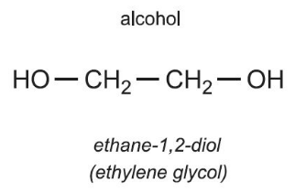
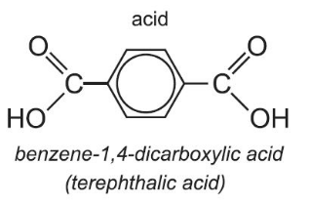
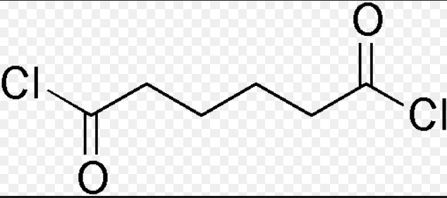
Polyesters
In general polyesters are made from:
A diol (a compound with two hydroxyl groups)
A dicarboxylic acid (a compound with two carboxyl groups) or a dioyl dichloride (a compound with two acyl chloride groups)

Slide 7
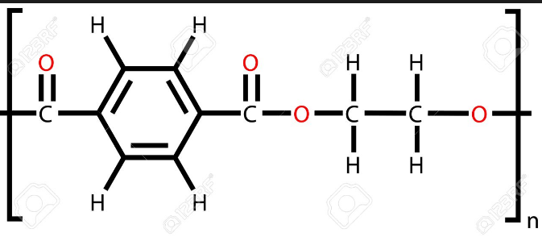
Condensation Polymerisation
Making polyethylene terephthalate, PET a polyester
The diol monomer is: The other monomer is:
Two carboxyl groups
Two hydroxyl groups
PET

Slide 8
Condensation Polymerisation
A hydroxyl group on the diol can react with a carboxyl group on the dicarboxylic acid.
Reaction
Note the ester linkage
Note the water molecule formed
The product has a hydroxyl group and a carboxyl group. Further reactions can happen, leading to a long polymer molecule.
Notes:
Pg 127 Pearsons, pg 83 cgp, 190-191 text book

Slide 9
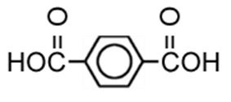
Monomers:
Ethane-1,2-diol
Benzene-1,4-dicarboxylic acid
Repeat unit:
n
Ester linkage

Slide 10
Polyesters
Lesson objective: To know how we make polyesters
Success criteria:
Identify the monomer(s) required to form a given section of a polymer and vice versa
Describe condensation polymerisation
Compare addition and condensation polymerisation
Explain how polyesters are formed during condensation polymerisation

Slide 11
Polymerisation
Compare addition and condensation polymerisation.
What are the similarities and differences?

Slide 12
Addition Polymerisation
Examples such as poly(ethene)
Monomers are unsaturated organic compounds, e.g. alkenes
The polymer formed is the only product
Condensation Polymerisation
Monomers are organic compounds with at least two reactive groups (such as hydroxyl, carboxyl or amine groups)
The polymer is not the only product formed (a smaller product such as H₂O or HCl forms too)

Slide 13
Polyesters
Lesson objective: To know how we make polyesters
Success criteria:
Identify the monomer(s) required to form a given section of a polymer and vice versa
Describe condensation polymerisation
Compare addition and condensation polymerisation
Explain how polyesters are formed during condensation polymerisation

Slide 14
Questions
Notes:
Page 127 pearsons, worked example and look example with dioyl dichloride, Now try this. Pg 127 workbook

Slide 15
Questions
1 – methyl methanoate is an ester.
a) Draw the structure of this ester
Notes:
CGP page 83

Slide 16
Questions
1 – methyl methanoate is an ester.
b) Write an equation to show the formation of this ester from a suitable acid and an alcohol
Notes:
CGP page 83

Slide 17
Questions
1 – methyl methanoate is an ester.
c) Name the type of reaction that is taking place to form this ester.
Notes:
CGP page 83

Slide 18
Polyesters
Lesson objective: To know how we make polyesters
Success criteria:
Identify the monomer(s) required to form a given section of a polymer and vice versa
Describe condensation polymerisation
Compare addition and condensation polymerisation
Explain how polyesters are formed during condensation polymerisation

