Slide 1
Show reflux and distillation equipment

Slide 2
Oxidation of alcohols
Tuesday, 28 March 2017

Slide 3
Oxidation of Alcohols
Objective: To know what happens we oxidise alcohols
Outcomes:
Understand the reactions of alcohols with oxygen in air (combustion)
Understand the reactions of alcohols with potassium dichromate(VI) in dilute sulfuric acid to oxidise primary alcohols to aldehydes (including a test for the aldehyde using Benedict’s/Fehling’s solution) and carboxylic acids, and secondary alcohols to ketones
In equations, the oxidising agent can be represented as [O]
Descriptions of the mechanisms of these reactions are not expected

Slide 4
Alcohols – complete oxidation
Combustion!
We can burn alcohols.
In this reaction C-C bonds are broken, so a lot of energy is given out.
Ethanol can be used for cooking, or added to petrol to make cheaper motor fuel.
  C₂H₅-OH + 3O₂ → 2CO₂ + 3H₂O

Slide 5
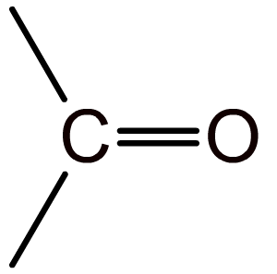
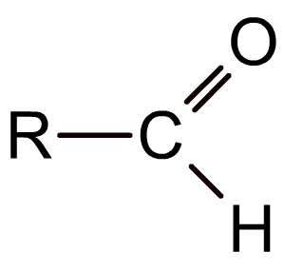
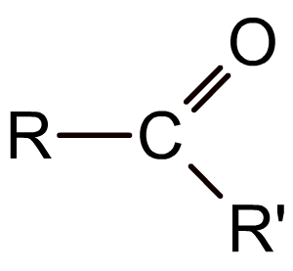
The carbonyl group
The carbonyl group (>C=O) is the functional group found in compounds such as aldehydes, ketones, and carboxylic acids.
In aldehydes the carbonyl group is at the end of the carbon chain and so has at least one hydrogen attached to it.
In ketones the carbonyl group is in the middle of a carbon chain and so has two alkyl groups attached to it.
Notes:
Teacher notes
It could be pointed out to students that the carbonyl group is sometimes orientated differently in different displayed formulae (compare the top diagram with the bottom two) and that they should take care when identifying such structures.

Slide 6
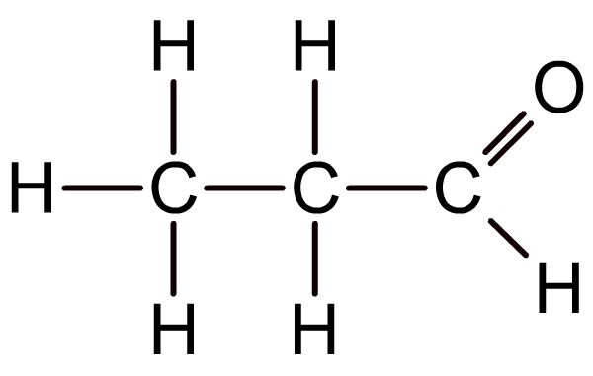
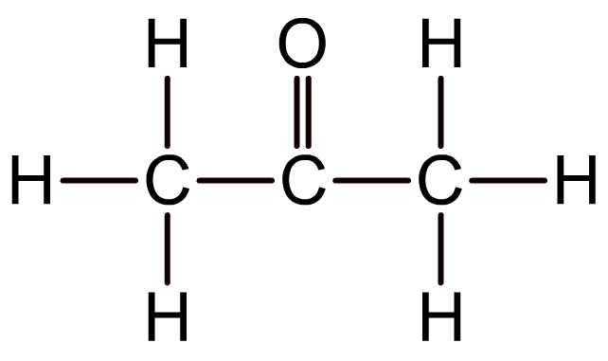
Representing aldehydes and ketones
Aldehydes and ketones cannot be distinguished by their molecular formula because they have the same functional group.
What is the molecular formula of the aldehyde and ketone below?
an aldehyde
a ketone
Both have the molecular formula C₃H₆O

Slide 7
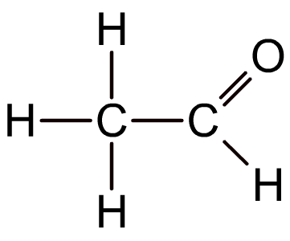
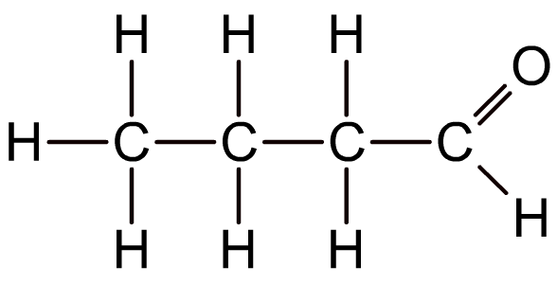
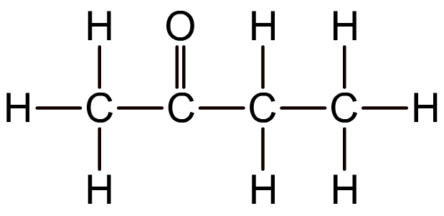
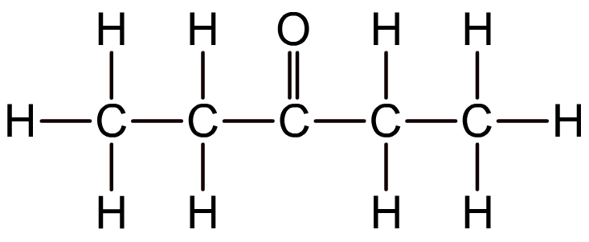
Representing aldehydes and ketones
Aldehydes and ketones are therefore represented either using displayed or structural formulae.
CH₃CHO
CH₃CH₂CH₂CHO
CH₃COCH₂CH₃
CH₃CH₂COCH₂CH₃
Notes:
Teacher notes
See the Boardworks AS Chemistry ‘Introducing Organic Chemistry’ presentation for more information about representing chemical structures.

Slide 8
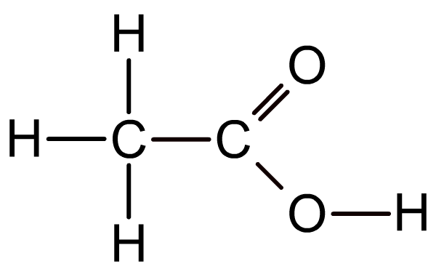
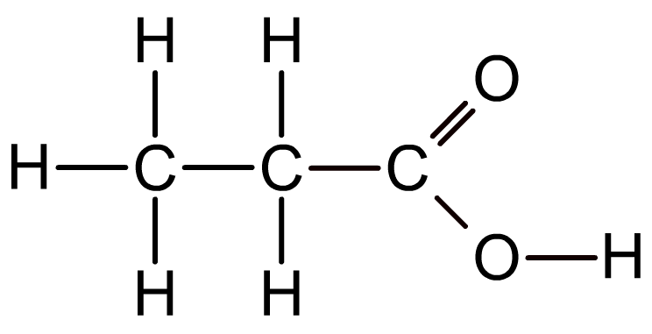
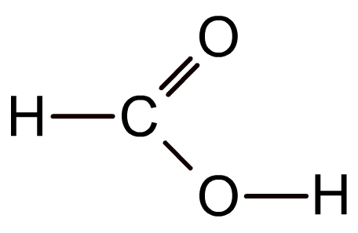

Carboxylic Acids
Carboxylic acids contain -COOH
methanoic acid
(HCOOH)
ethanoic acid
(CH₃COOH)
propanoic acid
(CH₃CH₂COOH)

Slide 9
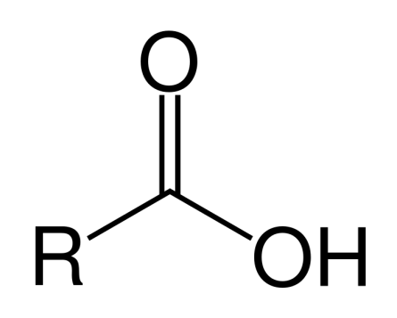
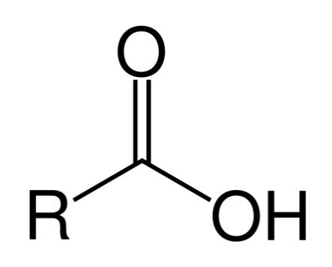
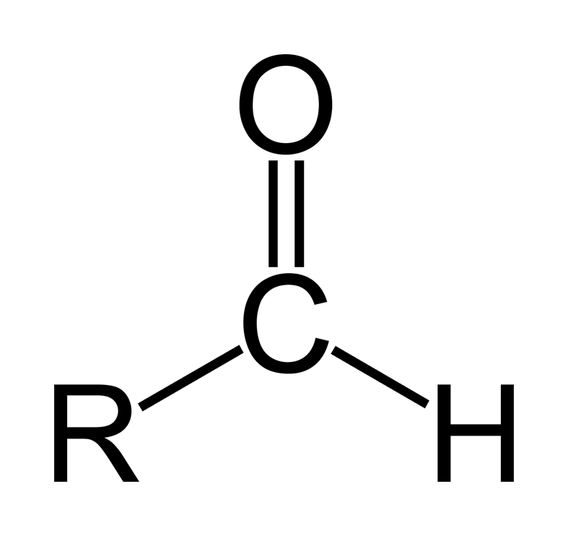
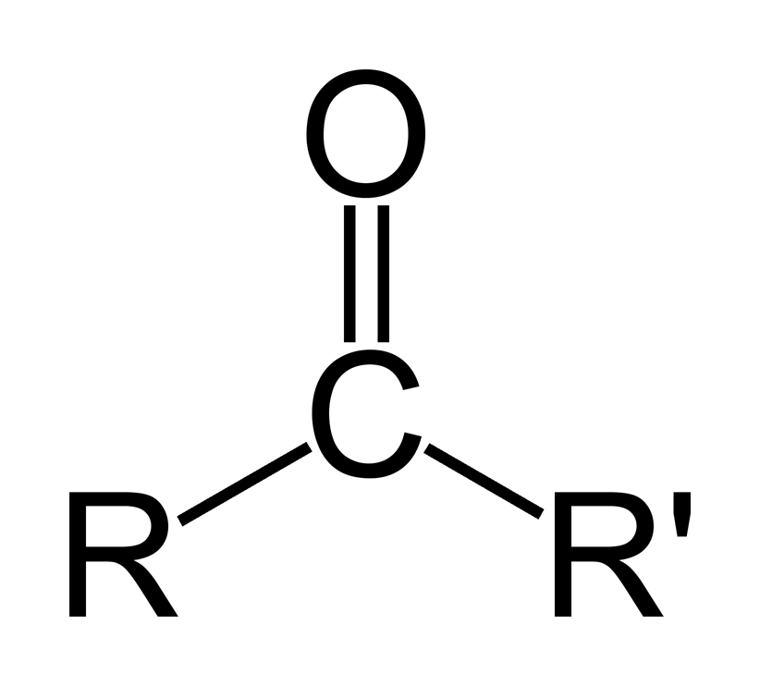
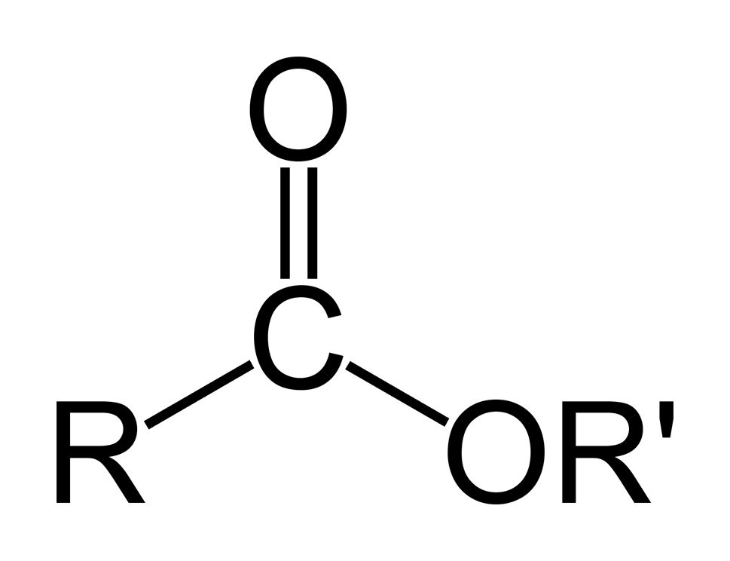
Alcohol | Carboxilic acid
Aldehyde | Ketone | Ester

Slide 10
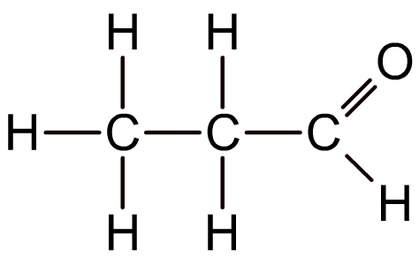
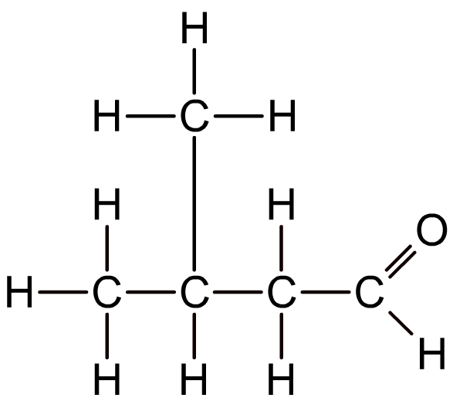
Naming aldehydes
Aldehydes are named using the suffix –al, and follow the same conventions as for naming alkanes.
ethanal
propanal
2-methylbutanal
Notes:
Teacher notes
See the Boardworks AS Chemistry ‘Alkanes’ presentation for more information about naming alkanes, including branched-chain alkanes.

Slide 11
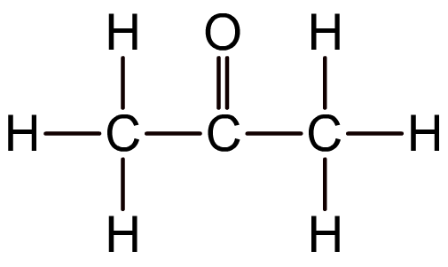
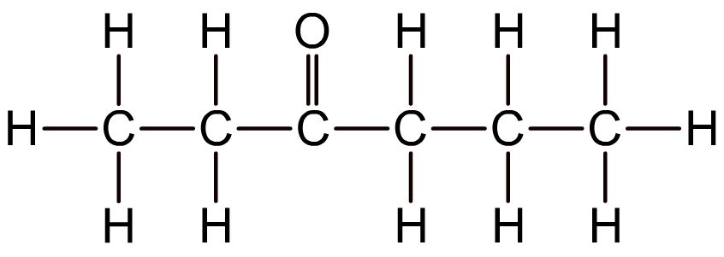
Naming ketones
Ketones are named using the suffix –one.
propanone
hexan-3-one
Like alkenes, ketones with four or more carbon atoms display positional isomerism because the carbonyl group may appear between different carbon atoms. In these cases, a number is used before the –one to indicate the first carbon involved.
Notes:
Teacher notes
See the Boardworks AS Chemistry ‘Alkenes’ presentation for more information about naming alkenes.
Propanone is more commonly known as acetone, which is an important solvent.

Slide 12
Alcohols - oxidation
Oxidation reactions do depend on the type of alcohol we have: primary, secondary or tertiary.
Primary and secondary alcohols can be oxidised with acidified aqueous potassium dichromate(VI).
This reagent will not affect tertiary alcohols. They are resistant to oxidation.

Slide 13
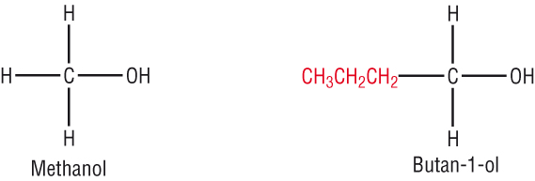
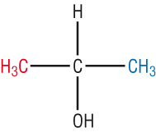
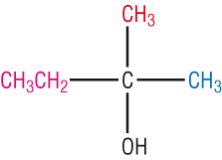
Alcohols - classification
Which is which: (Primary, Secondary, Tertiary)
PRIMARY
C is attached to one
other C atom
SECONDARY
C is attached to two
other C atoms
TERTIARY
C is attached to three
other C atoms

Slide 14
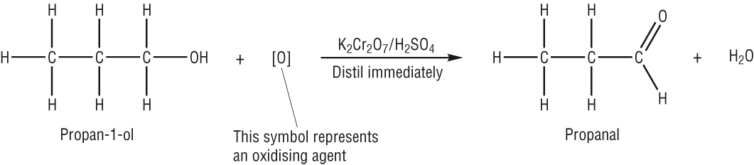
Alcohols – oxidation with potassium dichromate
Primary: an aldehyde is formed.
Propanol produces propanal:
We can separate the aldehyde from the reaction mixture by distillation as it will usually be more volatile than the alcohol.

Slide 15

Oxidation of 1° alcohols: aldehydes
Primary alcohols can be oxidized to aldehydes by an oxidizing agent such as an aqueous solution of acidified potassium dichromate(VI).
When the symbol equation is written, the oxidizing agent is represented by [O]:
RCH₂OH + [O] → RCHO + H₂O
Aldehydes contain a carbonyl group (C=O) at the end of the carbon chain, and are named using the suffix –al.
propanal
Notes:
Teacher notes
Students could be made aware that alcohols are oxidized during combustion, but that this destroys the carbon skeleton. Oxidizing alcohols using potassium dichromate(VI) (which contains the dichromate ion (Cr₂O₇²⁻)) or potassium manganate(VII) (which contains the manganate ion (MnO₄⁻)) leaves the carbon skeleton of the alcohol intact.

Slide 16
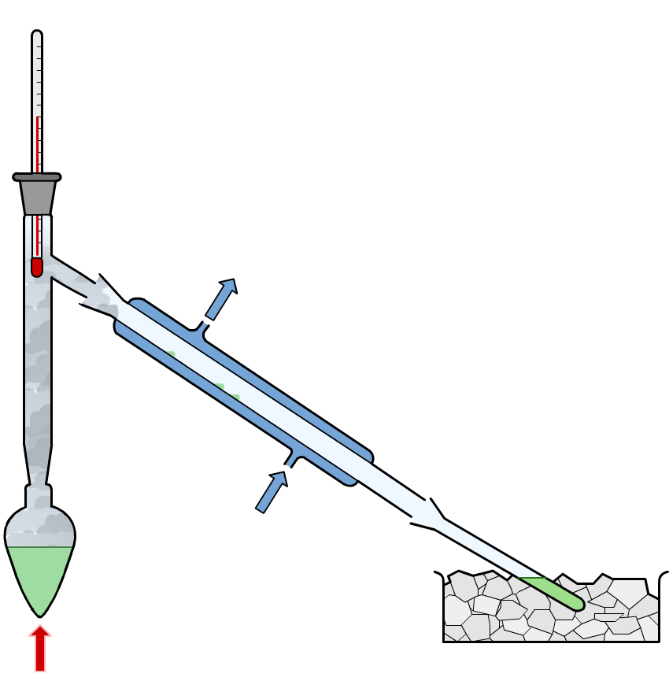
Synthesis of aldehydes
When aldehydes are prepared by the reaction of a primary alcohol with acidified potassium dichromate(VI), the aldehyde is distilled off and collected, preventing further oxidation.
mixture of alcohol,
dilute sulfuric acid and potassium dichromate(VI)
water out
water in
aldehyde
ice
heat
Notes:
Teacher notes
An excess of alcohol is also used to prevent secondary oxidation – this ensures there isn’t enough oxidizing agent present.

Slide 17
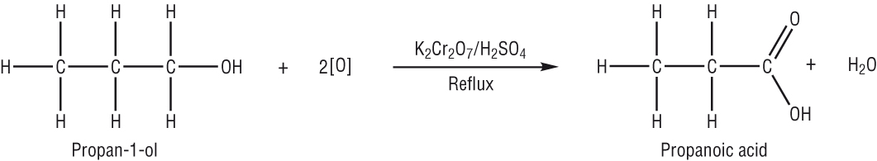
Alcohols – oxidation with potassium dichromate
Primary: further oxidation forms a carboxylic acid (we need an excess of potassium dichromate(VI)).
Propanol will produce propnoic acid.
We can separate the acid from the reaction mixture by distillation after refluxing for 15 minutes.

Slide 18
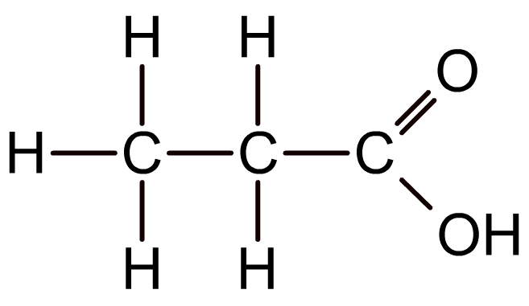
Oxidation of 1° alcohols: carboxylic acids
If primary alcohols are reacted with an excess of oxidizing agent and refluxed, they can be oxidized to aldehydes and then oxidized further to carboxylic acids.
RCH₂OH + [O] → RCHO + H₂O
RCHO + [O] → RCOOH
Carboxylic acids contain a carbonyl group (C=O) at the end of the carbon chain, with a hydroxyl group (OH) attached to the carbonyl carbon.
Carboxylic acid are named using the suffix –oic acid.
propanoic acid

Slide 19


Synthesis of carboxylic acids
Notes:
Teacher notes
See the ‘Redox Reactions’ presentation for more information about oxidation states.

Slide 20
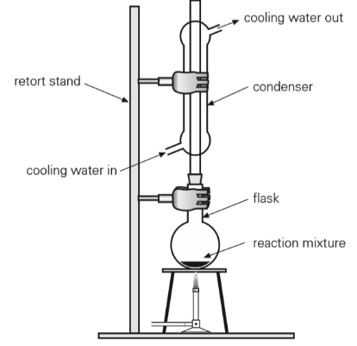
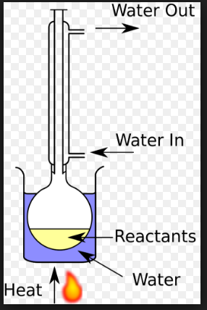
Reflux

Slide 21
Oxidation of 2° alcohols: ketones
Secondary alcohols can be oxidized to ketones by an oxidizing agent such as an aqueous solution of acidified potassium dichromate(VI).
R₁CH(OH)R₂ + [O] → R₁COR₂ + H₂O
Ketones contain a carbonyl group (C=O) attached to any carbon in the chain except a terminal carbon atom, and are named using the suffix –one.
propanone
Tertiary alcohols are resistant to oxidation due to the lack of hydrogen atoms on the carbon atom to which the hydroxyl group is attached.
Notes:
Teacher notes
Tertiary alcohols are very resistant to oxidation except under extreme conditions, which result in the breaking of C–C bonds.

Slide 22
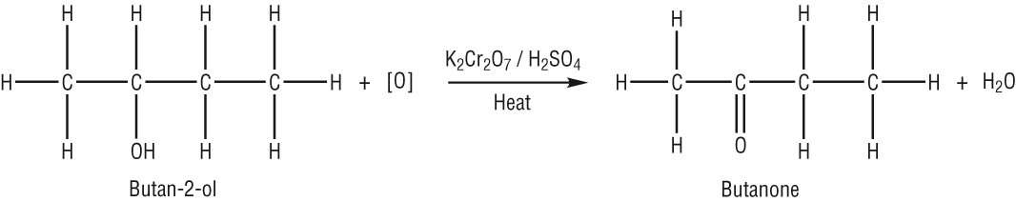
Alcohols – oxidation with potassium dichromate
Secondary: a ketone is formed.
Butan-2-ol produces butanone:
Ketones have pleasant odours of wood or fruit.
They cannot be oxidised further.

Slide 23
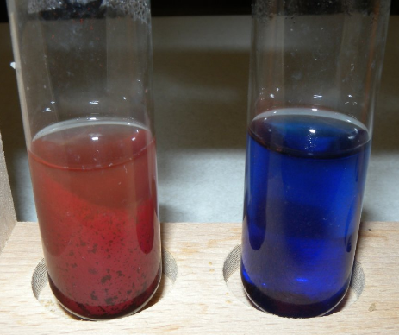
Distinguishing between aldehydes and ketones
Benedict’s solution is a blue solution of complexed copper (II) ions dissolved in sodium carbonate.
When heated with an aldehyde the blue copper (II) ions are reduced to a brick – red precipitate of copper (I) oxide.
If heated with a ketone nothing happens as ketones cannot be easily oxidised.
Benedict's solution
Positive test with an aldehyde

Slide 24
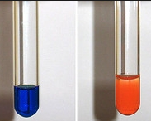
Distinguishing between aldehydes and ketones
Fehling’s solution can also be used.
This contains copper (II) ions dissolved in sodium hydroxide.
The colour change is the same for an aldehyde (blue to red).
Again there is no reaction with a ketone.
Positive test with an aldehyde
Fehling's solution

Slide 25
Questions
Ethanol is oxidised when it reacts with potassium dichromate (VI), acidified with sulfuric acid.
Write an equation to represent the reaction under distillation, and name the organic product.
Write an equation to represent the reaction under reflux, and name the organic product.
CH₃CH₂OH + [O] → CH₃CHO + H₂O
Ethanal
CH₃CH₂OH + 2[O] → CH₃COOH + H₂O
Ethanoic acid

Slide 26
Questions
Propan-1-ol and propan-2-ol, are oxidised by acidified potassium dichromate (VI) under distillation.
Name the organic product of each reaction.
From propan – 1- ol:
From propan – 2 – ol:
Describe a simple laboratory test to distinguish
Propanal
Propanone
Benedict’s/Fehling’s. With propan-1-ol blue to red precipitate
With propan-2-ol no change/stays blue

Slide 27
Oxidation of Alcohols
Objective: To know what happens we oxidise alcohols
Outcomes:
Understand the reactions of alcohols with oxygen in air (combustion)
Understand the reactions of alcohols with potassium dichromate(VI) in dilute sulfuric acid to oxidise primary alcohols to aldehydes (including a test for the aldehyde using Benedict’s/Fehling’s solution) and carboxylic acids, and secondary alcohols to ketones
In equations, the oxidising agent can be represented as [O]
Descriptions of the mechanisms of these reactions are not expected

