Slide 1
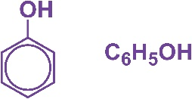
Phenol
Understand the reaction of phenol with bromine water
Understand reasons for the relative ease of bromination of phenol compared with benzene

Slide 2
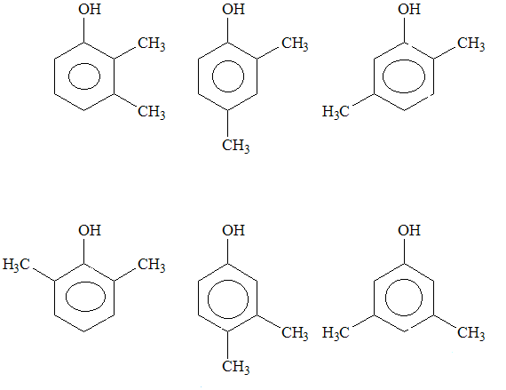

Slide 3
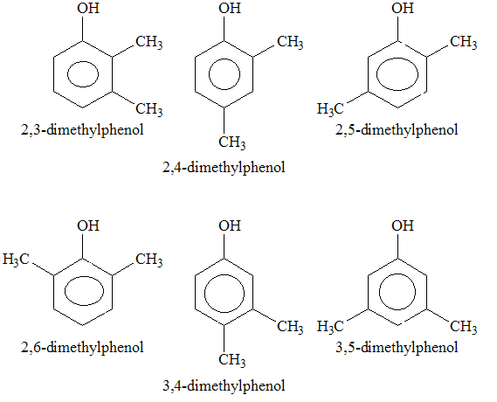

Slide 4
What reagents and conditions are required for the bromination of benzene?
Catalyst (Halogen carrier)
Heated
Under reflux

Slide 5
What reagents and conditions are required for the bromination of phenol?
Room Temperature
Bromine Water

Slide 6
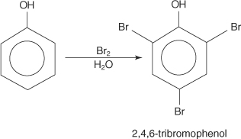
What is the obvious difference about the bromination of benzene and the bromination of phenol?

Slide 7
Discuss the following question….
Why do you think the reaction between phenol and bromine happens more readily than with benzene?

Slide 8
Reasons why…
Oxygen in the OH group has lone pairs of electrons → these e⁻ can merge with the electrons in the delocalised pi (Π) bond
Electron density above and below the ring of atoms is increased → referred to as ‘activation’ because the molecule is now much more reactive towards electrophiles
Bromine molecules, although usually non-polar, are polarised as they approach the benzene ring. Eventually, the Br-Br bond breaks and the Br⁺ electrophile attacks the benzene ring.

Slide 9
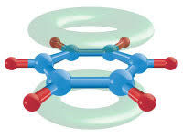
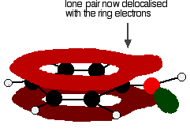
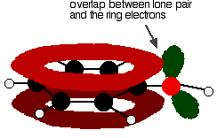

Slide 10
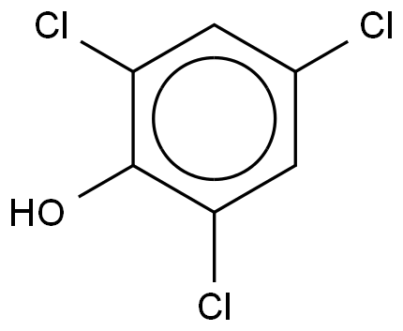
What is this compound?

Slide 11
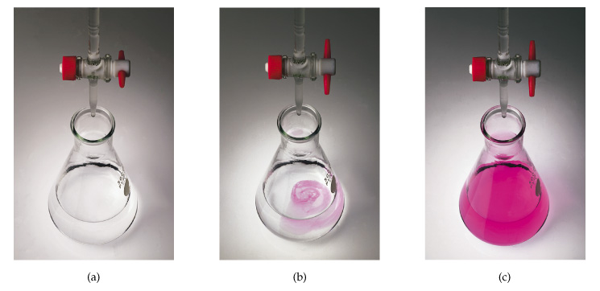
Phenolphthaelin

Slide 12
Phenolphthaelin
Colourless
Pink

Slide 13
Questions
Suggest why phenol is a solid at room temperature and is slightly soluble in water
Write an equation for the formation of TCP from phenol

Slide 14
Answers
Due to permanent dipole-dipole attractions due to the electronegativity of the oxygen - but is mainly due to hydrogen bonding.
Hydrogen bonds can form between a lone pair on an oxygen on one molecule and the hydrogen on the -OH group of one of its neighbours.
Phenol is moderately soluble in water - about 8 g of phenol will dissolve in 100 g of water.
If you try to dissolve more than this, you get two layers of liquid. The top layer is a solution of phenol in water, and the bottom one a solution of water in phenol. The solubility behaviour of phenol and water is complicated, and beyond UK A level.
Phenol is somewhat soluble in water because of its ability to form hydrogen bonds with the water.
C₆H₅OH + 3Cl₂ → C₆H₂Cl₃OH + 3HCl

Slide 15
Notes:
d

