Slide 1
Objectives for Bonding and Periodicity (2)
to understand the concept of bonding and lone (non-bonding) pairs of electrons as charge clouds
to use the electron pair repulsion theory to predict the shapes and bond angles in simple molecules and ions

Slide 2
Bonding and Periodicity
Lesson 5 – Shapes of Molecules (1)

Slide 3
Objectives for Lesson 5
Already from AS Level you know that
a covalent bond is a shared pair of electrons

Slide 4
Lesson Outcomes
And after this Lesson you should
understand the concept of bonding pairs of electrons as charge clouds
be able to predict the shapes of simple molecules, and their bond angles

Slide 5
Success Criteria
Give the five main shapes of simple molecules.
Identify the bond angles for these simple molecules
Give an example of a compound for each of the basic shapes

Slide 6
Shapes of molecules

Slide 7
Shapes of Molecules
Pairs of electrons act like clouds of negative charge
They repel each other so that they are as far apart as possible.
This keeps the repulsion to a minimum and gives characteristic shapes
We can work out the shapes of compounds by counting the number of pairs around the central atom

Slide 8
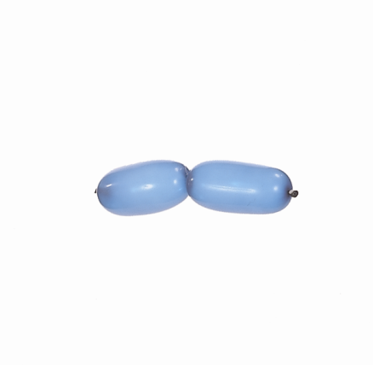
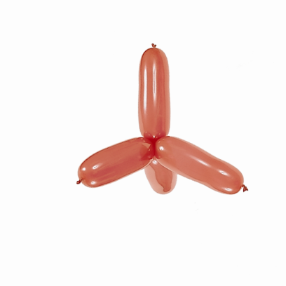
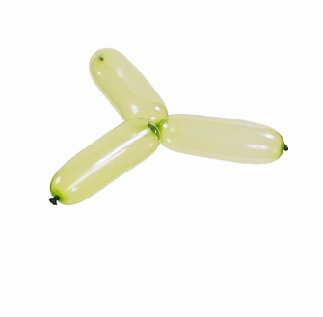
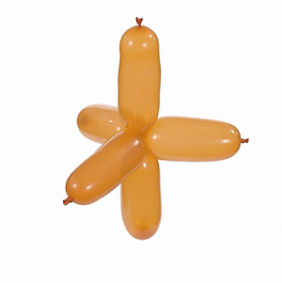
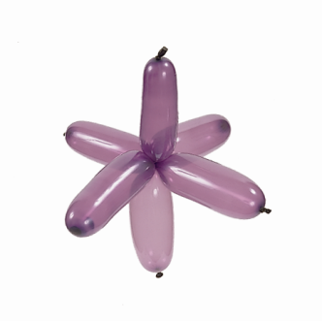
Week 8: Images
You can use balloons to model the five main molecular shapes.
Notes:
You can use balloons to model the five main molecular shapes.
Photo credit: P80 Martin Sookias.
Section 3.05

Slide 9
Linear

Slide 10
Week 8: Images
The beryllium chloride molecule is linear.
Notes:
The beryllium chloride molecule is linear.
Section 3.05

Slide 11
Week 8: Images
The beryllium chloride molecule is linear.
Notes:
The beryllium chloride molecule is linear.
Section 3.05

Slide 12
Week 8: Images
The bond angle is 180˚ in beryllium chloride and other linear molecules.
Notes:
The bond angle is 180˚ in beryllium chloride and other linear molecules.
Section 3.05

Slide 13
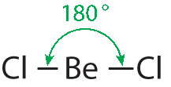
Week 8: Images
The bond angle is 180˚ in beryllium chloride and other linear molecules.
Notes:
The bond angle is 180˚ in beryllium chloride and other linear molecules.
Section 3.05

Slide 14
Week 8: Images
The carbon dioxide molecule is linear.
Notes:
The carbon dioxide molecule is linear.
Section 3.05

Slide 15
Week 8: Images
The carbon dioxide molecule is linear.
Notes:
The carbon dioxide molecule is linear.
Section 3.05

Slide 16
Triagonal planar

Slide 17
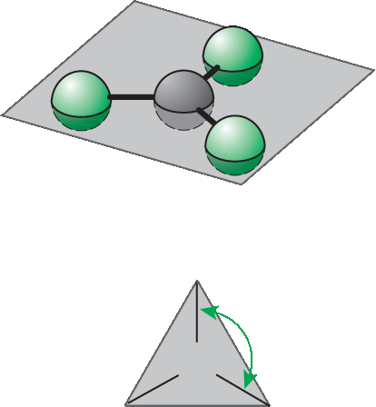
Week 8: Images
The boron trichloride molecule is trigonal planar.
Notes:
The boron trichloride molecule is trigonal planar.
Section 3.05

Slide 18
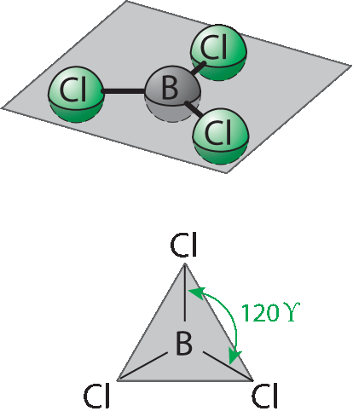
Week 8: Images
The boron trichloride molecule is trigonal planar.
Notes:
The boron trichloride molecule is trigonal planar.
Section 3.05

Slide 19
Tetrahedral

Slide 20
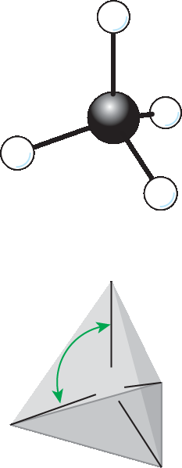
Week 8: Images
The methane molecule is tetrahedral.
Notes:
The methane molecule is tetrahedral.
Section 3.05

Slide 21
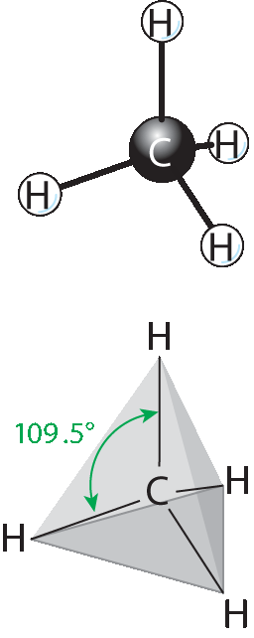
Week 8: Images
The methane molecule is tetrahedral.
Notes:
The methane molecule is tetrahedral.
Section 3.05

Slide 22
Triagonal bipyramidal

Slide 23
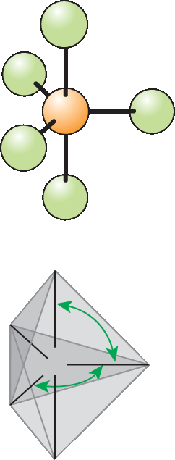
Week 8: Images
The phosphorus pentafluoride molecule is trigonal bipyramidal. The sulfur hexafluoride molecule is octahedral.
Notes:
The phosphorus pentaflouride molecule is trigonal bipyramidal. The sulphur hexafluoride molecule is octahedral.
Section 3.05

Slide 24
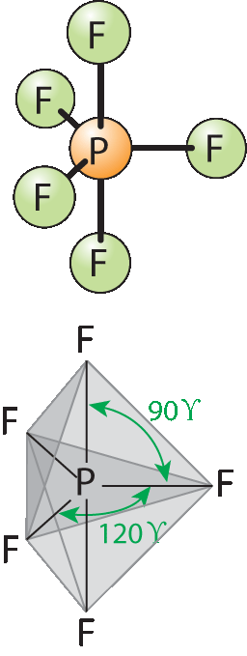
Week 8: Images
The phosphorus pentaflouride molecule is trigonal bipyramidal. The sulfur hexafluoride molecule is octahedral.
Notes:
The phosphorus pentaflouride molecule is trigonal bipyramidal. The sulphur hexafluoride molecule is octahedral.
Section 3.05

Slide 25
octahedral

Slide 26
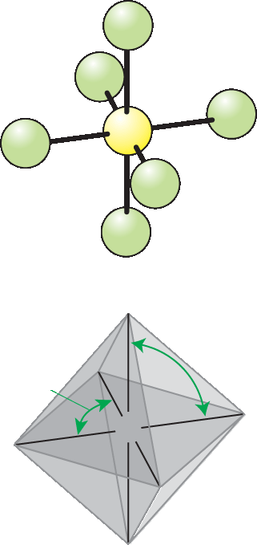
Week 8: Images
The sulfur hexafluoride molecule is octahedral.
Notes:
The sulfur hexaflouride molecule is octahedral.
Section 3.05

Slide 27
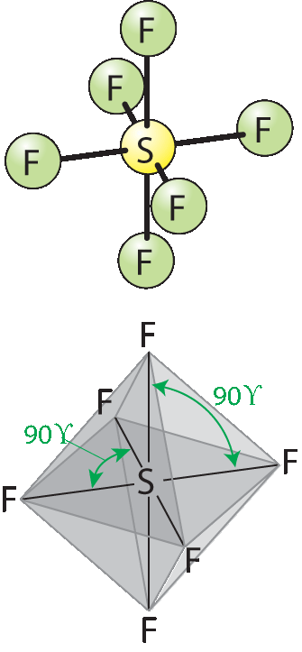
Week 8: Images
The sulfur hexafluoride molecule is octahedral.
Notes:
The sulfur hexaflouride molecule is octahedral.
Section 3.05

Slide 28
Summary
Here is a summary table:
Shapes_of_molecules_table.doc

Slide 29
Lesson Outcomes
And after this Lesson you should
understand the concept of bonding pairs of electrons as charge clouds
be able to predict the shapes of simple molecules, and their bond angles

Slide 30
Success Criteria
Give the five main shapes of simple molecules.
Identify the bond angles for these simple molecules
Give an example of a compound for each of the basic shapes

