Slide 1
Objectives for Bonding and Periodicity (2)
to understand the concept of bonding and lone (non-bonding) pairs of electrons as charge clouds
to use the electron pair repulsion theory to predict the shapes and bond angles in simple molecules and ions

Slide 2
Bonding and Periodicity
Lesson 6 – Shapes of Molecules (2)

Slide 3
Already from AS Level you
understand the concept of bonding pairs of electrons as charge clouds
can predict the shapes of simple molecules and their bond angles

Slide 4
Lesson Outcomes
And after this Lesson you should be able to
predict the shapes of simple molecules with lone pairs of electrons around the central atom, and their bond angles

Slide 5
Success Criteria
Recognise that lone pairs can affect shapes of molecules.
Draw one example for each combination of lone pairs and molecular shapes

Slide 6
Lone pairs

Slide 7
Lone Pairs
Lone pairs affect the shape and bond angles of compounds

Slide 8
Week 8: Images
A comparison of the strength of repulsion by pairs of electrons.
Notes:
A comparison of the strength of repulsion by pairs of electrons.
Section 3.06

Slide 9
Week 8: Images
A comparison of the strength of repulsion by pairs of electrons.
Notes:
A comparison of the strength of repulsion by pairs of electrons.
Section 3.06

Slide 10
Drawing molecules

Slide 11
Drawing Molecules
To do this, you will need to draw 3D molecules in 2D. To do this you will need to know.....

Slide 12
Week 8: Images
Different bond styles show if a bond comes towards you or away.
Notes:
Different bond styles show if a bond comes towards you or away.
Section 3.06

Slide 13
Week 8: Images
Different bond styles show if a bond comes towards you or away.
Notes:
Different bond styles show if a bond comes towards you or away.
Section 3.06

Slide 14
Week 8: Images
A diagram of a methane molecule. Two bonds are in the plane of the paper, the middle one comes out towards you and the left hand bond goes away from you.
Notes:
A diagram of a methane molecule. Two bonds are in the plane of the paper, the middle one comes out towards you and the left hand bond goes away from you.
Section 3.06

Slide 15
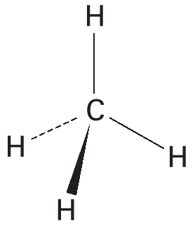
Week 8: Images
A diagram of a methane molecule. Two bonds are in the plane of the paper, the middle one comes out towards you and the left hand bond goes away from you.
Notes:
A diagram of a methane molecule. Two bonds are in the plane of the paper, the middle one comes out towards you and the left hand bond goes away from you.
Section 3.06

Slide 16
Tetrahedral arrangements

Slide 17
Tetrahedral Arrangements
In methane, there are four bonding pairs.
The bond angle is 109.5 °C.
Both ammonia and water are tetrahedral in shape but contain lone pairs instead of bonds.
This changes the bond angles

Slide 18
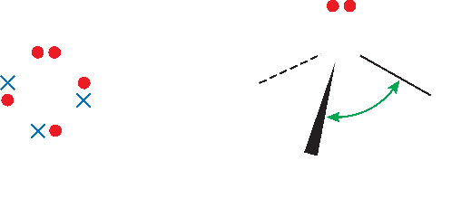
Week 8: Images
The bond angles in ammonia are 107˚ because of the presence of a lone pair of electrons.
Notes:
The bond angles in ammonia are 107˚ because of the presence of a lone pair of electrons.
Section 3.06

Slide 19
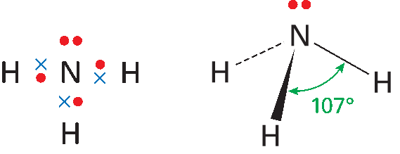
Week 8: Images
The bond angles in ammonia are 107˚ because of the presence of a lone pair of electrons.
Notes:
The bond angles in ammonia are 107˚ because of the presence of a lone pair of electrons.
Section 3.06

Slide 20
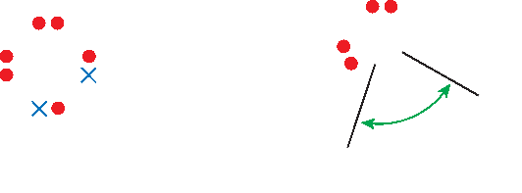
Week 8: Images
The bond angle in water is 104.5˚ because of the presence of two lone pairs of electrons.
Notes:
The bond angle in water is 104.5˚ because of the presence of two lone pairs of electrons.
Section 3.06

Slide 21
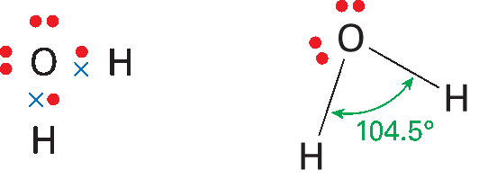
Week 8: Images
The bond angle in water is 104.5˚ because of the presence of two lone pairs of electrons.
Notes:
The bond angle in water is 104.5˚ because of the presence of two lone pairs of electrons.
Section 3.06

Slide 22
Triagonal bipyramidal arrangements

Slide 23
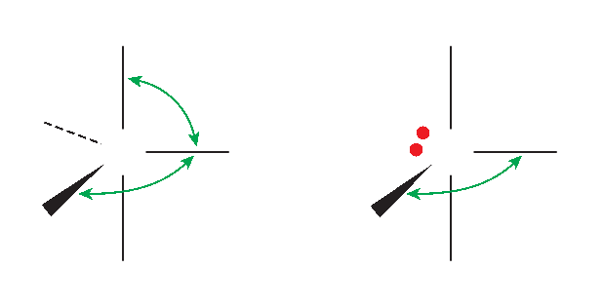
Week 8: Images
Phosphorus pentafluoride and sulfur tetrafluoride molecules.
Notes:
Phosphorus pentaflouride and sulphur tetraflouride molecules.
Section 3.06

Slide 24
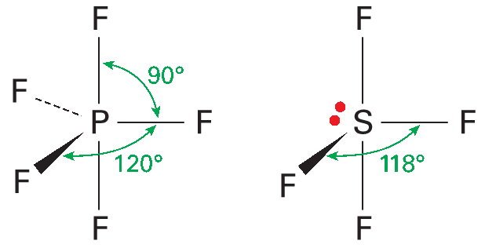
Week 8: Images
Phosphorus pentafluoride and sulphur tetrafluoride molecules.
Notes:
Phosphorus pentaflouride and sulphur tetraflouride molecules.
Section 3.06

Slide 25
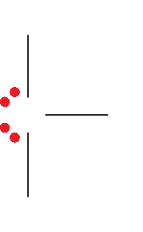
Week 8: Images
The chlorine trifluoride molecule.
Notes:
The chlorine triflouride molecule.
Section 3.06

Slide 26
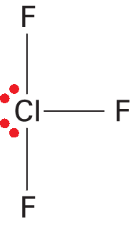
Week 8: Images
The chlorine trifluoride molecule.
Notes:
The chlorine triflouride molecule.
Section 3.06

Slide 27
Octahedral arrangements

Slide 28
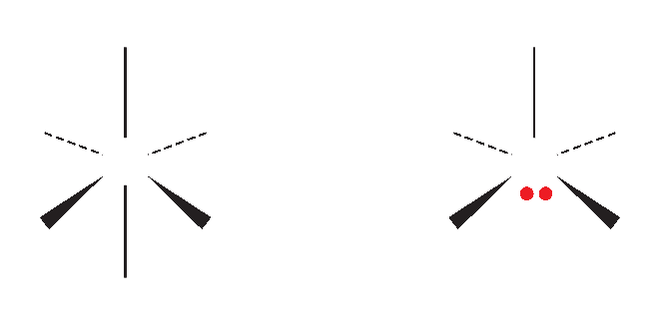
Week 8: Images
Sulfur hexafluoride and iodine pentafluoride molecules.
Notes:
Sulfur hexafluoride and iodine pentaflouride molecules.
Section 3.06

Slide 29
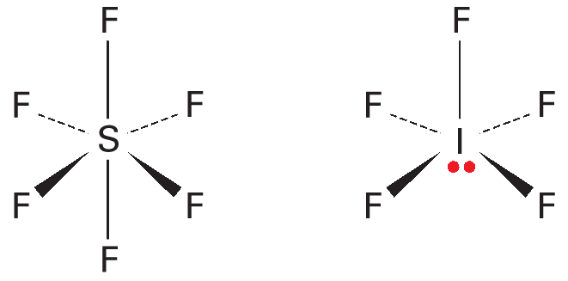
Week 8: Images
Sulfur hexafluoride and iodine pentafluoride molecules.
Notes:
Sulfur hexafluoride and iodine pentaflouride molecules.
Section 3.06

Slide 30
Summary

Slide 31
Lesson Outcomes
And after this Lesson you should be able to
predict the shapes of simple molecules with lone pairs of electrons around the central atom, and their bond angles

Slide 32
Success Criteria
Recognise that lone pairs can affect shapes of molecules.
Draw one example for each combination of lone pairs and molecular shapes

