Slide 1
% Yield and % Atom Economy
Targets
Be able to calculate % Atom Economy and % Yield from balanced equations
Specification 3.1.2
Do Now:
What do the following mean?
How would you calculate them?
Why are they important?
% Yield
% Atom economy

Slide 2
Think back to GCSE
What do the following mean?
How would you calculate them?
Why are they important?
% Yield
% Atom economy
These 2 equations are probably the most USEFUL if you study chemistry beyond A Level.
Used on a DAILY basis during research and in industry
Notes:
Once we know the balanced equation for a chemical reaction, we can calculate the THEORETICAL YIELD – the theoretical amount that we should be able to make for any of the products.
Most chemical reactions produce 2 (or more) products, but often only 1 of them is needed. This means that some of them will be wasted – obviously not a good idea.
One technique that chemists use to assess a given process is to determine the % atom economy.

Slide 3
% Yield
The yield of a chemical reaction is the amount of product formed.
Calculate the THEORETICAL yield using a reacting masses calculation.
This is the MAXIMUM possible amount of product from a reaction.
The ACTUAL yield is usually much less than the theoretical yield:
The reactants may be impure
The reaction may not go to completion
Some of the product may be left in the container
It may be difficult to purify the product
% Yield = Actual yield x 100
Theoretical yield
Notes:
How are % atom economies and % yield different to each other?
Atom economy tell us IN THEORY how many atoms MUST be wasted in a reaction.
The Yield tells us about the practical efficiency of the process, i.e., how much is lost by:
The PRACTICAL process of obtaining a product
As a result of reactions that do not go to completion

Slide 4
% Yield
The theoretical yield for a certain method to obtain copper(II) sulfate crystals is 2.0g. The actual yield obtained was 1.8g. What was the % yield?
% Yield = Actual yield x 100
Theoretical yield
= 1.8 x 100 = 90%
2

Slide 5
The Haber Process
If the % yield of ammonia in the Haber process is 15%, what mass of ammonia is produced from 6 tonnes of hydrogen?
N₂ (g) + 3H₂(g)  2NH₃(g)
Mass = 6x10⁶ g Mass = ?
Mr = 2.0 Mr = 17.0
Moles = 3x10⁶ mol
% Yield = actual yield x 100
theoretical yield
Actual yield = % yield x theoretical yield= 15x 34.0x10⁶ = 5.1.0x10⁶ = 5.1 tonnes
100
Mass = Moles x Mr= 2.0x10⁶ x 17 = 34.0x10⁶ g
Moles = 2/3 x 3x10⁶
= 2.0x10⁶ mol
Notes:
Over 100 million tonnes of ammonia manufactured worldwide each year.
About 85% used to make fertilizers.
Under typical conditions, the % yield of ammonia is only about 15%.
Reaction is reversible and does not go to completion.

Slide 6
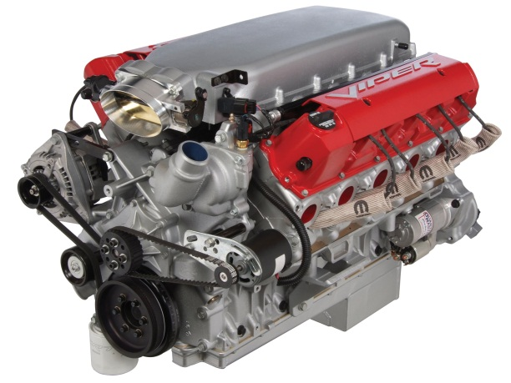
If a car factory can make…
16 engines per week
40 seats per week
58 doors per week
33 windscreens per week
… how many finished cars can it make in a week?

Slide 7
Limiting Reactants
Reactants often mixed in different proportions from the ones in the balanced equation.
Where there are 2 reactants, one of them will be in EXCESS – it will not be used up in the reaction.
The other reactant is the LIMITING Reactant – it will be completely used in the reaction so determines the theoretical yield.
Fe(s) + S(s) → FeS(s)
1 mole of Fe reacts with 1 mole of sulfur to produce 1 mole of iron(II) sulfide.
If more than 1 mole of iron is mixed with 1 mole of sulfur the iron will be in excess. Sulfur will be the limiting reagent.
No matter how much excess iron is added, no more than 1 mole of iron(II) sulfide can be produced from 1 mole of sulfur.

Slide 8
Atom Economy
Found directly from the BALNACED EQUATION
It is THEORETICAL rather than PRACTICAL
The proportion of reactants that are converted into useful products rather than waste products.
E.g., In a cretin process, 50 tonnes of reactants produce 30 tonnes of the desired product and 20 tonnes of waste by-product.
% Atom economy = 30 x 100 = 60%
50
% Atom economy = Mass of desired product x 100
Total mass of products
Notes:
Is this MORE or LESS efficient than a process with an atom economy of 80%?
ANS: LESS

Slide 9
Atom Economy
% atom economy can also be predicted from the Mr of the reactants and products:
You need to know:
The balanced equation
The Ar/Mr of the products
E.g., Iron can be extracted from its ore by using carbon monoxide in a blast furnace. What is the atom economy of this process?
Fe₂O₃(s) + 3CO(g) → 2Fe(l) + 3CO₂(g)
Ar=55.8 Mr=44.0
Total relative mass of desired product = 2x 55.8 = 111.6
Total relative mass of all products = (2x55.8)+(3x44.0) = 243.6 % Atom economy = 111.6 x 100 = 45.8%
243.6
% Atom economy = Molar mass of desired product x 100
Total molar mass of all products (or reactants)

Slide 10
Comparing Reactions
Hydrogen gas is used in the manufacture of margarine and as a fuel. It can be produced in 2 ways:
Reacting coal with steam
C(s) + H₂O(g) → H₂(g) + CO (g)
% Atom economy = 2.0 x 100 = 6.67%
(2.0+28.0)
2. Reacting natural gas with steam
CH₄(s) + H₂O(g) → 3H₂(g) + CO (g)
% Atom economy = (3x2.0) x 100 = 17.6%
([3x2.0]+28.0)
Notes:
What is hydrogen gas used for? Why might industries want to make it?
Which process is more efficient? 2. Reacting natural gas with steam

Slide 11
Is 100% Atom Economy Possible?
Calculate the % Atom Economy when ethene reacts with bromine to for 1,2-dibromoethane.
CH₂=CH₂ + Br₂ → CH₂BrCH₂Br
Mr=28 Mr = 160 Mr = 188
% Atom economy = Mr of desired product x 100
Total Mr of all products (or reactants)
= 188 x 100 = 100%
(28+160)
Yes,
100% Atom Economy Possible
IN THEORY
Notes:
Ask pupils to vote yes/no.
Question on reasons WHY.

Slide 12
Tasks ...
Complete Tasks 12 and 13

