Slide 1
AS Chemistry
Atoms and Reactions Lesson 1
1.1.2. Atomic Masses
WARM UP:
Work out the relative molecular mass of:
Calcium carbonate - CaCO₃
Magnesium chloride - MgCl₂
Methane – CH₄
Copper sulphate - CuSO₄
Water

Slide 2
Warm-up questions
Work out the relative molecular mass of:
Calcium carbonate - CaCO₃
Magnesium chloride - MgCl₂
Methane – CH₄
Copper sulphate - CuSO₄
Water
100
95
16
160
18

Slide 3
Lesson objectives
Relative masses
(f) state that ¹²C is used as the standard measurement of relative masses;
(g) define the terms relative isotopic mass and relative atomic mass, based on the ¹²C scale;
(h) calculate the relative atomic mass of an element given the relative abundances of its isotopes;
(i) use the terms relative molecular mass and relative formula mass and calculate values from relative atomic masses.

Slide 4
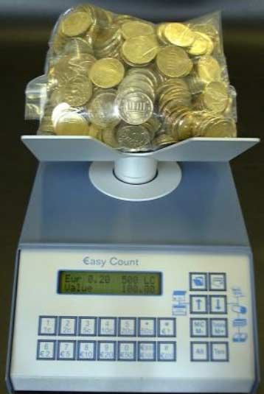
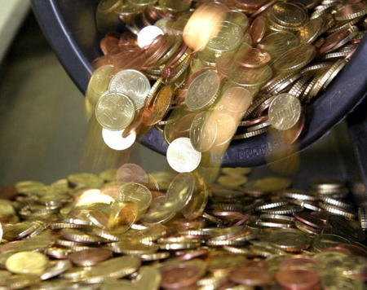
How do we count atoms?
How does a bank count very large numbers of coins?
By weighing them.

Slide 5
How do we count atoms?
What do they need to know in order to do this?
How much a single coin weighs.
Chemists count atoms in the same way, but we need to know how much an atom weighs – this is it’s R.A.M. (Relative atomic mass)

Slide 6
Relative Atomic Mass
Relative atomic mass is also written A_{r}
This is relative to carbon-12
Definition:
Relative atomic mass A_{r}, is the weighted mean mass of an atom of an element compared with one-twelfth of the mass of an atom of carbon-12

Slide 7
Relative Atomic Mass
Carbon 12 is used as the standard.
All masses are relative to this.
1/12 of the mass of ¹²C is one mass unit.
Carbon 12 is the isotope of carbon that has…
…6 protons and 6 neutrons
Carbon-12 is defined as having a relative isotopic mass 12.

Slide 8
Relative Isotopic Mass
Relative isotopic mass is the mass of an atom of an isotope compared with one-twelfth of the mass of an atom of carbon-12
E.g. oxygen-16 has a relative isotopic mass of 16.0

Slide 9
Relative Atomic Mass
Relative atomic masses are found in the periodic table.
Why are these not whole numbers?
They are actually the average mass of all atoms of that element.
So why do we need an average?
Elements have more than one naturally occurring isotope with different masses.

Slide 10
Relative Atomic Mass
So what two things do we need to calculate the relative atomic mass for an element?
The relative isotopic masses of the different isotopes.
The relative abundance of these isotopes.

Slide 11
Relative Atomic Mass
What is the relative atomic mass of chlorine:
75.5% of chlorine atoms are chlorine-35
24.5% of chlorine atoms are chlorine-37
Relative atomic mass = (75.5 x 35 + 24.5 x 37)
100
= 35.5

Slide 12
Relative Atomic Mass
In general
R.A.M. = (R.I.M.¹ x abundance¹) + (R.I.M.² x abundance²)
100

Slide 13
Relative Molecular Mass
The relative molecular mass, M_{r} is the weighted mean mass of a molecule compared with one-twelfth of the mass of an atom of carbon-12

Slide 14
Relative Formula Mass
Relative molecular mass refers to compounds containing molecules.
The term relative formula mass, is used for compounds containing ions.
This is because ionic compounds exist as a giant lattice so the concept of a single molecule is misleading.

Slide 15
Relative Formula Mass
The relative formula mass, is the weighted mean mass of a formula unit compared with one-twelfth of the mass of an atom of carbon-12.
Now complete questions 2 and 3 on page 9.

Slide 16
Personal Study Task
Complete the GCSE question sheet “Remember these”
Make sure you have, and know, and understand definitions for:
Relative atomic mass A_{r}
Relative isotopic mass
Relative molecular mass M_{r}
Relative formula mass
and are able to calculate them.

Slide 17
Lesson objectives
Relative masses
(f) state that ¹²C is used as the standard measurement of relative masses;
(g) define the terms relative isotopic mass and relative atomic mass, based on the ¹²C scale;
(h) calculate the relative atomic mass of an element given the relative abundances of its isotopes;
(i) use the terms relative molecular mass and relative formula mass and calculate values from relative atomic masses.

