Slide 1
Complete spot the bonding worksheet

Slide 2
Homework
Private study work (bring notes to show me next lesson);
Read pages 66 – 71 in your text book
Complete the summary questions on each double page spread.
Look at the following websites
http://www.chemguide.co.uk/atoms/structsmenu.html#top
(Not the structures of period 3)
http://www.chemnotes.org.uk/f321.html
Topic 5, concentrate on structure, bonding and properties

Slide 3
Metallic Bonding and Ionic Properties
Friday, 21 October 2016

Slide 4
Metallic Bonding and Ionic Substances
Metallic Bonding
Know that metallic bonding is the strong electrostatic attraction between metal ions and the delocalised electrons
For metallic and ionic substances
know that giant lattices are present in:
i) ionic solids (giant ionic lattices)
iii) solid metals (giant metallic lattices)
be able to predict the type of structure and bonding present in a substance from numerical data and/or other information
be able to predict the physical properties of a substance, including melting and boiling temperature, electrical conductivity and solubility in water, in terms of:
i) the types of particle present (atoms, molecules, ions, electrons)
ii) the structure of the substance
iii) the type of bonding and the presence of intermolecular forces, where relevant
Explain why different ionic substances have different melting and boiling points

Slide 5
Metallic Bonding
As with all bonding metals move towards a stable structure.
They delocalise their outer shell electrons, leaving a fixed lattice of positive ions.
The delocalised electrons are free to move throughout the structure.

Slide 6
Metallic Bonding
Metallic bonding is the attraction of the positive ions to the sea of electrons.
Over the whole structure the charges balance.
It is impossible to tell which electron originated from which particular positive ion.

Slide 7
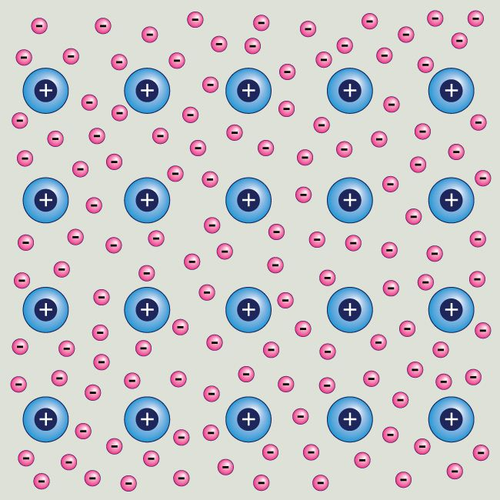
In a metal the atoms LOSE SEVERAL OF THEIR OUTER ELECTRONS which drift around between the metal ions, the electrons are delocalised. It is referred to as a sea of electrons.
As they have LOST a few electrons, the atoms become POSITIVE IONS
delocalised electrons
electrostatic forces of attraction between the delocalised electrons and positive metal ions

Slide 8
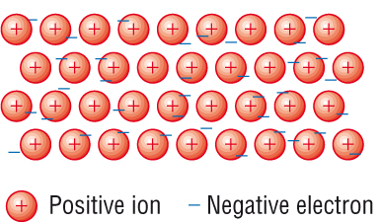
Metallic Bonding

Slide 9
Definitions
Metallic bonding | The strong electrostatic attraction between positive metal ions and the “sea” of delocalised electrons
Delocalised electrons | Are bonding electrons which are not fixed in a bond between two atoms. They are free to move and are shared between many atoms
Giant Metallic lattice | 3-D Structure of positive ions and delocalised electrons bonded together by strong metallic bonds

Slide 10
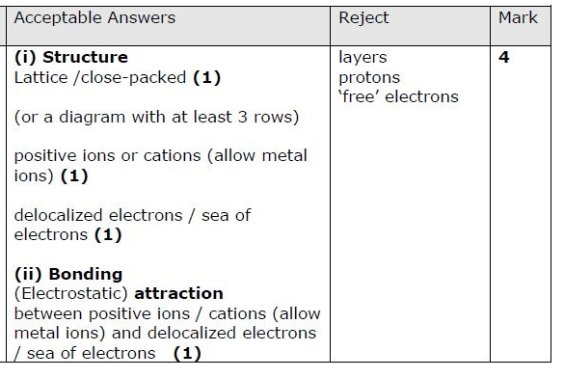
Exam questions
i) Describe the structure of a metal (2 marks)
ii) Explain the bonding in a metal (2 marks)

Slide 11
Exam questions
Explain the bonding in a metal (2 marks)

Slide 12
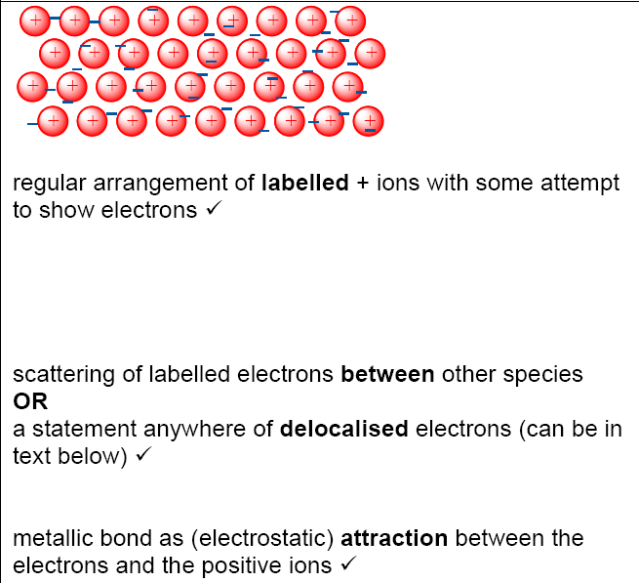
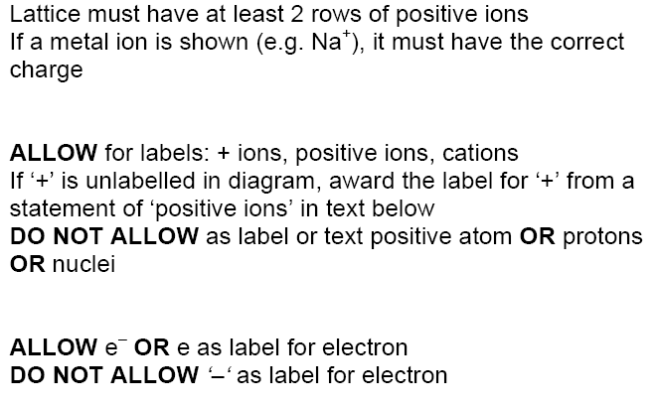

Slide 13
Properties of ionic and metallic substances investigation
Put some sodium chloride into a boiling tube.
Heat it using a Bunsen burner. Does it melt?
What does this tell you about it’s boiling point?
Transfer the sodium chloride to a beaker.
Then submerge the electrodes and connect them to a lamp and power supply
What did the bulb do?
Turn on the power and make observations
Add distilled water to the sodium chloride crystals in the beaker, swirl the solution.
Do the sodium chloride crystals dissolve?
What does this tell you about their solubility?
Then submerge the electrodes again.
Make observations.
What did the bulb do?
What is happening at the electrodes?
Repeat the above for copper

Slide 14
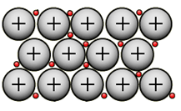
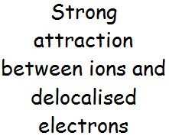
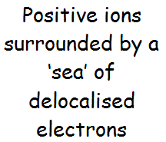
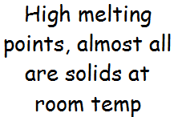


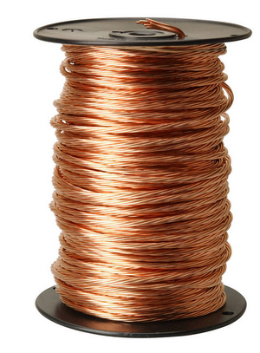

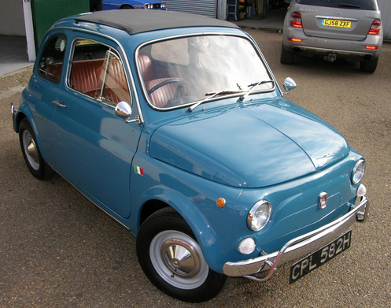
Metallic Bonding
Ductile

Slide 15
Properties of giant metallic lattices
Most metals have high melting and boiling points
Electrons free to move, positive ions in fixed position
Attraction between the positive ions and negative delocalised electrons is strong
High temperatures are needed to break metallic bonds and dislodge ions from their rigid positions

Slide 16
Properties of giant metallic lattices
Metals are good conductors of electricity
Delocalised electrons can move freely anywhere within metallic lattice
Allows the metal to conduct electricity even when on solid state

Slide 17
Properties of giant metallic lattices
Metals are good conductors of heat
When a metal is heated, energy is transferred to the electrons
The delocalised electrons in the heated region move around faster and conduct the heat (energy) rapidly to other parts of the metal

Slide 18
Properties of giant metallic lattices
Metals have high densities
Atoms are close packed with as little space between them as possible

Slide 19
Metals are ductile and malleable
Ductile = can be drawn out or stretched e.g. into wires
Malleable = can be hammered into shape (and thin sheets)

Slide 20
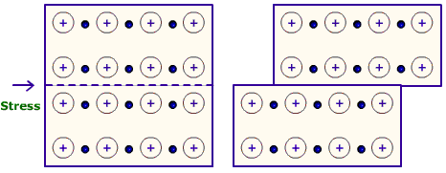
Metals are ductile and malleable
The bonds between the metal atoms are strong, but not directional because the delocalised electrons can drift the lattice and attract any positive atoms
When a force is applied to a metal, lines or layers of atoms can slide over each other
This is known as “slip”

Slide 21
Alloys
Alloys are mixtures of metals. They are not compounds.
Compounds always have the same proportion of atoms of each element. E.g. H₂O
In alloys the metals can mix together in different proportions. In the structure, the positive ions of one element simply replace the ions of another element.

Slide 22
Carbon and other metals added
Steel (an alloy)
Pure iron (wrought iron)
Alloys modify a metal’s properties.
Often one ion is a different size from the one that it replaces.
This can make the metal harder by creating a barrier, and therefore preventing the layers of atoms sliding past each other.
By controlling the amounts of elements added to an alloy you can control it’s properties e.g. With different steels

Slide 23
Metallic Bonding and Ionic Substances
Metallic Bonding
Know that metallic bonding is the strong electrostatic attraction between metal ions and the delocalised electrons
For metallic and ionic substances
know that giant lattices are present in:
i) ionic solids (giant ionic lattices)
iii) solid metals (giant metallic lattices)
be able to predict the type of structure and bonding present in a substance from numerical data and/or other information
be able to predict the physical properties of a substance, including melting and boiling temperature, electrical conductivity and solubility in water, in terms of:
i) the types of particle present (atoms, molecules, ions, electrons)
ii) the structure of the substance
iii) the type of bonding and the presence of intermolecular forces, where relevant
Explain why different ionic substances have different melting and boiling points

Slide 24
Ionic compounds’ characteristics:
High melting and boiling points
Hard, brittle crystalline structures
Uniform, repeat structure (alternating + & – ions)
Are often soluble in water and other polar solvents, but insoluble in non – polar solvents
Do not conduct electricity when solid, but do in solution or when molten

Slide 25
Ionic Lattices
In an ionic compound there are positive and negative ions.
They are held together by electrostatic attraction.
These attractions happen in all directions.
This means that the ionic compound is in the form of a giant ionic lattice.

Slide 26
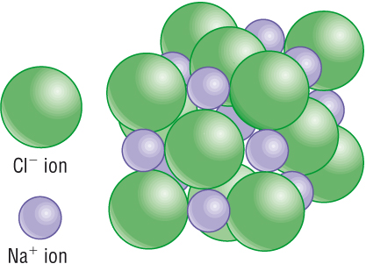
Ionic Lattices
This strong multi-directional attraction means that ionic compounds have high melting and
boiling points.

Slide 27
Ionic Lattices
Ionic compounds can conduct electricity when molten or in solution but not when solid.
Why?

Slide 28
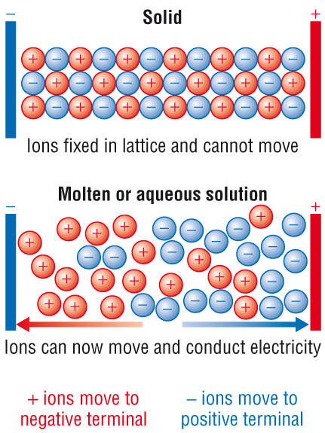
Ionic Lattices

Slide 29
Conductivity of ionic substances
In an ionic solid the ions fixed in a lattice. They vibrate but cannot move around – ionic solids cannot conduct electricity
+
Ions in uniform structure
Water
Ions moving freely in solution

Slide 30
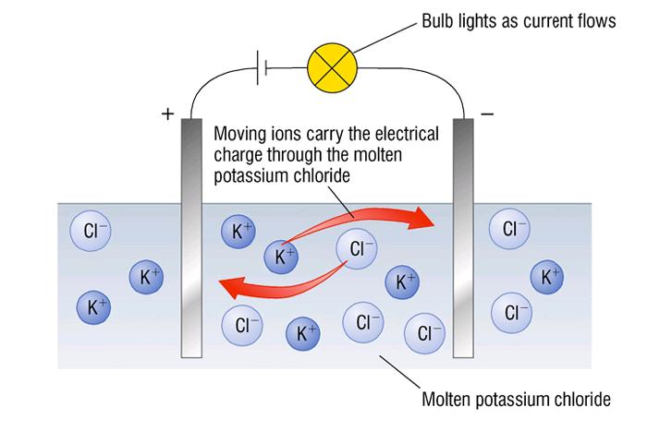
When an ionic substance dissolves, the ions break out of their lattice structure and are free to move about and carry a charge.
Because of this, an electric current can be passed through the solution.
The same is true when ionic substances are molten.

Slide 31
Ionic Lattices
Ionic compounds are also soluble in water.
Why?

Slide 32
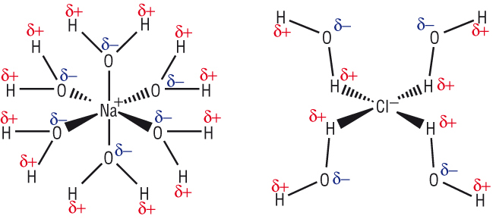
Ionic lattices
The ions are electrostatically attracted to the polar water molecules.

Slide 33
Metallic Bonding and Ionic Substances
Metallic Bonding
Know that metallic bonding is the strong electrostatic attraction between metal ions and the delocalised electrons
For metallic and ionic substances
know that giant lattices are present in:
i) ionic solids (giant ionic lattices)
iii) solid metals (giant metallic lattices)
be able to predict the type of structure and bonding present in a substance from numerical data and/or other information
be able to predict the physical properties of a substance, including melting and boiling temperature, electrical conductivity and solubility in water, in terms of:
i) the types of particle present (atoms, molecules, ions, electrons)
ii) the structure of the substance
iii) the type of bonding and the presence of intermolecular forces, where relevant
Explain why different ionic substances have different melting and boiling points

Slide 34
Melting points of ionic compounds
The melting point of sodium chloride is lower than that of magnesium oxide because it has weaker ionic bonds, which need less heat energy to overcome.
This is for two reasons:
The Na⁺ and Cl– ions in sodium chloride have fewer charges than the Mg²⁺and O^{2–} ions in magnesium oxide
Na⁺ ions are larger than Mg²⁺ and cannot get as close to the negatively charged ions
Also oxygen ions are smaller than chlorine atoms

Slide 35
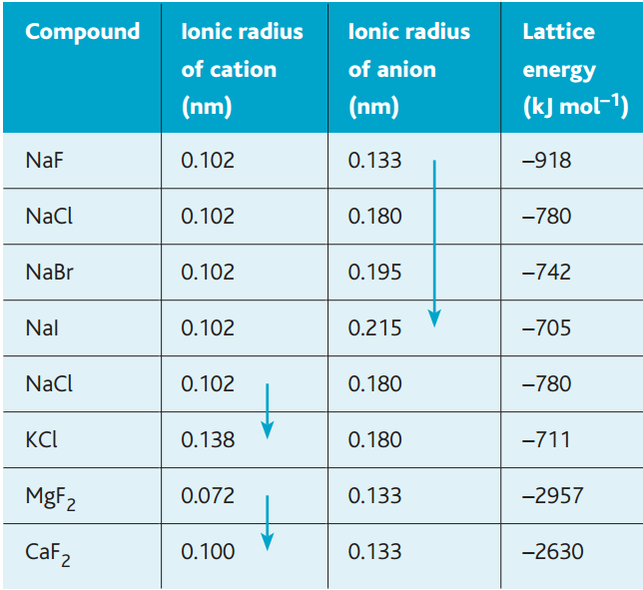
Looking at table, you can see that the lattice energy of a compound is affected by both the charge and the size of the ions. The effect of the ionic radius is shown by the trend in the sodium halides, in the chlorides of sodium and potassium, and in the fluorides of magnesium and calcium. The lattice energy becomes less negative as the size of the ions increases. In smaller ions the attractive force of the positive nucleus holds the outer electrons more tightly because they are closer to the nucleus.

Slide 36
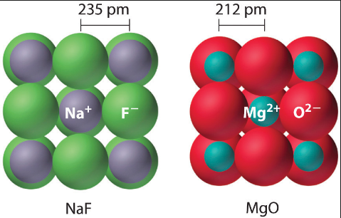
Although this is for sodium fluoride it shows that sodium ion is bigger.
Chloride ions would be bigger than oxide ions

Slide 37
You can also see that the lattice energy becomes more negative with ions of greater charge (Mg²⁺ , Ca²⁺) because they attract other ions more strongly – compare the lattice energy of sodium fluoride with those of magnesium fluoride and calcium fluoride, which have a much greater magnitude.

Slide 38
Metallic Bonding and Ionic Substances
Metallic Bonding
Know that metallic bonding is the strong electrostatic attraction between metal ions and the delocalised electrons
For metallic and ionic substances
know that giant lattices are present in:
i) ionic solids (giant ionic lattices)
iii) solid metals (giant metallic lattices)
be able to predict the type of structure and bonding present in a substance from numerical data and/or other information
be able to predict the physical properties of a substance, including melting and boiling temperature, electrical conductivity and solubility in water, in terms of:
i) the types of particle present (atoms, molecules, ions, electrons)
ii) the structure of the substance
iii) the type of bonding and the presence of intermolecular forces, where relevant
Explain why different ionic substances have different melting and boiling points

Slide 39
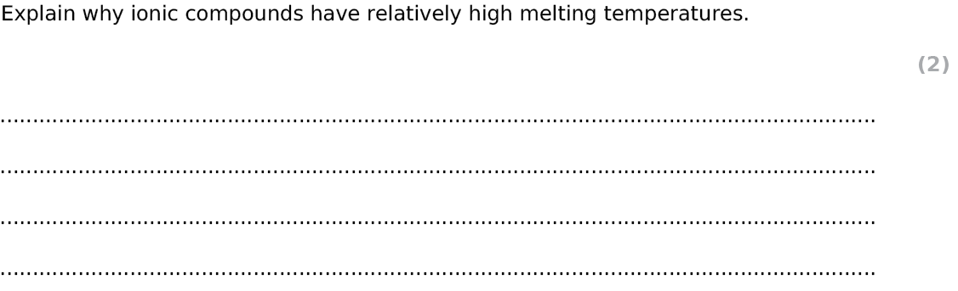
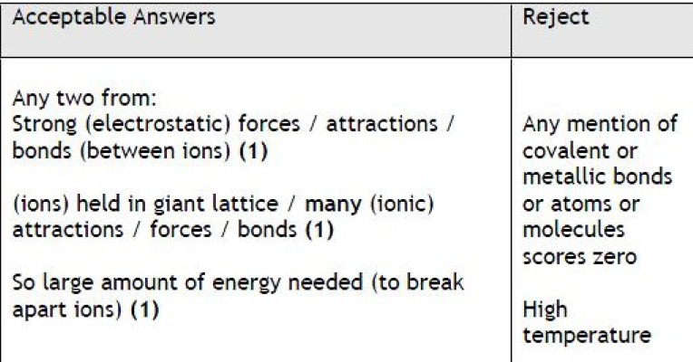
Exam Questions
Notes:
edexcel

Slide 40
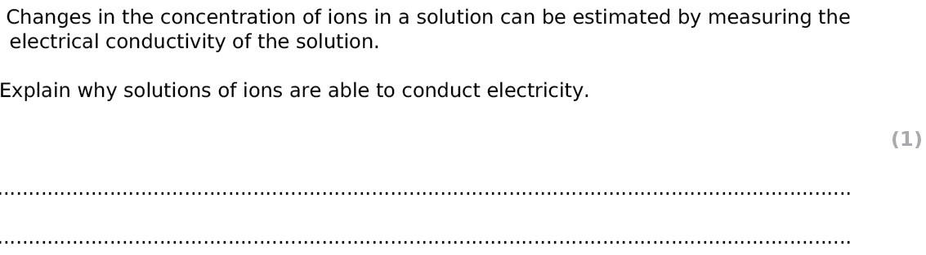
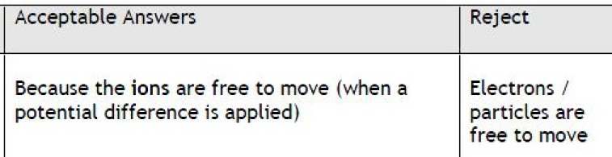
Exam Questions
Notes:
edexcel

Slide 41
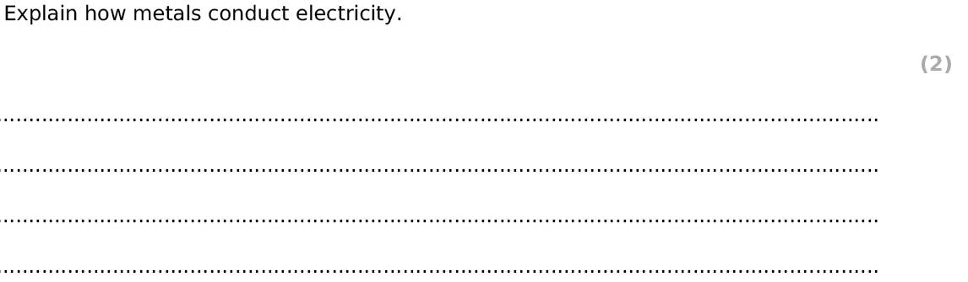
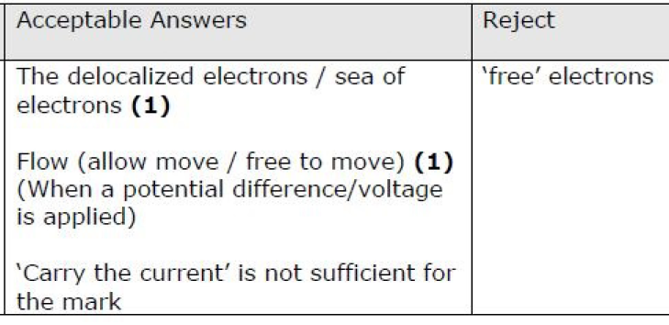
Exam Questions
Notes:
edexcel

Slide 42
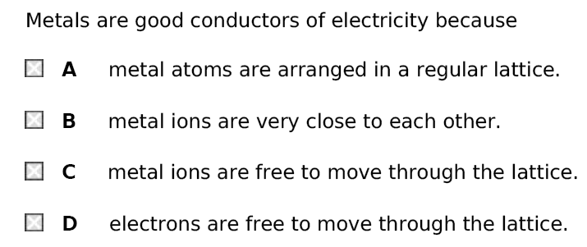
Exam Questions
Notes:
edexcel

Slide 43
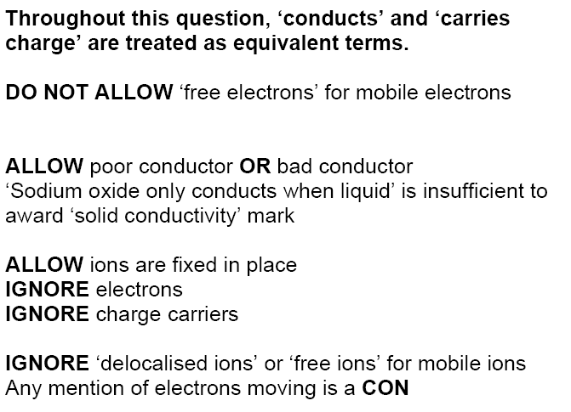
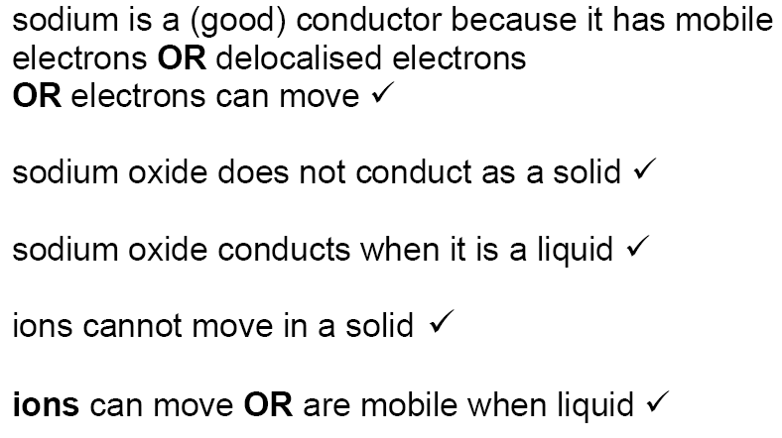
Exam question
Compare and explain the electrical conductivities of sodium and sodium oxide in the solid and liquid states. [5 marks]

Slide 44
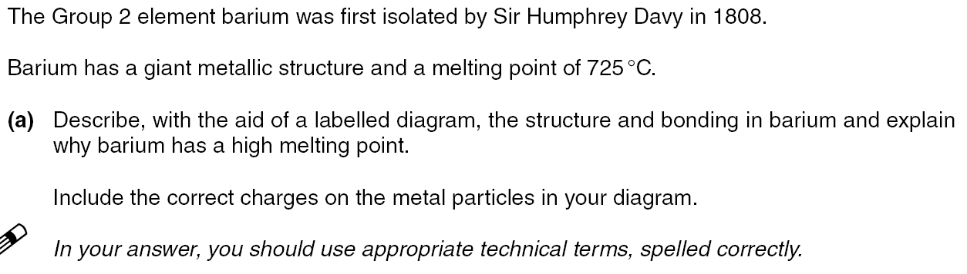
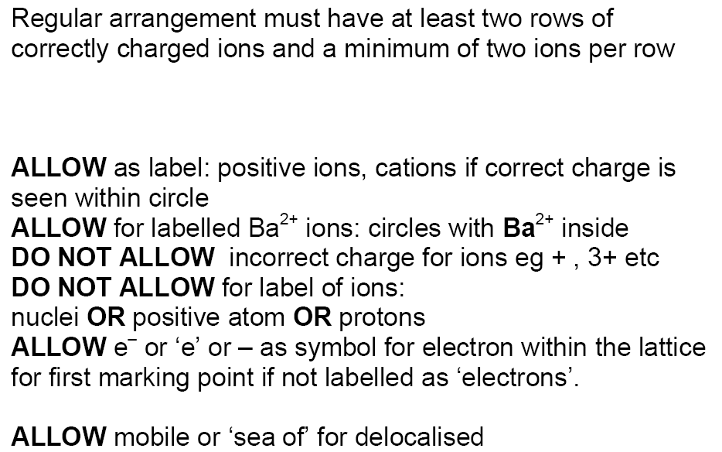
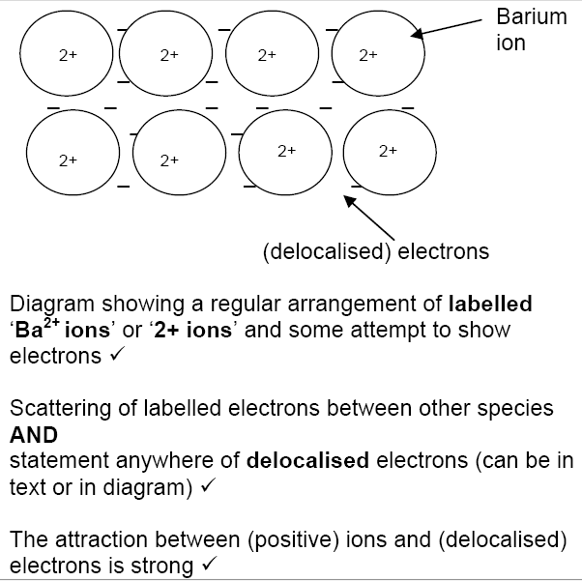
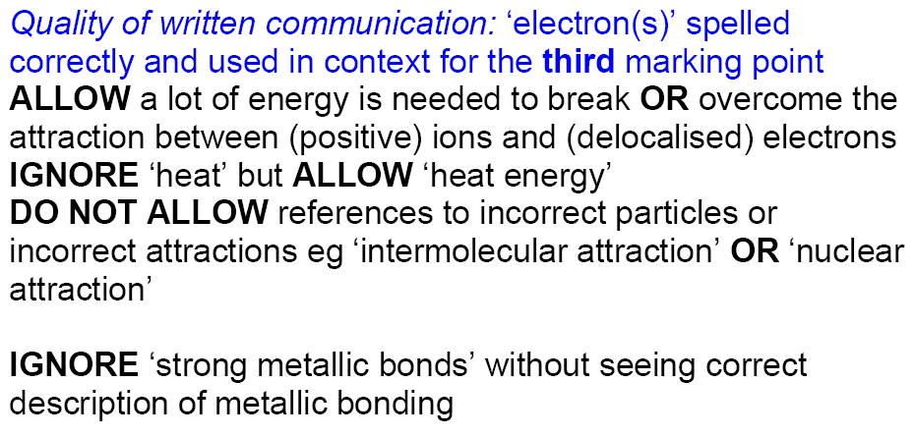
3 marks

Slide 45
Metallic Bonding and Ionic Substances
Metallic Bonding
Know that metallic bonding is the strong electrostatic attraction between metal ions and the delocalised electrons
For metallic and ionic substances
know that giant lattices are present in:
i) ionic solids (giant ionic lattices)
iii) solid metals (giant metallic lattices)
be able to predict the type of structure and bonding present in a substance from numerical data and/or other information
be able to predict the physical properties of a substance, including melting and boiling temperature, electrical conductivity and solubility in water, in terms of:
i) the types of particle present (atoms, molecules, ions, electrons)
ii) the structure of the substance
iii) the type of bonding and the presence of intermolecular forces, where relevant
Explain why different ionic substances have different melting and boiling points

