Slide 1
Nucleophilic Addition Reactions
Understand the reactions of carbonyl compounds with:
HCN, in the presence of KCN, as a nucleophilic addition reaction, using curly arrows, relevant lone pairs, dipoles and evidence of optical activity to show mechanism
2,4-dinitrophenylhydrazine (2,4-DNPH), as a qualitative test for the presence of a carbonyl group and to identify a carbonyl compound given melting temperature of derivatives data

Slide 2
What do you think you will make…
CH₃CH₂CHO + HCN → ?
CH₃COCH₂CH₃ + HCN → ?
What do you think they are called?

Slide 3
What do you think you will make…
CH₃CH₂CHO + HCN → CH₃CH₂CH(OH)CN
CH₃COCH₂CH₃ + HCN → CH₃C(CN)(OH)CH₂CH₃
2-hydroxybutanenitrile
2-hydroxy-2-methylbutanenitrile

Slide 4
Nucleophilic Addition Mechanism

Slide 5
Nucleophilic Addition Mechanism

Slide 6
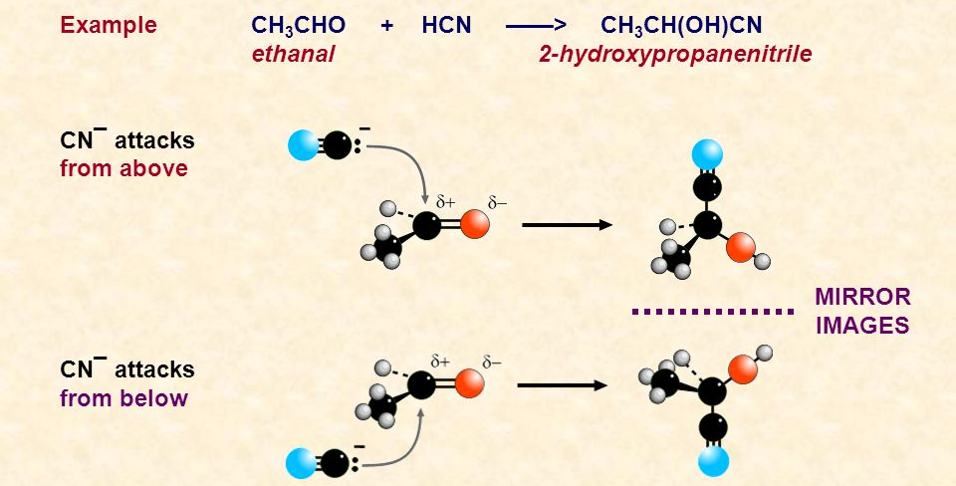
Why can it make a racemic mixture?
C=O is planar
Step 1 → equal chance of attacking from each side of the plane
Equal amounts of dextrorotary and laevorotatory enantiomers
No optical activity

Slide 8
Questions
Show the reaction of methanal and hydrogen cyanide
Name the organic product
Show the reaction of propanone and hydrogen cyanide
Name the organic product

Slide 9
Exam Question

Slide 10
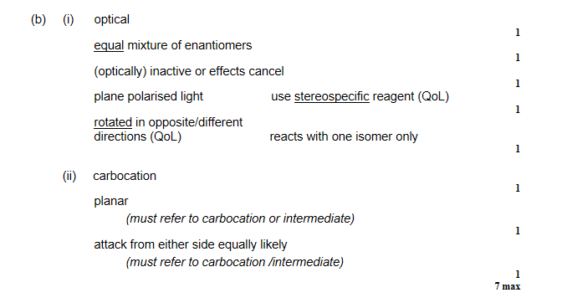

Slide 11
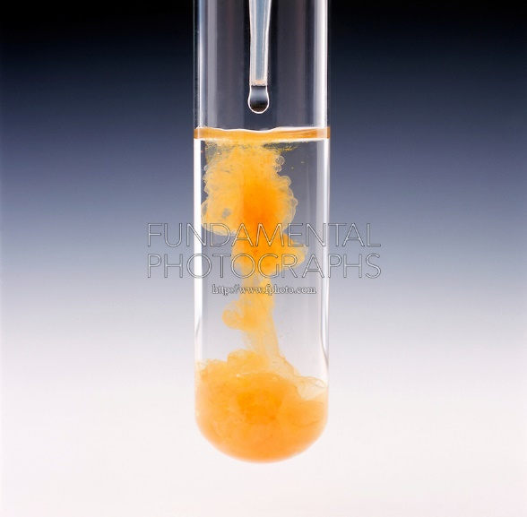
The reaction with 2,4-dinitrophenylhydrazine
Brady’s reagent
2,4-DNPH
Do not need to know equations or mechanisms for any reaction involving this reagent
Useful to know the structure, and the structure product of its reaction with a carbonyl compounds

Slide 13
Melting temperature of derivatives
Carbonyl Compounds | Boiling Temperature (°C) | Melting temperature of 2,4-dinitrophenylhydrazone derivative (°C)
Pentanal | 102 | 104
Pentan-2-one | 102 | 144
Pentan-3-one | 102 | 156
What can you conclude from this data?

Slide 14
Derivatives
Compounds formed known as derivatives
Filtered, purified and dried
Melting temperatures measured
Derivatives have the ending ‘-one’
E.g. derivative of butanal is butanal 2,4-dinitrophenylhydrazone
Can compare the experimental values to identify the original carbonyl compound
Match melting temperature to data book

Slide 15
Exit Pass
Compound X reacts with 2,4-dinitrophenylhydrazine and with iodine in aqueous alkali in separate tests. In both cases a coloured precipitate is formed.
Explain which of these could be compound X:
Propanal Propan-1-ol Propan-2-ol Propanone

