Slide 1
Do Now:
Answer the two multiple choice exam questions
Notes:
Y
Z

Slide 2
MWB
Show the mechanism between bromoethane and sodium hydroxide in cold, aqueous solution

Slide 3
Nucleophilic Substitution

Slide 4
What is meant by ‘rate-determining’ step?

Slide 5
The S_{N}2 mechanism
S = substitution
N = nucleophilic
2 = bimolecular and second order
Bimolecular – two species involved in the rate-determining step

Slide 6
Example

Slide 7
The S_{N}2 mechanism
Notice the arrangement of the three groups that remain attached to the central carbon has been inverted.
Due to the inversion, the optical activity of the product is different from that of the reactant.
If the reactant is dextrorotatory, then the product will be laevorotary.
By measuring the optical activity of the original halogenoalkane and the alcohol formed, we can show whether it has occurred by the S_{N}2 mechanism.

Slide 8
Question
2-chloropentane and hydroxide ions react together by an S_{N}2 mechanism. Show the formation of 2-hydroxypentane.
2-bromobutane and cyanide ions react together by an S_{N}2 mechanism. Draw the structure of the transition state formed in this reaction.

Slide 9
The S_{N}1 mechanism
S = substitution
N = nucleophilic
1 = unimolecular and first order
Unimolecular – only one species is involved in the rate-determining step

Slide 10
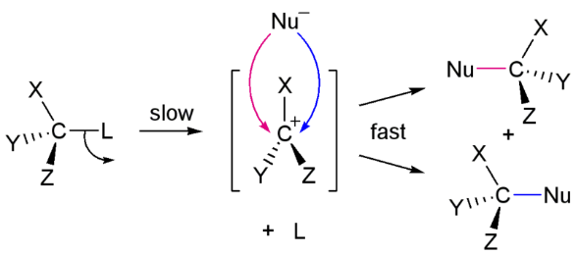

Slide 11
The S_{N}1 mechanism
Original halogenoalkane has a tetrahedral shape
Product of the first step of the reaction is a carbocation with a planar shape
Therefore there is an equal chance of the attacking nucleophile approaching from the left and the right
Two enantiomer products are made
Made in equal numbers, so a racemic mixture is formed./

Slide 12
Question
2-bromobutane and cyanide ions react together by an S_{N}2 mechanism. Explain why there is no change in optical activity in this reaction.

Slide 13
S_{N}1 or S_{N}2?
S_{N}1 – tertiary halogenoalkanes
S_{N}2 – primary halogenoalkanes

