Slide 2
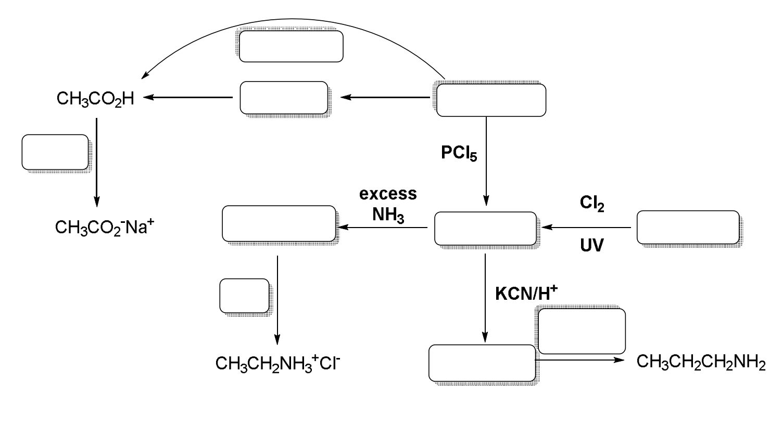

Slide 3
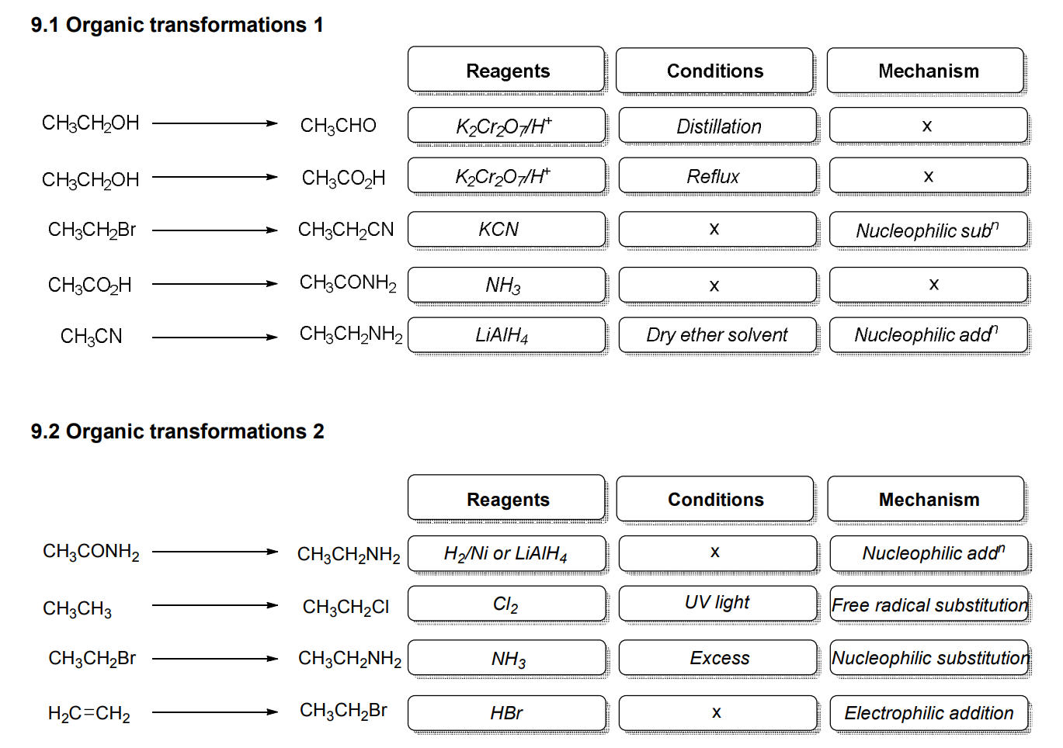

Slide 5
How could you?
Synthesise 1-bromobutane to pentanenitrile?
Synthesise ethanoic acid to methyl ethanoate?
Synthesise but-1-ene to butan-2-ol?
Synthesise cyclohexanol to cyclohexene?
Synthesise ethane to ethanoic acid?
Synthesise propanone to 2-bromopropane?
Must include as much information as possible! Do not forget reagents and conditions.

Slide 6
Organic Analysis Revision

Slide 9
Exam Questions

