Slide 1
Oxidation of Alcohols

Slide 2
Aldehydes, Ketones and Carboxylic Acids
General formulas:

Slide 3
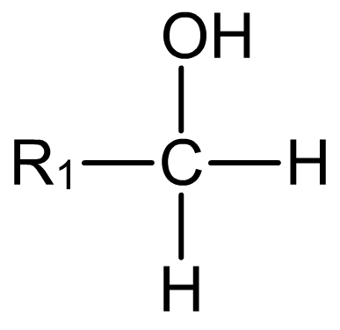
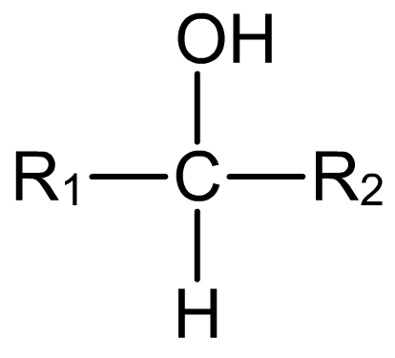
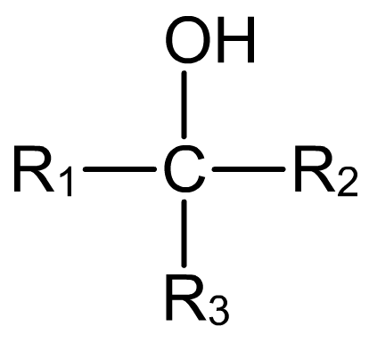
Primary, secondary and tertiary
A chain of carbon atoms can be represented by R when drawing the structure. This is referred to as an R group.
Primary (1°) alcohols have one R group attached to the carbon to which the OH group is attached.
Secondary (2°) alcohols have two R groups attached to the carbon to which the OH group is attached.
Tertiary (3°) alcohols have three R groups attached to the carbon to which the OH group is attached.

Slide 4
MBW – Draw the following compounds..
Ethanal
Ethanoic acid
Propanal
Propanoic acid
Propanone
Butanal
Butanoic acid
Butanone

Slide 5
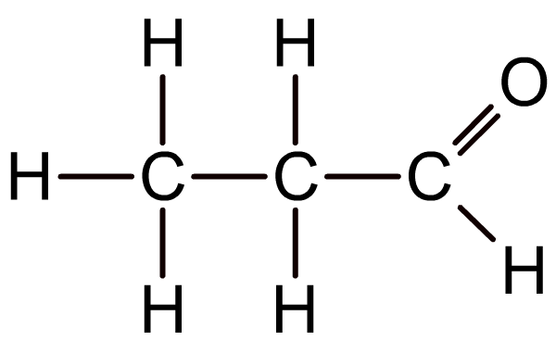
Oxidation of 1° alcohols: aldehydes
Primary alcohols can be oxidized to aldehydes by an oxidizing agent such as an aqueous solution of acidified potassium dichromate(VI).
When the symbol equation is written, the oxidizing agent is represented by [O]:
RCH₂OH + [O] → RCHO + H₂O
Aldehydes contain a carbonyl group (C=O) at the end of the carbon chain, and are named using the suffix –al.
propanal
Notes:
Teacher notes
Students could be made aware that alcohols are oxidized during combustion, but that this destroys the carbon skeleton. Oxidizing alcohols using potassium dichromate(VI) (which contains the dichromate ion (Cr₂O₇²⁻)) or potassium manganate(VII) (which contains the manganate ion (MnO₄⁻)) leaves the carbon skeleton of the alcohol intact.

Slide 6
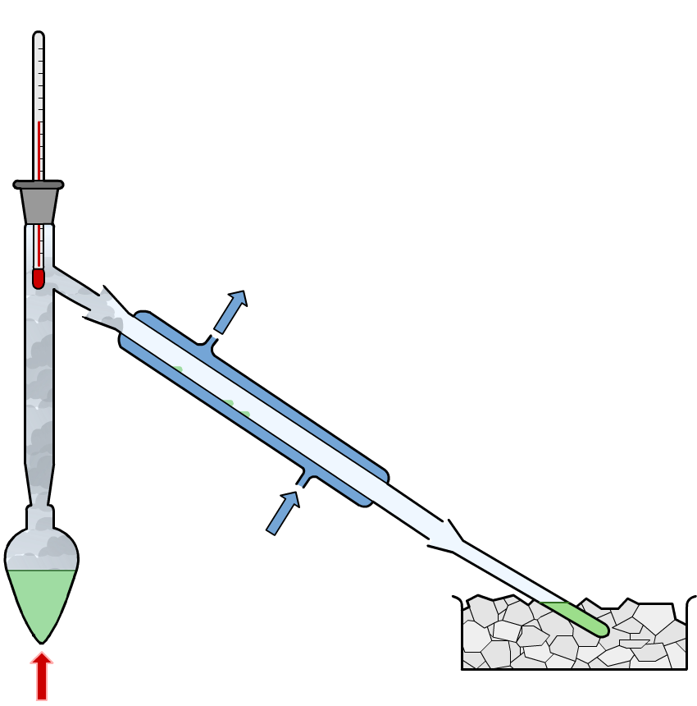
Synthesis of aldehydes – Distillation with addition
When aldehydes are prepared by the reaction of a primary alcohol with acidified potassium dichromate(VI), the aldehyde is distilled off and collected, preventing further oxidation.
mixture of alcohol, dilute sulfuric acid and potassium dichromate(VI)
water out
water in
aldehyde
ice
heat
Notes:
Teacher notes
An excess of alcohol is also used to prevent secondary oxidation – this ensures there isn’t enough oxidizing agent present.
Ethanal has a boiling temperature of 294K so vaporises as soon as it is formed and distils off so ice keeps it cool.

Slide 7
The Conditions…
Potassium chromate, acidified with dilute sulfuric acid is used to oxidise alcohols.
It is an oxidising agent.
The orange dichromate ions are reduced to green chromium ions.

Slide 8
Oxidising Agent
[O] = oxidising agent NOT oxygen!!!
CH₃CH₂OH(l) + [O] → CH₃CHO(g) + H₂O(g)
Still has to balance!!!

Slide 9
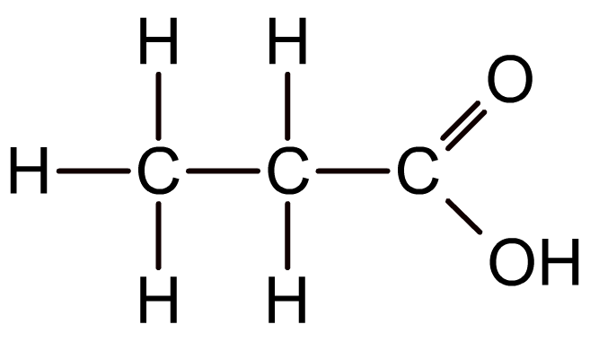
Oxidation of 1° alcohols: carboxylic acids
If primary alcohols are reacted with an excess of oxidizing agent and refluxed, they can be oxidized to aldehydes and then oxidized further to carboxylic acids.
RCH₂OH + [O] → RCHO + H₂O
RCHO + [O] → RCOOH
Carboxylic acids contain a carbonyl group (C=O) at the end of the carbon chain, with a hydroxyl group (OH) attached to the carbonyl carbon.
Carboxylic acid are named using the suffix –oic acid.
propanoic acid

Slide 10
H H
H C C OH
H H
H O
H C C
H
H
Alcohol in excess – no reflux
ethanol
ethanal (an aldehyde)
H O
H C C
OH
H
Oxidising agent in excess - reflux
ethanoic acid (a carboxylic acid)

Slide 11
Notes:
Teacher notes
See the ‘Redox Reactions’ presentation for more information about oxidation states.

Slide 12
Notes on Reflux…
Reflux is the process of boiling reactants while continually cooling the vapour returning it back to the flask as a liquid.
When the mixture is refluxing, any ethanol or ethanal vapour will condense and drip back into the flask until, eventually, it is all oxidised to carboxylic acid.
After 20 minutes, we can distil off the ethanoic acid, boiling temperature of 391K.

Slide 13
Ethanol → Ethanoic Acid
CH₃CH₂OH(l) + 2 [O] → CH₃COOH(g) + H₂O(l)
What is the difference between this reaction and the reaction to make ethanal?

Slide 14
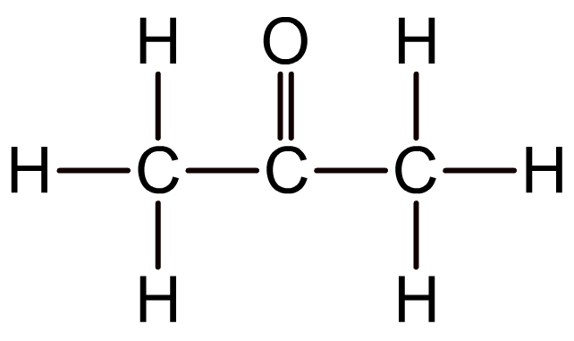
Oxidation of 2° alcohols: ketones
Secondary alcohols can be oxidized to ketones by an oxidizing agent such as an aqueous solution of acidified potassium dichromate(VI).
R₁CH(OH)R₂ + [O] → R₁COR₂ + H₂O
Ketones contain a carbonyl group (C=O) attached to any carbon in the chain except a terminal carbon atom, and are named using the suffix –one.
propanone
Tertiary alcohols are resistant to oxidation due to the lack of hydrogen atoms on the carbon atom to which the hydroxyl group is attached.
Notes:
Teacher notes
Tertiary alcohols are very resistant to oxidation except under extreme conditions, which result in the breaking of C–C bonds.

Slide 15
H H
H C C OH
H CH₃
H O
H C C
CH₃
H
propan-2-ol
propanone (a ketone)
Secondary alcohols are oxidised to ketones by acidified dichromate.
H O
H C C
OH
H
cannot oxidise to carboxylic acid

Slide 16
Aldehyde, ketone or carboxylic acid?

Slide 17
What’s the structure?

Slide 18
Exam Questions

