Slide 1
Elements in group 1 & 2
Inorganic chemistry

Slide 2
STARTER
Write an equation for Barium reacting with water. Use state symbols.
What is the trend for atomic radius as we go down the group?
Explain this trend.
Define ionic radius

Slide 3
LO; Understanding the physical properties of group 1/2 elements
Success criteria
Understand the trends that occur in group 1 elements (LD)
Be able to explain each trend that occurs (MD)
Using prior knowledge to link the trend to group 2 metals (HD)

Slide 4
Group 2
Chemical Properties
Physical Properties
Solubility

Slide 5
Trends that you need to know
Atomic radius
Ionic radius
Ionisation energy
Melting/Boiling points

Slide 6
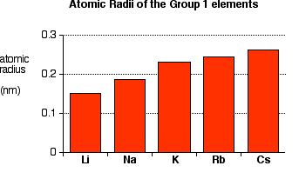
Atomic radius
Atomic radius is the size of an atom.

Slide 7
Explaining the trend
Why does it increase? (2)
More shells
Shielding increases
The nuclear attraction between the outer electron and the nucleus decreases.
Atoms get bigger
Be able to explain each trend that occurs (MD)
Understand the trends that occur in group 1 elements (LD)

Slide 8
Ionic radius
Ionic Radius is the measure of an atom's ion. It is half the distance between two ions that are barely touching each other.

Slide 9
WHAT ELEMENT HAS A BIGGER Atomic RADIUS?
K or Ca
K has a bigger atomic radius.
Why?
Ca has more protons are added to the nucleus.
The outer electrons are closer to the nucleus and more strongly attracted to the nucleus.
So, Ca has a smaller atomic radius.
Using prior knowledge to link the trend to group 2 metals (HD)

Slide 10
State the trend in atomic radius down Group II from Mg to Ba and give a reason for this trend. (2)

Slide 11
Explaining the trend
Why does it increase? (2)
More shells
Shielding increases
The nuclear attraction between the outer electron and the nucleus decreases.
Atoms get bigger
Using prior knowledge to link the trend to group 2 metals (HD)

Slide 12
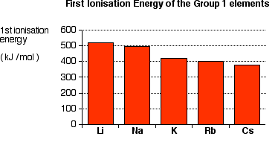
IONISATION ENERGY
What is ionisation energy?
Energy required to remove an electron from a gaseous atom or ion

Slide 13
General trend
What is the general trend?
As you move down a group, ionization energy decreases.
Explain why?
More shielding
Electrons are further from the nucleus, nuclear attraction decreases
Easier to remove the outermost one
Be able to explain each trend that occurs (MD)
Understand the trends that occur in group 1 elements (LD)

Slide 14
Challenge: WHICH ELEMENT HAS A HIGHER IONISATION ENERGY?
Li or Be
They are both in the same period. However Be has a higher ionisation energy.
Explain why?
Because the atomic radius decreases, the atom is smaller.
This increases the nuclear attraction between the nucleus and outer electrons.
Making the electrons harder to remove.
Using prior knowledge to link the trend to group 2 metals (HD)

Slide 15
SECOND IONISATION ENERGY
Which element do you think has a lower 2nd ionisation energy. Explain why?
Na⁺ or Mg⁺
Write the electron configuration for both ions.
Magnesium has a lower 2nd ionisation energy because it has one electron on its outer shell. Whereas for sodium it will have to remove an electron from the second shell, with 8 outer electrons. Hence, more energy required.

Slide 16
MELTING POINTS
General Trend for group 1 elements – Decreases as we go down the group
Why?
All of these elements are held together by metallic bonds.
The atoms in a metal are held together by the attraction of the nuclei to the delocalised electrons.
As the atoms get bigger, the nuclei get further away from these delocalised electrons, and so the attractions fall. Nuclear attraction decreases.
That means that the atoms are more easily separated, less energy needed
Be able to explain each trend that occurs (MD)
Understand the trends that occur in group 1 elements (LD)

Slide 17
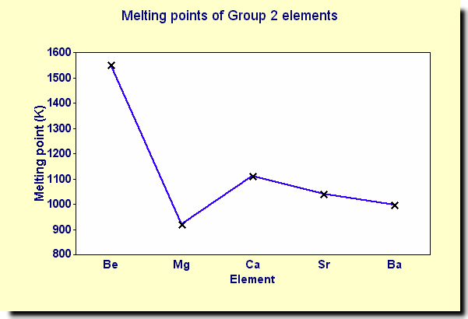
Using prior knowledge to link the trend to group 2 metals (HD)

Slide 18
State the general trend in melting point down Group II from Mg to Ba and give a reason for this trend. (3)

Slide 19
PLENARY
Is the first ionisation energy of radium more or less than that of barium? Explain your reasoning. (4)
Is the melting point of radium more or less than that of barium? Explain your reasoning.(3)
A group 2 metal, Y, has slow reaction when added to water. Identify Y and write an equation for the reaction with water. (2)

Slide 20
ANSWERS
Lower, atomic radius greater, more shielding, weaker attraction between outer shell electrons and nucleus.
Lower, weaker metallic bonding, metal ions (atoms) are larger
Mg

