Slide 1
Starter for 10

Slide 3
Answers
1a) Zn → oxidised Cu → reduced
b) Zn → Zn²⁺ + 2e⁻ Cu²⁺ + 2e⁻ → Cu
2a) Oxidised
b) Reduced
c) Neither
d) Reduction
e) Oxidised
f) Neither
3a) Fe → Loses 2 electrons to bond with sulfate ion
b) Na → loses 1 electron to bond with hydride ion
c) Cu(s) → loses 2 electrons to bond with oxygen ion
d) Fe → loses 1 electron (goes from Fe²⁺ to Fe³⁺)
e) Zn → loses 2 electrons

Slide 4
Task
Chemsheets Oxidation States and Redox
Part A “Oxidation States”

Slide 6
What are Half Equations?
They show the GAIN or LOSS of e- by one chemical.
E.g., FULL EQUATION for sodium reacting with chlorine:
2Na(s) + Cl₂ (g) → 2NaCl(s)
Each sodium atom is losing an e- so you could write a half equation:
Na → Na⁺ + e-
Each chlorine atom in a chlorine molecule gains an e-, so you could write a half equation:
Cl₂ + 2e- → 2Cl⁻
(You must show 2 chloride ions because each chlorine molecule, Cl₂, contains 2 chlorine atoms)
Notes:
Note that the e- are on different sides of the arrow: oxidation and reduction – loss of e- and gain of e-

Slide 7
Your Turn
2Na(s) + Br₂ (g) → 2NaBr(s)
Write the half equation for:
Sodium
Bromine

Slide 8
Your Turn
2Na(s) + Br₂ (g) → 2NaBr(s)
Write the half equation for:
1. Sodium
Na → Na⁺ + e-
2. Bromine
Br₂ + 2e- → 2Br⁻

Slide 9
Spectator Ions
Which ones are spectator ions?
Ones that :
Are not oxidized or reduced
Do not change state (e.g., from solid to aq solution)
Zn (s) + CuSO₄(aq) → Cu(s) + ZnSO₄ (aq)
Each Zinc atom is oxidized:
Zn (s) → Zn²⁺(aq) + 2e-
Each Copper ion is reduced:
Cu²⁺(aq) +2e- → Cu(s)
The sulfate ions SO₄^{2- so} not appear in the equations.
They do not change during the reaction.
They are dissolved in water so are just floating around.
They “watch” the reaction - spectator ions.
Which ones do I include?
Ones that :
Those that are oxidized or reduced.
Those that change state

Slide 10
Check Your Understanding so Far
Write half equations for these changes:
1 .An iodide ion changes into iodine
2. A fluorine molecule changes into fluoride ions.
3. A potassium atom changes into a potassium ion.
4. A barium atom changes into a barium ion
5. An aluminium ion is changed into an aluminium atom.
EXT: State whether each half equation is showing oxidation or reduction.

Slide 11
Check Your Understanding so Far - Answers
2I⁻ → I₂ + 2e⁻
F₂ + 2e⁻ → 2F⁻
K → K⁺ + e⁻
Ba → Ba²⁺ + 2e⁻
Al³⁺ + 3e⁻ → Al

Slide 12
Working out Half Equations
The numbers of atoms on each side of the equation must be the same.
The total charge on each side of the equation must be the same
a) Calculate oxidation states on each side of the equation.
b) Balance the element changing oxidation state.
c) Sort out electrons. If the oxidation state becomes more negative then it gains electrons. If the oxidation state becomes more positive then electrons are lost.
d) Sort out Os. For every O gained/lost, add/remove one H₂O molecule.
e) Sort out Hs. For every H gained/lost, add/remove one H⁺ ion.
f) Check – if the total electric charge on the left equals that on the right then it is probably correct. If it is not then you know that you have gone wrong!

Slide 13
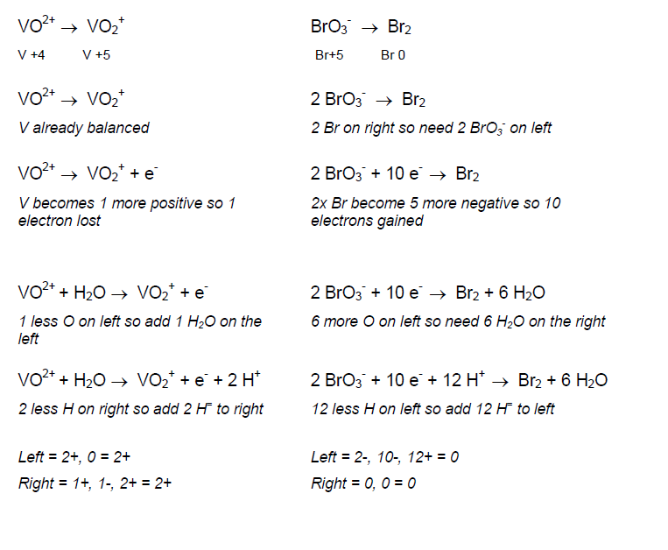

Slide 15
Task
Chemsheets Task B Q 3

Slide 17
Combining Half Equations
Step 1: Write out the 2 half equations
Step 2: Note the number of e- each half equation gains or loses. So that both equations involve the same number of e-, you may have to multiply up one or both equations.
Step 3: Multiply up the reactants and products.
Step 4: Write all the reactants together and the products together.
Step 5: There should be the same number of e- on each side of the equation. Cancel them. What is left behind is the full balanced equation.

Slide 18
Example

Slide 19
Task
Chemsheets C: Combining equations Q4

Slide 21
Overall notes
Any redox reaction divided into 2 half equations:
One represents Oxidation and the other Reduction.
1. Balance with respect to MASS
A) Element being ox or red
B) Any oxygen molecules with water molecules.
C) Hydrogen atoms in water with H+ ions
2. Balance with respect to CHARGE using e-
(to check how many e-, see the change in oxidation state).
3. To get the FULL overall redox equation
A. Balance no of e- in each half equation
B. Add together and the e- will cancel.

Slide 22
Half-Equations
TIPS:
Balance the number of atoms
Balance the number of charges
Always have “+e-” rather than “‒ e-” in your half-equations
They can be recombined to give your full equations again
If you have a different number of electrons, MULTIPLY each equation by a factor that will give you equal numbers of electrons in each one
They show the LOSS or GAIN of e- by one substance.
E.g.,
FULL EQUAITON:
Mg(s) + Cl₂ (g) → MgCl₂ (s)
2 half-equations:
An Oxidation Reaction
A Reduction Reaction
Mg → Mg²⁺ +2e-
Cl₂ +2e- → 2Cl⁻

Slide 23
Example
Combine these 2 half-equations:
Al³⁺ + 3e- → Al
(Multiply by 4 to get 12e- 4Al³⁺ + 12e- → 4Al)
2O²⁻ → O₂ +4e-
(Multiply by 3 to get 12e- 6O²⁻ → 3O₂ +12e-)
OVERALL:
4Al³⁺ + 6O²⁻ → 4Al + 3O₂

Slide 24
Quick Check …
Work out the oxidation state of the underlined element in
SO₂; PCl₃; Na₂S₂O₃
S²⁻; ClO₃⁻; PCl₄⁺
2. Zinc reacts with copper chloride
Zn + CuCl₂ → ZnCl₂ +Cu
Write 2 half-equations, and identify which species is oxidised and which one is reduced.
3. Combine these 2 half-equations
Al → Al³⁺ + 3e- and Cl₂ +2e- → 2Cl-

Slide 25
Task
Complete the Redox Reactions worksheet

Slide 26
Exam Questions
Notes:
June 2013 Unit 2 Question 4a (QS13.2.04)
January 2012 Unit 2 Question 5ab (QW12.2.05)
June 2011 Unit 2 Question 5a (QS11.2.05)
January 2005 Unit 2 Question 2 (QW05.2.02)
January 2002 Unit 2 Question 4 (QW02.2.04)

