Slide 1
Write the half equation for the reduction of manganate (VII) in acidic conditions
MnO₄⁻ _{(aq)} +
Challenge: What is potassium manganate (VII) good at?
Why does this reaction not work well for titrations in alkaline conditions?

Slide 2
Acting as its own indicator
In a titration, the Mn²⁺ ions accumulate
At the dilution used → gives a colourless solution
As soon as the potassium manganate (VII) is in excess, the solution becomes pink
End point → first permanent pink colour

Slide 3
Titration of potassium manganate (VII) with iron (II) ions

Slide 4
Combining Half-Equations
When you combine 2 half-equations multiply each half-equation by factors needed to give equal numbers of e-
MnO₄⁻ + 8H⁺ + 5e-→ Mn²⁺ + 4H₂O
Fe²⁺ → Fe³⁺ +e-
(Multiply by 5)
MnO₄⁻ + 8H⁺ + 5e-→ Mn²⁺ + 4H₂O
5Fe²⁺ → 5Fe³⁺ + 5e-
(Add together and cancel e-)
MnO₄⁻ + 8H⁺ + 5Fe²⁺ → Mn²⁺ +4H₂O + 5Fe³⁺
Think back to TM – What are the colours of the metal ions?

Slide 5
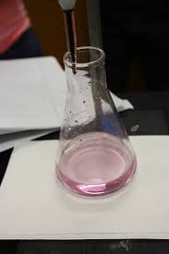
Titration – Core Practical 11

Slide 6
Questions

Slide 7
Titration of potassium manganate (VII) with ethanedioic acid
MnO₄⁻ + 8H⁺ + 5e-→ Mn²⁺ + 4H₂O
H₂C₂O₄(aq) → 2H⁺(aq) + 2CO₂(g) + 2e⁻

Slide 8
Questions - Discuss
What would you acidify the ethanedioic acid with?
Why do you think the ethanedioic acid is heated to 60°C before starting the titration?
Why do you think the reaction speeds up during the titration?

Slide 9
Use titration results to calculate the concentration of a reagent
27.5cm³ of 0.0200 moldm⁻³ aqueous potassium manganate(VII) reacted with 25.0cm³ of acidified ethanedioate solution. Calculate the concentration of C₂O₄²⁻ in the solution.
2MnO₄⁻ + 16H⁺ + 5C₂O₄²⁻ → 2Mn²⁺ +8H₂O + 10CO₂
Moles of MnO₄⁻ = c x V = 0.0200 x (27.5/1000) = 5.50x10⁻⁴ mol
Ratio = 2:5
Moles of C₂O₄²⁻ = 5.50x10⁻⁴ x 5/2 = 1.38x10⁻³ mol
25cm³ contained 1.38x10⁻³ mol
So 1000cm³ (1dm³) contains 1.38x10⁻³ x 1000/25.0 = 0.552 mol
So conc in moldm⁻³ = 0.552 moldm⁻³

Slide 10
Use titration results to calculate the volume of a reagent
0.00800 moldm⁻³ aqueous potassium manganate(VII) reacted with 25.0cm³ of 0.0600 moldm⁻³ acidified iron(II) sulfate solution. Calculate the volume of potassium manganate(VII) used.
MnO₄⁻ + 8H⁺ + 5Fe²⁺ → Mn²⁺ +4H₂O + 5Fe³⁺
Moles of Fe²⁺⁻ = c x V = 0.0600 x (25.0/1000) = 1.50x10⁻³ mol
Ratio = 5:1
Moles of MnO₄⁻ = 1.50x10⁻³ /5= 3.00x10⁻⁴ mol
Vol = mol/conc = 3.00x10⁻⁴ /0.00800 = 0.0375 dm³ = 37.5cm³

Slide 11
Determine the number of moles of water of crystallisation per mole of hydrated iron(II) sulfate crystals
Concentration of potassium manganate (VII) solution = 0.0198mol dm⁻³
Mass of hydrated iron (II) sulfate = 6.84g
Mean titre of potassium manganate = 24.95cm³
Volume of iron(II) solution = 25.0cm³

Slide 12
Iodine and sodium thiosulfate
Thiosulfate ions reduce iodine to iodide ions.
2S₂O₃²⁻ (aq) → S₄O₆²⁻ (aq) + 2e⁻
I₂ (aq) + 2e⁻ → 2I⁻ (aq)
2S₂O₃²⁻ (aq) + I₂ (aq) → S₄O₆²⁻ (aq) + 2I⁻ (aq)
Reaction is used for the direct estimation of iodine, or for the estimation of a substance that can take part in a reaction that produces iodine.

Slide 13
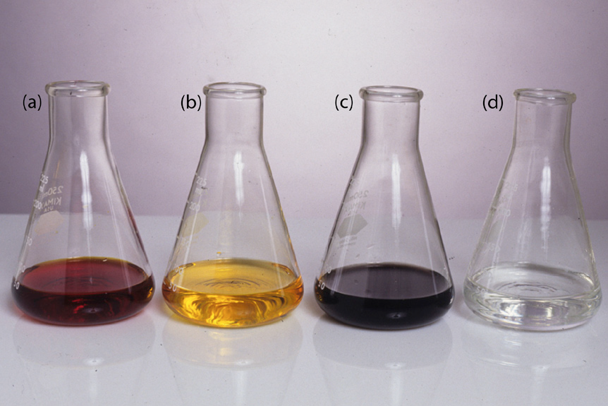
Iodine and sodium thiosulfate
Indicator → starch solution
With free iodine → produces a deep blue-black colour
Blue-black colour disappears as soon as sufficient sodium thiosulfate has been added to react with all of the iodine
What do you think would happen if the starch was added too early?
What would happen if the starch was not added at all?

Slide 14
Determine the percentage of copper (II) ions in a sample of hydrated copper (II) sulfate
2Cu²⁺ _{(aq)} + 4I⁻ _{(aq)} → 2CuI_{(s)} + I₂ _{(aq)}
Concentration of sodium thiosulfate solution = 0.00995 moldm⁻³
Mass of hydrated copper (II) sulfate crystals = 5.85g
Mean titre of sodium thiosulfate solution = 23.45cm³

