Slide 1
Relative Mass
http://www.chemguide.co.uk/analysis/masspec/elements.html

Slide 2
Lesson objectives relative mass
Understand the term ‘isotopes’
Define the terms ‘relative isotopic mass’ and ‘relative atomic mass’ based on the ¹²C scale
Understand the terms ‘relative molecular mass’ and ‘relative formula mass’ including calculating these from relative atomic masses Definitions of these terms will not be expected. The term ‘relative formula mass’ should be used for compounds with giant structures.
Be able to analyse and interpret data from mass spectrometry to calculate relative atomic mass from relative abundance of isotopes and vice versa
Be able to predict the mass spectra, including relative peak heights, for diatomic molecules, including chlorine
Understand how mass spectrometry can be used to determine the relative molecular mass of a molecule Limited to the m/z value for the molecular ion, M+, giving the relative molecular mass of the molecule.

Slide 3
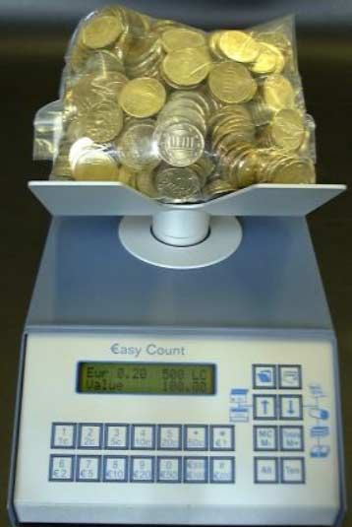
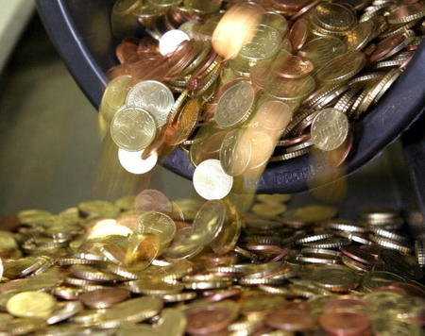
How do we count atoms?
How does a bank count very large numbers of coins?
By weighing them.

Slide 4
How do we count atoms?
What do they need to know in order to do this?
How much a single coin weighs.
Chemists count atoms in the same way, but we need to know how much an atom weighs – this is it’s R.A.M. (Relative atomic mass)

Slide 5
Relative Atomic Mass
Relative atomic mass is also written A_{r}
This is relative to carbon-12
Definition:
Relative atomic mass A_{r}, is the weighted mean mass of an atom of an element compared with one-twelfth of the mass of an atom of carbon-12

Slide 6
Relative Atomic Mass
Carbon 12 is used as the standard.
All masses are relative to this.
1/12 of the mass of ¹²C is one mass unit.
Carbon 12 is the isotope of carbon that has…
…6 protons and 6 neutrons
Carbon-12 is defined as having a relative isotopic mass 12.

Slide 7
Isotopes
Definition:
Isotopes are atoms of the same element with different numbers of neutrons.

Slide 8
Relative Isotopic Mass
Relative isotopic mass is the mass of an atom of an isotope compared with one-twelfth of the mass of an atom of carbon-12
E.g. oxygen-16 has a relative isotopic mass of 16.0

Slide 9
Relative Atomic Mass
Relative atomic masses are found in the periodic table.
Why are these not whole numbers?
They are actually the average mass of all atoms of that element.
So why do we need an average?
Elements have more than one naturally occurring isotope with different masses.

Slide 10
Relative Atomic Mass
So what two things do we need to calculate the relative atomic mass for an element?
The relative isotopic masses of the different isotopes.
The relative abundance of these isotopes.

Slide 11
Relative Atomic Mass
What is the relative atomic mass of chlorine:
75.5% of chlorine atoms are chlorine-35
24.5% of chlorine atoms are chlorine-37
Relative atomic mass = (75.5 x 35 + 24.5 x 37)
100
= 35.5

Slide 12
Relative Atomic Mass
In general
R.A.M. = (R.I.M.1 x abundance1) + (R.I.M.2 x abundance2)
100

Slide 13
Relative Molecular Mass
The relative molecular mass, M_{r} is the weighted mean mass of a molecule compared with one-twelfth of the mass of an atom of carbon-12

Slide 14
Relative Formula Mass
Relative molecular mass refers to compounds containing molecules.
The term relative formula mass, is used for compounds containing ions.
This is because ionic compounds exist as a giant lattice so the concept of a single molecule is misleading.

Slide 15
Relative Formula Mass
The relative formula mass, is the weighted mean mass of a formula unit compared with one-twelfth of the mass of an atom of carbon-12.

Slide 16
Lesson objectives relative mass
Understand the term ‘isotopes’
Define the terms ‘relative isotopic mass’ and ‘relative atomic mass’ based on the ¹²C scale
Understand the terms ‘relative molecular mass’ and ‘relative formula mass’ including calculating these from relative atomic masses Definitions of these terms will not be expected. The term ‘relative formula mass’ should be used for compounds with giant structures.
Be able to analyse and interpret data from mass spectrometry to calculate relative atomic mass from relative abundance of isotopes and vice versa
Be able to predict the mass spectra, including relative peak heights, for diatomic molecules, including chlorine
Understand how mass spectrometry can be used to determine the relative molecular mass of a molecule Limited to the m/z value for the molecular ion, M+, giving the relative molecular mass of the molecule.

Slide 17
Answer the following questions on whiteboards
Calculate the relative atomic mass, A_{r} , of the following.
Give your answers to 4 significant figures
Boron contains: 19.77% ¹⁰B and 80.23% ¹¹B
Silicon contains: 92.18% ²⁸Si ; 4.70% ²⁹Si ; and 3.12% ³⁰Si
Chromium contains: 4.31% ⁵⁰Cr; 83.76% ⁵²Cr; 9.55% ⁵³Cr; and 2.38% ⁵⁴Cr
10.80
28.11
52.06

Slide 18
Answer the following questions on whiteboards
Use A_{r} values from the Periodic Table to calculate the relative molecular mass of the following.
HCl
CO₂
H₂S
NH₃
H₂SO₄
36.5
44.0
34.1
17.0
98.1

Slide 19
Answer the following questions on whiteboards
Use A_{r} values from the Periodic Table to calculate the relative formula mass of the following.
Fe₂O₃
Na₂O
Pb(NO₃)₂
(NH₄)₂SO₄
Ca₃(PO₄)₂
159.6
62.0
331.2
132.1
310.3

Slide 20
Lesson objectives relative mass
Understand the term ‘isotopes’
Define the terms ‘relative isotopic mass’ and ‘relative atomic mass’ based on the ¹²C scale
Understand the terms ‘relative molecular mass’ and ‘relative formula mass’ including calculating these from relative atomic masses Definitions of these terms will not be expected. The term ‘relative formula mass’ should be used for compounds with giant structures.
Be able to analyse and interpret data from mass spectrometry to calculate relative atomic mass from relative abundance of isotopes and vice versa
Be able to predict the mass spectra, including relative peak heights, for diatomic molecules, including chlorine
Understand how mass spectrometry can be used to determine the relative molecular mass of a molecule Limited to the m/z value for the molecular ion, M+, giving the relative molecular mass of the molecule.

Slide 21
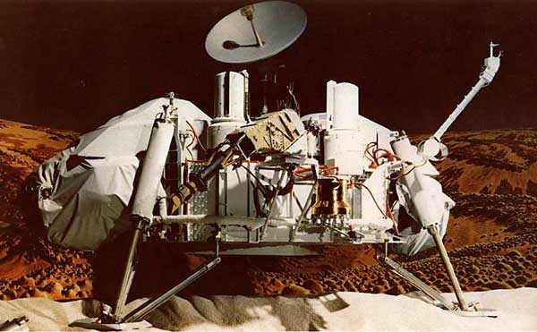
The Viking Space Probe
In 1975 two Viking space probes were launched by NASA to land on Mars.
One of their goals was to look for traces of organic compounds in the soil of the planet.
For this purpose they carried machines called mass spectrometers.

Slide 22
Mass spectrometry
Mass spectrometry can:
Identify unknown compounds
Measure the abundance of elemental isotopes
Find out something about the structure of large, complex molecules
It can break them into parts.
Modern uses of Mass spectrometry include:
Monitoring environmental pollution (e.g. lead)
Detecting banned substances (e.g. althletes)
Analysing molecules in space
Detecting toxins (e.g. in marine or river environments)

Slide 23
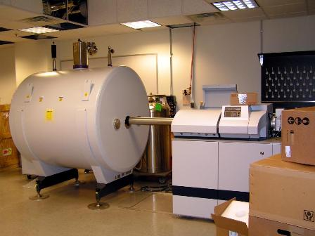
Mass Spectrometer
These are expensive analytical machines, common in industrial laboratories but too expensive for most schools or colleges.
They are used to find the mass and abundance of the different isotopes of an element.
A method to separate atoms of different masses is required.

Slide 24
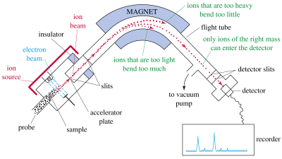
How a Mass Spectrometer works
A sample of the element to be tested is vaporised.
The vaporised atoms are bombarded with high energy electrons.
A collision with an electron will knock an electron off of the atom forming a _________ ion.
positive

Slide 25
How a Mass Spectrometer works
The beam of positive ions is accelerated by repelling it with a positively charged electrode.
The beam passes through a magnetic field where the ions are deflected (change direction).
The lighter the ion, the more it is deflected so separation occurs.
The charge on each ion produces a tiny current on the detector:
Where the current is indicates the mass of the ion (how far it has been deflected)
How strong the current is indicates the number of ions (the abundance of this isotope).

Slide 26
How a Mass Spectrometer works
Note about the mass spectrometer:
A vacuum is required inside so that ions do not collide with air molecules.
The output of a mass spectrometer is a graph of abundance (%) against mass.
Actually mass is a mass/charge (m/e) ratio.

Slide 27
Mass spectra of elements
Why are atomic masses not whole numbers on the periodic table?
Isotopes
How do we know what the isotopes of an element are?
We can use mass spec:

Slide 28
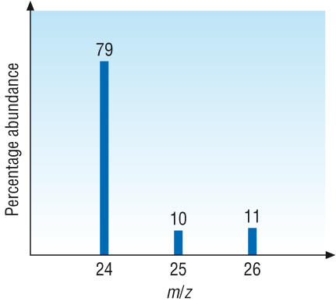
Mass spectra of elements
This is the mass spec of magnesium.
What does it show us?
The percentage abundance of all the different isotopes.
For an element each line will represent a different isotope of the element.

Slide 29
Mass spectra of elements
Y axis gives the abundance of ions often as a percentage. For an element the height of each peak gives the relative isotopic abundance. E.g. 79% are the 24 Mg isotope.
The X axis units are given as “mass/charge” ratio. Since the charge on the ions is mostly +1, you can often assume the x axis is simply the relative mass.
Now calculate the relative atomic mass of Mg

Slide 30
Now calculate the relative atomic mass of Mg

Slide 31
Solution
For each peak read the % relative isotopic abundance (y) and relative isotopic mass (x)
Multiply them together to get the total mass for each isotope 79 x 24 = 1896; 10 x 25 = 250; 11 x 26 = 286
Add up these totals: 1896 + 250 + 286 = 2432
Divide by 100 (since %ages were used) Ar (Mg) = 2432 / 100 = 24.32 = 24.3

Slide 32
If the relative abundance is not given as a percentage, the total abundance may not add up to 100.
Do the same but instead of dividing by 100 in the final step divide by the total relative abundance

Slide 33
Example Neon
Notes:
Page 17 revision guide

Slide 34
Mass spectra in organic chemistry
Mass spec starts by knocking electrons out of a molecule.
This forms a molecular ion, M⁺ :
E.g.
C₂H₅OH + e⁻ → C₂H₅OH⁺ + 2e⁻

Slide 35
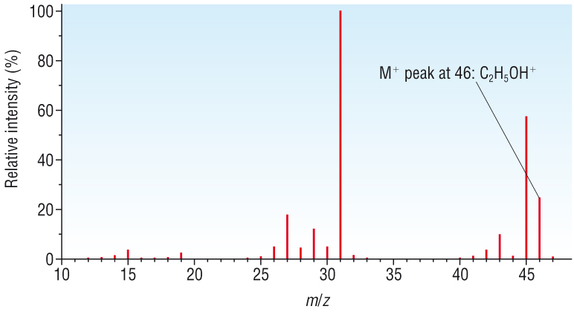
Molecular ion
The molecular ion will be the heaviest ion detected by our mass spectrometer.
So we know the M_{r} of our compound.
E.g. ethanol:
But what are these other peaks?

Slide 36
Molecular ion
Molecular ions have been hit by high energy particles.
They vibrate and sometimes break up.
This is called fragmentation, e.g.
C₂H₅OH⁺ → CH3 + CH₂OH⁺
The fragment ion will be detected and appear in the spectrum.
Sometimes these ions break up into even smaller fragments.

Slide 37
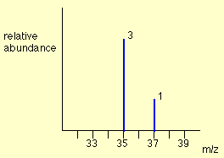
Diatomic molecules
Chlorine has two isotopes, ³⁵Cl and ³⁷Cl, in the approximate ratio of 3 atoms of ³⁵Cl to 1 atom of ³⁷Cl. You might suppose that the mass spectrum would look like this:
This is wrong!

Slide 38
Chlorine consists of molecules, not individual atoms
When chlorine is passed into the ionisation chamber, an electron is knocked off the molecule to give a molecular ion,Cl₂⁺.
These ions won't be particularly stable, and some will fall apart to give a chlorine atom and a Cl⁺ ion. The term for this is fragmentation.
Cl₂⁺ → Cl + Cl⁺
Notes:
If the Cl atom formed isn't then ionised in the ionisation chamber, it simply gets lost in the machine - neither accelerated nor deflected.

Slide 39
The Cl⁺ ions will pass through the machine and will give lines at 35 and 37, depending on the isotope and you would get exactly the pattern in the last diagram.
The problem is that you will also record lines for the unfragmented Cl₂⁺ ions.

Slide 40
Possible combinations in Cl₂⁺ ion
Both atoms could be ³⁵Cl, both atoms could be ³⁷Cl, or you could have one of each sort. That would give you total masses of the Cl₂⁺ ion of:
35 + 35 = 70
35 + 37 = 72
37 + 37 = 74

Slide 41
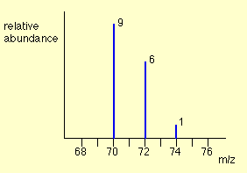
These lines would be in addition to the lines at 35 and 37.
Notes:
The relative heights of the 70, 72 and 74 lines are in the ratio 9:6:1. If you know the right bit of maths, it's very easy to show this. If not, don't worry. Just remember that the ratio is 9:6:1.
What you can't do is make any predictions about the relative heights of the lines at 35/37 compared with those at 70/72/74. That depends on what proportion of the molecular ions break up into fragments. That's why you've got the chlorine mass spectrum in two separate bits so far. You must realise that the vertical scale in the diagrams of the two parts of the spectrum isn't the same.

Slide 42
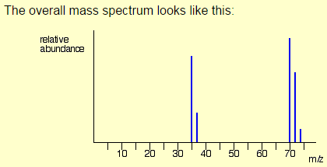

Slide 43
Complete the questions on the worksheet
Starters for 10 analysis page 4

Slide 44
Lesson objectives relative mass
Understand the term ‘isotopes’
Define the terms ‘relative isotopic mass’ and ‘relative atomic mass’ based on the ¹²C scale
Understand the terms ‘relative molecular mass’ and ‘relative formula mass’ including calculating these from relative atomic masses Definitions of these terms will not be expected. The term ‘relative formula mass’ should be used for compounds with giant structures.
Be able to analyse and interpret data from mass spectrometry to calculate relative atomic mass from relative abundance of isotopes and vice versa
Be able to predict the mass spectra, including relative peak heights, for diatomic molecules, including chlorine
Understand how mass spectrometry can be used to determine the relative molecular mass of a molecule Limited to the m/z value for the molecular ion, M+, giving the relative molecular mass of the molecule.

