Slide 1
Objectives for Bonding and Periodicity (2)
to understand the concept of bonding and lone (non-bonding) pairs of electrons as charge clouds
to use the electron pair repulsion theory to predict the shapes and bond angles in simple molecules and ions

Slide 2
Bonding and Periodicity
Lesson 7 – Shapes of Ions

Slide 3
Already from AS Level you
understand the concept of bonding pairs of electrons as charge clouds
understand the effect of lone pairs of electrons on bond angles
can predict the shapes of simple molecules and their bond angles

Slide 4
Lesson Outcomes
And after this Lesson you should be able to
predict the shapes of ions and their bond angles

Slide 5
Success Criteria
Predict the shape of any simple molecular compound using the method provided
Predict the shape of any simple molecular ion by the same method

Slide 6
How to work out shapes

Slide 7
How to work out shapes
Find the group number of the central atom.
Add the number of atoms around the central atom to the group number
If it is a negatively charged ion add the number of charges to Step 2
If it is a positively charged ion minus the number of charges to Step 2
If no charge, leave as step 1.

Slide 8
How to work out shapes
Divide the number from Step 2 by 2. This gives up the basic shape, as it gives the number of electron pairs around the central atom.
Pairs | Shape
2 | Linear
3 | Triagonal Planar
4 | Tetrahedral
5 | Triagonal Bipyramidal
6 | Octahedral

Slide 9
How to work out basic shapes
Work out the number of lone pairs by taking away the number of atoms around the central atom from the result from Step 3

Slide 10
examples

Slide 11
Example – CH₄
Group number of C = 4; number of H’s = 4
So 4+4 = 8
No charge so remains at 8
8/2 = 4 so contains 4 pairs. Basic shape is tetrahedral.
From step 3 there are 4 pairs. The numbers of H’s are 4. Therefore 4 – 4 = 0 so no lone pairs.
CH₄ is therefore tetrahedral.

Slide 12
Example – NH₄⁺
Group number of N, plus the number of atoms:
5 + 4 = 9
Adjust for single positive charge:
9 – 1 = 8
Divide by 2:
8 ÷ 2 = 4 so tetrahedral in shape
The number of lone pairs:
4 – 4 = 0 so no lone pairs

Slide 13
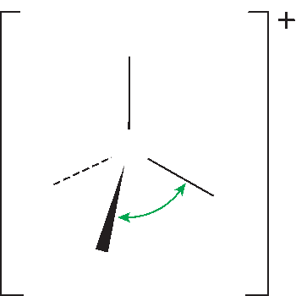
Week 8: Images
The bond angles in an ammonium ion are all 109.5˚.
Notes:
The bond angles in an ammonium ion are all 109.5˚.
Section 3.07

Slide 14
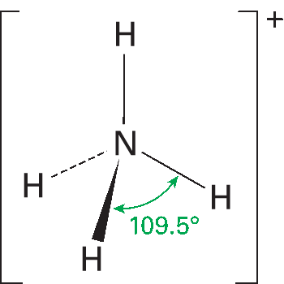
Week 8: Images
The bond angles in an ammonium ion are all 109.5˚.
Notes:
The bond angles in an ammonium ion are all 109.5˚.
Section 3.07

Slide 15
Example – I₃⁻ (Treat as II₂⁻)
Group number of I, plus the number of atoms:
7 + 2 = 9
Adjust for single negative charge:
9 + 1 = 10
Divide by 2:
10 ÷ 2 = 5 so triagonal bipyramidal in shape
The number of lone pairs:
5 – 2 = 3 so three lone pairs

Slide 16
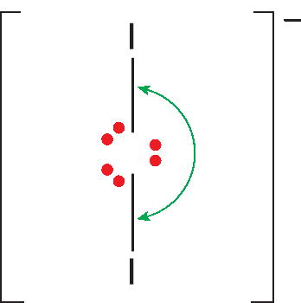
Week 8: Images
The bond angle in the I₃– ion is 180˚.
Notes:
The bond angle in the I₋₃ ion is 180˚.
Section 3.07

Slide 17
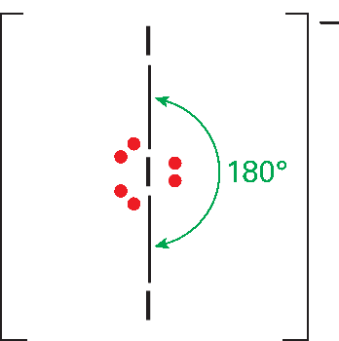
Week 8: Images
The bond angle in the I₃– ion is 180˚.
Notes:
The bond angle in the I₋₃ ion is 180˚.
Section 3.07

Slide 18
Example – ICl₄⁻
Group number of I, plus the number of atoms:
7 + 4 = 11
Adjust for single negative charge:
11 + 1 = 12
Divide by 2:
12 ÷ 2 = 6 so octahedral in shape
The number of lone pairs:
6 – 4 = 2 so two lone pairs

Slide 19
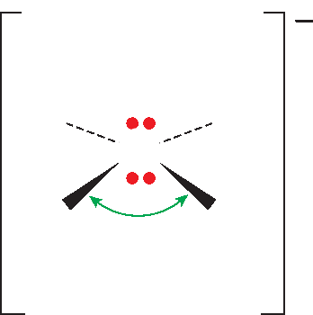
Week 8: Images
The bond angles in the ICl₄– ions are all 90˚.
Notes:
The bond angles in the ICl₋₄ ions are all 90˚.
Section 3.07

Slide 20
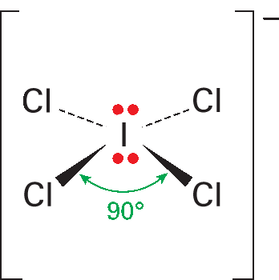
Week 8: Images
The bond angles in the ICl₄– ions are all 90˚.
Notes:
The bond angles in the ICl₋₄ ions are all 90˚.
Section 3.07

Slide 21
Multiple bonds

Slide 22
Multiple Bonds
If there are multiple bonds, you have to draw out the compound as a dot-and-cross diagram.
You can then know the number of bonding pairs and lone pairs
You should be able to predict the shape

Slide 23
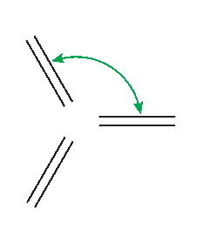
Week 8: Images
The bond angles are all 120˚ in the sulfur trioxide molecule.
Notes:
The bond angles are all 120˚ in the sulfur trioxide molecule.
Section 3.07

Slide 24
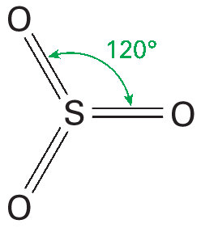
Week 8: Images
The bond angles are all 120˚ in the sulfur trioxide molecule.
Notes:
The bond angles are all 120˚ in the sulfur trioxide molecule.
Section 3.07

Slide 25
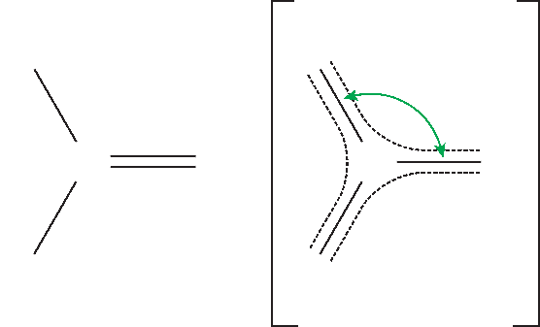
Week 8: Images
Delocalization of electrons from the C=O bond makes the bond angles all 120˚ in the carbonate ion.
Notes:
Delocalization of electrons from the C=O bond makes the bond angles all 120˚ in the carbonate ion.
Section 3.07

Slide 26
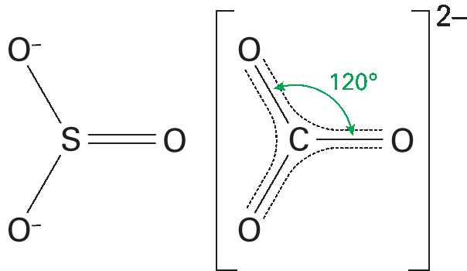
Week 8: Images
Delocalization of electrons from the C=O bond makes the bond angles all 120˚ in the carbonate ion.
Notes:
Delocalization of electrons from the C=O bond makes the bond angles all 120˚ in the carbonate ion.
Section 3.07

Slide 27
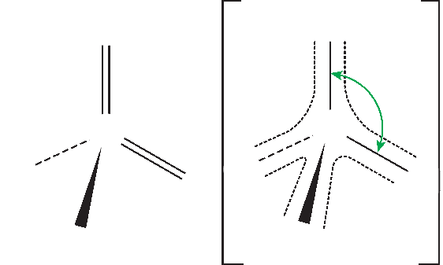
Week 8: Images
Delocalization of electrons in the S=O bonds make the bond angles all 109.5˚ in the sulfate ion.
Notes:
Delocalization of electrons in the S=O bonds make the bond angles all 109.5˚ in the sulfate ion.
Section 3.07

Slide 28
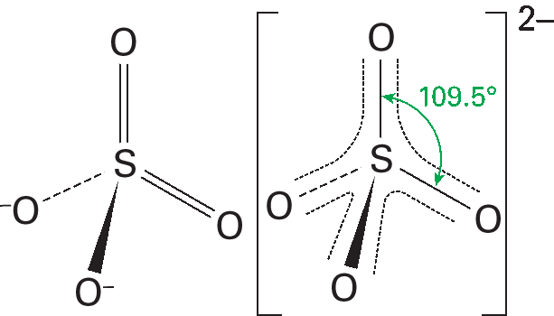
Week 8: Images
Delocalization of electrons in the S=O bonds make the bond angles all 109.5˚ in the sulfate ion.
Notes:
Delocalization of electrons in the S=O bonds make the bond angles all 109.5˚ in the sulfate ion.
Section 3.07

Slide 29
Your go....
AS 3.02.docx

Slide 30
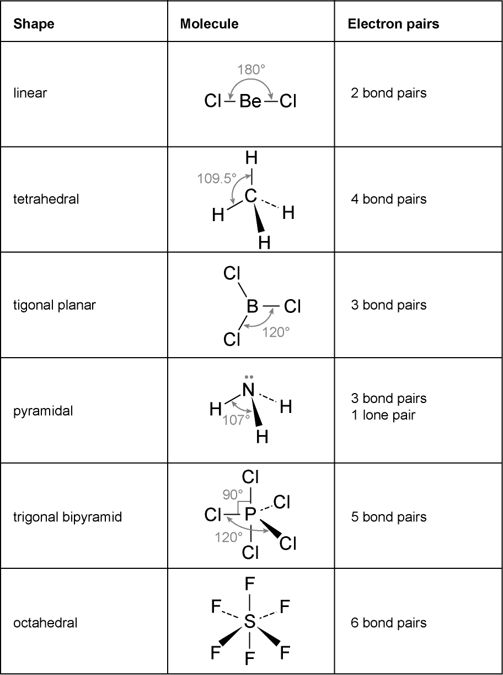
Answers
1.

Slide 31
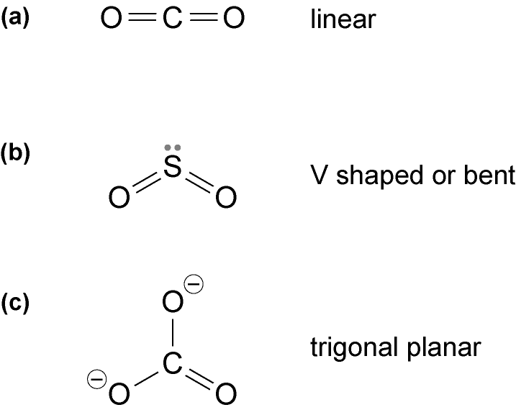
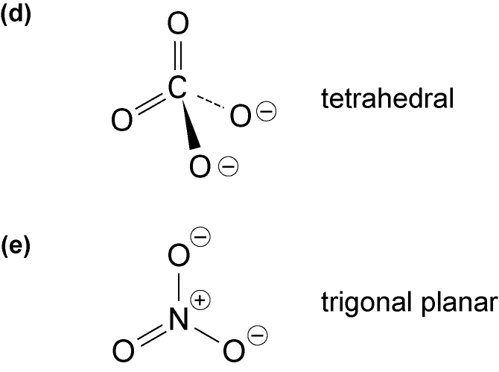
Answers
2.

Slide 32
summary

Slide 33
1. Why do different simple molecules and ions have different shapes?
2. Which charge clouds must be considered when determining the shape of a simple molecule?
3. Why is boron trifluoride, BF₃, trigonal planar, while ammonia, NH₃, is pyramidal?
4 State the bond angles and name the shape of phosphorous pentachloride, which has five covalent bonds.
5. Why is the bond angle in water 104.5°, while that in methane is 109°, even though both have four electron pairs around the central atom.
6. State the shape and bond angle in BF₃.
7. Give an example of a molecule which is octahedral.
8. Draw a dot-and-cross diagram for the ion PCl₄⁺ and so deduce the shape.
9. Draw a dot-and-cross diagram for sulfur dioxide (which contains double bonds) and so deduce the shape.
10. Draw a dot-and-cross diagram for the molecule BrCl₃.

Slide 34
1. Why do different simple molecules and ions have different shapes?
Different molecules and ions have different numbers of electron pairs around each central atom. The electron pairs repel and move until they are as far apart as possible.
2. Which charge clouds must be considered when determining the shape of a simple molecule?
The bonding pairs and lone pairs (non-bonding) of electrons.
3. Why is boron trifluoride, BF₃, trigonal planar, while ammonia, NH₃, is pyramidal?
BF₃ has three covalent bonds and no lone pairs, while ammonia has three covalent bonds and one lone pair.
4. State the bond angles and name the shape of phosphorous pentachloride, which has five covalent bonds.
Trigonal bipyrimidal, 120° and 90°.
5. Why is the bond angle in water 104.5°, while that in methane is109.5°, even though both have four electron pairs around the central atom.
In water the lone pairs repel more than the bonding pairs, so the bonds are pushed togther, while in methane there are no lone pairs, only covalent bonds. Lone pairs repel more than bonding pairs.
6. State the shape and bond angle in BF₃.
trigonal planar, 120°
7. Give an example of a molecule which is octahedral.
SF₆

Slide 35
8. Draw a dot-and-cross diagram for the ion PCl₄⁺ and so deduce the shape.
tetrahedral
9. Draw a dot-and-cross diagram for sulfur dioxide (which contains double bonds) and so deduce the shape.
V- shaped (which is also known as bent)
10. Draw a dot-and-cross diagram for the molecule BrCl₃.
Around the central atom in this molecule are three covalent bonds and two lone pairs, so the shape is based on trigonal bipyramidal.

Slide 36
Lesson Outcomes
And after this Lesson you should be able to
predict the shapes of ions and their bond angles

Slide 37
Success Criteria
I can predict the shape of any simple molecule using the method provided

