Slide 1
Solutions and Solubility
Understand factors that influence the choice of solvents, including:
i) water, to dissolve some ionic compounds, in terms of the hydration of the ions
ii) water, to dissolve simple alcohols, in terms of hydrogen bonding
iii) water, as a poor solvent for compounds (to include polar molecules such as
halogenoalkanes), in terms of inability to form hydrogen bonds
iv) non-aqueous solvents, for compounds that have similar intermolecular forces to those in the solvent

Slide 2
Key words
Solute
Solvent
Saturated
Solubility

Slide 3
Practical
Nuffield solubility of organic substances
Solubility of ionic substances

Slide 4
Conditions for a substance to dissolve
A substance will dissolve in a given solvent if:
The solute particles can be separated from one another
The separated solute particles become surrounded by solvent particles
The solute – solvent forces are greater than the solute – solute and solvent – solvent forces
Energy is released when bonds form
Usually a substance will only dissolve if the strength of the new bonds formed is about the same as or greater than the strength of the bonds that are broken

Slide 5
Types of solvent
There are two main types of solvent.
Polar solvents are made of polar molecules, e.g. water. Water molecules bond to each other by hydrogen bonding. However other polar solvents only form permanent dipole dipole bonds (and London forces)
Non polar solvents e.g. hexane. Hexane molecules only bond to each other by London forces

Slide 6
Rough Classification
Very soluble
Soluble
Sparingly soluble/slightly
Insoluble

Slide 7
Solubility and intermolecular forces
Patterns of solubility for molecular solids are determined by intermolecular forces
The intermolecular forces between solute molecules
The intermolecular forces between solvent molecules
The intermolecular forces between solute and solvent molecules

Slide 8
In general
Like dissolves like.
Substances usually dissolve best in solvents with similar intermolecular forces
E.g. Highly polar water dissolves ionic substances

Slide 9
Ionic Lattices
Ionic compounds are also soluble in water.
Why?

Slide 10
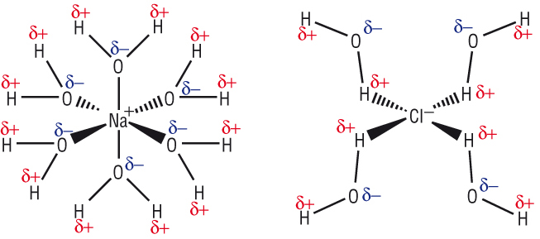
Ionic lattices
The ions are electrostatically attracted to the polar water molecules.

Slide 11
Alcohols are covalent but they also dissolve in polar solvents such as water

Slide 12
Alcohols are covalent but they also dissolve in polar solvents such as water
This is because the polar O – H bind is an alcohol is attracted to the polar O – H bonds in water
Hydrogen bonds form between the lone pairs on the δ- oxygen atoms and the δ+ hydrogen atoms
The carbon chain part of the alcohol isn’t attracted to water, so the more carbon atoms there are, the less soluble the alcohol will be

Slide 13
Not all molecules with polar bonds dissolve in water

Slide 14
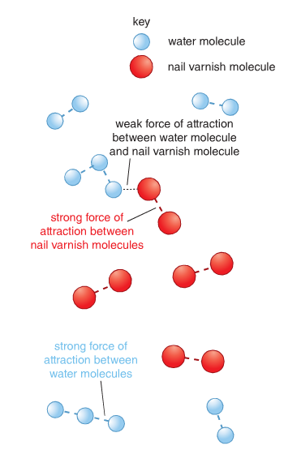

Slide 15
Not all molecules with polar bonds dissolve in water
Halogenoalkanes contain polar bonds but their dipoles aren’t strong enough to form hydrogen bonds with water
The hydrogen bonding between water molecules is stronger than the bonds what would be formed with halogenalkanes, so they don’t dissolve

Slide 16
Not all molecules with polar bonds dissolve in water
But halogenoalkanes can form permanent dipole – permanent dipole bonds
They will dissolve in polar solvents that also form permanent dipole – permanent dipole bonds (but not hydrogen bonds)

Slide 17
Non polar substances dissolve best in non polar solvents
Non polar substances such as ethene have London forces between their molecules
They form similar bonds with non polar solvents such as hexane so they tend to dissolve in them
Water molecules are attracted to each other more strongly than they are to non polar molecules such as iodine – so non polar substances don’t tend to dissolve easily in water

Slide 18
Questions page 16 workbook

Slide 19
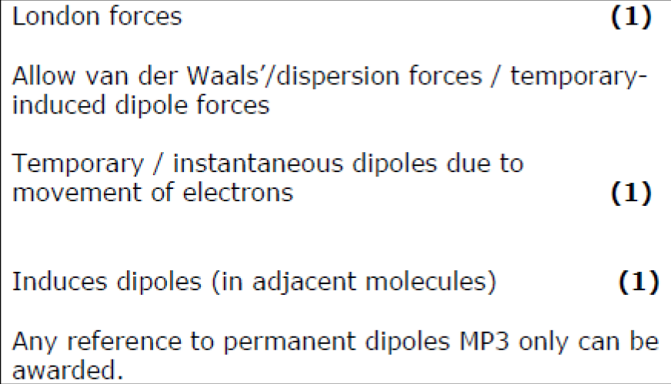
Exam question (new sample material)

Slide 20
Solutions and Solubility
Understand factors that influence the choice of solvents, including:
i) water, to dissolve some ionic compounds, in terms of the hydration of the ions
ii) water, to dissolve simple alcohols, in terms of hydrogen bonding
iii) water, as a poor solvent for compounds (to include polar molecules such as
halogenoalkanes), in terms of inability to form hydrogen bonds
iv) non-aqueous solvents, for compounds that have similar intermolecular forces to those in the solvent

