Slide 1
Spot the chiral centres

Slide 2
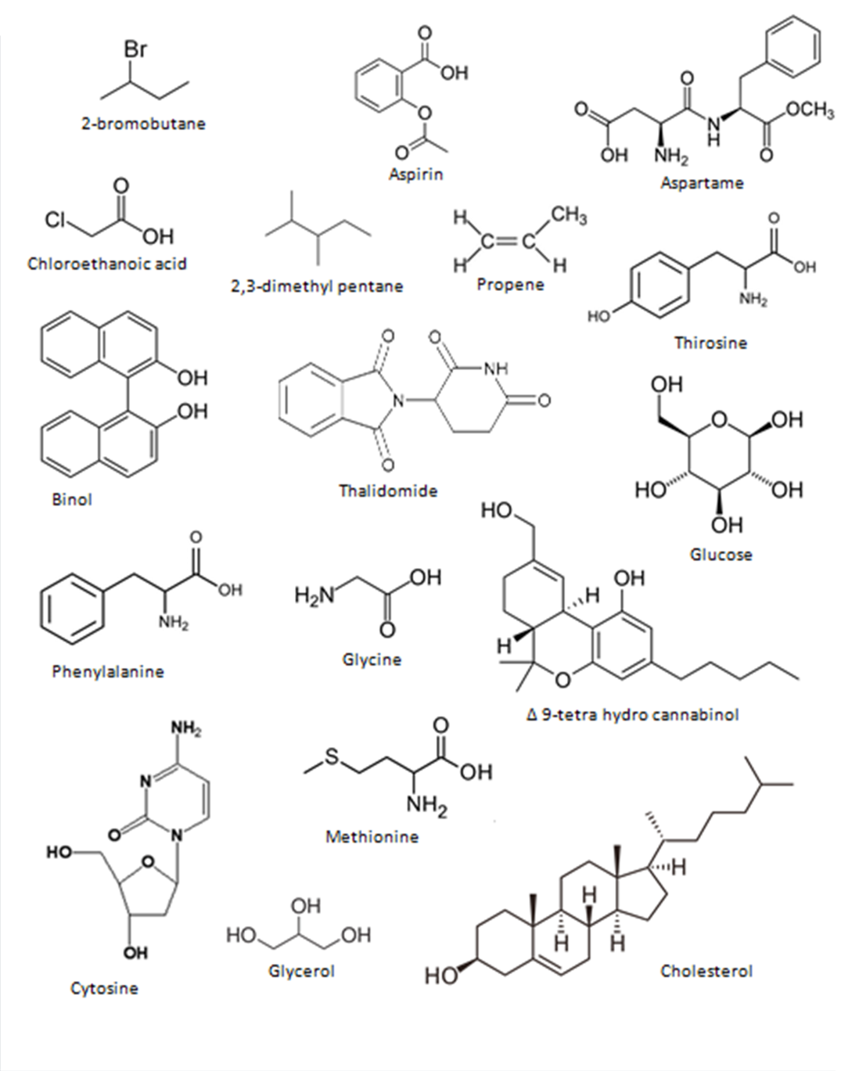
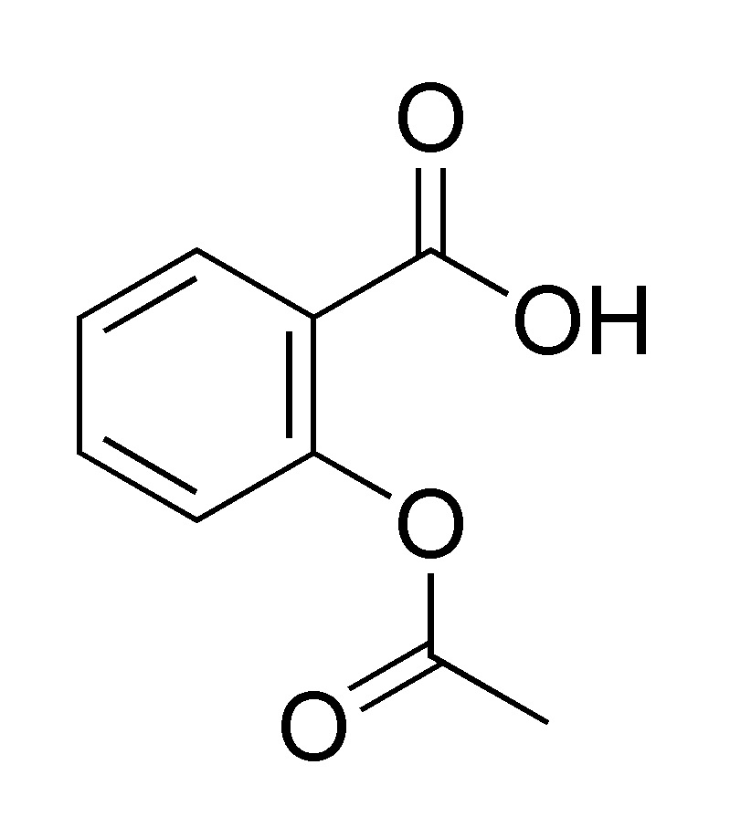
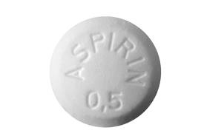
Check your answers…
Aspirin
No chiral carbon atoms

Slide 3
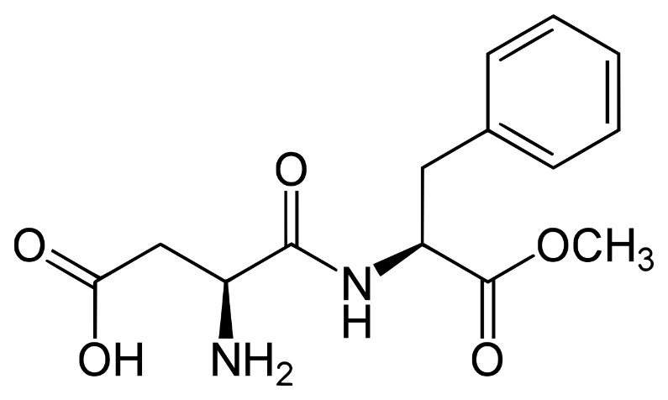
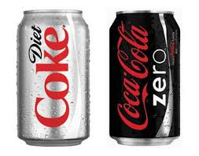
Check your answers…
*
*
Aspartame

Slide 4
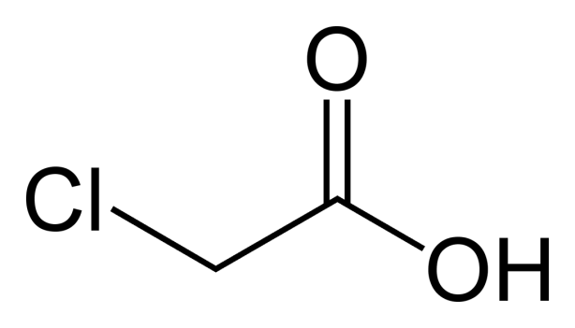
Check your answers…
Chloroethanoic acid
No chiral carbon atoms

Slide 5
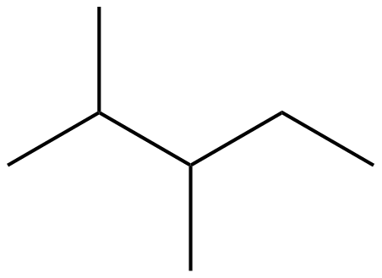
Check your answers…
*
2,3-dimethyl pentane

Slide 6
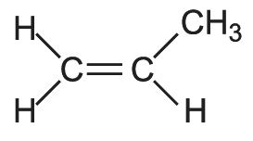
Check your answers…
Propene
No chiral carbon atoms

Slide 7
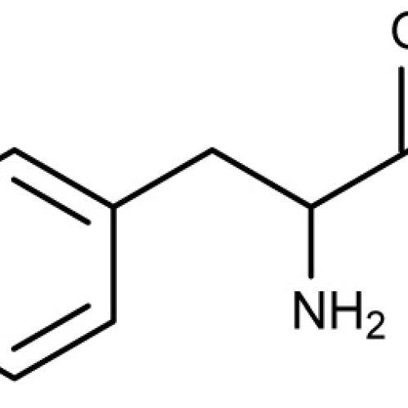
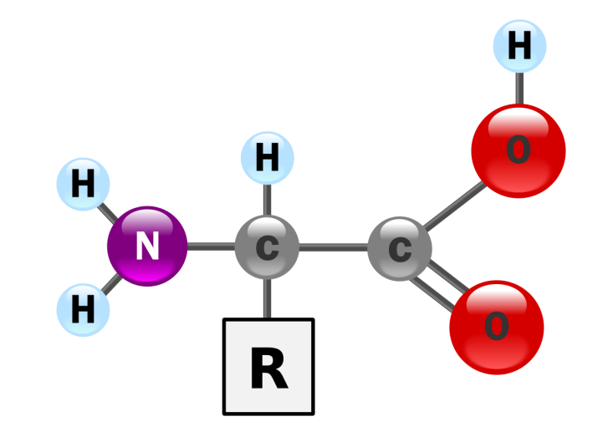
Check your answers…
*
Thirosine

Slide 8
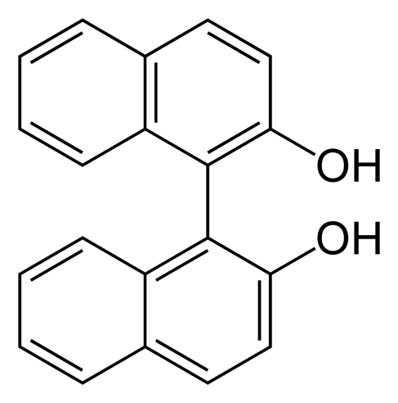
Check your answers…
Binol
No chiral carbon atoms

Slide 9
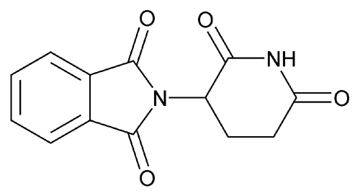
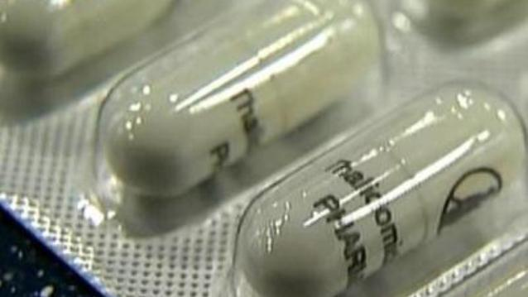
Check your answers…
*
Thalidomide

Slide 10
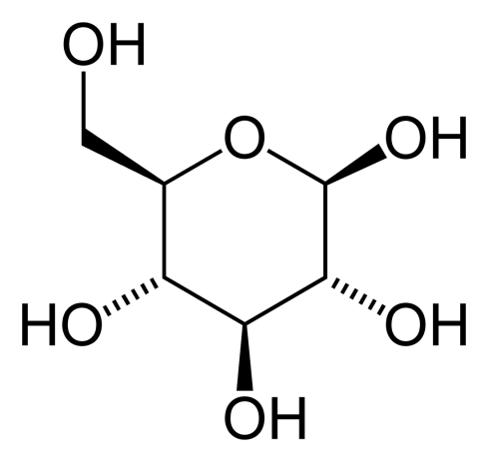
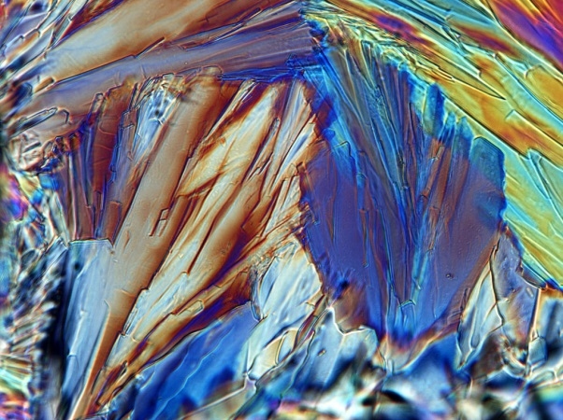
Check your answers…
*
*
*
*
*
Glucose

Slide 11
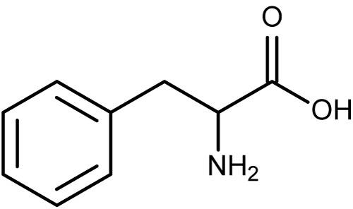
Check your answers…
*
Phenylalanine

Slide 12
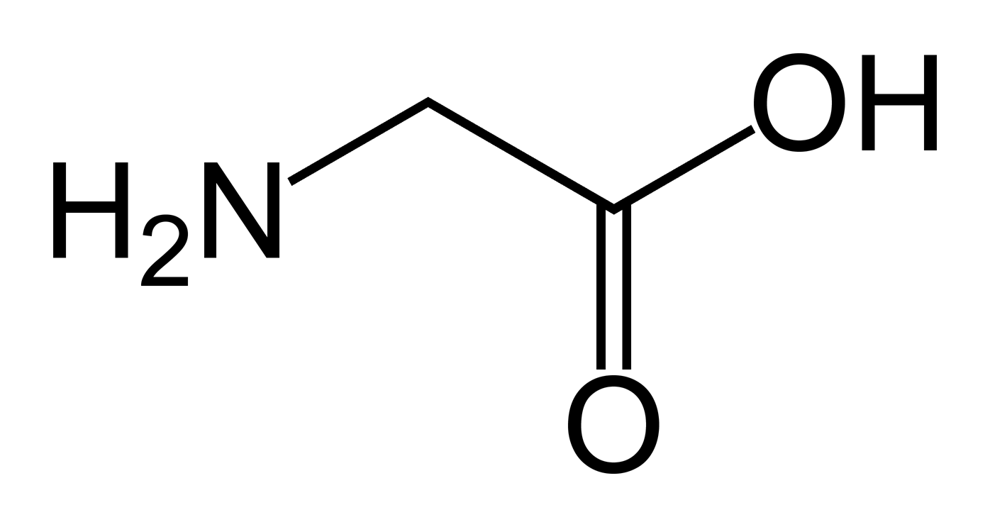
Check your answers…
Glycine
No chiral carbon atoms

Slide 13
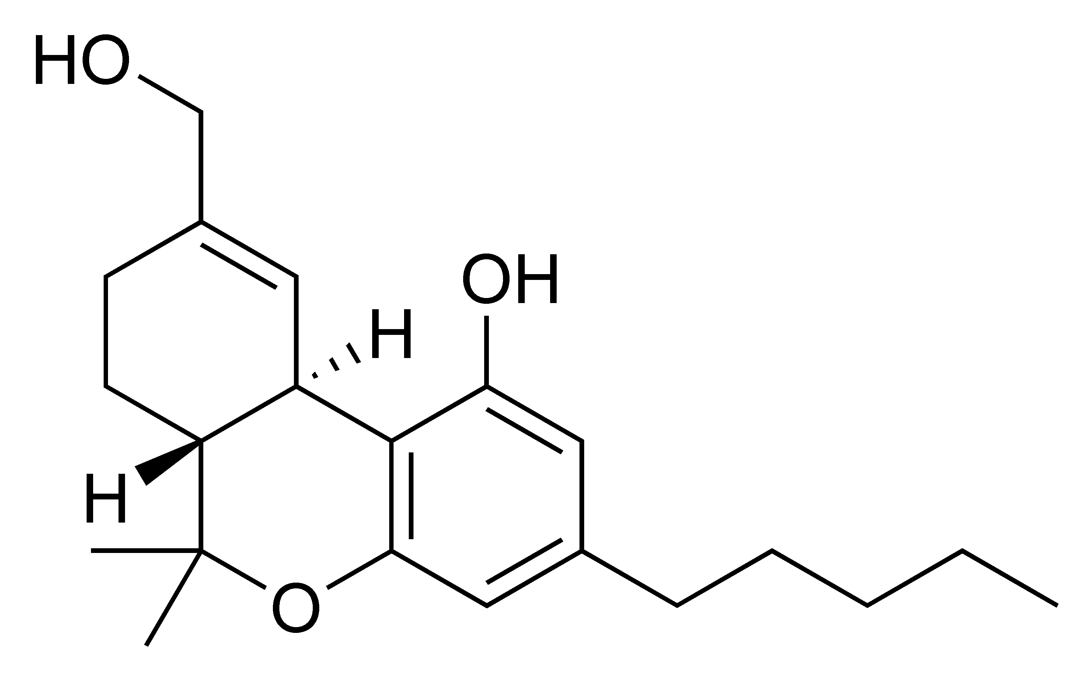
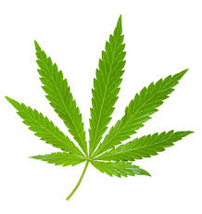
Check your answers…
*
*
∆ 9-tetrahydrocannabinol

Slide 14
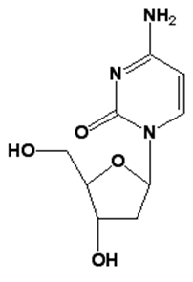
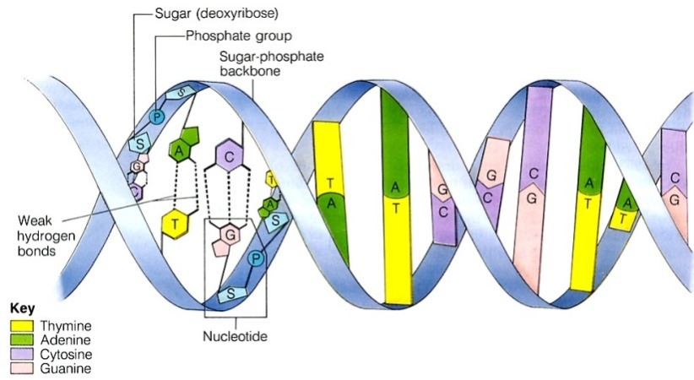
Check your answers…
*
*
*
Cytosine

Slide 15
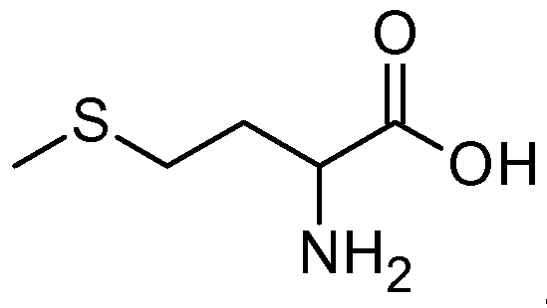
Check your answers…
*
Methionine

Slide 16
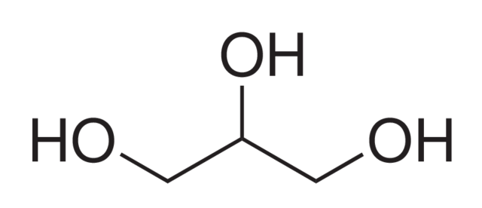
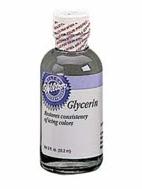
Check your answers…
Glycerol
No chiral carbon atoms

Slide 17
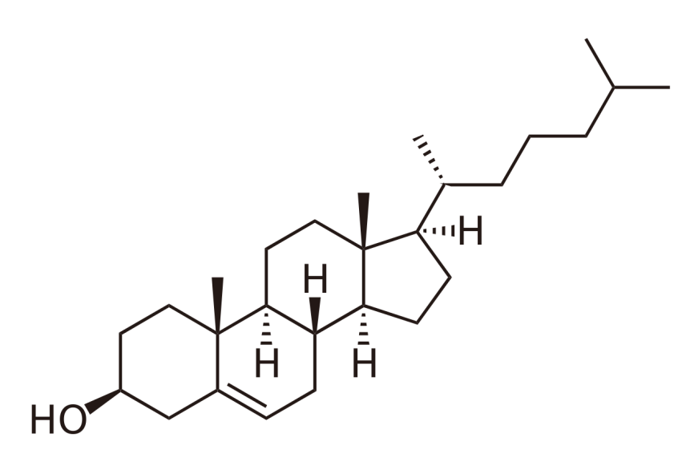
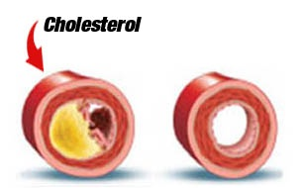
Check your answers…
*
*
*
*
*
*
*
*
Cholesterol

